Slide 1
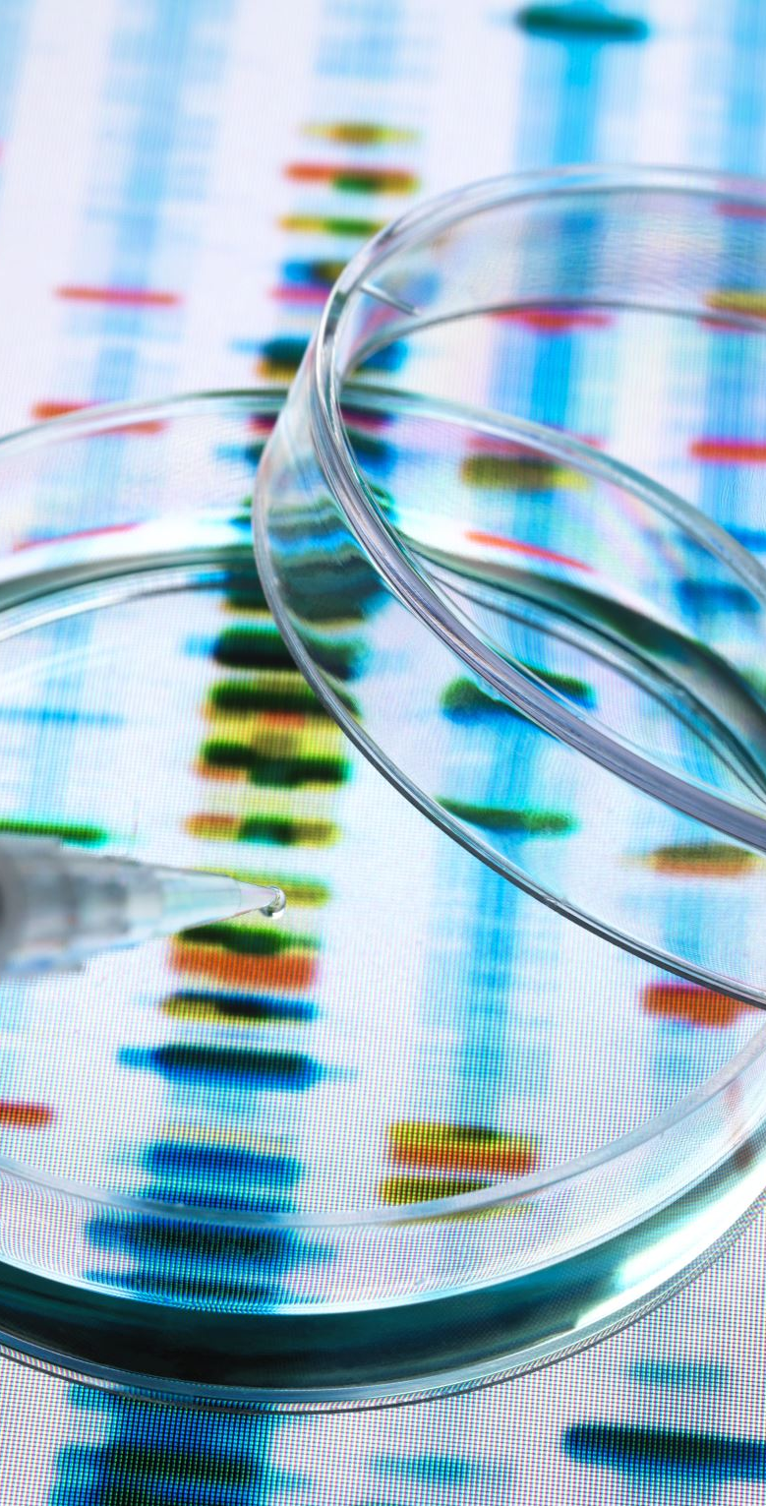
Comparative Analysis of ML Models for Diabetes Prediction
Berk Sancak 152120201059
Eray Birel 152120211086
Department of Computer Engineering

Slide 2
Introduction
Diabetes is a major global health issue.
Goal: Use ML for early diabetes detection.
Dataset: BRFSS 2015 from Kaggle.
Tool: Gradio interface for user interaction.

Slide 3

Dataset
BRFSS 2015 Dataset
70,692 samples
Balanced (50% diabetic, 50% non-diabetic)
Features include: HighBP, BMI, Age, etc.

Slide 4
Preprocessing
Used StandardScaler for feature scaling.
Split data into 80% train and 20% test sets.
Ensured a fair evaluation environment.

Slide 5
Machine Learning Models
Support Vector Machine (linear)
Random Forest (100 trees)
Gradient Boosting (100 trees)
Logistic Regression
Voting Classifier (ensemble of above)

Slide 6
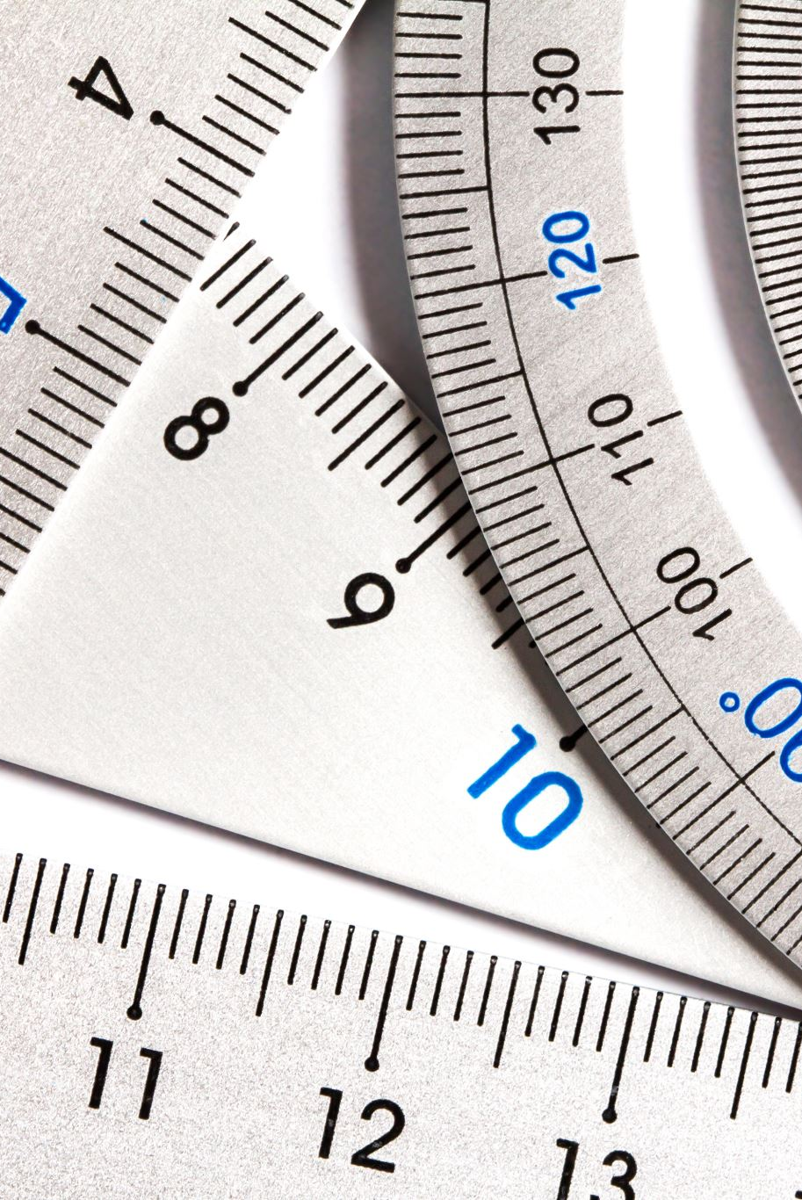
Evaluation Metrics
Used metrics:
Accuracy
AUC (Area Under Curve)
F1-Score
Confusion Matrix for visual analysis

Slide 7
Results Overview
Model | Acc | AUC | F1
SVM | 0.7485 | 0.7486 | 0.7586
Random Forest | 0.7380 | 0.7382 | 0.7484
Gradient Boosting | 0.7536 | 0.7537 | 0.7628
Logistic Regr. | 0.7484 | 0.7485 | 0.7531
Voting Classifier | 0.7507 | 0.7507 | 0.7541

Slide 8
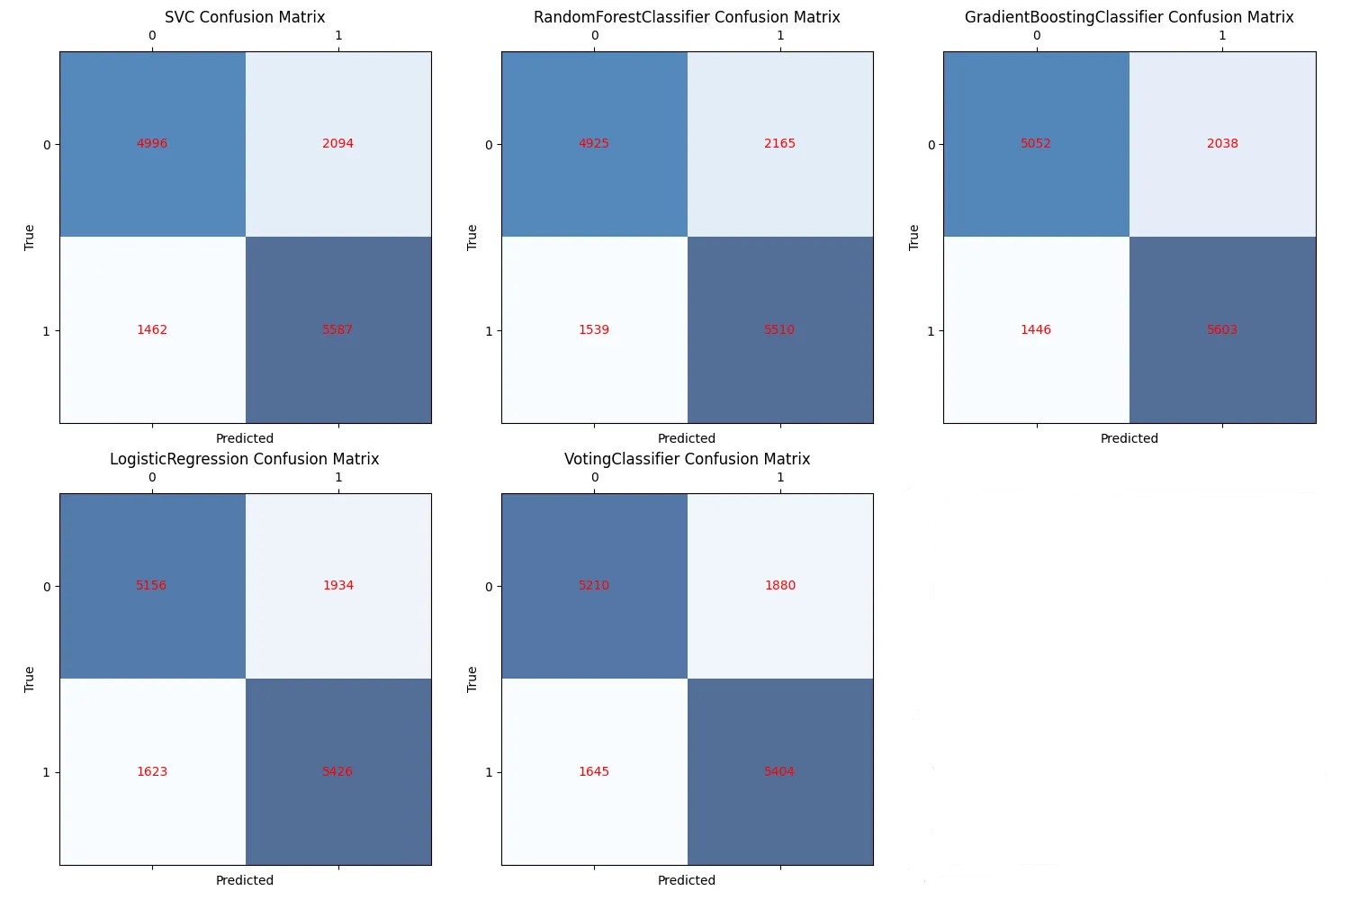
Confusion Matrices
Visual comparison of each model’s confusion matrix

Slide 9
Discussion
Gradient Boosting performed best.
Random Forest overfitted to some noisy features.
Ensemble (Voting) showed balanced performance.
Confusion matrices revealed false positives.

Slide 10
Gradio Interface
Developed interactive web app using Gradio.
Collected user input for features.
Returned prediction, metrics, and visualization.
Challenge: Interface design and real-time scaling.

Slide 11
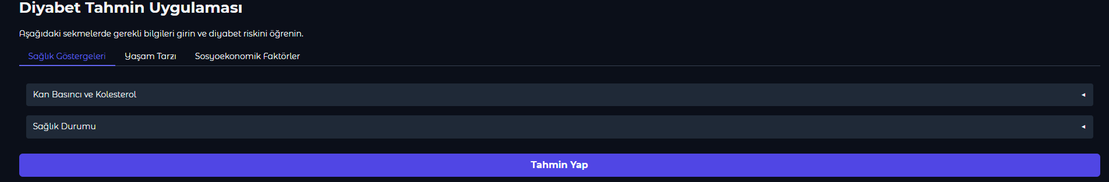
Gradio Tabs Overview
Tab 1: Health Indicators
Tab 2: Lifestyle
Tab 3: Socioeconomic Factors
User-friendly sliders and dropdowns

Slide 12
Prediction Logic
Inputs scaled using StandardScaler
Used Random Forest for final prediction
Displayed result, metrics, and confusion matrices

Slide 13
Lessons Learned
Learned end-to-end ML pipeline
Experience with multiple classifiers
Gained skills in data preprocessing, model evaluation
Built interactive ML app for real users

Slide 14
Tools Used
Python: The entire project was written in Python.
Scikit-learn: Used for model training, data preprocessing, and metric calculations.
Gradio: Built an interactive web interface for diabetes risk prediction.
Matplotlib: Visualized confusion matrices.
NumPy: Handled data processing and mathematical operations.
Pandas: Loaded and preprocessed the dataset.

Slide 15
Thank you for listening

