Slide 1
DemandSense
$65,125
Demand Forecasting & Inventory Optimization System
Next Month Forecast
Sanchit Khandelwal | S24CSEU2729
5,591 units
Lakshay Godara | S24CSEU2725
Recommended Order
Aniket Yadav | S24CSEU2724
80.4%
Aditya Raj Singh Parmar | S24CSEU2731
Model Accuracy
Mentor: Prof. Ankit Vijay Bansal
Bennett University, Greater Noida | April 2026
19.57%
MAPE Error Rate

Slide 2
The Problem We Are Solving
Inventory mismanagement costs businesses billions every year
$1.75T
$634B
12%
83%
Lost globally due to
overstocking annually
Lost due to stockouts
and lost sales
Revenue lost by SMEs
from inventory errors
SMEs use manual
spreadsheets today
Problem Statement
SMEs lack access to affordable, accurate demand forecasting tools that integrate with inventory optimization. Existing solutions are either too expensive, require data science expertise, or fail to provide actionable recommendations alongside their forecasts.

Slide 3
DemandSense — Our Solution
A complete AI-powered decision support system for inventory intelligence
📊 AI Forecasting
📦 Inventory Optimizer
ARIMA + Gradient Boosting models trained on real retail data
Automated EOQ, Safety Stock & Reorder Point calculations
🖥️ Live Dashboard
📂 CSV Upload
Interactive dark-theme web app with real-time KPI cards
Upload any sales file — get fresh forecasts instantly
🔔 Smart Alerts
📈 Model Comparison
Colour-coded stock status alerts — Critical, Medium, Low
Transparent ARIMA vs GB performance metrics side by side

Slide 4
System Architecture
3-tier full-stack architecture: React → FastAPI → ML Models
LAYER 1
Dashboard • Upload Page • Charts • KPI Cards
localhost:3000
React Frontend
Dashboard | Upload Page | Charts | KPI Cards
↓
LAYER 2
/upload • /forecast • /inventory • /dashboard
localhost:8000
FastAPI Backend
/upload | /forecast | /inventory | /dashboard
↓
LAYER 3
Gradient Boosting • ARIMA • EOQ Engine
gb_model.pkl
ML & Data Layer
Gradient Boosting | ARIMA | EOQ Engine
CORS enabled • Stateless REST • JSON responses • Real-time model inference

Slide 5
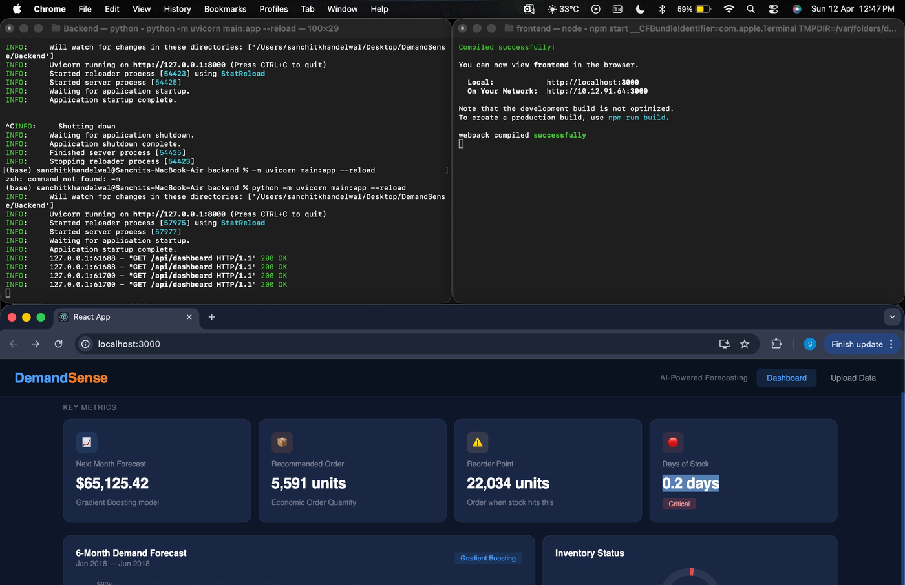
Dataset & Exploratory Data Analysis
Kaggle Superstore Sales Dataset — 9,994 records, 2014–2017
9,994
21
Total Records
Columns
4 Years
$2.29M
Date Span
Total Revenue
5,009
0
Unique Orders
Missing Values ✓
Figure: Monthly Sales Trend & KPI Dashboard (2014–2017)
Key Insights
• Strong Q4 seasonality every year
• Consistent year-on-year revenue growth
• Technology leads all categories at $836K

Slide 6
AI Models — Forecasting Engine
Two models trained and compared for best accuracy
MODEL 1 — ARIMA (2,1,1)
MODEL 2 — Gradient Boosting 🏆
Statistical Time Series Baseline
200 estimators · LR 0.05 · Max depth 3
MAE
$19,893
MAE
$11,660
RMSE
$26,746
RMSE
$14,825
MAPE
25.68%
MAPE
19.57%
R²
N/A
R²
0.6472
🏆 Gradient Boosting wins — 40% lower MAE, 24% lower MAPE vs ARIMA | Selected as primary forecasting model

Slide 7
Inventory Optimization Engine
Three classical supply chain formulas powering smart decisions
EOQ — Economic Order Quantity
5,591 units
EOQ = √(2 × D × S / H)
Optimal order size
D = Annual demand | S = Ordering cost | H = Holding cost per unit
Safety Stock — Z-Score Method
6,838 units
SS = Z × √(LT × σd² + D² × σLT²)
Buffer inventory
Z = 1.645 at 95% service level | σd = demand std dev
ROP — Reorder Point
22,034 units
ROP = (Avg Daily Demand × Lead Time) + SS
Order trigger point
Lead time = 7 days | Safety Stock included

Slide 8
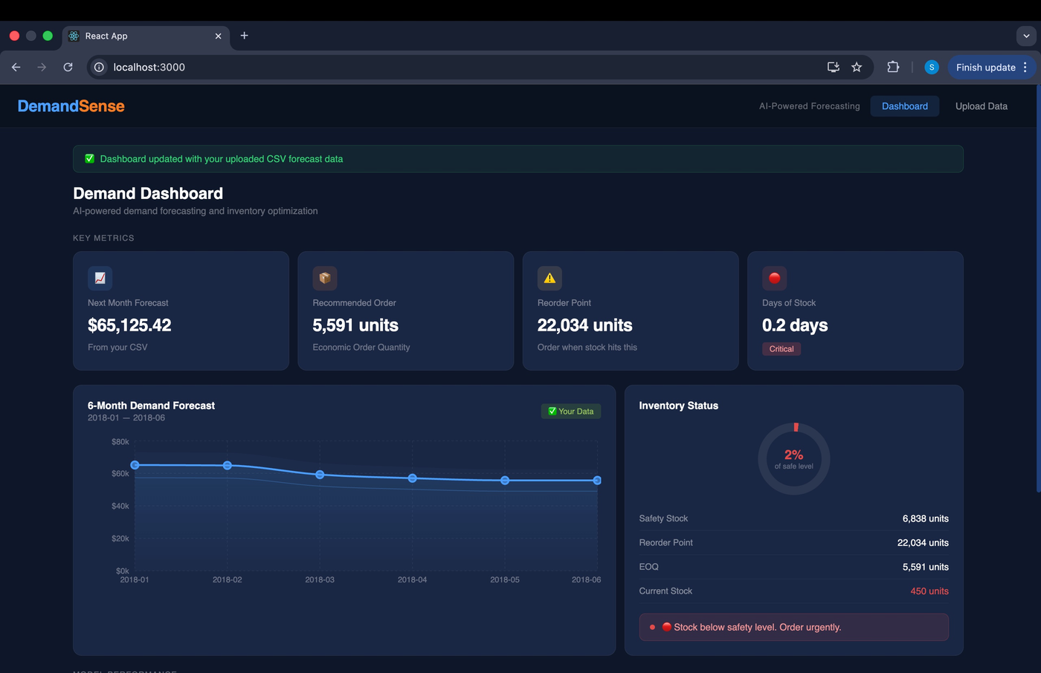
Live Dashboard — KPI Cards & Forecast Chart
Running at localhost:3000 — React frontend connected to FastAPI backend
Screenshot: DemandSense Dashboard showing real-time KPI cards and 6-month demand forecast

Slide 9
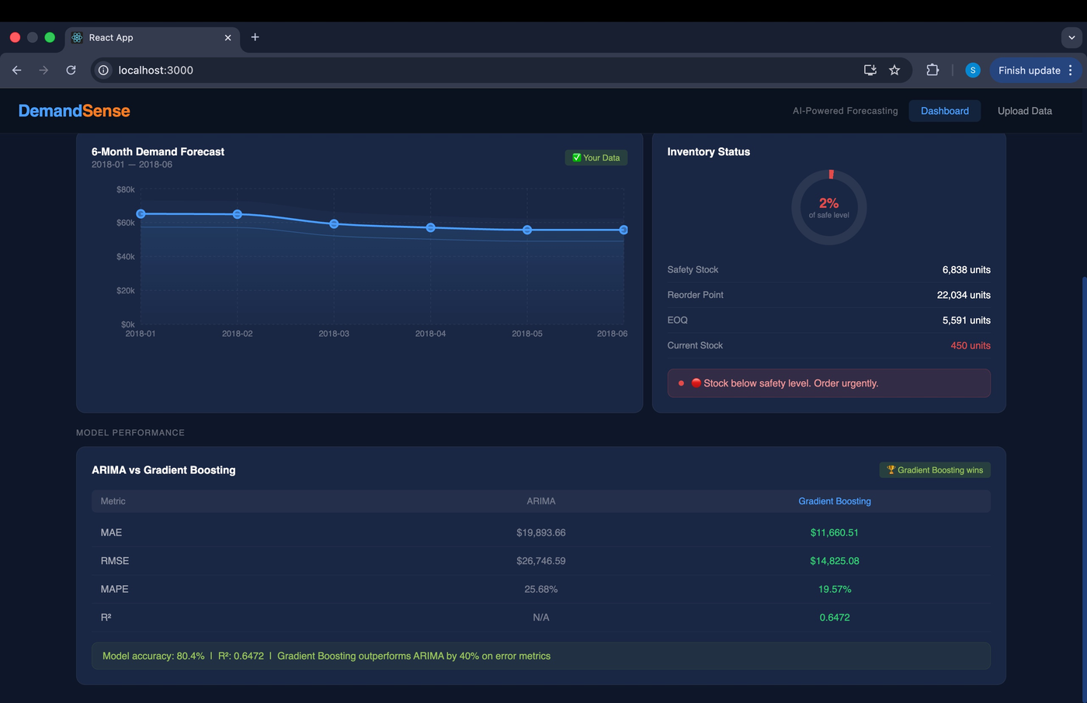
Inventory Status & Model Performance
Real-time stock alerts and transparent AI model comparison
Screenshot: Inventory status gauge with critical alert + ARIMA vs Gradient Boosting comparison table

Slide 10
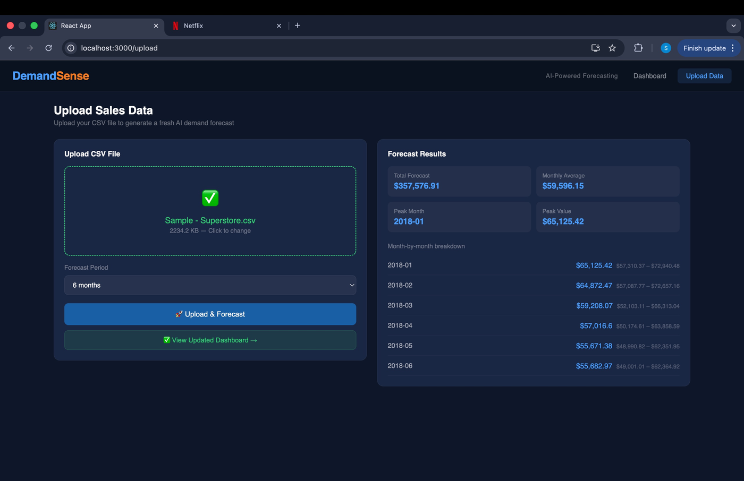
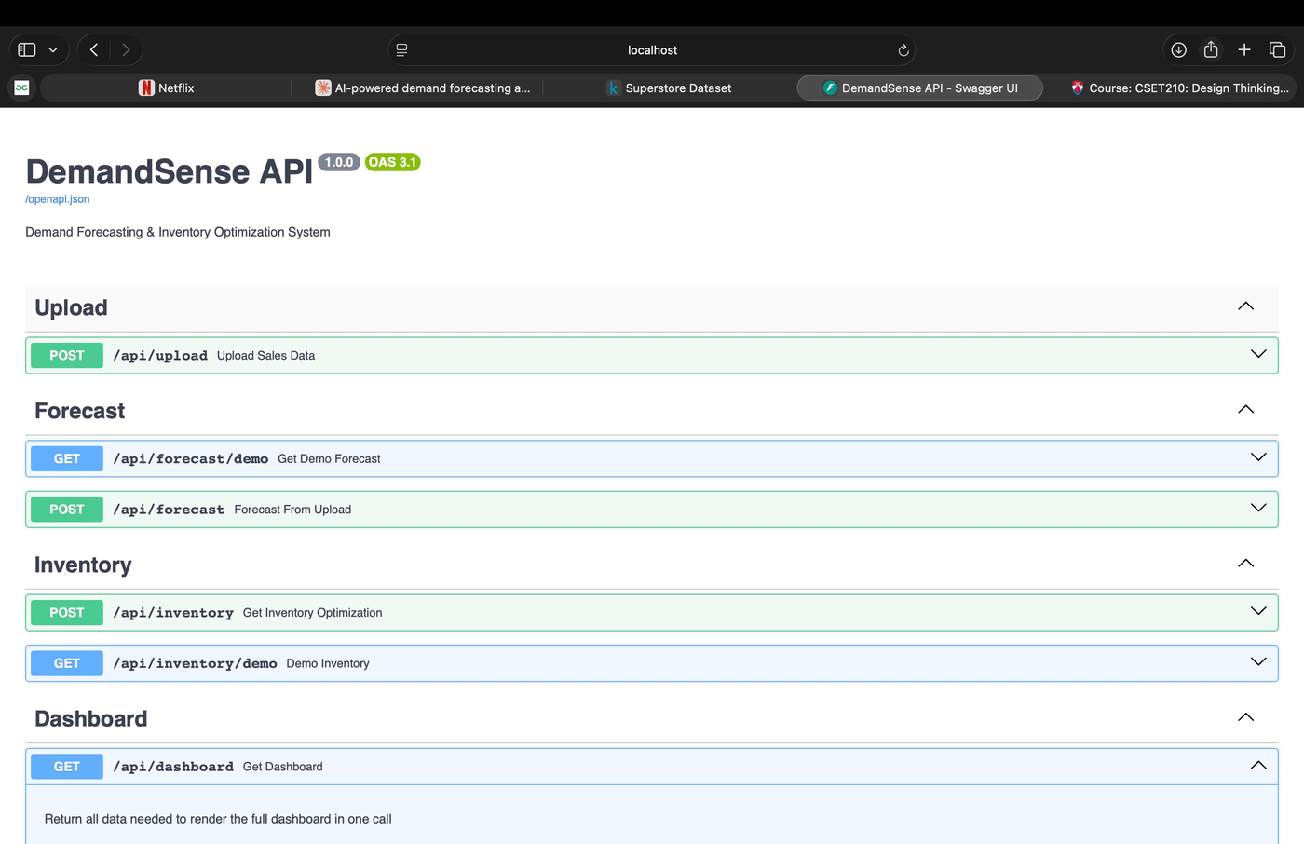
CSV Upload & REST API
Self-service forecasting with full FastAPI backend documentation
Swagger UI — 5 live REST endpoints
POST
/api/upload
Upload page — drag-and-drop CSV → instant AI forecast
POST
/api/forecast
POST
/api/inventory
GET
/api/dashboard
GET
/api/forecast/demo

Slide 11
Results & Key Achievements
All project goals met — fully functional end-to-end system
✅ Model Accuracy
✅ Full Stack App
Gradient Boosting MAPE: 19.57%
Target was below 25% — exceeded
React (port 3000) + FastAPI (port 8000)
Full integration working
✅ 5 API Endpoints
✅ Inventory Engine
Upload, Forecast, Inventory,
Dashboard, Demo — all live
EOQ = 5,591 units
Safety Stock = 6,838 | ROP = 22,034
✅ Real CSV Upload
✅ Live Dashboard
Upload any Superstore-format CSV
Get fresh forecast in seconds
KPI cards, chart, gauge, alerts
Model comparison — all rendered

Slide 12
Conclusion & Future Work
What We Delivered
Future Enhancements
▸ Complete AI demand forecasting system
▸ Cloud deployment (Render + Vercel)
▸ ARIMA + Gradient Boosting models trained
▸ Multi-product & category forecasting
▸ FastAPI backend with 5 REST endpoints
▸ Email alerts when stock hits ROP
▸ React dashboard with real-time updates
▸ PDF report download from dashboard
▸ CSV upload triggers live AI inference
▸ JWT-based user authentication
▸ EOQ, Safety Stock, ROP all computed
▸ Automated model retraining pipeline
▸ 80.4% model accuracy on real retail data
▸ 12 and 24-month forecast horizons
DemandSense | Bennett University | Team: Sanchit · Lakshay · Aniket · Aditya | Mentor: Prof. Ankit Vijay Bansal | April 2026

