Slide 1
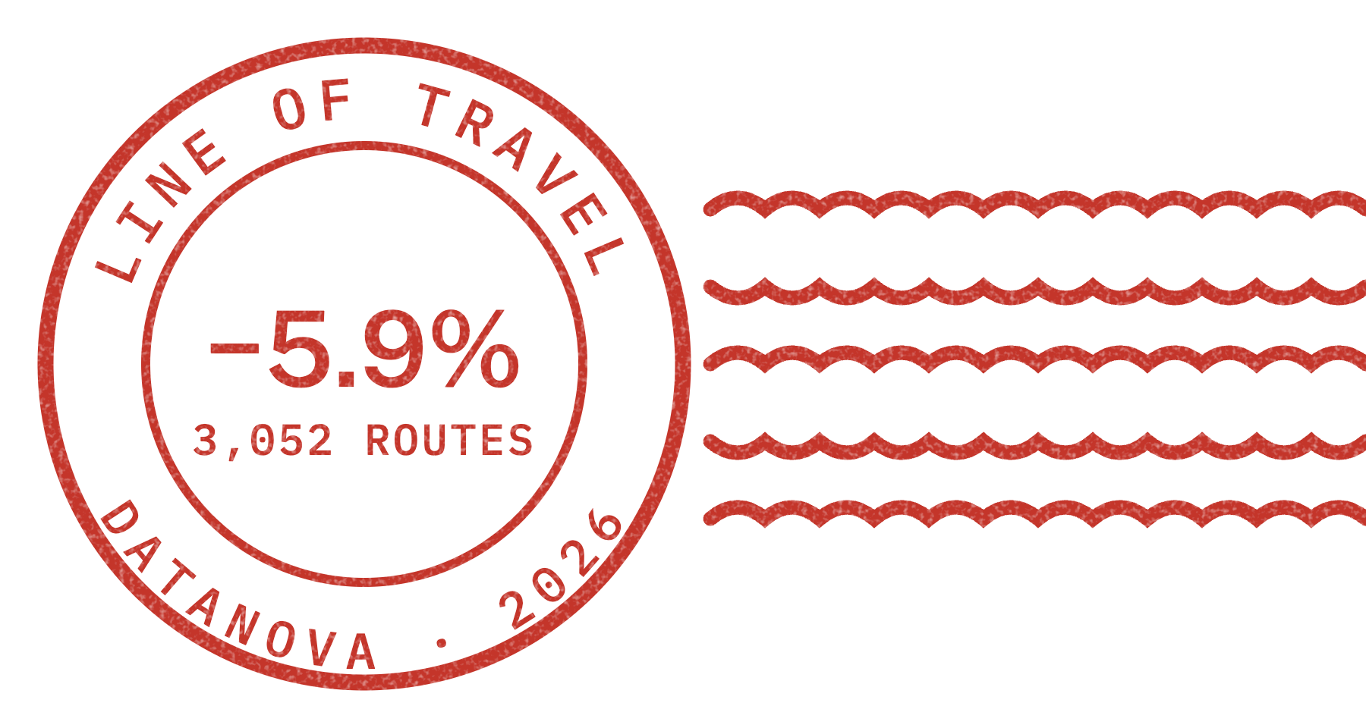
Line of Travel
DATANOVA 2026 · DN-OR-01 · LAST-MILE DELIVERY ROUTE OPTIMIZATION
Learns the order Amazon drivers actually deliver in, then removes only the detours.
−5.9%
0.01
3,052
drive time vs the driver's own order
zone re-entries per route (shortest path: 15.7)
real held-out routes in 5 US metros
SANCHAY SINGH · SOLO ENTRY · LIVE DEMO: HTTPS://SANCHAY117.GITHUB.IO/LINE-OF-TRAVEL/
Notes:
Line of Travel is a route sequencer for last-mile delivery that keeps the order drivers already use. It learns that order from 6,112 real Amazon routes and then removes only the detours. On 3,052 held-out routes it cuts drive time by 5.9% while almost never sending a van back into a zone it already finished.

Slide 2
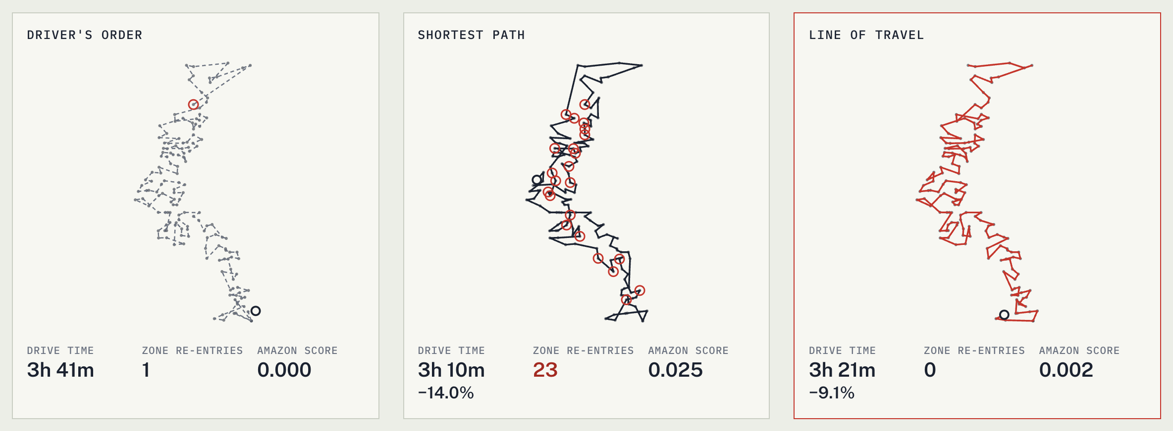
The shortest route is 11.3% shorter. Drivers won't drive it.
THE PROBLEM
A pure optimizer ignores the zones drivers work in. On the held-out routes it re-enters 15.7 zones per route, where drivers re-enter 1.4. A plan the driver will not follow saves nothing, which is why Amazon's 2021 challenge scored routes on how closely they match what drivers really do.
Notes:
Here is one real Boston route, three ways. Left is what the driver did. Middle is the shortest path through Amazon's own travel-time matrix: it is shorter, but it zig-zags back into zones the van already finished. Drivers don't drive that. Right is Line of Travel: it keeps the zones in the driver's order and still cuts the drive.

Slide 3
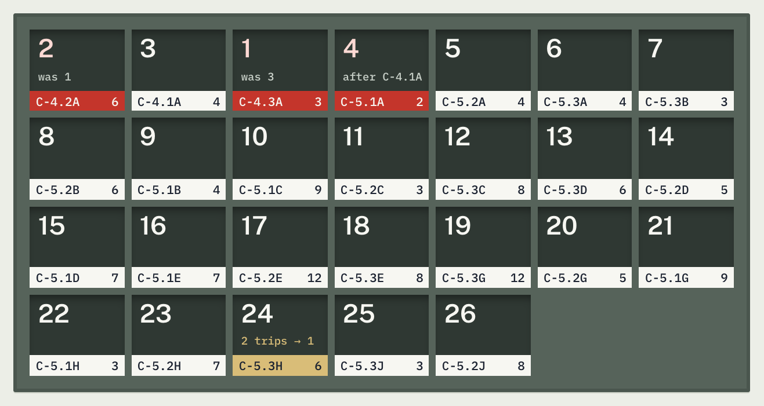
Drivers work zone by zone, in an order they repeat.
WHAT DRIVERS ACTUALLY DO
ZONES KEPT WHOLE
94%
of zones the driver finishes in one visit (about 19 zones per route)
NEXT ZONE PREDICTED
68%
of the driver's next zones our model predicts, from about 21 choices
NEAREST-ZONE GUESS
35%
Where the name comes from. Mail carriers sort each day's mail into a case of pigeonholes in the order they walk. The US Postal Service records that order for every carrier route and calls it the Line of Travel. Amazon drivers have one too. Nobody wrote it down, so we learned it.
if you simply pick the nearest zone
Notes:
Amazon splits each route into planning zones. Drivers finish 94% of zones in one visit and move between zones in an order that repeats from day to day. That order is predictable: our model gets the next zone right 68% of the time, against 35% for the nearest zone. The case on the right is the route from the previous slide, one slot per zone.

Slide 4
Built only on Amazon's own routes, start to finish.
DATA AND PIPELINE
01 · DATA
02 · INGEST
03 · LEARN
04 · SOLVE
05 · SCORE
Amazon Last Mile Routing Research Challenge 2021
Parquet tables and float32 travel matrices
Next-zone ranker (LightGBM)
Driver-aware sequencing engine
Held-out benchmark
9,164 routes, 1,337,758 stops, 17 stations in 5 metros. Public S3, CC BY-NC 4.0.
Stops, zones, packages, delivery windows, service times, the driver's actual order.
Trained on the 6,112 training routes. Gives every zone-to-zone move a habit cost.
Plain JavaScript. The same file runs the benchmark in Node and the demo in your browser.
3,052 evaluation routes, Amazon's official route score, bootstrap intervals.
6,112 / 3,052
6.6%
n × n
0
training / held-out routes, split by Amazon
of held-out stops carry a delivery time window
travel seconds per route, Amazon's road-network estimates
personal data used: no driver IDs, no customer names
Notes:
The whole system runs on Amazon's public Last Mile dataset. The pipeline downloads it in parallel, writes compact tables and travel matrices, trains the next-zone ranker on the training routes only, and benchmarks on the evaluation routes Amazon held back. The engine is one JavaScript file, so the numbers in this deck and the demo come from the same code.

Slide 5
Price every move the way a driver would. Then search.
METHOD
EDGE COST USED BY THE SEARCH
cost(i → j) = travel(i, j) + [j in a new zone] × (crossing + w × −log p(zone j | zone i))
travel(i, j)
Seconds on the road, straight from Amazon's travel-time matrix for that route.
THE SEARCH, 0.3 S PER ROUTE IN THE BENCHMARK
Start from nearest neighbour under that cost.
Improve with asymmetric 2-opt, or-opt, and moves that lift a whole zone to a better place.
Kick with double bridges, half of them cut at zone boundaries.
Accept on cost plus 20 × seconds late, from a full schedule simulation.
Repair windows: move whole zones first, single stops only if still late.
crossing
A flat charge for leaving a zone, so the van finishes a zone before it moves on.
−log p
The habit cost: cheap for moves drivers usually make, expensive for moves they rarely make.
TRUST DIAL OFF: TRAVEL TIME ONLY (SHORTEST PATH) · ZONES ONLY: W 0, CROSSING 600 S · MEDIUM: W 30, CROSSING 300 S · HIGH: W 60, CROSSING 600 S · MAXIMUM: W 300, CROSSING 1200 S
Notes:
Every move between two stops gets a cost. Inside a zone it is just road time. Leaving a zone adds a flat crossing charge and a habit cost, minus the log of how likely drivers are to make that move. The search is iterated local search. The zone-block move matters: once leaving a zone is expensive, single-stop moves cannot reorder zones, so we move whole zones. The dial at the bottom is how much the dispatcher trusts the driver's habits.

Slide 6
The model knows where drivers go next.
VALIDATION 1 · THE HABIT MODEL
HOW IT WORKS
A LightGBM lambdarank model ranks every unvisited zone as the next one.
Features: distance between zone centres and its rank among the candidates, steps between Amazon's zone codes (cluster, block, row, column), and how often drivers at this station made the same move on other days.
Station history for a training route counts other days only, so the model never sees the answer.
Scores become a habit cost of −log p for each move, which the search adds to travel time.
66,621 HELD-OUT ZONE-TO-ZONE MOVES
About 21 zones to choose from at each step. Chance would be under 5%.
Notes:
We checked the habit model on its own before trusting it. On 66,621 zone-to-zone moves from routes it never saw, it picks the driver's actual next zone 68% of the time. Picking the nearest zone gets 35%, and station history alone gets 63%.

Slide 7
5.9% less driving, and closer to the driver than any optimizer.
RESULTS · 3,052 HELD-OUT ROUTES
METHOD | DRIVE TIME VS DRIVER | 95% INTERVAL | AMAZON SCORE (0 = DRIVER) | ZONE RE-ENTRIES PER ROUTE | LATE STOPS
Driver's own order | baseline |  | 0 | 1.38 | 469
Nearest neighbour | +2.2% |  | 0.105 | 20.98 | 2,027
Shortest path (our engine, travel time only) | −11.3% | 11.2 to 11.5% | 0.080 | 15.72 | 1
Line of Travel, zones only | −8.0% |  | 0.050 | 0.00 | 2
Line of Travel, default | −5.9% | 5.8 to 6.1% | 0.032 | 0.01 | 1
DRIVER-HOURS
MEDIAN ROUTE
ROUTES THAT LOSE
592 h
5.5%
2.4%
of driving saved across the 3,052 routes, about 11.6 minutes per route
saved on the median route: half of all routes save more than this
of routes drive longer than the driver did; 0.2% by more than 4%
Notes:
The headline table. Every number is on the 3,052 evaluation routes. The default setting cuts drive time by 5.9%, with a bootstrap interval of 5.8 to 6.1%. Its Amazon score, which measures distance from the driver's real order, is 0.032, lower than the shortest path's 0.080, so it is closer to what the driver does. Late stops fall from 469 to 1.

Slide 8
Trust is a dial. Each setting is a different deal with the driver.
THE TRADE-OFF
Shortest path
−11.3% drive time, but 15.7 zone re-entries per route.
Zones only
−8.0%. Keeps zones whole, ignores the driver's zone order.
Default
−5.9%. Keeps zones whole and follows the usual order. Score 0.032.
High and max trust
−5.2% and −4.3%. For stations that want plans closest to habit.
Notes:
This chart is the core trade-off. Up is less driving. Left is closer to what the driver really did. A pure optimizer sits top right: short but alien. The driver sits at zero, zero. Line of Travel's settings form a curve between them, and the dispatcher picks the point. The default is the knee: most of the zone-keeping benefit, while staying closest to the driver's order.

Slide 9
It holds route by route, and the waste is on well-rated routes too.
VALIDATION 2 · ROUTE BY ROUTE
Even routes Amazon rated High have about 11% to recover. Median drive time a shortest path recovers, by Amazon's own route-quality label, 6,112 training routes. The labels do not predict the waste, so the saving is not confined to a few badly run routes.
3,052 held-out routes at the default setting. Median 5.5%. 2.4% of routes drive longer than the driver did.
Notes:
Two more checks. Left: savings route by route, not just on average. Most routes save; 2.4% drive longer, mostly by a little. Right: Amazon labelled its training routes High, Medium or Low quality. We asked whether the waste we recover sits only on badly rated routes. Even routes Amazon rated High have about 11% to recover. Median drive time a shortest path recovers, by Amazon's own route-quality label, 6,112 training routes. The labels do not predict the waste, so the saving is not confined to a few badly run routes.

Slide 10
A late van keeps its saving. Rush orders keep every deadline.
SCENARIO ANALYSIS · 400 HELD-OUT ROUTES
SCENARIO | WHAT CHANGES | DRIVE TIME, LINE OF TRAVEL | DRIVE TIME, SHORTEST PATH | LATE STOPS: DRIVER | LATE STOPS: LINE OF TRAVEL | RE-ENTRIES, LINE OF TRAVEL
Normal day | The day as planned. | −6.2% | −11.6% | 61 | 0 | 0.01
Van leaves 45 min late | Van leaves 45 minutes late, so every window closes 45 minutes sooner. | −5.7% | −11.2% | 227 | 0 | 0.01
8 same-day orders added | 8 same-day orders near existing stops, each due within 4 hours. Driver inserts each where it adds least time. | +5.3% | −4.9% | 1,809 | 0 | 1.75
LATE START
RUSH ORDERS
ZONES KEPT
227 → 0
1,809 → 0
1.75 vs 20.5
late stops after a 45-minute late start; drive time still −5.7%
missed deadlines with 8 rush orders, for +5.3% drive time
zone re-entries per route with rush orders: ours vs shortest path
Notes:
The brief asks for scenario analysis, so we stress-tested 400 held-out routes. Late start: the van leaves 45 minutes late, so every time window closes sooner. Line of Travel keeps its saving, −5.7%, and cuts late stops from 227 to 0. Rush: eight same-day orders appear near existing stops, each due within four hours, and the baseline slots each one in where it adds the least driving. That baseline misses 1,809 deadlines. Line of Travel misses 0, and it pays with +5.3% drive time, because meeting those deadlines means breaking some of the driver's zone order. The shortest path drives less, but re-enters 20.5 zones per route. On a day like this a dispatcher would turn the trust dial down.

Slide 11
Every number is reproducible from one script.
HOW WE CHECKED
Held-out test. The habit model learns from Amazon's 6,112 training routes. Every number here is scored on the 3,052 evaluation routes Amazon held back.
Uncertainty. Drive time saved at the default setting: 5.9% (95% bootstrap interval 5.8% to 6.1%). Shortest path: 11.3% (11.2% to 11.5%).
Official metric. Amazon score uses a port of the challenge scorer that matches the original exactly on 40 randomised test routes.
Delivery windows. 28,354 stops have a time window. Late stops: driver's order 469, Line of Travel 1.
Solver quality. On 200 routes our engine's shortest path (the code the browser runs) is 2.26% shorter than Google OR-Tools given 5 s per route, with a 0.3 s budget.
No leakage. Station-history features for a training route only count other days; evaluation routes only see training history.
Ablation. Our first engine saved 3.3% and drove longer than the driver on 18% of routes. Moving whole zones in the search and counting lateness when accepting a tour took that to 5.9% and 2.4%.
Honest limit. Travel times are Amazon's planned estimates, not GPS traces, so savings are measured in Amazon's own matrix. Drivers may know shortcuts the matrix does not.
Notes:
Rigor slide. The model trains on training routes and every result is on held-out routes. Our scorer matches Amazon's official scorer exactly. Intervals are bootstrapped over routes. Our engine's plain shortest path is checked against Google OR-Tools. And the ablation: our first engine lost to the driver on too many routes. We found the cause, a time-window repair that broke zones apart, fixed it, and re-ran everything.

Slide 12
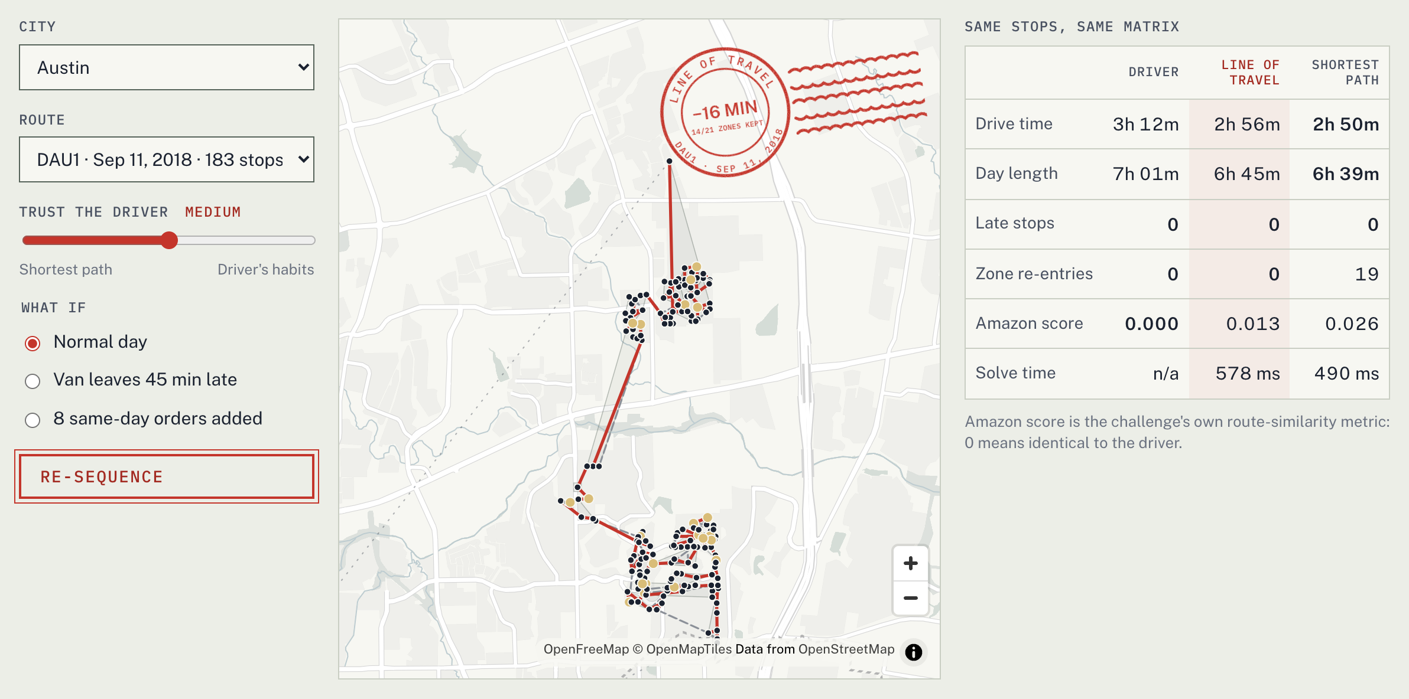
Pick a real route. Decide how much to trust the driver.
LIVE DEMO
TRY IT
36 real held-out routes from 5 cities.
Trust dial from shortest path to the driver's habits.
What-if: late start, or 8 same-day orders.
Drive time, day length, late stops, zone re-entries and Amazon score, side by side.
Solved in your browser by the benchmark's own engine: 0.4 to 0.7 s a route on an M4 Pro laptop. No backend.
OPEN
https://sanchay117.github.io/line-of-travel/
Notes:
This is the working demo. Pick a city and a real held-out route, set how much to trust the driver, and choose a scenario. The engine runs in a Web Worker in the browser, the same code as the benchmark, with a fixed number of search rounds so the same route always gives the same answer. The postmark stamps the result: minutes saved and how many zones kept their order.

Slide 13
Minutes per van, every day, with nothing new to install.
IMPACT AND FEASIBILITY
PER VAN
PER STATION
PER YEAR
11.6 min
19.4 h
$102k
less driving per route per day at the default setting, on held-out routes
of driving saved per day at a 100-van station
a year per station at the BLS 2025 median wage for delivery drivers ($21.13/h), 250 days
HOW IT FITS INTO A STATION
1 Plan
2 Re-sequence
3 Dial
4 Learn
The station's planner assigns stops to vans, as today.
Line of Travel orders each van's stops in well under a second, in a browser.
Each station sets its trust level. New drivers can start nearer the shortest path.
Each day's completed routes add to the station history the model reads.
Fewer late deliveries too: 469 late stops in the drivers' own orders, 1 with Line of Travel, across 28,354 stops with a window. The US has about 1.5 million delivery truck driver jobs (BLS 2025).
Notes:
Impact in plain numbers: 11.6 minutes less driving per van per day. At a hundred-van station that is 19.4 driver-hours a day, about $102 thousand a year at the median wage, before fuel and emissions. Feasibility: it needs only the data a station already has, runs in a fraction of a second on any device, and slots in after stop assignment.

Slide 14
It keeps the driver's knowledge. Here is what it cannot know.
RESPONSIBLE USE AND LIMITS
WHAT IT PROTECTS
LIMITS
Driver judgment. It starts from how drivers already work instead of overriding it, and a dial decides how far it may depart.
Deliveries. Lateness is part of the objective, so saving minutes never comes from missing a window.
Privacy. Only stops, zones and travel times. No driver identity, no customer names, no GPS traces.
Explainability. Every choice is road time plus two named charges a dispatcher can read and change.
Planned, not driven. Savings are measured in Amazon's travel-time estimates, not GPS. Drivers may know shortcuts the matrix does not.
Habits are not always good. Some habits are detours. That is why the dial exists, and why the default does not trust habit fully.
Five US metros, 2018. Other countries, vehicles or seasons need their own history before the habit model is trusted.
Research licence. The dataset is CC BY-NC 4.0, so a commercial rollout would retrain on the operator's own routes.
Notes:
Responsible use. The design choice that matters most is that it learns from drivers rather than overriding them, and the dispatcher controls how far it departs. Lateness is in the objective. No personal data. The limits are real: savings are in Amazon's planned travel times, not GPS, and habits can encode detours, which is why the default is moderate trust, not full trust.

Slide 15
Keep the order drivers already know.
LINE OF TRAVEL
Remove the detours.
LIVE DEMO
https://sanchay117.github.io/line-of-travel/
CODE AND REPRODUCTION
https://github.com/Sanchay117/line-of-travel
DATA
Amazon Last Mile Routing Research Challenge 2021, CC BY-NC 4.0
SANCHAY SINGH · SOLO ENTRY · DATANOVA 2026
Notes:
To close: an optimizer that drivers ignore saves nothing. Line of Travel learns the order drivers already use and removes only the detours: 5.9% less driving on 3,052 held-out routes, zones kept whole, fewer late stops, in a third of a second. Thank you.

