Slide 1














Data Mining

Slide 2
Data Description
The data for this project has three components:
Genomics
Imaging
Survival
Each of the components contain information about 61 patients who were diagnosed with LGG.
LGG refers to Low Grade Glioma which is a type of brain cancer.

Slide 3
Genomics
The Genomic data is obtained from a publicly available portal that includes data from multiple cancer types in The Cancer Genome Atlas (TCGA). This data contains 1283 gene pathway scores for 61 cancer patients.
A set of genes constitutes a gene pathway
A pathway score assesses the relative variability of gene expression of genes in the pathway as compared to expression of genes not in the pathway. These scores are computed using the gene-set variation analysis (GSVA) procedure.

Slide 4
Genomics
Patients | Gene Pathway 1 | Gene Pathway 2 | … | Gene Pathway 1283
1
2
3
4
5
.
.
.
61

Slide 5
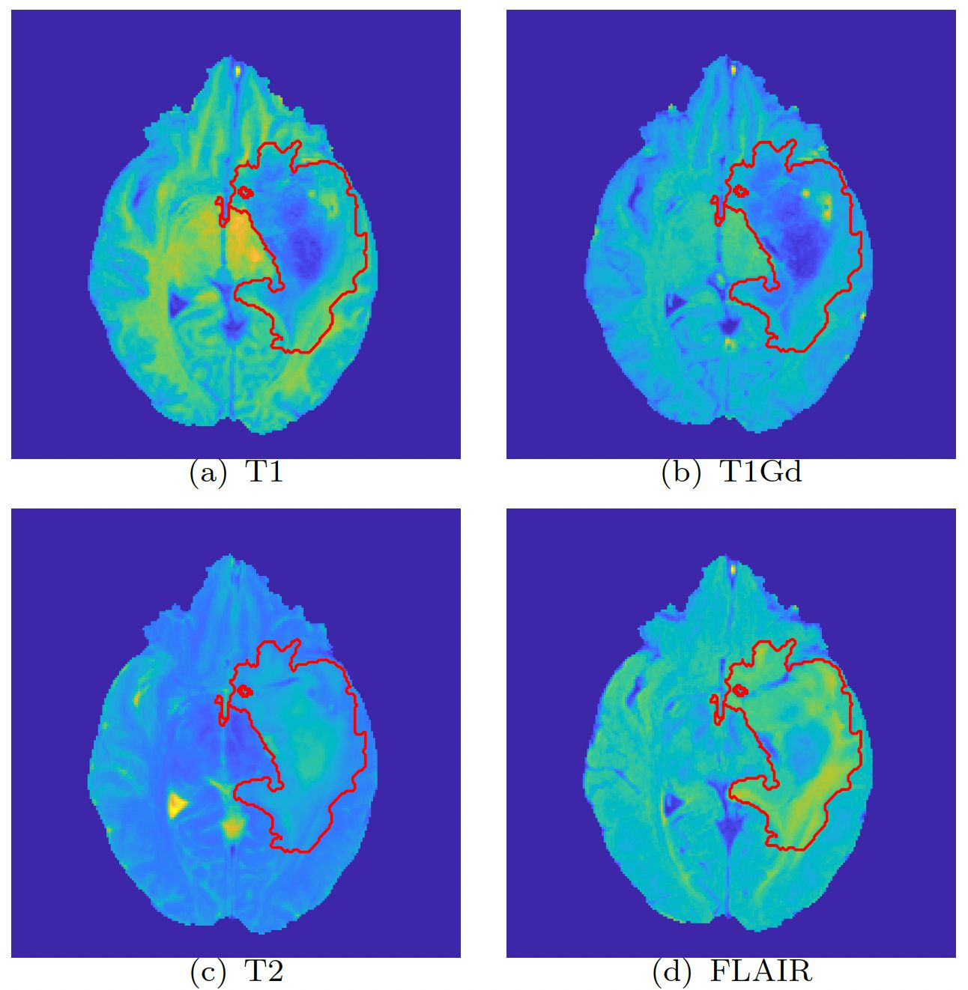
Imaging
The Imaging data is based on multi-institutional Magnetic Resonance Imaging (MRI) sequences available in The Cancer Imaging Archive (TCIA).
Four types of MRI Sequences are used
T1
T1Gd
T2
FLAIR

Slide 6
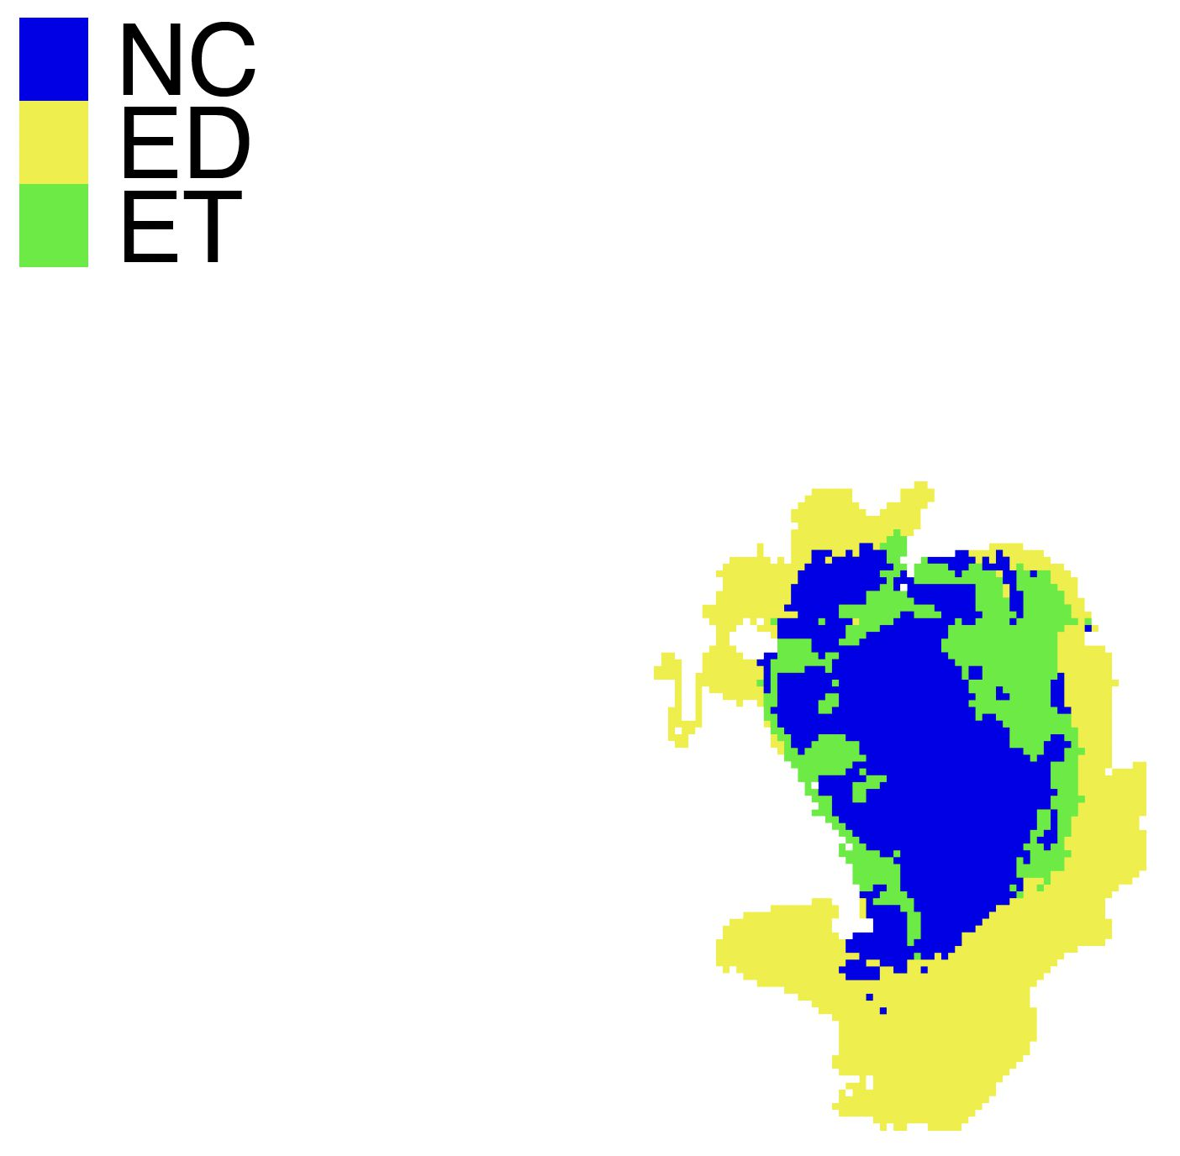
Imaging
Tumor region is further classified into 3 subregions

Slide 7
Imaging
Voxel-level intensity values are measured from these sequences.
Smoothed density is constructed using the voxel level intensity histogram
Variability in the intensity histograms is captured through the scores from a PCA
Note that the PCA is on the space of density functions by using a Reimannian-geometric framework.

Slide 8
Imaging
Patients | T1.ED.1 | T1.ED.2 | …
1
2
3
4
5
.
.
.
61

Slide 9
Survival Time
The length of time from the date of diagnosis for a disease, such as cancer, that patients diagnosed with the disease are still alive.
The time ranges from 0.1 to 156.1 months

Slide 10
Predicting Survival Time of LGG Patients: Refining Feature Selection Methods
Mackenzie M., Neo K., Rosie D., and Sanchayan B.
Data
Feature Selection
Box-Cox Transformation
Tests
Ridge Regression
Stability Selection

Slide 11
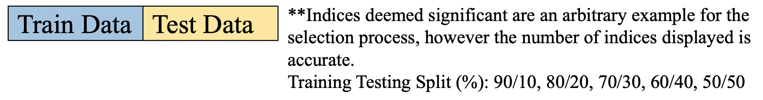
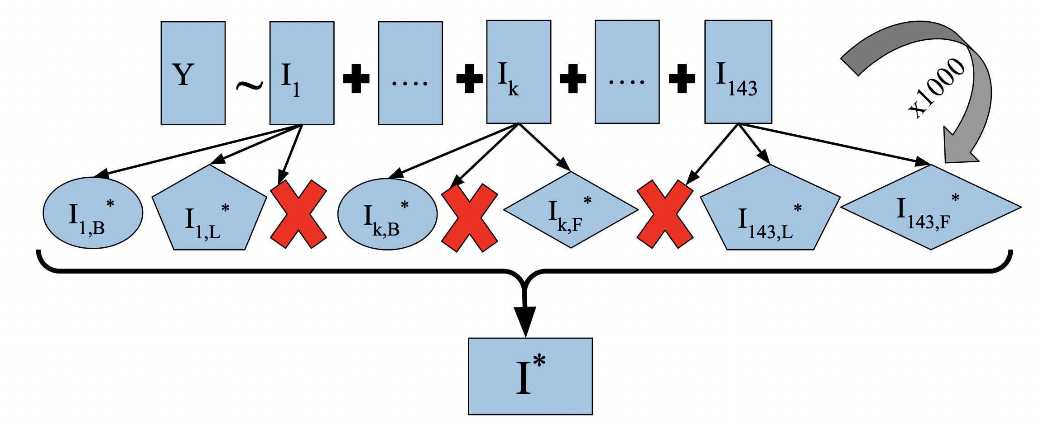
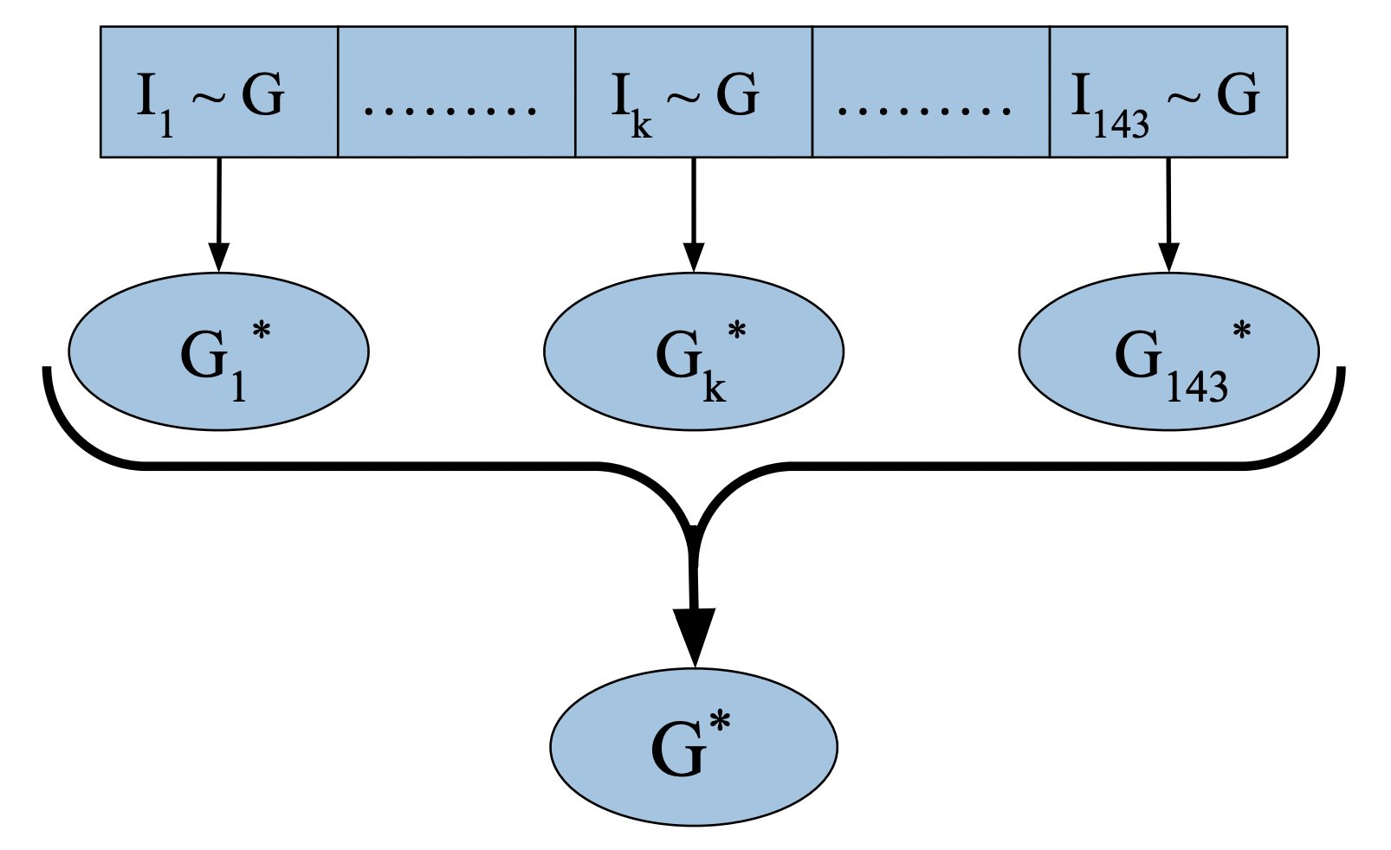
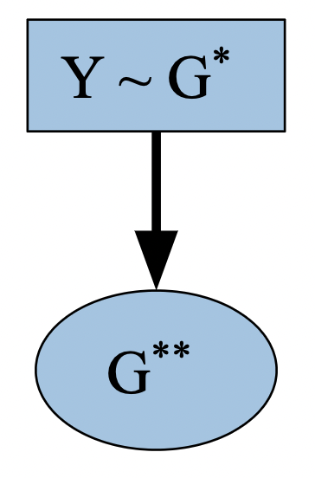

Imaging Informed Inference: Modeling Survival Time through Imaging-aware Gene Selection
Main Focuses:
Building a method
Tuning hyperparameters
Comparing different training/testing splits
Statistical Inference

Slide 12
Investigating Biological Correlations Using Dimension Reduction
Dimension Reduction
PCA
Clustering
K-means
Biological Functions
Related biological functions within clusters?
Sparse PCA
Kernel PCA
Agglomerative
Billy Bratton, Samprit Chakraborty, Thejasvi Dhanireddy, Cynthia Liu

