Slide 1














Data Mining

Slide 2
Data Description
The data for this project has three components:
Genomics
Imaging
Survival
Each of the components contain information about the same 61 patients who were diagnosed with LGG.
LGG refers to Low Grade Glioma which is a type of brain cancer.

Slide 3
Genomics
The Genomic data is obtained from a publicly available portal that includes data from multiple cancer types in The Cancer Genome Atlas (TCGA). This data contains 1283 gene pathway scores for 61 cancer patients.
A set of genes constitutes a gene pathway
A pathway score assesses the relative variability of gene expression of genes in the pathway as compared to expression of genes not in the pathway. These scores are computed using the gene-set variation analysis (GSVA) procedure.
Hänzelmann, S., Castelo, R., & Guinney, J. (2013). GSVA: gene set variation analysis for microarray and RNA-seq data. BMC bioinformatics, 14, 1-15.
Notes:
The first dataset that we used in our research involved the expression of certain gene pathways for the LGG patients
This data comes from the Cancer Genome Atlas and contains expression scores for 1283 different gene pathways
The scores are calculated by assessing the relative variability of gene expression in the respective pathway when compared to the expression of genes not in the pathway; a process called gene-set variation analysis

Slide 4
Genomics
1283 columns
Patients | HALLMARK_TNFA | HALLMARK_HYPOXIA | … | LEF1_UP.V1_UP
1 | -0.126860761 | -0.18574255 |  | -0.1732392086
2 | 0.168803012 | 0.21150548 |  | 0.2379491869
3 | -0.333927828 | -0.13548448 |  | -0.0848353309
4 | -0.038806908 | 0.11504567 |  | -0.0523854227
5 | 0.116890346 | 0.09082899 |  | 0.2700511453
.
.
.
60 | 0.306441603 | 0.09915881 |  | 0.197961369
61 | 0.492655067 | 0.33642534 |  | 0.0769247170

Slide 5
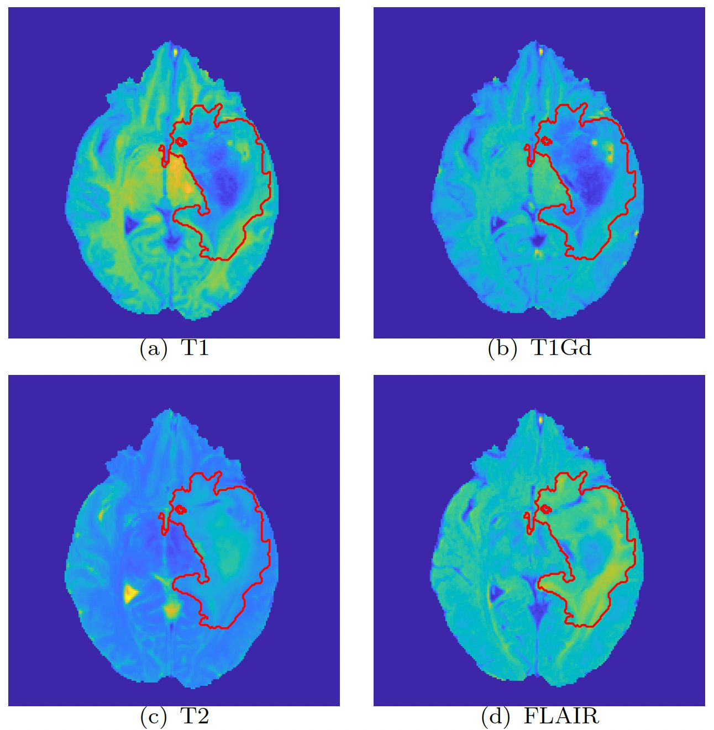
Imaging
The Imaging data is based on Magnetic Resonance Imaging (MRI) sequences available in The Cancer Imaging Archive (TCIA).
PCA scores are obtained for different MRI sequences and for different regions.
This data contains 143 imaging scores for the same 61 cancer patients.
Saha, A., Banerjee, S., Kurtek, S., Narang, S., Lee, J., Rao, G., ... & Baladandayuthapani, V. (2016). DEMARCATE: Density-based magnetic resonance image clustering for assessing tumor heterogeneity in cancer. NeuroImage: Clinical, 12, 132-143.

Slide 6
Imaging
143 columns
Patients | T1_NCR.NET.1 | T1_NCR.NET.2 | … | FLAIR_ET.17
1 | 15.163961 | 11.93531487 |  | -0.439410426
2 | 6.010334 | 11.16042060 |  | 0.029878022
3 | 15.943048 | 7.40563100 |  | -0.246888770
4 | -1.748044 | -0.55519718 |  | -0.124747401
5 | 15.935045 | -12.24068179 |  | 0.041867501
.
.
.
60 | 1.354076 | 7.994179 |  | -0.2843669
61 | 12.460006 | -3.42174345 |  | -0.967588701

Slide 7
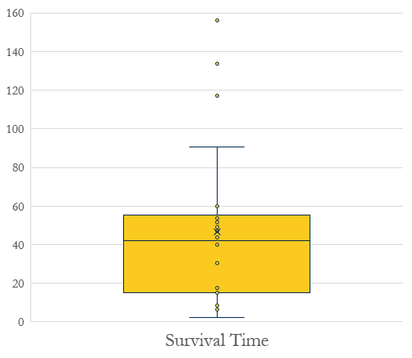
Survival Time
The length of time from the date of diagnosis for LGG till death.
The time ranges from 0.1 to 156.1 months

Slide 8
Predicting Survival Time of LGG Patients: Refining Feature Selection Methods
Mackenzie M., Neo K., Rosie D., and Sanchayan B.
Data
Feature Selection
Box-Cox Transformation
Tests
Ridge Regression
Stability Selection

Slide 9

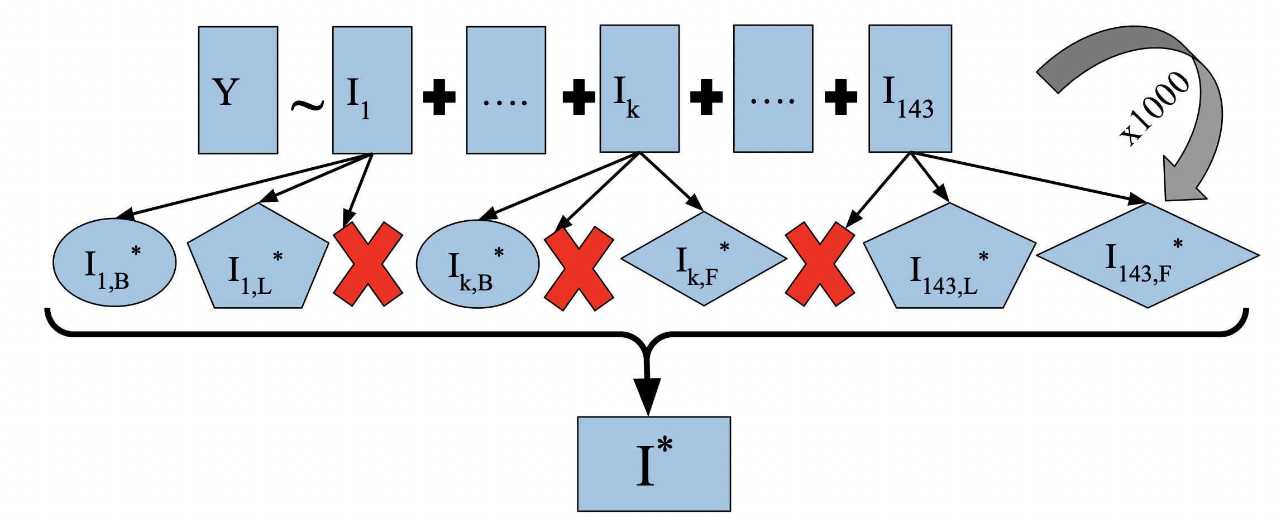
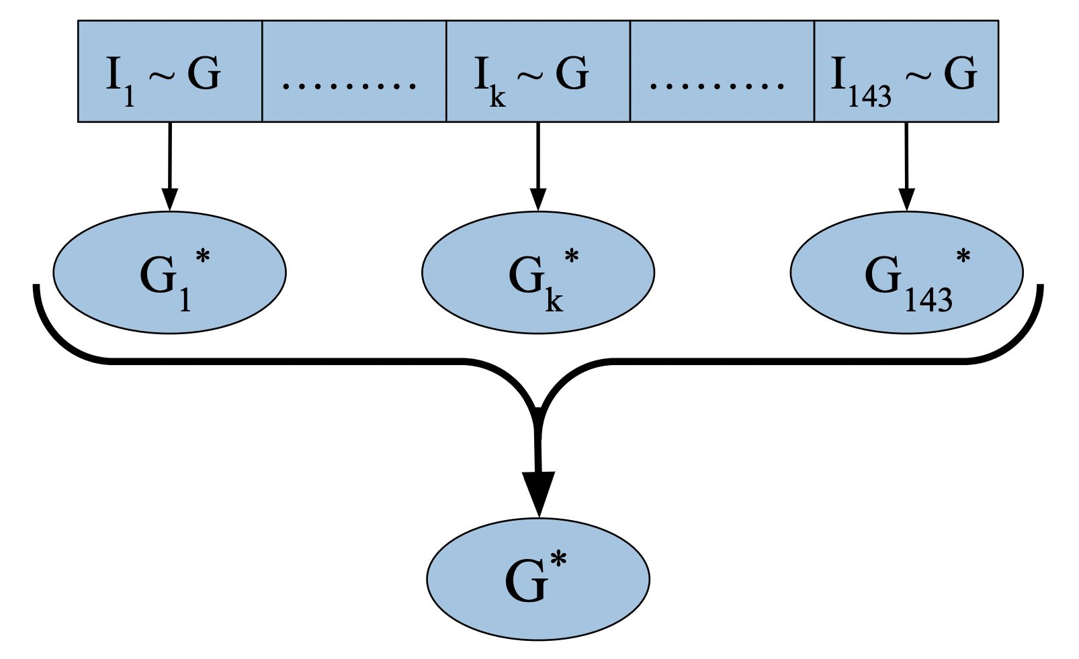
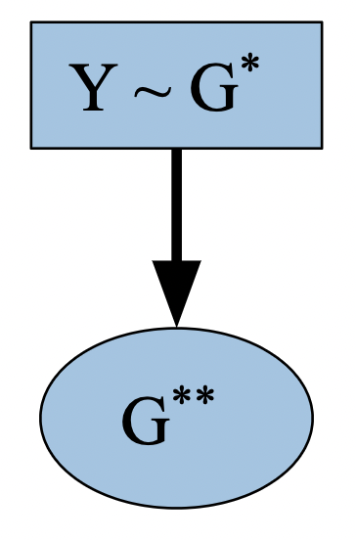

Imaging Informed Inference: Modeling Survival Time through Imaging-aware Gene Selection
Main Focuses:
Building a method
Tuning hyperparameters
Comparing different training/testing splits
Statistical Inference

Slide 10
Investigating Biological Correlations Using Dimension Reduction
Dimension Reduction
PCA
Clustering
K-means
Biological Functions
Related biological functions within clusters?
Sparse PCA
Kernel PCA
Agglomerative
Billy Bratton, Samprit Chakraborty, Thejasvi Dhanireddy, Cynthia Liu

