Slide 1
Feature Selection methods on LGG patients’ survival time prediction
Mackenzie, NEO, rosie, Sanchayan

Slide 2
Pipeline of Project
Data
Feature Selection
Transformation
Linear Model
Cross Validation
Tests
Genomics
Imaging
Naïve Method
Recursive Feature Elimination
Boxcox Transformation
Linear Regression
10-fold cross validation
RMSE
R Squared
MAE
Diagnostic Plots

Slide 3
Pipeline of Project
Data
Feature Selection
Transformation
Linear Model
Cross Validation
Tests
Genomics
Imaging
Naïve Method
Recursive Feature Elimination
Boxcox Transformation
Linear Regression
10-fold cross validation
RMSE
R Squared
MAE
Diagnostic Plots

Slide 4
Feature Selection Methods
NAÏVE Method
Genomics
Imaging
Boruta
Genomics
Imaging
Recursive Feature Elimination
Genomics
Imaging

Slide 5
Feature Selection Methods
Recursive Feature Elimination
Genomics
Imaging
NAÏVE Method
Genomics
Imaging
Boruta
Genomics
Imaging

Slide 6
Feature Selection Methods
Boruta
Genomics
Imaging
NAÏVE Method
Genomics
Imaging
Recursive Feature Elimination
Genomics
Imaging

Slide 7
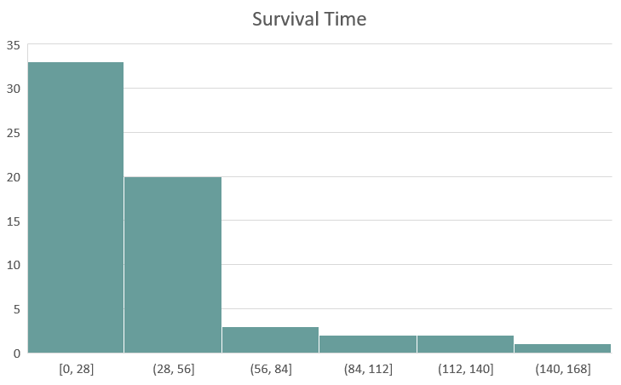

Boxcox Transformation
$$g\left(y\right)=\frac{y^{λ}−1}{λ}$$

Slide 8
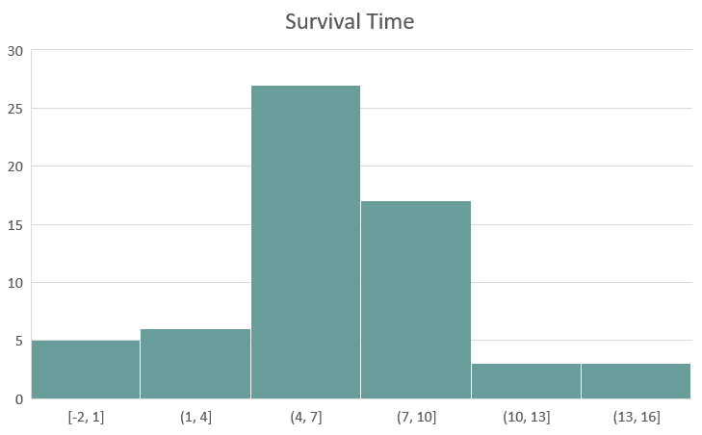
Boxcox Transformation

Slide 9
Compare methods

Slide 10
Compare methods

