Slide 1
Content Store management in Named Data Network
Sanchita Badkas (2019H1030520P)
Yashita Goswami (2019H1030521P)

Slide 2
Introduction
Information Centric Networks: Evolve the Internet infrastructure away from a host-centric paradigm around the data/content
Named Data Network : Assumes hierarchical structure of data
In network caching : Attractive option in NDN to avoid server bottlenecks and reduce data access latency
Cache allocation problem : Given a finite set of cache storage and a specific topology, how should the storage be distributed across the routers?

Slide 3
Proposed Solution
Cache size depends on various factors like
Level of the node
Distance from consumers
Interest rate
Distribution type, etc.
Attempt to create a model using machine learning that will predict cache size for each level.

Slide 4
Assumptions and Environment
Assumptions:
A dynamic cache, plug-n-play device
ZIPF distribution with 0.7 skewness
Binary tree topology
Root = Producer, Leaf Nodes = Consumers, Internal Nodes = Routers
Simulation environment:
Cache replacement policy : Least Recently Used(LRU)
Packet size : 1024 bytes
Routing strategy : Best path strategy.
Caching Policy : Non-cooperative

Slide 5
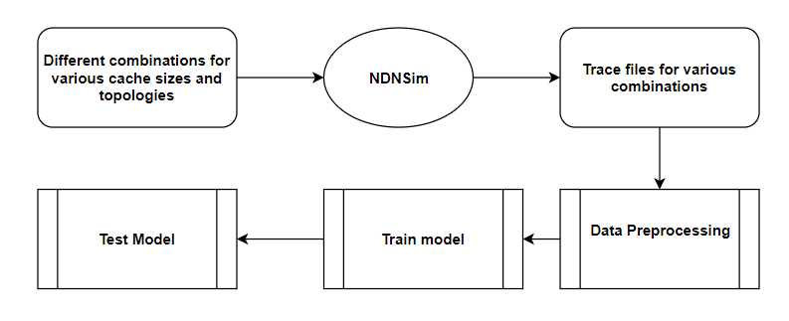
Flow diagram

Slide 6
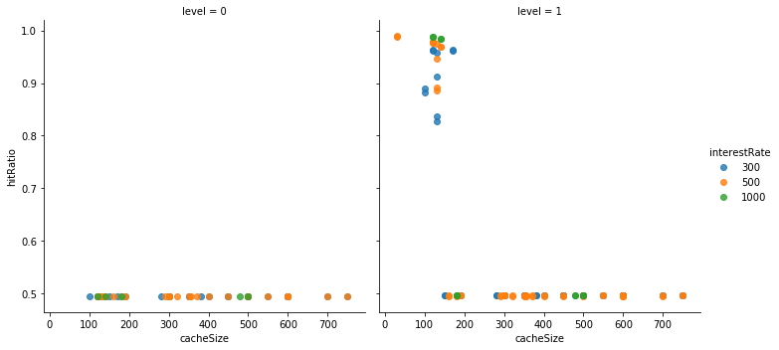
Observations
Hit ratio vs cache size for complete binary tree of 15 nodes

Slide 7
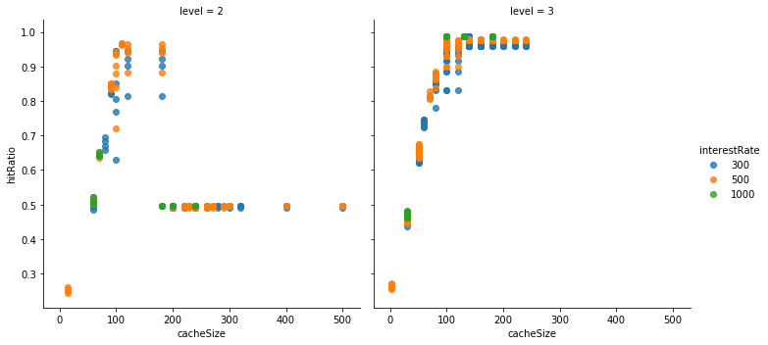
Observations
Hit ratio vs cache size for complete binary tree of 15 nodes

Slide 8
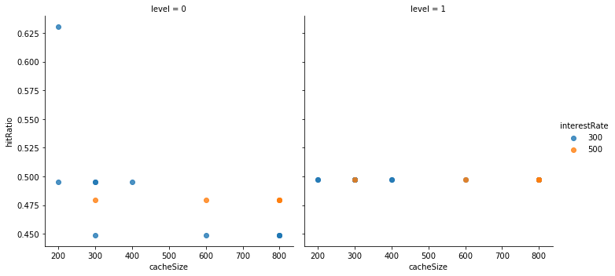
Observations
Hit ratio vs cache size for complete binary tree of 31 nodes

Slide 9
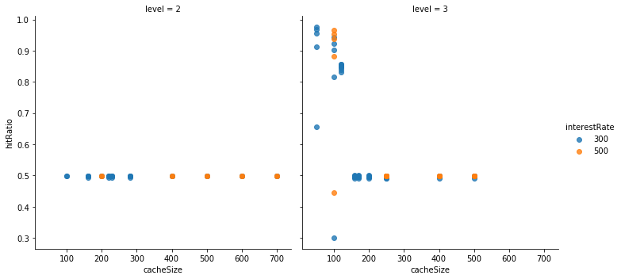
Observations
Hit ratio vs cache size for complete binary tree of 31 nodes

Slide 10
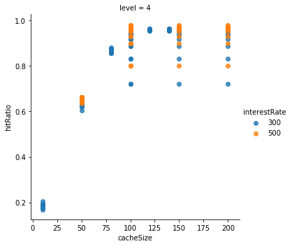
Observations
Hit ratio vs cache size for complete binary tree of 31 nodes

Slide 11
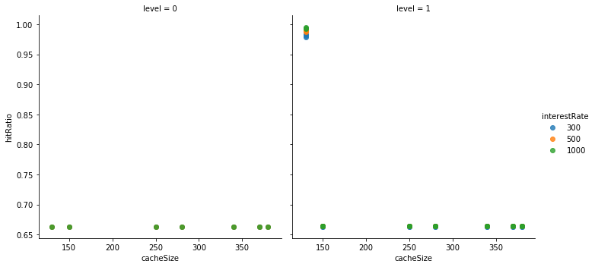
Observations
Hit ratio vs cache size for complete ternary tree of 15 nodes

Slide 12
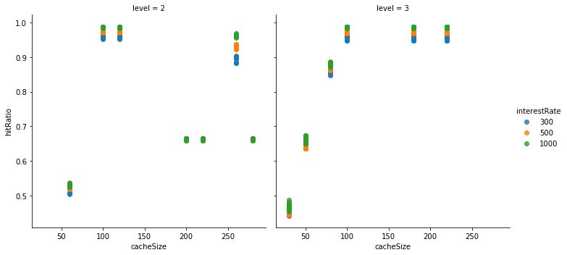
Observations
Hit ratio vs cache size for complete ternary tree of 15 nodes

Slide 13
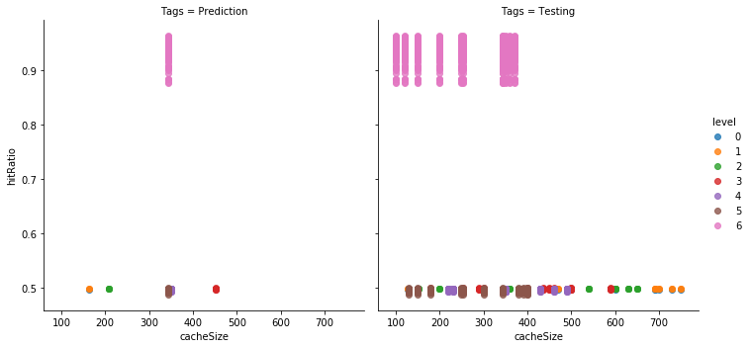
Results:
Prediction vs Random in level 7 tree

Slide 14
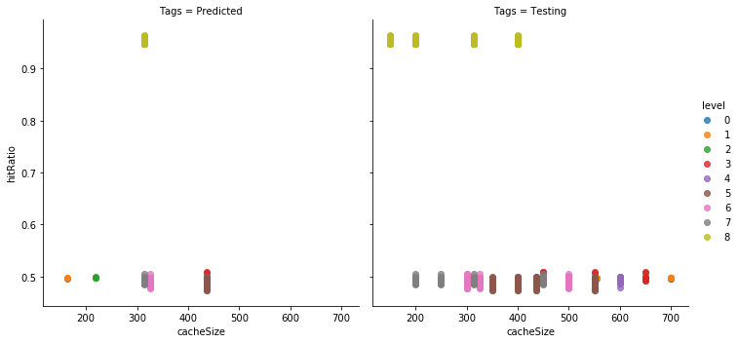
Results:
Predictions vs Random in Level 9 tree

Slide 15
Can the accuracy be improved:
Less Assumptions
More dimensions, more data
More insights in to data
Greater accuracy
Different topologies, different data flow patterns
Dimensions like, distribution skewness, node centrality, multiple producers, multiple children nodes, etc
Proper correlations of the added dimensions with cache size would be uncovered
Less noise, more data, less overfitting

Slide 16
Thank you!

