Slide 1


MULTIPLI HACKATHON / 2026
BUILT FOR THE BUILDERS
ROUND 1 · IDEA SUBMISSION
404Slayers
Web3 Wallet and Contract Reputation System
19–20 SEPTEMBER 2026
36 HOURS. MAKE THEM COUNT.

Slide 2

HACKATHON 2026 / ROUND 1
01 · THE TEAM
Team details.
 | NAME | EMAIL | COLLEGE / COMPANY
MEMBER 1 | Sanchit Agarwal | sanchit.agarwal2024@vitstudent.ac.in | VIT , Vellore
MEMBER 2 | S Giridharan | giridharan.s2024a@vitstudent.ac.in | VIT, Vellore
MEMBER 3 | Aman Gupta | aman.gupta2024@vitstudent.ac.in | VIT, Vellore
MEMBER 4 | Vishavjeet Sharma | vishavjeet.sharma2024@vitstudent.ac.in | VIT, Vellore
404Slayers
02 / 7

Slide 3
HACKATHON 2026 / ROUND 1
02 · THE PROBLEM
The problem.
PROBLEM STATEMENT
WHAT IS BROKEN?
Wallet and Contract Reputation
Web3 users often interact with unknown wallets and smart contracts without knowing their reputation or exposure to malicious activity.
WHY IT MATTERS?
One interaction with a malicious wallet or contract can expose users to scams, phishing, drainers, or other attacks . Current security tools rely on opaque labels rather than actionable proof . Solving this will deliver explainable trust layer essential to protect funds.
404Slayers
03 / 7

Slide 4
HACKATHON 2026 / ROUND 1
03 · THE SOLUTION
Our solution.
IN ONE LINE
Our project Chainguard, is an explainable cross-chain reputation and threat engine helping Web3 users and protocols verify unknown addresses before transacting..
KEY FEATURES
WHAT MAKES IT DIFFERENT
Explainable Risk Score .
Deterministic 0–100 reputation score with transparent risk signals.
On-Chain Evidence.
  Analyzes transactions, counterparties, contract interactions and threat intelligence.
Interaction Graph.
Visualizes relationships between the target address, wallets, contracts and flagged entities.
Instead of assigning black-box "good" or "bad" scores, it delivers granular, verifiable evidence tracing exact transaction pathways and dormant contract exploit vectors across chains.
404Slayers
04 / 7

Slide 5
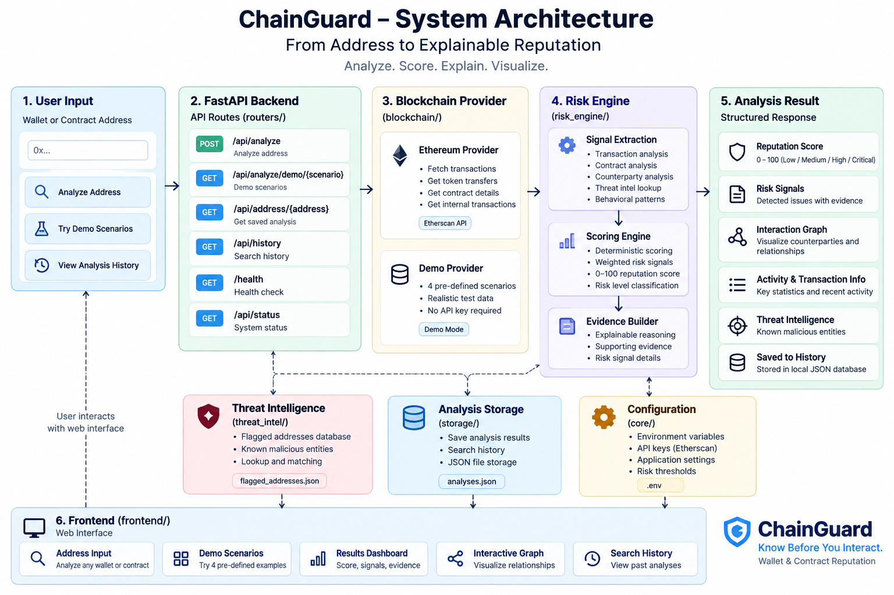
HACKATHON 2026 / ROUND 1
04 · HOW IT WORKS
How it works.
ARCHITECTURE
TECH STACK
Add a simple block diagram here.
Backend : Python , FastAPI
Blockchain : Ethereum , Etherscan API , Demo blockchain provide
Risk Engine : Deterministic rule-based scoring , Threat intelligence ,
graph analysis.
Frontend : HTML , CSS , JS ,
SVG interaction graph.
r
404Slayers
05 / 7

Slide 6
HACKATHON 2026 / ROUND 1
05 · BUSINESS MODEL
Business model.
WHO IT IS FOR
HOW IT EARNS
IMPACT
Individual Web3 Users.
Check wallets/contracts before interacting.
Web3 Applications
Screen users, counterparties and contracts.
Security / compliance teams.
Monitor address reputation and investigate suspicious activity.
Use a simple freemium + API model.
Free
Limited address checks through the ChainGuard dashboard.
Pro/Developer
Subscription for higher analysis limits, deeper history and advanced reputation data.
API
Pay-per-request / usage-based API for wallets, exchanges, DeFi protocols and security platforms.
Reduce risk before interaction
Give users actionable information before they sign or transact.
Turn blockchain transparency into usable intelligence
Convert raw transaction history into understandable risk evidence.
Enable safer Web3 applications
Allow platforms to integrate address reputation into their own workflows.
404Slayers
06 / 7

Slide 7
MULTIPLI HACKATHON / 2026
BUILT FOR THE BUILDERS
Thank you.
19–20 SEPTEMBER 2026
THINK. BUILD. MULTIPLI.

