Slide 1
Project Presentation of Industry Oriented Hands on Experience (22CS422)
On
QuickShow – Smart Movie Show Booking and Seat Reservation System Sanchit 2211981341
Rohit 2211981316
Shivanshu 2211981375
Shivani 2211981370
Supervised By
Dr. Swati goel
Department of Computer Science and Engineering,
Chitkara University, Punjab

Slide 2
Acknowledgement
I would like to express my sincere gratitude to Dr. Swati Goel for her valuable guidance, support, and encouragement throughout the development of the project QuickShow – Smart Movie Show Booking and Seat Reservation System.
I also thank the faculty members of the Department of Computer Science and Engineering, Chitkara University, for providing the necessary resources and technical support.
Special thanks to my teammates, friends, and family for their continuous motivation, collaboration, and support during the project development journey.
Finally, I would like to acknowledge the contribution of online resources, open-source libraries, and developer communities that helped in the successful completion of this project.

Slide 3
Introduction
QuickShow is a smart online movie and event ticket booking platform developed to simplify the entertainment booking experience. The system allows users to browse movies, comedy shows, and local events, select theatres and show timings, choose seats in real time, and securely book tickets online.
The platform provides features such as:
User Authentication & Secure Login
Movie and Event Listings
Real-Time Seat Selection
Secure Online Payment Integration
Digital Ticket Generation
Admin Dashboard for Management
QuickShow is designed using modern web technologies like React.js, Node.js, Express.js, and MongoDB to provide a fast, responsive, and user-friendly experience similar to platforms like BookMyShow.

Slide 4
Problem Statement:
Traditional ticket booking systems often cause long queues, booking errors, and inconvenience for users. Many platforms do not provide real-time seat availability, secure online payments, or easy access to local events and comedy shows.
QuickShow solves these problems by providing:
Real-time seat selection
AI chatbot assistance and smart recommendations
Secure online ticket booking
Digital ticket generation
Easy movie & event browsing
User-friendly booking experience
The system aims to make entertainment booking faster, smarter, and more convenient for users.

Slide 5
Objectives:
The main objective of QuickShow is to develop a smart and user-friendly online movie and event booking platform that simplifies the ticket reservation process.
Key Objectives:
Provide secure user authentication and account management
Enable real-time seat selection and booking
Generate instant digital tickets after booking
Allow admins to manage movies, events, and bookings efficiently
Integrate an AI chatbot for smart user assistance and recommendations
Support both movies and local entertainment events
Build a responsive and scalable web application

Slide 6
Literature Review
The development of QuickShow was inspired by existing online ticket booking platforms such as BookMyShow and other modern entertainment systems. Research was conducted on web development technologies, secure payment systems, user authentication, and responsive UI design.
Various resources such as:
React.js & Node.js Documentation
MongoDB Documentation
GeeksforGeeks & freeCodeCamp Tutorials
Groq AI Documentation
were studied to understand real-world booking systems and implement a scalable, secure, and user-friendly platform.

Slide 7
Technology Stack:
Frontend
HTML5
CSS3
JavaScript
React.js
Socket.io
Backend
Node.js
Express.js
Socket.io
Database
MongoDB
Authentication & Security
JWT Authentication
bcrypt
AI & APIs
Groq API
AI-based Recommendations
Development Tools
GitHub
Postman
VS Code

Slide 8
Core Features
1. User Authentication
Secure signup and login system using JWT authentication and encrypted passwords.
2. AI Chatbot Assistance
Integrated AI chatbot to help users with recommendations, booking guidance, and queries.
3. Real-Time Seat Selection
Users can view and select available seats dynamically during booking.
4. Online Ticket Booking
Provides smooth and fast movie and event ticket reservation process.
5. Digital Ticket Generation
Automatically generates downloadable digital tickets after successful booking.
6. Community Chat System
Allows users to interact, discuss movies, and share reviews in real time.
7. Admin Dashboard
Admins can manage movies, events, users, bookings, and theatre details efficiently.
8. Responsive Web Application
The platform works smoothly across desktops, tablets, and mobile devices.

Slide 9
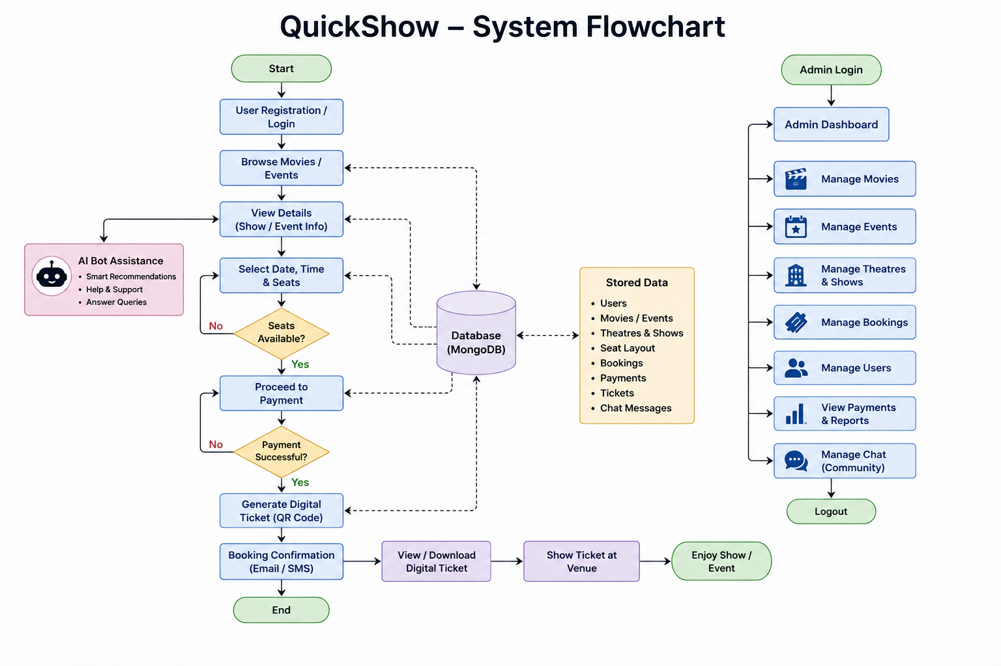
Flow Chart

Slide 10
Challenges & Solutions:
Challenges | Solutions
Real-time seat booking conflicts | Implemented dynamic seat locking system
Secure user authentication | Used JWT and bcrypt for security
Managing large movie/event data | Used MongoDB for efficient database handling
Responsive UI for all devices Implementing AI-based recommendations Building real-time community chat | Developed responsive frontend using React.js Integrated Groq API for smart suggestions Used socket-based communication for instant messaging

Slide 11
Limitations:
The platform currently supports limited theatres and local events.
Continuous internet connection is required for booking and community chat features.
High user traffic may affect real-time seat updates and chat performance.
AI recommendations depend on available user activity and data accuracy.
Some advanced features like multilingual support and live streaming are not implemented yet.

Slide 12
Future Scope:
Integration of advanced AI-based personalized recommendations.
Support for multilingual interface and voice search.
Expansion to more cities, theatres, and event categories.
Implementation of live streaming and virtual event booking.
Enhanced community features like group discussions and reviews.
Mobile application development for Android and iOS platforms.

Slide 13
Conclusion:
QuickShow is a smart and user-friendly movie and event booking platform developed to simplify the online ticket reservation process. The system provides features such as secure authentication, real-time seat selection, AI-based recommendations, community chat, and responsive user experience.
Using modern technologies like React.js, Node.js, MongoDB, and Groq API, the project successfully delivers a scalable and efficient entertainment booking solution.
This project enhanced practical knowledge of full-stack development, database management, API integration, and real-world application design.

Slide 14
Thank You

