Slide 1

Home
About Us
Service
Contact
Smartphones
LinkedIn: linkedin.com/in/sanchitbytes
Market Insights using SQL
GitHub: github.com/sanchitbytes
SANCHIT GUPTA | 16-AUG-2025
Email: sanchitbytes
@gmail.com

Slide 2

Sanchit Gupta
Home
About Us
Service
Contact
SQL Data Analysis
Introduction
This project explores a smartphone dataset using SQL to uncover meaningful insights about pricing, features, performance, and market trends.
The goal was to move beyond raw specs and answer business-style questions — like which brands dominate premium segments, how features impact value, and what trends shape the market.
Project
SQL Data Analysis
Dataset source: Kaggle.com

Slide 3
Sanchit Gupta
Home
About Us
Service
Contact
SQL Data Analysis
Data
Overview
Total Columns: 24
Key Features Covered:
Brand & Model – brand_name, model
Price & Rating – price, rating
Connectivity – has_5g, has_nfc, has_ir_blaster
Performance – processor_brand, num_cores, processor_speed
Battery & Charging – battery_capacity, fast_charging_available, fast_charging
Memory – ram_capacity, internal_memory, extended_memory_available, extended_upto
Display – screen_size, refresh_rate, resolution_width, resolution_height
Cameras – num_rear_cameras, num_front_cameras, primary_camera_rear, primary_camera_front
Operating System – os
Total Rows: ~ 980
A structured dataset capturing both specifications and features of smartphones across multiple brands.
Project
Project
SQL Data Analysis
SQL Data Analysis
Project
SQL Data Analysis
Project
SQL Data Analysis

Slide 4
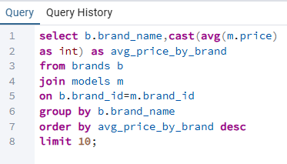
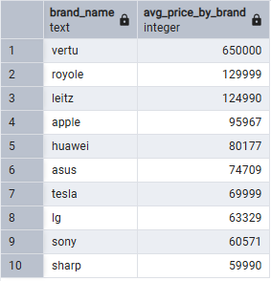
Sanchit Gupta
Home
About Us
Service
Contact
SQL Data Analysis
What is the average prices of
smartphones by brand?
Aggregation & Summary Insights

Slide 5
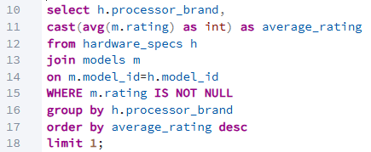

Sanchit Gupta
Home
About Us
Service
Contact
SQL Data Analysis
Which processor brand has the
highest average rating?
Aggregation & Summary Insights

Slide 6
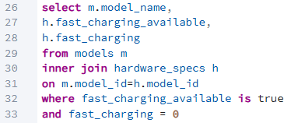
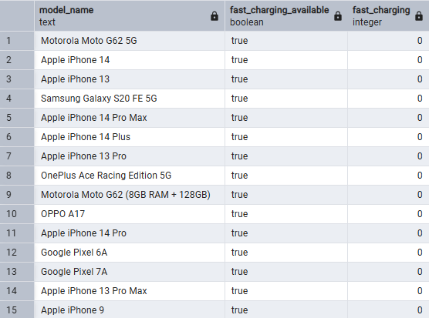
Sanchit Gupta
Home
About Us
Service
Contact
SQL Data Analysis
Identify models where fast_charging_available
is TRUE but fast_charging is NULL or 0.
NULLs, Defaults & Data Quality Checks

Slide 7
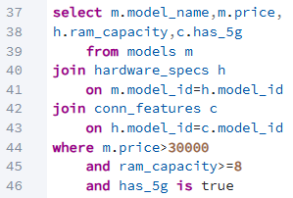
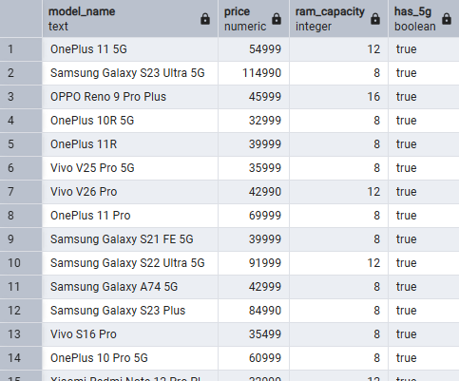
Sanchit Gupta
Home
About Us
Service
Contact
SQL Data Analysis
List all smartphones priced above ₹30,000
that support 5G and have at least 8GB RAM
Filtering & Conditions

Slide 8
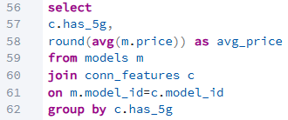

Sanchit Gupta
Home
About Us
Service
Contact
SQL Data Analysis
Compare average price of phones
with 5G vs. those without.
Derived Metrics & Comparisons

Slide 9
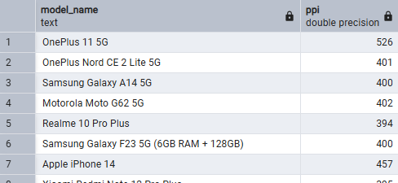
Sanchit Gupta
Home
About Us
Service
Contact
SQL Data Analysis
Calculate the pixel density (PPI) for each
model using resolution and screen size.
Derived Metrics & Comparisons

Slide 10
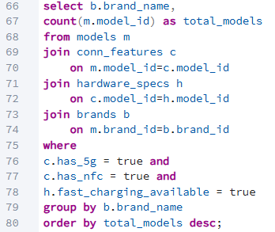
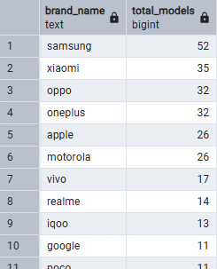
Sanchit Gupta
Home
About Us
Service
Contact
SQL Data Analysis
Which brands offer the most models
with 5G, NFC, and fast charging combined?
Advanced Analysis Ideas

Slide 11
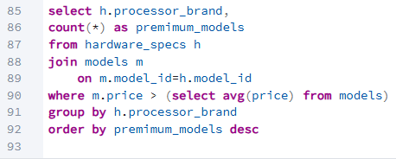
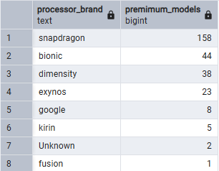
Sanchit Gupta
Home
About Us
Service
Contact
SQL Data Analysis
Which processor brand is used in the most
premium phones (say, price > (overall avg price))?
Advanced Analysis Ideas

Slide 12
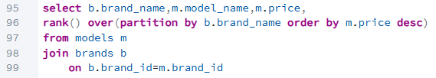
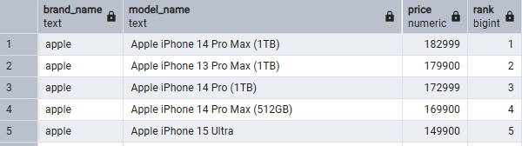
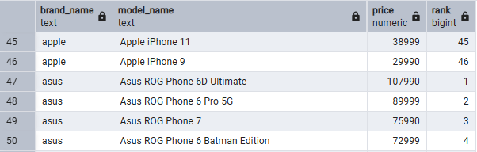
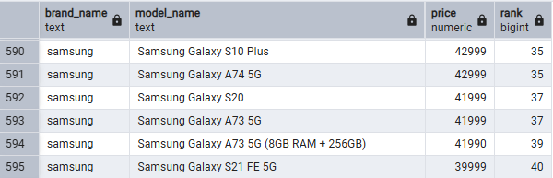
Sanchit Gupta
Home
About Us
Service
Contact
SQL Data Analysis
Rank Models by
Price Within Each Brand
Windows Function Ranking
1
2
3

Slide 13
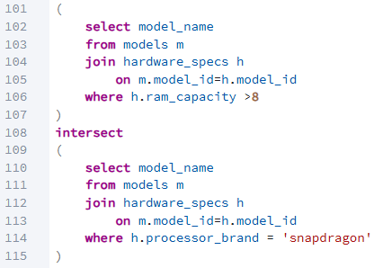
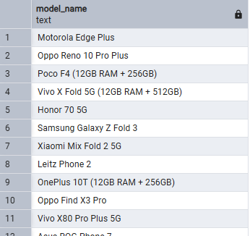
Sanchit Gupta
Home
About Us
Service
Contact
SQL Data Analysis
Models with High RAM
and Flagship Processor
Common Records Using INTERSECT

Slide 14
Sanchit Gupta
Home
About Us
Service
Contact
SQL Data Analysis
LinkedIn: linkedin.com/in/sanchitbytes
Thank you for viewing this project!
GitHub: github.com/sanchitbytes
: Let’s connect
Email: sanchitbytes
@gmail.com
Sanchit Gupta

