Slide 1
Poverty Alleviation System
Presented By- Nishad Ranadive, Rahul Zore, Sanchit Chavan

Slide 2
Content:
Problem Statement
Purpose
The Proposal
Object Model
Use Cases Organization Wise
Organization Work Areas
Scope

Slide 3
Problem Statement
More Americans are living in poverty than any time since the early 90s. All those who make less than federal government’s official poverty threshold which for a family of four is $24,000 are considered under the poverty line. Poverty creates grave national issues like unemployment, decline in education, poor child development, increase in crime rate, low social mobility.

Slide 4
Purpose
To come up with a solution so that unemployed, poor and people in need get all the help they can through a centralized system so that their basic life requirements can be met.

Slide 5

The Proposal
Build a centralized organization which with the help of non-profit organizations, business organizations and government helps as much people as possible to meet their basic needs.

Slide 6
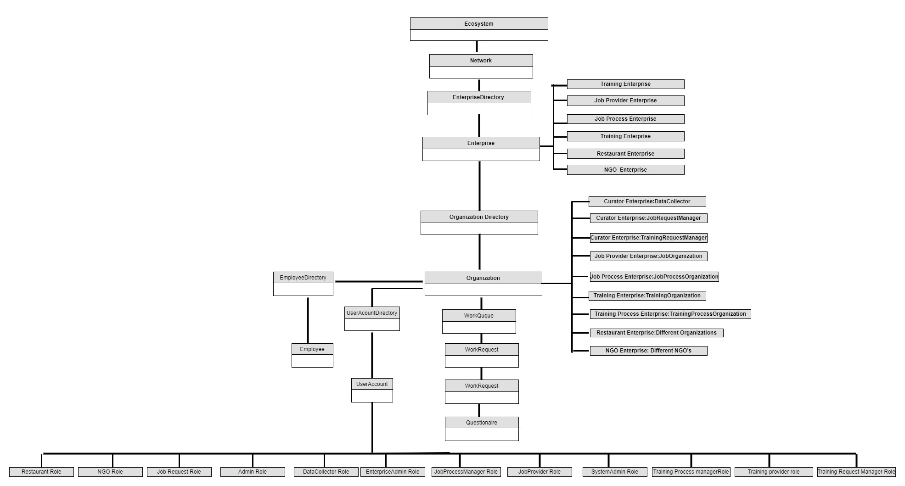
Object Model

Slide 7
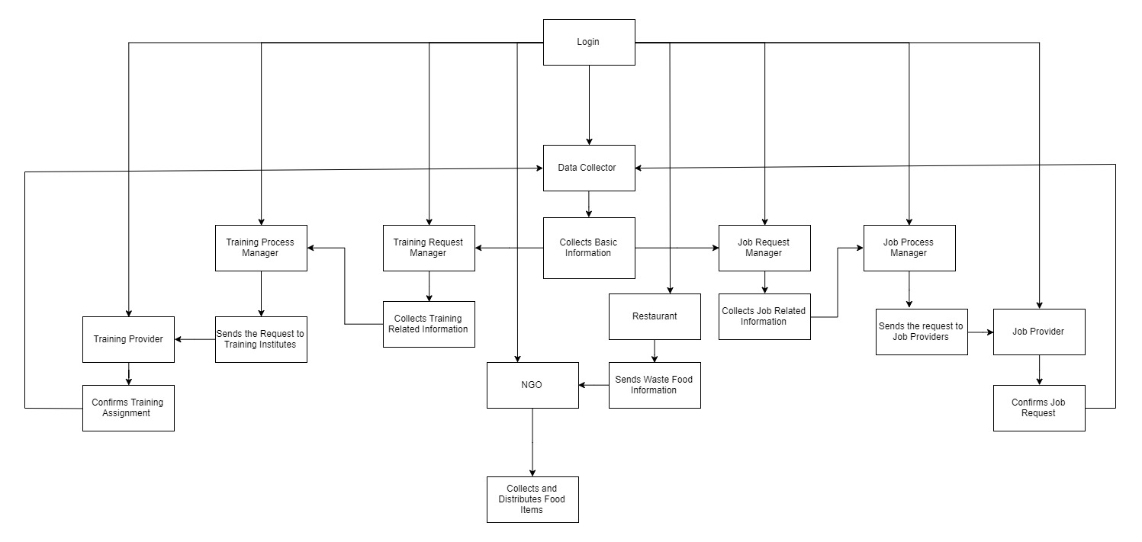
System Flow

Slide 8
Use Cases Organizations Wise
Admin Organization
Data Collector Organization
Job Process Organization
Job Provider Organization
Restaurant Organization
NGO Organization
Training Process Organization
Training Provider Organization

Slide 9
Data Collector Organization
Data Collector Role
Collects General Individual Data.
Passes on the information to either Job Manager or Training Manager as per the request type.
Job Request Manager Role
Collects the additional individual details related to Job assignment.
Passes on the information to Job Process Organization
Training Request Manager Role
Collects the additional individual details related to Training assignment.
Passes on the information to Training Process Organization

Slide 10
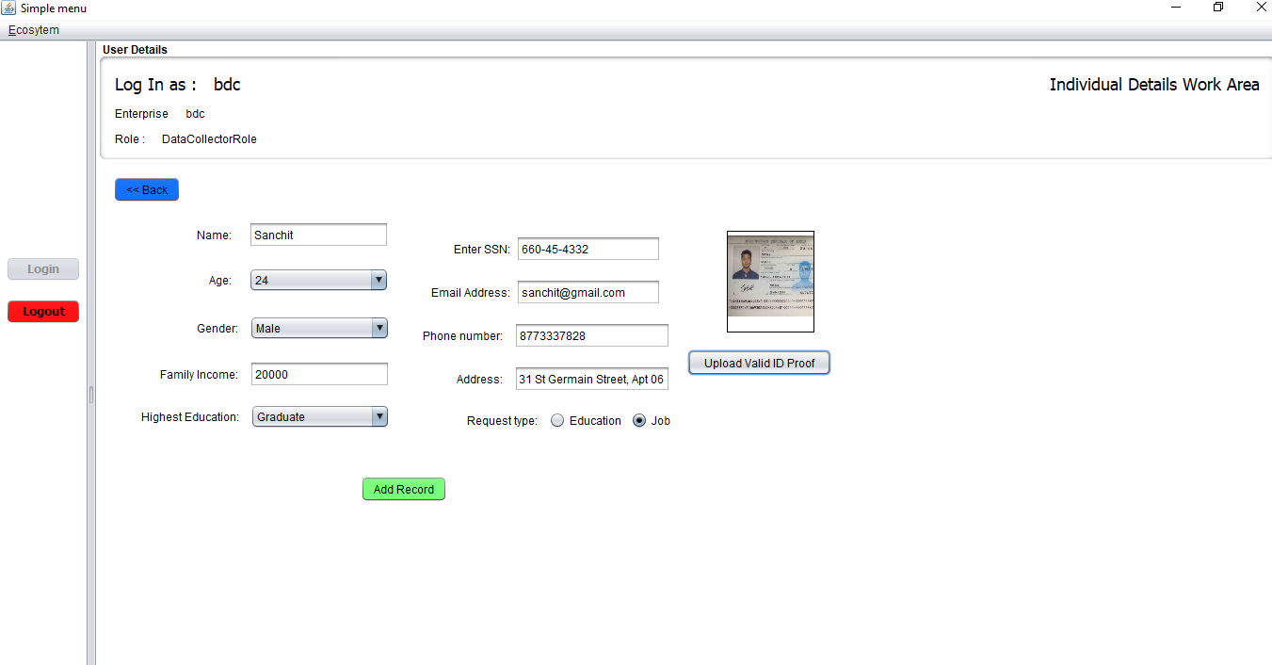
Data Collector Work Area

Slide 11
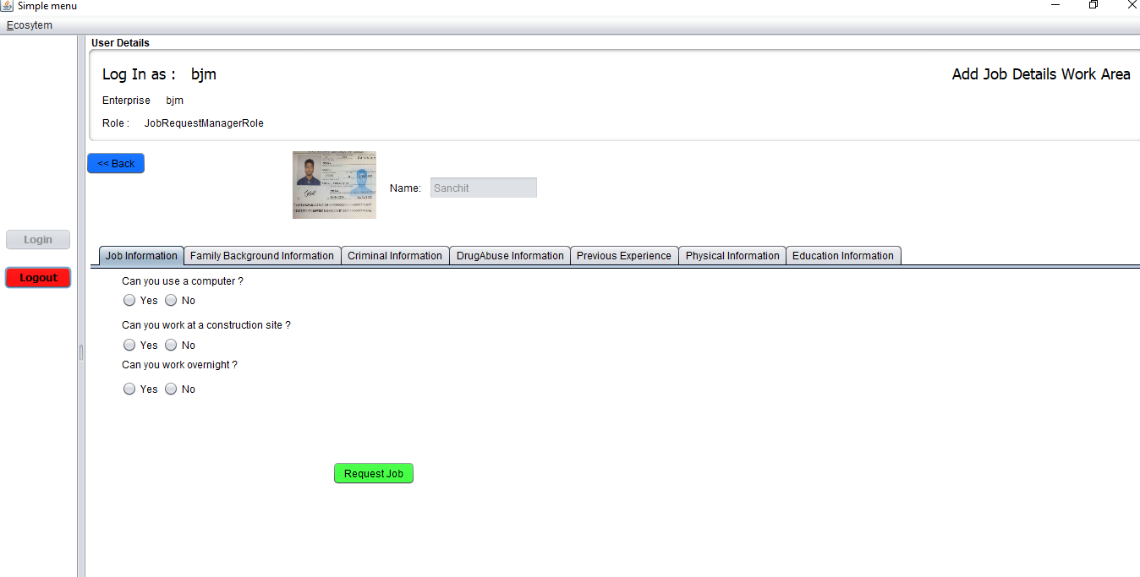
Request Manager Work Area

Slide 12
Job Process Organization
Job Process Manager
Receives the individual details and suggests an appropriate Job Provider to the individual where he can receive a job opportunity based on his background history and skills.
Passes the individual information to a Job Provider Organization for confirmation.

Slide 13
Job Provider Organization
Job Provider Organization
Receives the Job request from the Job Process Manager and gives confirmation that the job opportunity can be provided.
Once the request is confirmed, the confirmation flows back to the start of the chain informing the Data Collector Organization so that they can inform the individuals regarding the Job assigned to them.

Slide 14
Training Process Organization
Training Process Manager
Receives the individual details and assigns a particular training institute to the individual from where he can receive training based on his training interest.
Passes the individual information to a Training Provider Organization for confirmation.

Slide 15
Training Provider Organization
Training Provider Organization
Receives the training request from the Training Process Manager and gives confirmation that the training can be provided.
Once the request is confirmed, the confirmation flows back to the start of the chain informing the Data Collector Organization so that they can inform the individuals regarding the training assigned to them.

Slide 16
Restaurant Organization
The Restaurant organization creates a pickup request for the leftover food within their restaurant.
The admin enters the details of the leftover food inside the request.
This request is sent to all the available NGO organizations within the network.

Slide 17
NGO Organization
All NGO organization within the network receive the food request from the restaurant organizations.
These NGO organizations then send delivery vehicle to collect the food from the particular restaurant and then delivers it to the needful people for which the NGO belongs.

Slide 18
Special Features
Automated best suited jobs for the specific individual based on his profile.
01
Domain wise analysis of jobs and training opportunities provided by the respective organizations.
02
Analysis of requests received by the individuals throughout their lifecycle in the system.
03
Sending EMAIL notifications to the individuals on successful completion of their request.
04

Slide 19
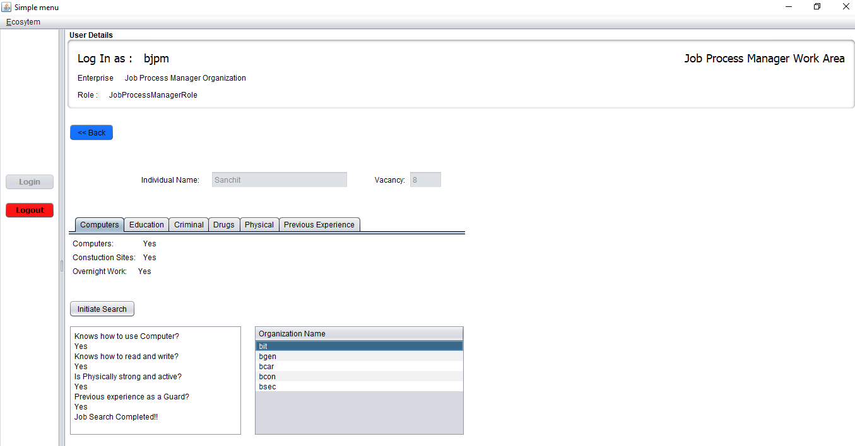
Automated Best Suited Jobs

Slide 20
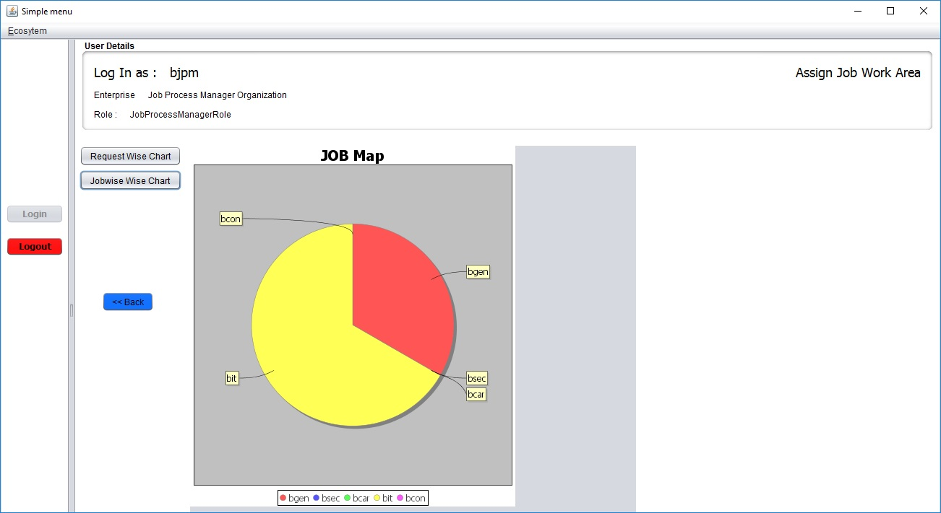
Domain wise analysis of Jobs Provided

Slide 21
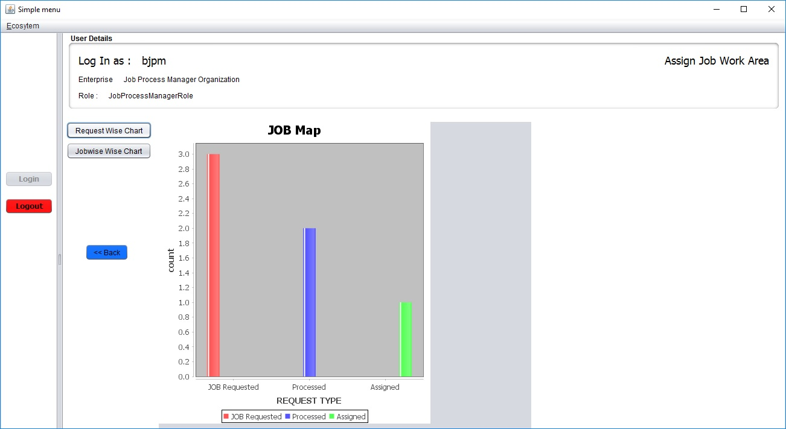
Analysis of Received Requests

Slide 22
Future Scope
The application can be extended to link training and job organizations to train individuals in need, providing them a job opportunity in the respective field on successful completion of training
Social problems associated with other domains could also be tackled by adding respective organizations and getting required information from individuals

Slide 23
Thank You
- Nishad Ranadive, Rahul Zore, Sanchit Chavan

