Slide 1


KITCHEN COACH APP
Database Management System
Sanchit Jaiswal
(RA2411003011741)
Riya Raj
(RA2411003011753)
Department: CTECH
29 JULY 2026

Slide 2
Abstract
The Kitchen Coach App is a comprehensive database-driven application designed to help users manage their kitchen inventory, discover recipes based on available ingredients, track daily meal consumption, and monitor nutritional intake — all while reducing food waste. The system is built on a robust MySQL 8.0 relational database that demonstrates advanced SQL concepts covered in the 21CSC205P Database Management Systems course.
The database schema comprises five interconnected tables — users, ingredients, recipes, recipe_ingredients (junction table for M:N relationships), and meal_logs — enforcing referential integrity through primary keys, foreign keys, UNIQUE constraints, CHECK constraints, and cascading deletes. The project demonstrates DDL operations, DML, aggregate functions (COUNT, SUM, AVG, MIN, MAX) with GROUP BY and HAVING clauses, set operations (UNION, INTERSECT, EXCEPT equivalents), subqueries, and multiple JOIN types.
Additionally, the project implements Views for reusable query encapsulation, Triggers for automated business logic enforcement, Cursors for row-by-row processing, Transactions with SAVEPOINTs for ACID-compliant operations, and Concurrency Control using row-level and table-level locks. A full-stack web application (React + TypeScript + Vite on Supabase/PostgreSQL) provides the user-facing interface.

Slide 3
Introduction
In today's health-conscious world, managing nutrition effectively requires tracking what food is available, what meals are being consumed, and what nutritional value they provide. The Kitchen Coach App addresses this need by providing a unified platform for ingredient inventory management, recipe discovery, meal logging, and nutritional tracking.
Problem Statement:
• Users often waste food because they lose track of ingredient expiry dates
• Finding recipes that match available ingredients is time-consuming
• Manual meal tracking is tedious and inconsistent
• Nutritional monitoring requires cross-referencing multiple sources
Objectives:
• Design a normalized relational database schema with proper constraints
• Implement smart recipe recommendations based on available inventory
• Automate inventory management using triggers and transactions
• Demonstrate advanced SQL: Views, Cursors, Transactions, Concurrency
• Build a full-stack web app with a React frontend on a managed Postgres backend
Technology Stack:
• Database: MySQL 8.0 (coursework) | Backend: Supabase | Frontend: React + TypeScript + Vite
• Cloud DB: Supabase (PostgreSQL) | Styling: Tailwind CSS + shadcn/ui

Slide 4
Literature Review
S.No | Author’s name | Title | Methods | Merits | Demerits
1. | Shajith S. & V. Jaitly (2025) | Building an AI Powered Nutrition Tracking System | BMI evaluation combined with a curated food–calorie dataset; CNN-based food recognition; AI recommendation engine scoring breakfast, lunch, snacks and dinner | Personalised meal suggestions tied to individual caloric need; automates daily calorie totalling; links BMI to nutritional analysis | Depends heavily on image quality; no kitchen inventory or expiry handling; no relational schema or multi-user design
2. | T.-L. Chueh, Z.-L. Wang, Y. J. Ngu et al. (2024) | A Mobile-Based Nutrition Tracker App Enhanced Dietitian-Guided 2:1:1 Diet-Induced Weight Loss | 8-week retrospective cohort of 10,297 participants; mobile tracker with a 2:1:1 portion-control plate and flexible low-carbohydrate diet; daily records reviewed by registered dietitians | Very large sample; intervention group lost 4.78% vs 1.54% body weight; shows app plus dietitian beats app alone | Short 8-week window and retrospective design; tracks intake only — no ingredient inventory or recipe matching

Slide 5
Literature Review
S.No | Author’s name | Title | Methods | Merits | Demerits
3. | A. Jaiswal, A. Solanki, A. Tomar et al. (2025) | Revolutionizing Diet and Fitness Tracking with AI: A User-Centric Approach to Nutrition and Wellness | “Diet Recall” mobile platform; Harris–Benedict formula for maintenance calories; K-Nearest Neighbours and content-based filtering for meal and workout plans | Integrates diet with fitness tracking; personalises on age, weight, height, activity level and dietary restrictions | Recommends from a fixed catalogue rather than what the user actually holds; no expiry or stock control; single-user
4. | C. Griffiths, L. Harnack & M. A. Pereira (2018) | Assessment of the Accuracy of Nutrient Calculations of Five Popular Nutrition Tracking Applications | Comparative evaluation of five consumer nutrition-tracking apps, benchmarking their nutrient calculations against a reference research food database | Quantifies accuracy gaps users cannot see for themselves; evidence-based framework; motivates trustworthy nutrient data | Evaluates existing apps only — proposes no system, schema or database design of its own

Slide 6
Literature Review
S.No | Author’s name | Title | Methods | Merits | Demerits
5. | W. Min, S. Jiang, L. Liu, Y. Rui & R. Jain (2019) | A Survey on Food Computing | Survey consolidating heterogeneous food data sources and the tasks built on them — perception, recognition, retrieval, recommendation and monitoring | Comprehensive taxonomy of datasets, tasks and applications; the standard reference for framing food-data research | Survey rather than an implementation; little attention to household inventory or transactional data management
6. | A. Salvador, N. Hynes, Y. Aytar et al. (2017) | Learning Cross-Modal Embeddings for Cooking Recipes and Food Images | Introduces Recipe1M (1M+ recipes, 800k images); trains a joint neural embedding of recipe text and images, regularised by a high-level classification objective | Largest public recipe corpus; image–recipe retrieval rivalling human performance; code, data and models released | Needs large-scale GPU training; retrieval is image-driven with no notion of stock on hand, quantities or expiry

Slide 7
Literature Review
S.No | Author’s name | Title | Methods | Merits | Demerits
7. | C. Trattner & D. Elsweiler (2017) | Food Recommender Systems: Important Contributions, Challenges and Future Research Directions | State-of-the-art review of food recommender systems, covering seminal and recent approaches plus group-based and health-aware specialisations | Explains why food choice is complex, multi-faceted and context dependent; sets out the field's open challenges | Review only, with no implementation or evaluation; inventory-aware recommendation is not addressed
8. | D. Elsweiler, C. Trattner & M. Harvey (2017) | Exploiting Food Choice Biases for Healthier Recipe Recommendation | Analysis of food-choice biases on a recipe portal; substitutes recommended meals with similar but healthier dishes; user study on how images affect choice | Demonstrates recommendations can nudge users toward healthier recipes without sacrificing appeal | Uses recipe-portal data only; ignores what a user physically has at home and when it expires

Slide 8
Literature Review
S.No | Author’s name | Title | Methods | Merits | Demerits
9. | C. Castro, E. Chitikova, G. Magnani et al. (2023) | Less Is More: Preventing Household Food Waste through an Integrated Mobile Application | Multilayered Installation Design approach mapping consumer activity across acquisition, storage, consumption and disposal; concept for one integrated app | Covers the whole waste lifecycle rather than a single stage; recommendations grounded in the empirical literature | Concept and design only — no working implementation, database schema or quantitative evaluation
10. | G. Mastorakis, I. Kopanakis, J. Makridis et al. (2024) | Managing Household Food Waste with the FoodSaveShare Mobile Application | Decision-support mobile app on a client–server architecture for monitoring household food supplies, expiration dates and redistribution of surplus | Targets the documented causes of waste — spoilage, date confusion, overbuying; a deployed working tool, not a concept | Centred on waste and sharing; no recipe matching from current stock and no advanced SQL/DBMS contribution

Slide 9
Literature Review
S.No | Author’s name | Title | Methods | Merits | Demerits
11. | O. Dospinescu, G. Grigorcea & B. Lefter (2025) | A Mobile Approach to Food Expiration Date Determination Using OCR and On-Cloud Image Classification | Mobile prototype using on-cloud image classification and Firebase ML Kit OCR to read printed expiry dates, with shelf-life inferred from category priors when none is printed | Low-cost and high-performance; removes manual entry of expiry dates; explicit that estimates are not safety judgements | Prototype stage; inferred shelf life is indicative only; no recipe layer and no multi-user relational schema
12. | M. Rodrigues, F. Fidalgo & Â. Oliveira (2023) | RecipeIS — Recipe Recommendation System Based on Recognition of Food Ingredients | Web application recognising an ingredient from a user-supplied image with a ResNet-50 CNN trained over 36 fruit and vegetable classes, then recommending recipes containing it | 96% classification accuracy; directly attacks “what can I cook with what I have?” as a food-waste lever | Recognises one ingredient at a time from an image; keeps no persistent inventory, quantities or expiry state

Slide 10
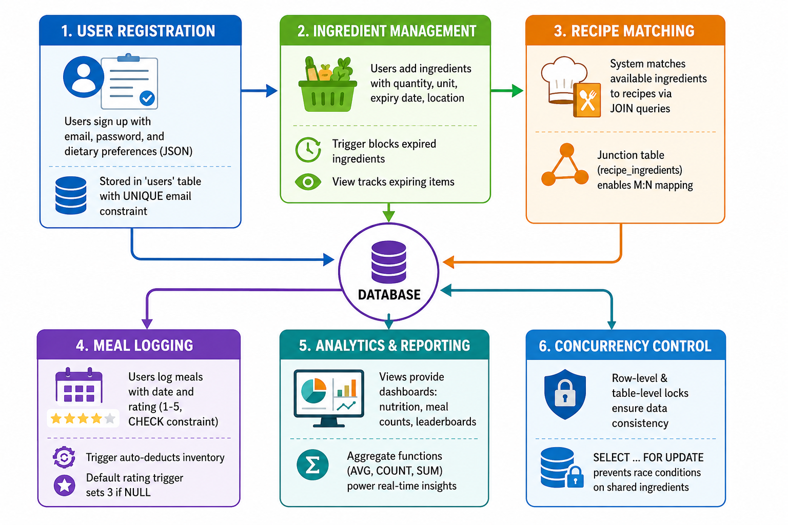
Work Flow of Proposed Model
System Architecture & Workflow
1. USER REGISTRATION — Users sign up with email, password, and dietary preferences (JSON)
↓ Stored in 'users' table with UNIQUE email constraint
2. INGREDIENT MANAGEMENT — Users add ingredients with quantity, unit, expiry date, location
↓ Trigger blocks expired ingredients | View tracks expiring items
3. RECIPE MATCHING — System matches available ingredients to recipes via JOIN queries
↓ Junction table (recipe_ingredients) enables M:N mapping
4. MEAL LOGGING — Users log meals with date and rating (1-5, CHECK constraint)
↓ Trigger auto-deducts inventory | Default rating trigger sets 3 if NULL
5. ANALYTICS & REPORTING — Views provide dashboards: nutrition, meal counts, leaderboards
↓ Aggregate functions (AVG, COUNT, SUM) power real-time insights
6. CONCURRENCY CONTROL — Row-level & table-level locks ensure data consistency
↓ SELECT ... FOR UPDATE prevents race conditions on shared ingredients

Slide 11
Proposed work -Explanation
Database Schema (5 Tables, 12+ Constraints)
• users — user_id (PK), email (UNIQUE NOT NULL), password_hash, name, dietary_preferences (JSON), created_at
• ingredients — ingredient_id (PK), user_id (FK CASCADE), name, quantity, unit, expiration_date, location, calories_per_unit
• recipes — recipe_id (PK), name, instructions (TEXT), prep_time, nutritional_info (JSON), difficulty_level
• recipe_ingredients — Composite PK (recipe_id, ingredient_name), FK CASCADE
• meal_logs — log_id (PK), user_id (FK), recipe_id (FK SET NULL), consumed_date, rating (CHECK 1-5)
Advanced SQL Features Implemented
• Constraints: PRIMARY KEY, FOREIGN KEY (CASCADE, SET NULL), UNIQUE, NOT NULL, CHECK
• Aggregates: COUNT, SUM, AVG, MIN, MAX with GROUP BY and HAVING (7 queries)
• Set Operations: UNION, UNION ALL, INTERSECT (via JOIN), EXCEPT (via LEFT JOIN + IS NULL)
• Subqueries: Scalar, row, table subqueries — correlated and non-correlated (6 queries)
• Joins: INNER, LEFT, CROSS, SELF JOIN across 6 scenarios
• Views: 4 views — recipe_details, expiring_ingredients, user_meal_count, user_nutrition
• Triggers: 3 BEFORE/AFTER — default rating, inventory deduction, expiry validation
• Cursors: 3 stored procedures — get_ingredients, count_ingredients, low_stock
• Transactions: 5 blocks with SAVEPOINT, ROLLBACK, COMMIT (ACID properties)
• Concurrency: Row-level locks (SELECT ... FOR UPDATE) and table-level locks

Slide 12
Results & Full-Stack Implementation
Dataset Overview
• 22 users with JSON dietary preferences (vegan, gluten-free, allergies)
• 30 ingredients across 3 storage locations (refrigerator, pantry, freezer)
• 22 recipes ranging from Easy to Hard difficulty (5–45 min prep time)
• 55 meal log entries with ratings from 1–5 across multiple users
Full-Stack Web Application
• Frontend: React 18 + TypeScript + Vite — 8 pages (Dashboard, Ingredients, Recipes, Meal Logs, Shopping List, Auth)
• Backend: Supabase (PostgreSQL) with Row-Level Security — Express.js REST API kept as prototype
• Database: Supabase (cloud PostgreSQL) + MySQL 8.0 (local dev)
• UI Components: shadcn/ui + Tailwind CSS + Framer Motion animations
Key Application Features
• Smart Inventory: Track ingredients with real-time expiry alerts
• Recipe Matching: Discover recipes based on available kitchen ingredients
• Meal Tracking: Log meals with date and 1-5 star ratings
• Nutritional Dashboard: Per-user calorie tracking with aggregate analytics

Slide 13
Conclusion
Summary of Work
• Designed a normalized 5-table schema with 12+ constraints (PK, FK with CASCADE / SET NULL, UNIQUE, NOT NULL, CHECK) enforcing referential integrity
• Implemented every concept required by 21CSC205P: aggregates with GROUP BY / HAVING, set operations, subqueries, and INNER / LEFT / CROSS / SELF joins
• Moved business logic into the database — 4 views, 3 triggers and 3 cursor-based procedures
• Guaranteed ACID behaviour across 5 transaction blocks (SAVEPOINT, ROLLBACK, COMMIT) with row- and table-level locking
Outcome
• The same schema was realised in both MySQL 8.0 and Supabase PostgreSQL, showing the design ports across dialects
• Expiry and inventory rules live in triggers, so they hold whichever client writes the data
Future Scope
• Per-user authentication with Row-Level Security for many independent kitchens on one deployment
• Nutrition API integration and recipe recommendation trained on meal-log history

Slide 14
References (1/2)
[1] S. Shajith and V. Jaitly, “Building an AI Powered Nutrition Tracking System,” 2025 Int. Conf. on Inventive Computation Technologies (ICICT), IEEE, 2025, pp. 789–794. doi: 10.1109/ICICT64420.2025.11004768
[2] T.-L. Chueh, Z.-L. Wang, Y. J. Ngu, P. Lin, E. Owaga and R. Hsieh, “A Mobile-Based Nutrition Tracker App Enhanced Dietitian-Guided 2:1:1 Diet-Induced Weight Loss,” Nutrients, vol. 16, no. 14, art. 2331, 2024. doi: 10.3390/nu16142331
[3] A. Jaiswal, A. Solanki, A. Tomar, S. Bhaduria and H. Khatter, “Revolutionizing Diet and Fitness Tracking with AI: A User-Centric Approach to Nutrition and Wellness,” 2025 2nd Int. Conf. on Computational Intelligence, Communication Technology and Networking (CICTN), IEEE, 2025, pp. 493–497. doi: 10.1109/CICTN64563.2025.10932496
[4] C. Griffiths, L. Harnack and M. A. Pereira, “Assessment of the Accuracy of Nutrient Calculations of Five Popular Nutrition Tracking Applications,” Public Health Nutrition, vol. 21, no. 8, pp. 1495–1502, 2018. doi: 10.1017/S1368980018000393
[5] W. Min, S. Jiang, L. Liu, Y. Rui and R. Jain, “A Survey on Food Computing,” ACM Computing Surveys, vol. 52, no. 5, art. 92, pp. 1–36, 2019. doi: 10.1145/3329168
[6] A. Salvador, N. Hynes, Y. Aytar, J. Marin, F. Ofli, I. Weber and A. Torralba, “Learning Cross-Modal Embeddings for Cooking Recipes and Food Images,” Proc. IEEE Conf. on Computer Vision and Pattern Recognition (CVPR), 2017, pp. 3068–3076. doi: 10.1109/CVPR.2017.327
[7] C. Trattner and D. Elsweiler, “Food Recommender Systems: Important Contributions, Challenges and Future Research Directions,” arXiv:1711.02760, 2017.
[8] D. Elsweiler, C. Trattner and M. Harvey, “Exploiting Food Choice Biases for Healthier Recipe Recommendation,” Proc. 40th Int. ACM SIGIR Conf. on Research and Development in Information Retrieval, 2017, pp. 575–584. doi: 10.1145/3077136.3080826
[9] C. Castro, E. Chitikova, G. Magnani, J. Merkle and M. Heitmayer, “Less Is More: Preventing Household Food Waste through an Integrated Mobile Application,” Sustainability, vol. 15, no. 13, art. 10597, 2023. doi: 10.3390/su151310597

Slide 15
References (2/2)
[10] G. Mastorakis, I. Kopanakis, J. Makridis, C. Chroni, K. Synani, K. Lasaridi, K. Abeliotis, I. Louloudakis, I. Daliakopoulos and T. Manios, “Managing Household Food Waste with the FoodSaveShare Mobile Application,” Sustainability, vol. 16, no. 7, art. 2800, 2024. doi: 10.3390/su16072800
[11] O. Dospinescu, G. Grigorcea and B. Lefter, “A Mobile Approach to Food Expiration Date Determination Using OCR and On-Cloud Image Classification,” Applied System Innovation, vol. 8, no. 6, art. 176, 2025. doi: 10.3390/asi8060176
[12] M. Rodrigues, F. Fidalgo and Â. Oliveira, “RecipeIS — Recipe Recommendation System Based on Recognition of Food Ingredients,” Applied Sciences, vol. 13, no. 13, art. 7880, 2023. doi: 10.3390/app13137880
[13] R. Elmasri and S. B. Navathe, Fundamentals of Database Systems, 7th ed. Pearson, 2016.
[14] A. Silberschatz, H. F. Korth and S. Sudarshan, Database System Concepts, 7th ed. McGraw-Hill, 2019.
[15] MySQL 8.0 Reference Manual, Oracle Corporation. https://dev.mysql.com/doc/refman/8.0/en/
[16] Supabase Documentation. https://supabase.com/docs
[17] React Documentation, Meta Platforms Inc. https://react.dev/

Slide 16


