Slide 1
RESEARCH PROOF OF CONCEPT
Type 2 Diabetes
Digital Twin
A patient-specific simulated state for forecasting whether glucose will exceed 160 mg/dL exactly 2 hours ahead.
Sanchit Kumar rai
NOT FOR CLINICAL USE

Slide 2
01 — THE PROBLEM FRAME
Diabetes is dynamic, but conventional records are mostly snapshots
WHAT THE EHR CAPTURES
THE QUESTION
Diagnoses, labs, and medications
What happens next?
Useful static context, but not the patient’s continuously changing state.
Can a patient-specific simulated state estimate whether glucose will exceed 160 mg/dL exactly 2 hours ahead?
160 mg/dL is a synthetic modeling target, not a clinical threshold. NOT FOR CLINICAL USE.
Type 2 Diabetes Digital Twin
2

Slide 3
02 — DIGITAL TWIN LOGIC
A digital twin fuses context, current state, and forecast
01
02
03
Static context
Dynamic state
Forecast loop
Demographics, diagnoses, labs, and medications.
Synthetic CGM, steps, sleep stage, and timestamped physiology.
XGBoost risk probability, 2-hour outcome, and SHAP explanation.
The twin is a continuously updated patient view, not a single record snapshot.
Type 2 Diabetes Digital Twin
3

Slide 4
03 — DATA LAYER
The data layer combines synthetic EHR with wearable streams
SYNTHETIC EHR
WEARABLE SIMULATION
98
5-minute time resolution
288 CGM readings per patient per day, joined with timestamped activity and sleep states.
simulated Type 2 Diabetes patients from Synthea.
CGM
STEPS
SLEEP
SLEEP STATES
AWAKE
LIGHT
DEEP
REM
Type 2 Diabetes Digital Twin
4

Slide 5
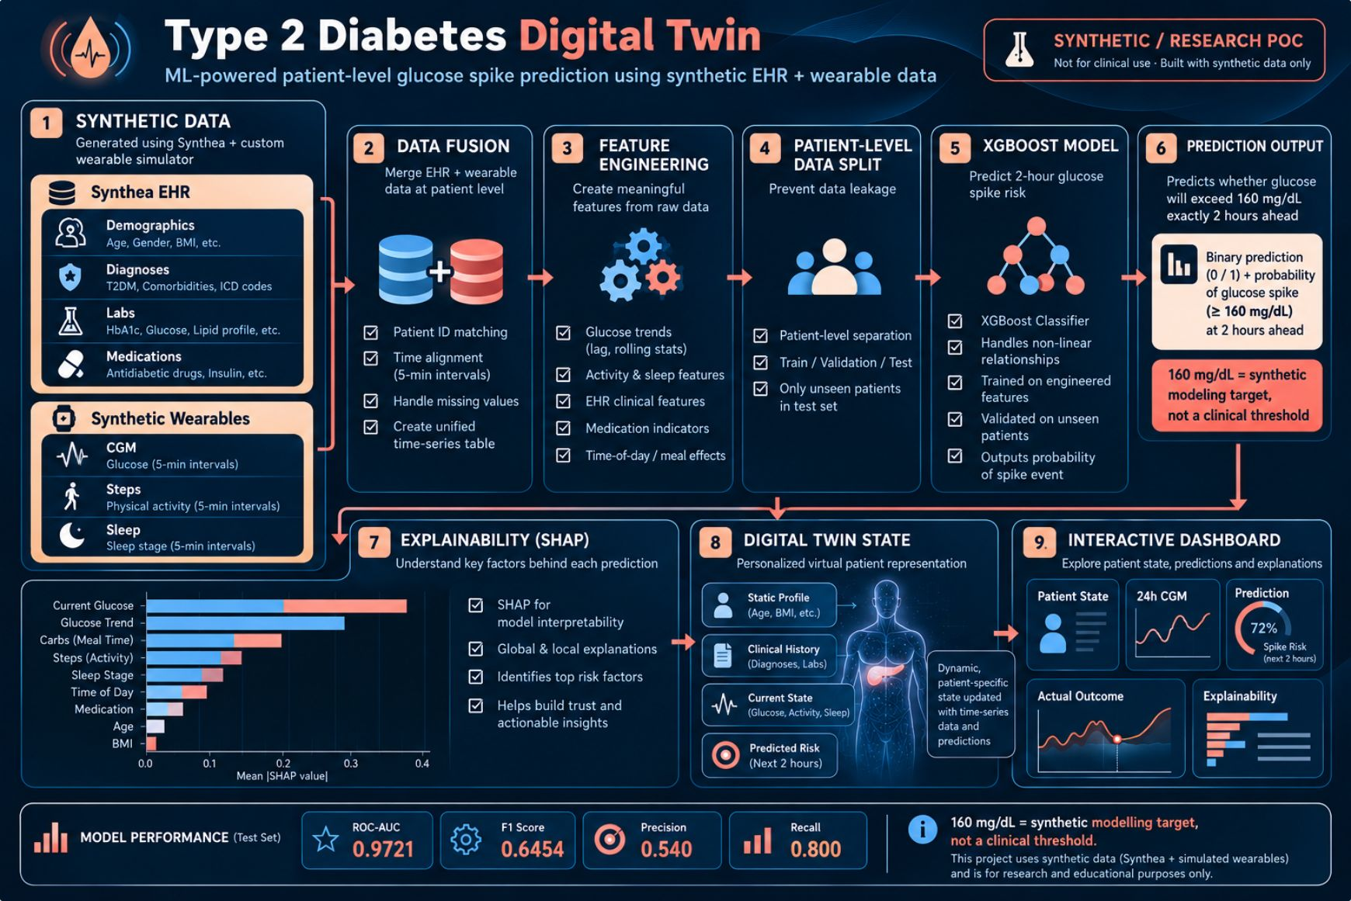
04 — IMPLEMENTED PIPELINE
One pipeline turns synthetic inputs into an explainable patient view
01
Synthetic data
Generate EHR and wearable streams.
02
Fusion + features
Align signals into predictive state.
03
Split + predict
Hold out patients, then forecast risk.
04
Explain + view
Expose SHAP drivers in the digital-twin state and dashboard.
Type 2 Diabetes Digital Twin
5

Slide 6
05 — FEATURE ENGINEERING
Feature engineering translates raw signals into predictive state
GLUCOSE STATE
DYNAMIC CONTEXT
PATIENT CONTEXT
Current signal
Recent behavior
Baseline profile
Current glucose, 15-minute change, 30-minute rolling mean, and variability.
Current steps, 30-minute step sum, sleep stage, hour, and minute.
Age, gender, HbA1c, BMI, baseline glucose, lipids, and medication count.
Raw streams become a compact state representation that the model can inspect at each timestamp.
Type 2 Diabetes Digital Twin
6

Slide 7
06 — EVALUATION DESIGN
Patient-level splitting reduces leakage from patient-specific patterns
TRAINING
VALIDATION
UNTOUCHED TEST
62
16
20
patients
patients
patients
16,058 rows
4,144 rows
5,180 rows
Threshold selection and model comparison.
Only unseen patients.
Final threshold: 0.64, selected on validation data.
Type 2 Diabetes Digital Twin
7

Slide 8
07 — MODEL
XGBoost converts engineered state into a 2-hour risk forecast
MODEL SETTINGS
IMBALANCE
OUTPUT
150 estimators
Class weighting
Spike probability
Depth 4
Learning rate 0.05
Addresses imbalance in the prediction target.
Binary decision at threshold 0.64.
Subsample and column sampling: 0.8.
ENGINEERED STATE
XGBOOST
2-HOUR RISK
Target: future glucose above 160 mg/dL exactly 2 hours ahead.
Type 2 Diabetes Digital Twin
8

Slide 9
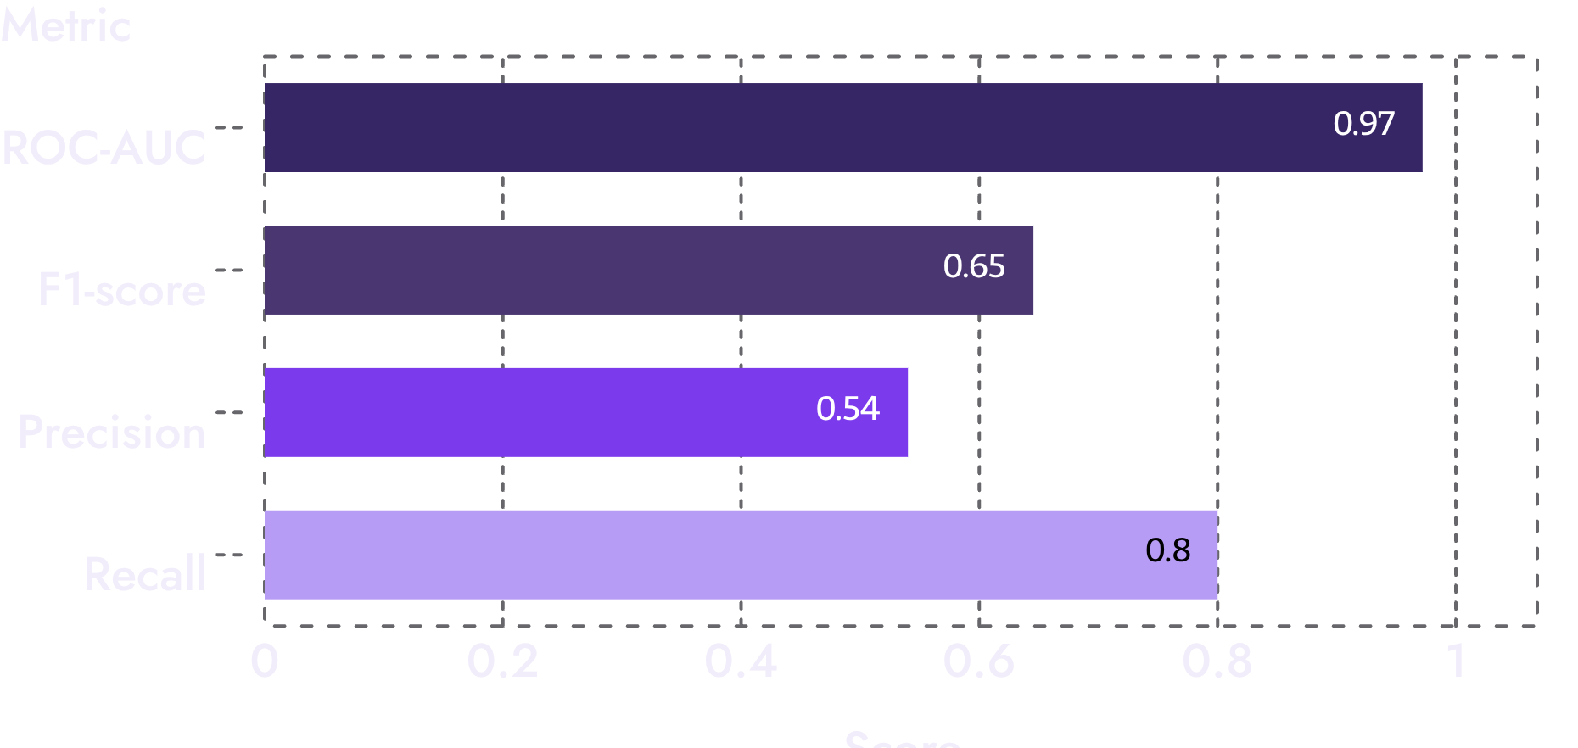
08 — HELD-OUT PERFORMANCE
The held-out test shows strong simulated performance, with important caveats
5-FOLD PATIENT-LEVEL CROSS-VALIDATION
CAVEAT
Mean ROC-AUC 0.9658
These results are simulation-dependent and should not be interpreted as clinical performance.
NOT FOR CLINICAL USE.
Mean F1-score 0.6337
Type 2 Diabetes Digital Twin
9

Slide 10
09 — EXPLAINABILITY
SHAP turns a risk score into a question the evaluator can inspect
01
02
03
Global contributors
Local moment
Evaluator question
30-minute glucose pattern, 30-minute activity, time of day, current activity, baseline glucose, and current glucose.
Inspect the strongest feature contributions at a selected patient’s highest-risk moment.
Which signals contributed to this risk score, and do they make sense in context?
SHAP describes model contribution, not biological causation.
Type 2 Diabetes Digital Twin
10

Slide 11
Limitations & Responsible Use
The PoC is intentionally transparent about what it does not yet prove.
Data limitations
Model limitations
Responsible framing
Synthetic EHR and wearable data
One simulated day
Simplified glucose physiology
Fixed meal timing
No genetic markers yet
Synthetic modeling target
No clinical validation
No external validation
No real-time production stream
Performance is simulation-dependent
Research proof of concept
Not a medical device
Not for diagnosis or treatment
Future work requires real longitudinal data and clinical validation
Type 2 Diabetes Digital Twin
11

Slide 12
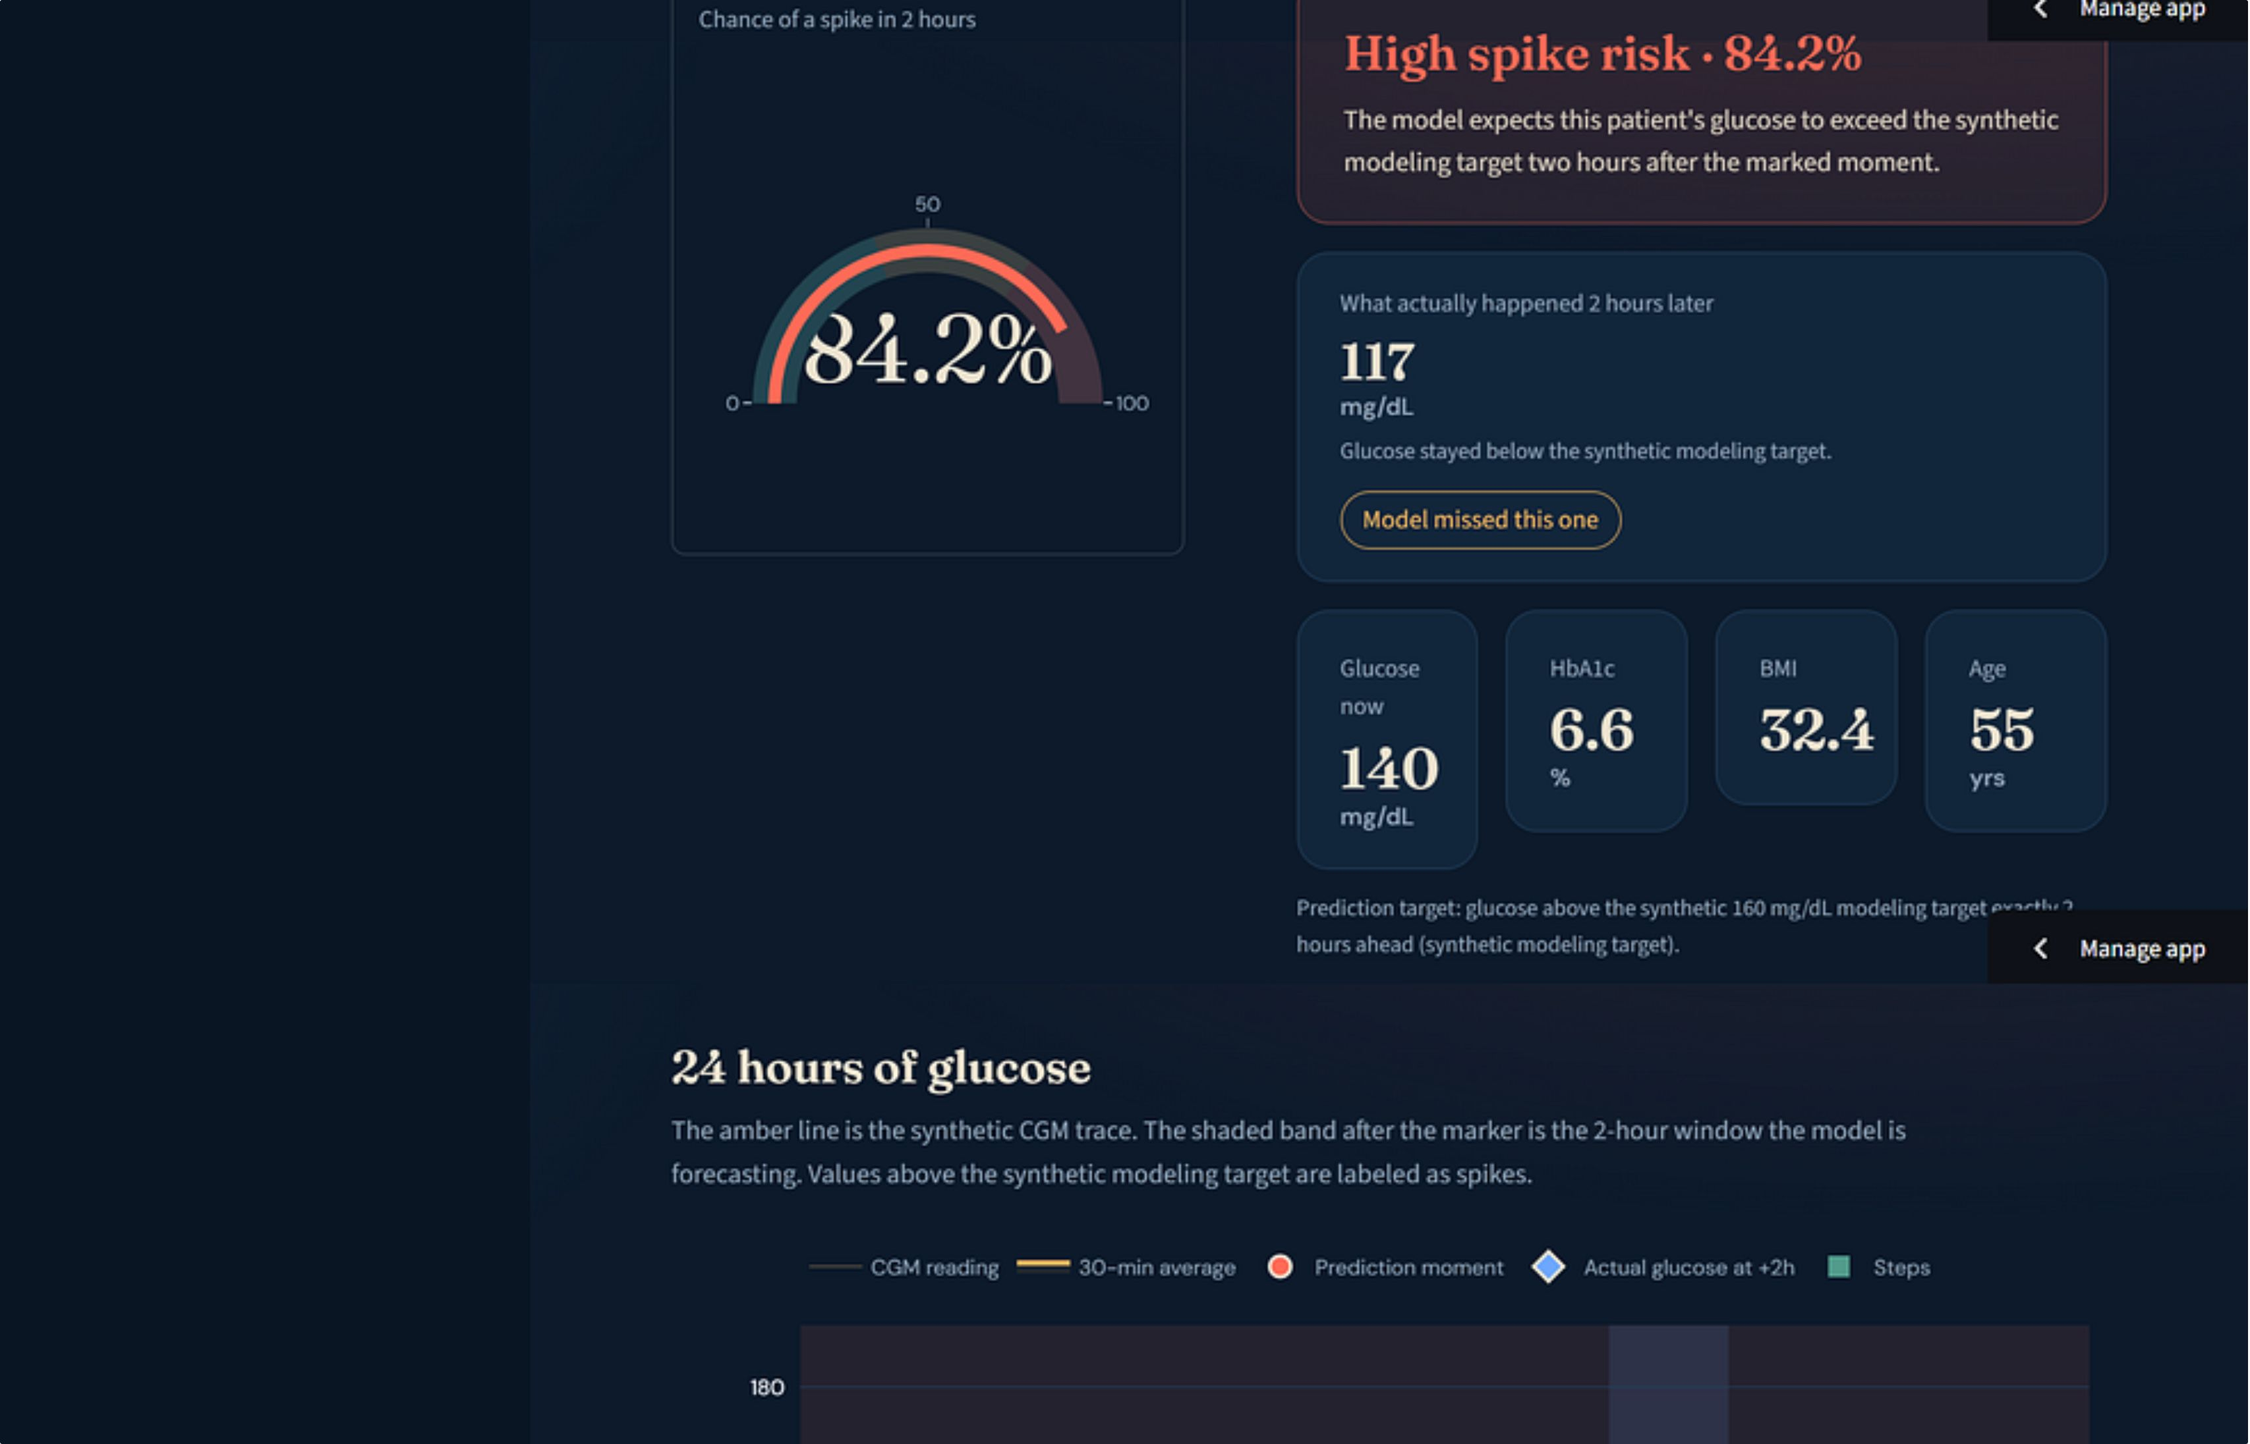
Type 2 Diabetes Digital Twin
12

Slide 13
ROADMAP
From PoC to a Real Digital Twin
The current architecture establishes the loop; the next step is richer longitudinal data and validation.
Next technical steps
Closing message
Real CGM + wearable streams
Longer longitudinal histories
HRV and additional physiological signals
Meals, insulin and medication timing
Personalized / adaptive models
Online state updating
Uncertainty estimation
From static patient records to a dynamic, explainable estimate of what may happen next.
The PoC demonstrates the data-fusion, prediction, explanation and dashboard loop required for a patient-specific diabetes Digital Twin.

