Slide 1
Data Science – Unit 3

Slide 2
Big Data
Big Data is a term used for a collection of data sets that are large and complex, which is difficult to store and process using available database management tools or traditional data processing applications.

Slide 3
According to an estimation provided by International Data Corporation (IDC), in 2003, the overall data generated in the world per annum was 5 Exabytes.
But currently, this is being generated in just 2 days.
In 2012, the overall data generated in the entire world expanded to 2.72 Zettabytes.
It may reach beyond 40 Zettabytes by 2020.

Slide 4
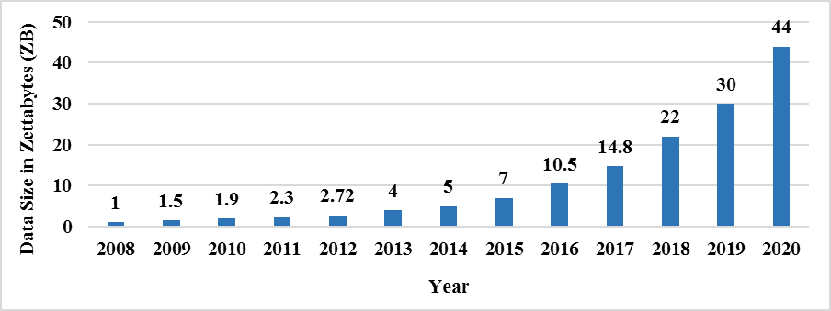
Figure 1 Growth pattern of Big Data over the years (Source: IDC)

Slide 5
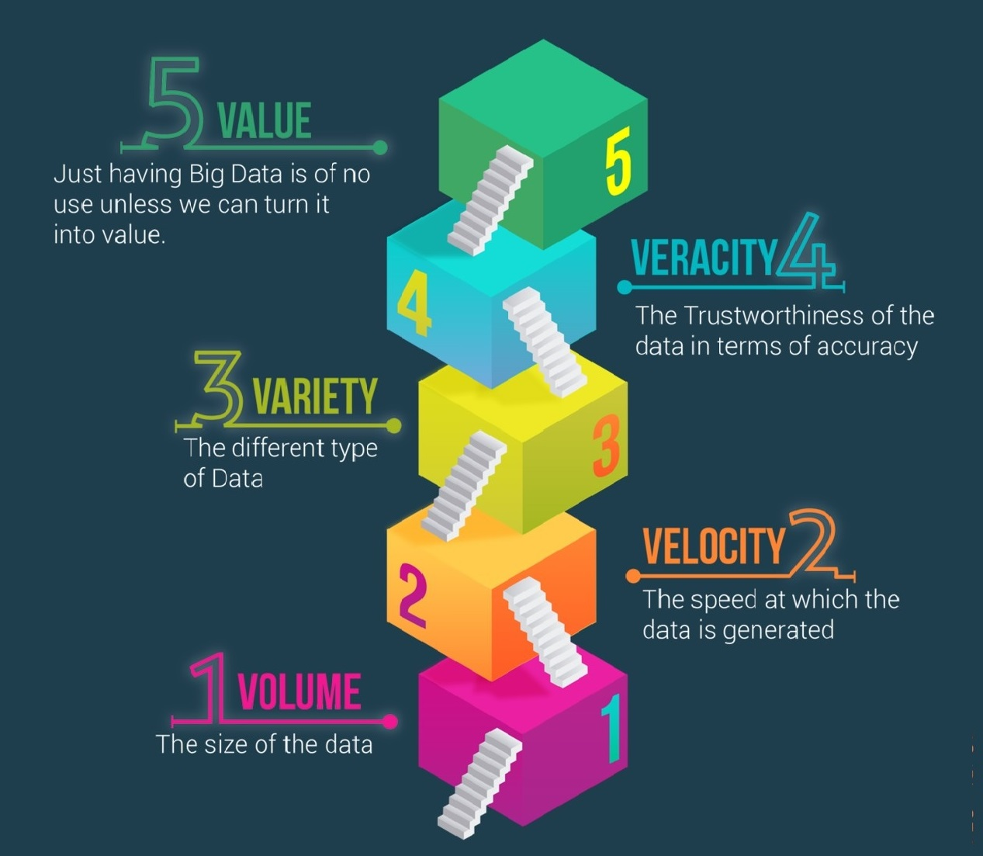
Big Data Characteristics
Volume
Velocity
Variety
Veracity
Value
Figure 2 The Five V’s of Big Data

Slide 6
Types of Big Data
Structured
Semi-Structured
Unstructured

Slide 7
Big Data Analytics
Big Data Analytics is the process of extracting meaningful information from large data sets.
The extracted information can be transformed into usable knowledge.

Slide 8
Traditional Data Analytics Tools
Traditional data analytics tools seem unable to handle Big Data as data to be handled is very large, changing at a fast pace and characteristically complex by nature.

Slide 9
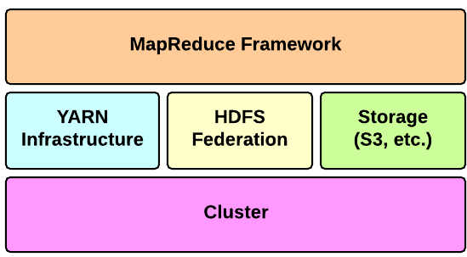
Hadoop
Hadoop is the most popular and powerful distributed computing framework.
It has the potential to capture, store, process and analyze huge amount of data.

Slide 10
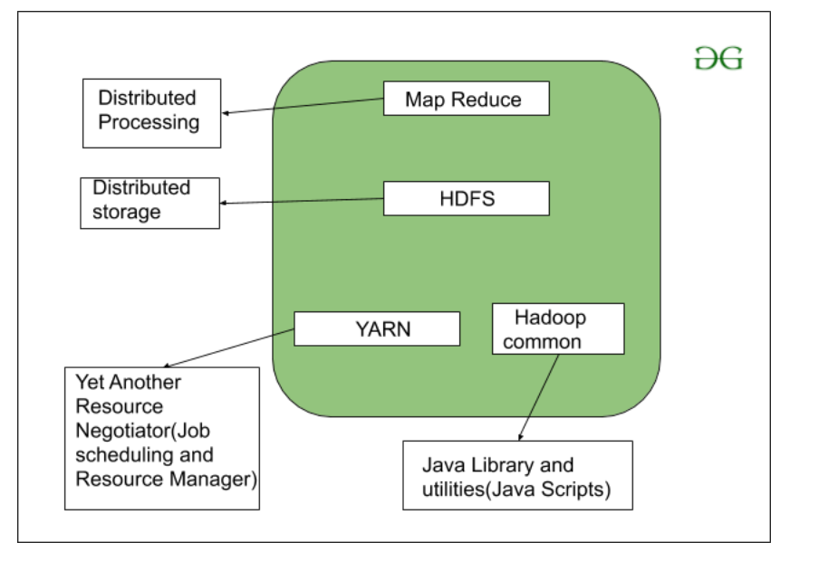
Hadoop
MapReduce Terminologies

Slide 11
Hadoop
HDFS – Hadoop Distributed File System provides for the storage of Hadoop. As the name suggests it stores the data in a distributed manner. The file gets divided into a number of blocks which spreads across the cluster of commodity hardware.
MapReduce – This is the processing engine of Hadoop. MapReduce works on the principle of distributed processing. It divides the task submitted by the user into a number of independent subtasks. These sub-task executes in parallel thereby increasing the throughput.
Mapping Stage: This is the first step of the MapReduce and it includes the process of reading the information from the Hadoop Distributed File System (HDFS), Reducing Stage: The reducer phase can consist of multiple processes. In the shuffling process, the data is transferred from the mapper to the reducer.
Yarn – Yet Another Resource Manager provides resource management for Hadoop. There are two daemons running for Yarn. One is Node Manager on the slave machines and other is the Resource Manager on the master node. Yarn looks after the allocation of the resources among various slave competing for it.

Slide 12
Hadoop
MapReduce Terminologies
Master Node – Place where JobTracker runs and which accepts job requests from clients
Slave Node – It is the place where the mapping and reducing programs are run
Job Tracker – it is the entity that schedules the jobs and tracks the jobs assigned using Task Tracker
Task Tracker – It is the entity that actually tracks the tasks and provides the report status to the JobTracker
Job – A MapReduce job is the execution of the Mapper & Reducer program across a dataset
Task – the execution of the Mapper & Reducer program on a specific data section
Task Attempt – A particular task execution attempt on a SlaveNode

Slide 13
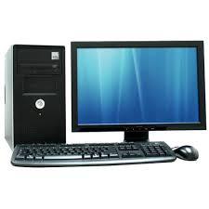
Hadoop Cluster
MULTIPLE DATANODES
NAMENODE

Slide 14
Hadoop Distributed File System
REPLICATION FACTOR 2
64 MB/128 MB
MULTIPLE DATANODES
DB 1
DB 3
INPUT DATA
DB 1
NAMENODE
DB 2
DB 2
DB 3
DB 3
DB 2

Slide 15
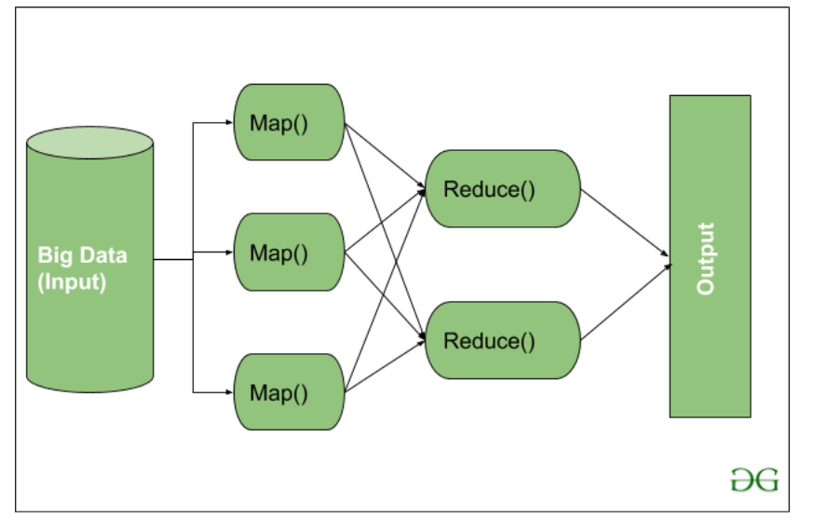
MapReduce work flow

Slide 16
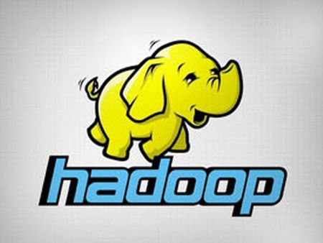

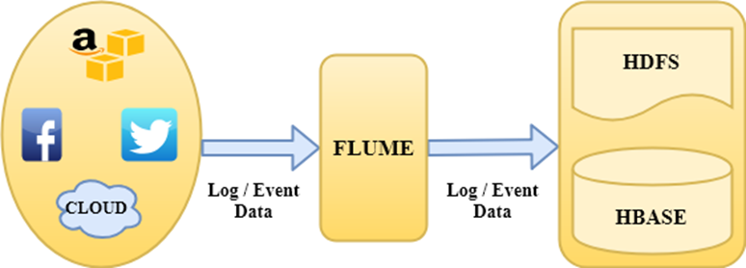
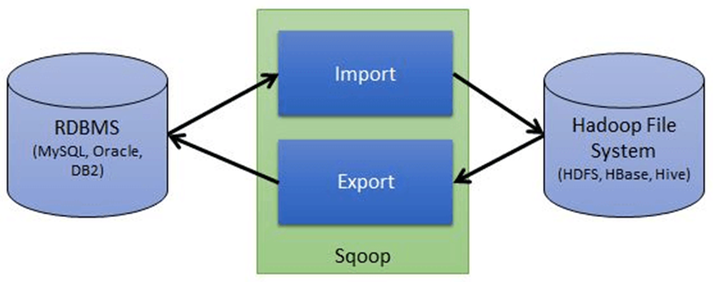
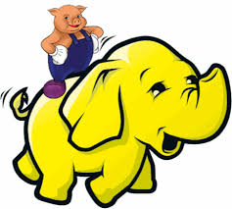
Hadoop Ecosystem

Slide 17
Key distinctions of Hadoop are
Accessible.
Robust.
Scalable.
Simple.

Slide 18
….. Next level Hadoop …… Apache Spark
The Apache Software Foundation (ASF) is a non-profit 501(c)(3) corporation, incorporated in Delaware, USA, in June of 1999. The ASF is a natural outgrowth of The Apache Group, which formed in 1995 to develop the Apache HTTP Server
Spark is an open source distributed computing engine. We use it for processing and analyzing a large amount of data. Likewise, hadoop mapreduce, it also works to distribute data across the cluster. It helps to process data in parallel.
Spark uses master/slave architecture, one master node, and many slave worker nodes. Here, Driver is the central coordinator.
In spark, driver program runs in its own Java process. These drivers handle a large number of distributed workers. These distributed workers are actually executors. Each executor works as a separate java process. Spark application is a collaboration of driver and its executors.
One of the reasons, why spark has become so popular is because it is a fast, in-memory data processing engine. As it is much faster with ease of use so, it is catching everyone’s attention across the wide range of industries.

Slide 19
….. Next level Hadoop …… Apache Spark
There are mainly two abstractions on which spark architecture is based. They are:
Resilient Distributed Datasets (RDD)
Directed Acyclic Graph (DAG)
Resilient Distributed Datasets (RDD)
These are the collection of object which is logically partitioned. It supports in-memory computation over spark cluster. Spark RDDs are immutable in nature. While we talk about datasets, it supports Hadoop datasets and parallelized collections.
Hadoop Datasets are created from the files stored on HDFS. Parallelized collections are based on existing scala collections (Scala is used in Data processing, distributed computing, and web development). As RDDs are immutable, it offers two operations transformations and actions.
Directed Acyclic Graph (DAG)
On decomposing its name:
Directed- Graph which is directly connected from one node to another. This creates a sequence.
Acyclic – It defines that there is no cycle or loop available.
Graph – It is a combination of vertices and edges, with all the connections in a sequence

Slide 20
Data Science

Slide 21
Data science is study of the massive amount of data, which involves extracting meaningful insights (Mining, Harvesting, Visualizing) from raw, structured, and unstructured data that is processed using the scientific method, different technologies, and algorithms for various domains & businesses

Slide 22
Data science employs powerful hardware, programming systems, and most efficient algorithms to solve the data related problems.
It has close links with Artficial intelligence.

Slide 23
In short, we can say that data science is all about:
Asking the correct questions and analyzing the raw data.
Modeling the data using various complex and efficient algorithms.
Visualizing the data to get a better perspective.
Understanding the data to make better decisions and finding the final result.

Slide 24
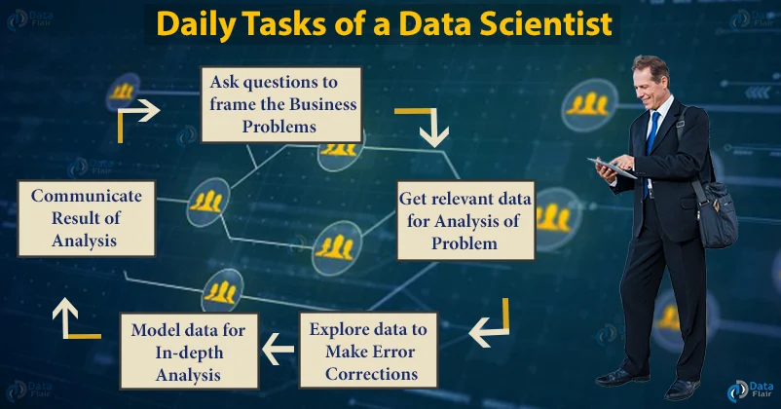
Data Science Process

Slide 25
Step 1. Ask Questions to Frame the Business Problem
In the first step, try to get an idea of what are the needs of a company and extract data based on it.
You begin the process of data science by asking the right questions to find what the problem is.
Let’s take a very common problem of a bag company – The sales problem.

Slide 26
Who are the target market and the customers?
How do you approach the target market?
How does the sales process look currently?
What information do you have about the target market?
How can we identify customers who are more likely to buy our product?

Slide 27
Step 2. Get Relevant Data for Analysis of the Problem
It is time to collect the data that will help you solve the problem. Before gathering the data, you should ask if the data required is already available with the company?
Data related to following is required: age, gender, previous customers transaction history, etc.

Slide 28
Step 3. Explore the Data to Make Error Corrections
Exploring the data is actually cleaning and organizing it.
More than 70% of the data scientist’s time is spent on this process.
Various tools and techniques are put to use for this purpose like Python, R, SQL, etc.

Slide 29
Are there missing values in the data i.e. are there customers without their contact numbers?
Are there any invalid values? If there are, how can you fix it?
Are there multiple datasets? Is merging datasets a good choice? If yes, then how should you merge them?

Slide 30
Step 4. Model the Data for In-depth Analysis
Build a model of the data to answer the question.
Validate the model against the data collected.
Usage of various visualization tools to present data.
Perform the necessary algorithms and statistical analysis.
Compare results against other techniques and sources.

Slide 31
Step 5. Communicate the Results of the Analysis
Graph or chart the information for presentation with tools – R, Python, Tableau, Excel.
Use “storytelling” to fit the results.
Answer the various follow-up questions.
Present data in different formats- reports, websites.
Believe me, answers will always spark more questions, and the process begins again.

Slide 32
Business Intelligence:
Business intelligence(BI) is basically a set of technologies, applications, and processes that are used by enterprises for business data analysis.
Business intelligence tools enhance the chances of an enterprise to enter a new market as well as help in studying the impact of marketing efforts.

Slide 33
Factor | Data Science | Business Intelligence
Concept | It is a field that uses mathematics, statistics and various other tools to discover the hidden patterns in the data. | It is basically a set of technologies, applications and processes that are used by the enterprises for business data analysis.
Focus | It focuses on the future. | It focuses the past and present.
Data | It deals with both structured as well as unstructured data. | It mainly deals only with structured data.
Flexibility | Data science is much more flexible as data sources can be added as per requirement. | It is less flexible as in case of business intelligence data sources need to be pre-planned.

Slide 34
Method | It makes the use of scientific method. | It makes the use of analytic method.
Complexity | It has a higher complexity in comparison to business intelligence. | It is much simpler when compared to data science.
Expertise | It’s expertise is data scientist. | It’s expertise is business user.
Questions | It deals with the questions what will happen and what if. | It deals with the question what happened.
Tools | It’s tools are SAS, Apache Haddop & Spark, BigML,etc. | It’s tools are InsightSquared Sales Analytics, Klipfolio, ThoughtSpot, Cyfe, TIBCO Spotfire etc.

Slide 35
Roles & Responsibilities of a Data Scientist
Management: The Data Scientist plays an insignificant managerial role where he supports the construction of the base of futuristic and technical abilities within the Data and Analytics field in order to assist various planned and continuing data analytics projects.

Slide 36
Roles & Responsibilities of a Data Scientist
Management
Analytics
Strategy/Design
Collaboration
Knowledge

Slide 37
Analytics:
The Data Scientist represents a scientific role where he plans, implements, and assesses high-level statistical models and strategies for application in the business’s most complex issues.
The Data Scientist develops econometric and statistical models for various problems including projections, classification, clustering, pattern analysis, sampling, simulations, and so forth.

Slide 38
Strategy/Design:
The Data Scientist performs a vital role in the advancement of innovative strategies to understand the business’s consumer trends and management as well as ways to solve difficult business problems, for instance, the optimization of product fulfillment and entire profit.

Slide 39
Collaboration:
The role of the Data Scientist is not a solitary role and in this position, he collaborates with superior data scientists to communicate obstacles and findings to relevant stakeholders in an effort to enhance drive business performance and decision-making.

Slide 40
Knowledge:
The Data Scientist also takes leadership to explore different technologies and tools with the vision of creating innovative data-driven insights for the business at the most agile pace feasible. In this situation, the Data Scientist also uses initiative in assessing and utilizing new and enhanced data science methods for the business, which he delivers to senior management of approval.

