Slide 1

Intro

Slide 2
To Know
What is Big Data?
Why need of Big Data?
Where is it used?
Who gets benefit?
Who uses it?
Why are we doing?

Slide 3

Big Data

Slide 4
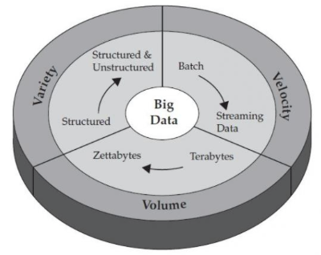
Big Data
3 Vs of Big Data
->>VALUE

Slide 5

Big Data

Slide 6
What?
JavaScript Stack
MongoDb
Express.Js
Angular.Js
Node.Js

Slide 7
Pattern
Little Theory
Examples of code
More on Practical
More & More on Assignments
Node->Express->Angular->MongoDb

Slide 8
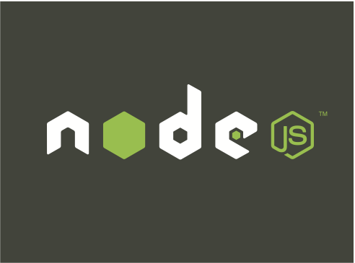

Slide 9
Node.Js
A JavaScript app running without browser.
Derived from Google Chrome engine.
NON-BLOCKING I/O
Asynchronous & Callback Base
Supports event based programming.
JSON – Every where
It is used to handle http, streams, sockets, large files, tcp-ip,udp.

Slide 10
Building Blocks of Node.Js App
JavaScript stack
Modules
Packages
Libraries
Objects/Classes
Functions
Variables

Slide 11
Install Node.Js
Download from http://nodejs.org
Using precompiled install binary set
Easy: wizard based installation
Automatic: configures environment for you.
Installs the version downloaded.

Slide 12
Install Node.Js
Disadvantages:
Update/Upgrade requires reinstallation.
Diff version requires reinstallation.
Removing previous version
Difficult to manage multiple versions for testing.

Slide 13
Install Node.Js
2. Install using Node Version Manager (NVM)
Install any version quickly using commands
Install multiple versions
Switch between versions quickly
Set default version to use
Easy install on Linux

Slide 14
Install Node.Js
Disadvantages:
No wizard, using commands only
Need to reinstall global modules when switching versions
Knowledge of commands required

Slide 15
Install Node.Js
3. Compiling the sources (we don't prefer)
Pretty long and time consuming process.
Too much of dependencies on other tools and libraries

Slide 16
Installing Node.Js using NVM
Supports Mac & Linux, Steps below:
Install curl & git
"curl https://raw.github.com/creationix/nvm/master/install.sh | sh"
Reopen terminal & run command nvm
To install node ver 0.10 using NVM use "nvm install 0.10"
Set default version of node "nvm use alias default 0.10”

Slide 17
Installing Node.Js using NVM
Check version using "node --version"
Close terminal and reopen.
Check version using "node --version"
To switch version using command "nvm use <version number>”
Run node on terminal to start node

Slide 18
Node.Js
Basic Node.Js objects
console
require
module
Many more…
Run commands on node prompt

Slide 19
Node.Js – require()
Load the module using require();
used to include the specified file name in the calling file
Similar to #import or #include
must specify the relative path in the require('./../')

Slide 20
Node.Js – require()
it either looks for the exact file with .js extension of the name specified
OR
looks for directory with the same name and loads the index.js from that directory
require(‘./projects’)
First it looks for projects.js in the current directory
If above is not found it looks for directory ‘projects’ and loads ‘index.js’ from it.

Slide 21
Node.Js – require()
Loading core modules from Node.Js
simply call require('os’)
Core modules are automatically identified by node
Examples of core modules
os
net
http
And many more…

Slide 22
Node.Js – Modules
Functionality breakup using modules
Logically
Physically
Created as separate group of .js file(s)
Loaded using require()

Slide 23
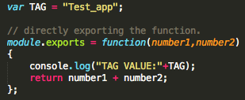
Node.Js – Modules
my_math.js

Slide 24

Node.Js – Modules
main.js

Slide 25
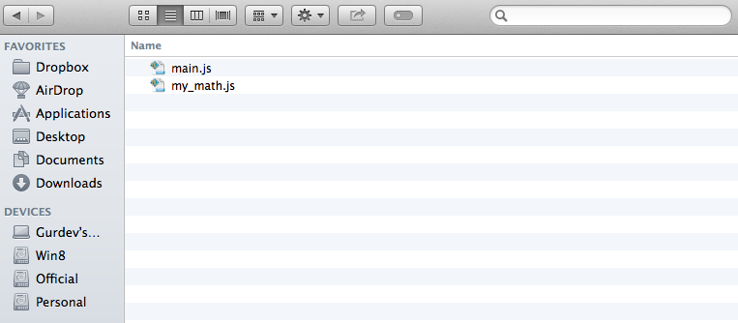
Node.Js – Modules

Slide 26
Node.Js – Modules
Run the basic app using node command
Node <filename.js>
Node main.js

Slide 27
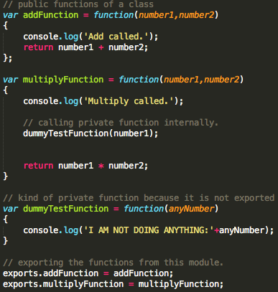
Exporting multiple functions from the same module

Slide 28
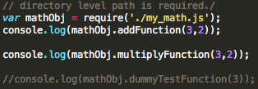

Slide 30
Node.Js – NPM
Global registry for Node Packages
https://www.npmjs.org
Maintains node packages - Dev Community
Recently updated
Downloaded
Search
Command (npm) gets installed with Node itself

Slide 31
Node.Js – NPM
What it does?
Manage (Install/Update/Delete) global packages.
Manage (Install/Update/Delete) project packages.
Global vs Project level
Initiate Project Structure & Dependencies.

Slide 32
Node.Js – NPM
Create New Project using NPM CLI
Create directory
Change to new directory
npm init
Wizard to create project
Output -> package.json

Slide 33
Node.Js – NPM
Adding more packages to the project
npm install --save express
Automatically Updates package.json file
node_modules directory is created
See example

Slide 34
Node.Js – NPM
Installing Global Packages
npm install -g express
It installs EXPRESS as global package on the system
Also installs express as command

Slide 35
Node.Js – NPM
Updating Project Dependencies Options
Manual
Remove package directory
Update package.json file
Using command (npm)
Remove entry from package.json
npm prune to unblid/remove
npm update to update to latest ver

Slide 36
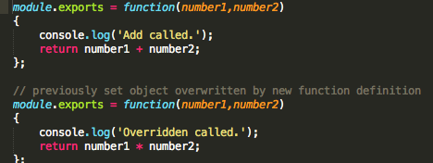
Function overridden

Slide 37


Slide 38
Node.Js – Package.json
Dependencies section
Share your project code only
Share code without node_modules
Clients will share code without node_modules
Use npm install to configure project

Slide 39
Node.Js – Creating Own Modules
using npm init
create setter functions
create getter functions
create main.js
load the module using require()
Call setter functions
Call getter functions
module start point in package.json

Slide 40
Node.Js – Creating Own Modules
using npm init
create setter functions
create getter functions
create main.js
load the module using require()
Call setter functions
Call getter functions
module start point in package.json

Slide 41
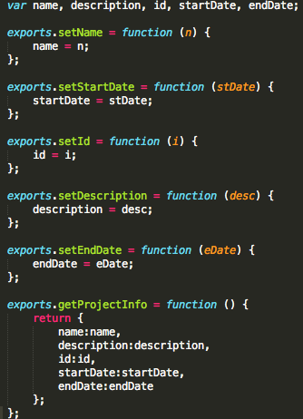

Slide 42
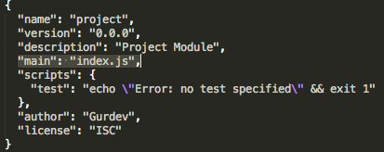

Slide 43
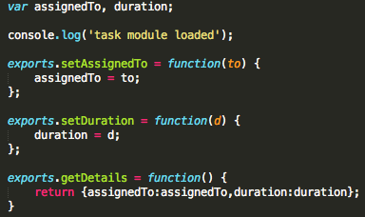

Slide 44
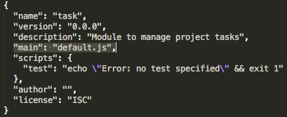

Slide 45
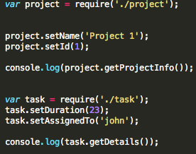

Slide 46
Run the sample using command
node main.js
So Far So Good… ☺
Modules Caching

Slide 47
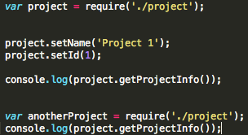
Node.Js – Modules Caching

Slide 48
Node.Js – Modules Caching
Modules loaded are always cached
Sometimes helpful but sometimes…
Need to create fresh instances
Example 5. Instance
Example 6. Instance (no factory)

Slide 49
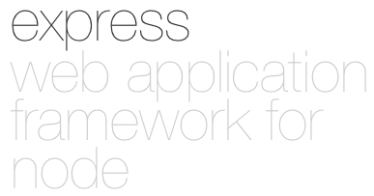

Slide 50
Express
Starting a new Express App
Must install express as global package
express <project_name>
Creates the express project with default settings

Slide 51
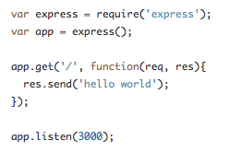
Create Express Object

Slide 52
App Object - Functions
set(<setting_name>,<value>);
get(<setting_name>);
enable(<setting_name>);
disable(<setting_name>);
enabled(<setting_name>);
disabled(<setting_name>);

Slide 53
App Object - Settings
case sensitive routing
Enable case sensitivity, disabled by default, treating "/Foo" and "/foo" as the same
strict routing
Enable strict routing, by default "/foo" and "/foo/" are treated the same by the router

Slide 54
App Object - Settings
view cache
Enables view template compilation caching, enabled in production by default
view engine
View engine to be used
views
view directory path, defaulting to "process.cwd() + '/views’”

Slide 55
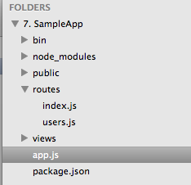
App Object – use();

Slide 56
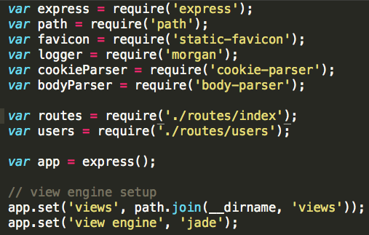
App Object – app.js

Slide 57
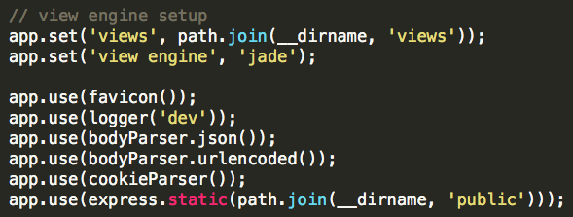
App Object – use();

Slide 58

App Object – use();

Slide 59
Now run the app ☺

Slide 60
next();
Node.js convention
Used as parameter in callback functions
Used to call next function in the line of execution.
To perform serial execution after the callback function

Slide 61
app.use([mountpath],callback);
To add middleware logic to all requests
Mount Path optional
Location of code defines execution level
Setup the application root (logical)

Slide 62
app.get([mountpath],callback);
Handle GET requests at mount path
Specific to GET requests only.
Will be called irrespective of code location

Slide 63
Express - Routers
Create using express.Router();
Provides inbuilt mechanism to handle incoming requests.
Flexible way of defining virtual/physical routes.
Complete control on the request and process as per requirement.
Multiple routers

Slide 64
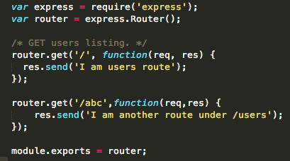
Express – Create Routers

Slide 65
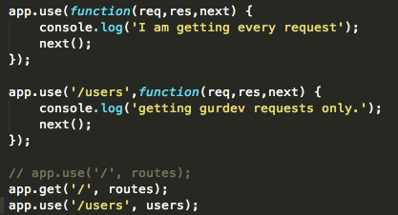
Express – Configure Routers

Slide 66
Custom Modules with Express
Load the module as normal syntax
Create the custom routes
Get the middleware added to route request

Slide 67
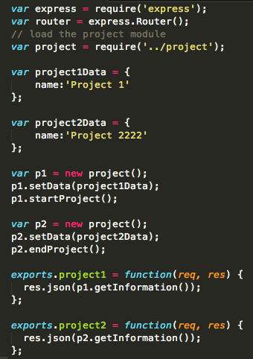
routes/projects.js

Slide 68

Express – Configure Routers app.js

Slide 69

Express – Configure Routers app.js

Slide 70
Express – Configure Routers app.js

Slide 71
Express – Routers with Parameters
Use req.param(‘<param_name>’);
Define route in the router
Use the router in app.js
Pass the value in URL

Slide 72
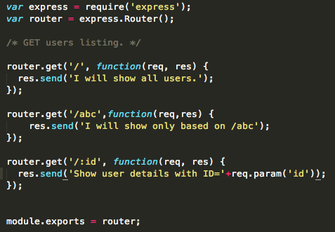
Express – Configure Routers

Slide 73
Express – Routers with Parameters
http://localhost:3000/users/
http://localhost:3000/users/abc
http://localhost:3000/users/12
http://localhost:3000/users/123
http://localhost:3000/users/my name/
To get param used
req.param(‘id’);

Slide 74

Express – Configure Routers

Slide 75
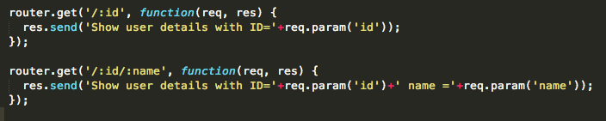
Express – Multiple Parameters

Slide 76
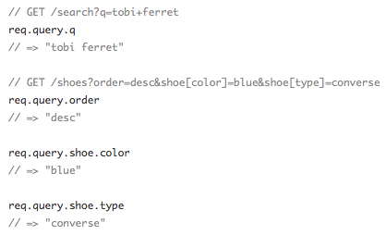
Express – req.query()

Slide 77
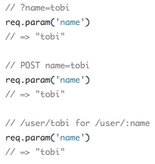
Express – req.param()

Slide 78
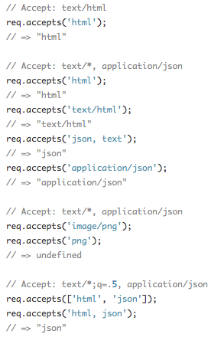
Express – req.accepts()

Slide 79
Express – res.cookie(name,value,options)

Slide 80

Express – res.clearCookie(name)

Slide 81

Express – res.redirect(status,url)

Slide 82
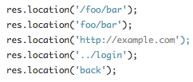
Express – res.location()

Slide 83
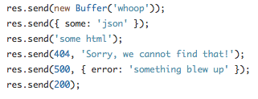
Express – res.send()

Slide 84
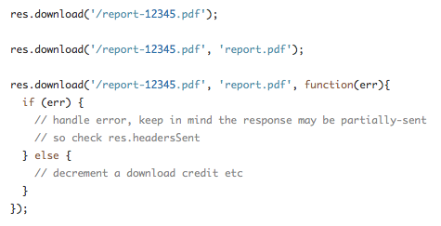
Express – res.download()

Slide 85


Slide 86
NoSql
NoSql vs SQL
Query language for Relational Databases
Used with Table based
Records are stored in rows; Columns represent fields of row
Query using relations between multiple tables

Slide 87
NoSql
Schema less databases
Allows definition of fields on record creation
Nested values are common
Hashes, Arrays, Objects
Fields are not standardized between records

Slide 88
NoSql
Does not solve website scalability
Offers flexibility as compared to RDBMS
Transactional records vs Write Once

Slide 89
NoSql - Document store
Stored in structured format (XML, JSON,etc.)
Usually organized as “collections” or “databases”
Individual documents can have unique structures
Each document usually has specific keys
Possible to query documents by fields

Slide 90
NoSql – key-value stores
Key by which data can be queried and value at that key
Drawback – Can’t query by anything else
Sometimes used with RDBMS for caching

Slide 91
NoSql – BigTable/Tabular
Named after Google’s “BigTable” implementation
Each row can have different set of columns
Designed for large number of columns
Rows are versioned

Slide 92
NoSql – Graph
Designed for data with interconnected nodes
Example:
A series of road intersections
Friends network
Social nodes

Slide 93
NoSql – Object
Tightly integrated with OO programming language
Acts as a persistence layer
Link pointers

Slide 94
NoSql
Notes:
Easily create web apps with customizable schema
Use as a caching layer
Store binary files

Slide 95
MongoDb
A document store database
Data is stored in the form of documents
Key Value Pair Data
Sets of documents stored together is called collection

Slide 96
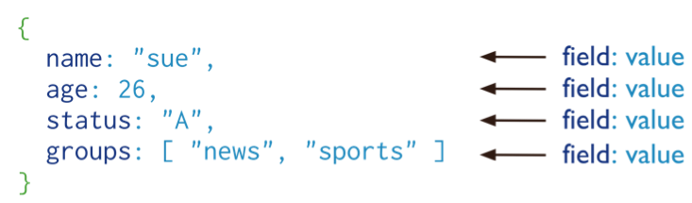
MongoDb – Document

Slide 97
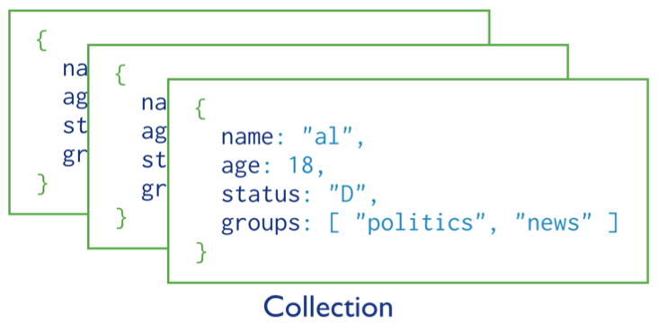
MongoDb – Collection

Slide 98
MongoDb – Database Commands
Show all databases
show dbs
Switch to database
use <db_name>
To show currently set database
db
To get current date
Date.now()

Slide 99

MongoDb – Insert Data in Collection

Slide 100
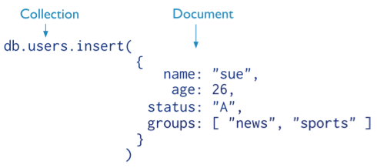
MongoDb – Insert Data in Collection

Slide 101
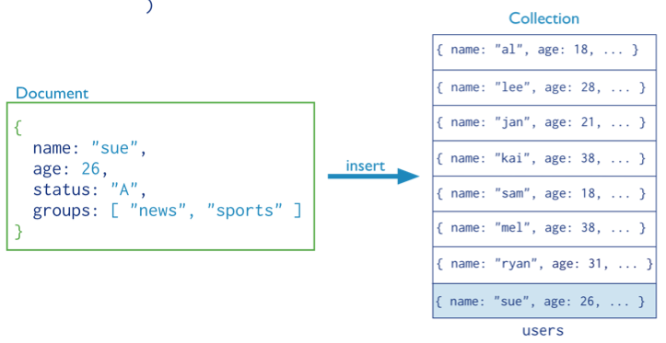
MongoDb – Insert Data in Collection

Slide 102
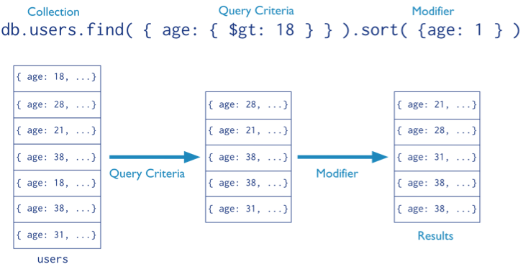
MongoDb – Query Data from Collection

Slide 103
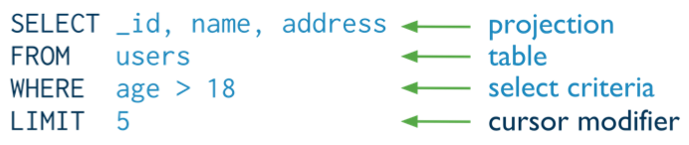
MongoDb – Query Data from Collection
Syntax in SQL Format

Slide 104
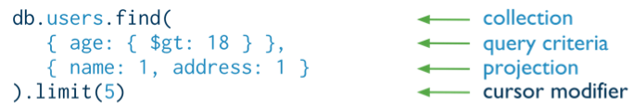
MongoDb – Query Data from Collection
Syntax in NoSQL Format

Slide 105

MongoDb – Update Query
Syntax in NoSQL Format

Slide 106
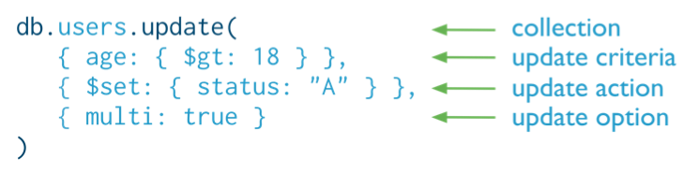
MongoDb – Update Query on Collection
Syntax in NoSQL Format
Default behavior: Update only modified single record unless multi is set TRUE

Slide 107


MongoDb – Update Query on Collection

Slide 108
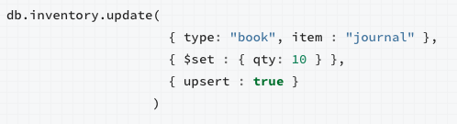
MongoDb – Update Query on Collection

Slide 109

MongoDb – Delete Query
Syntax in NoSQL Format

Slide 110
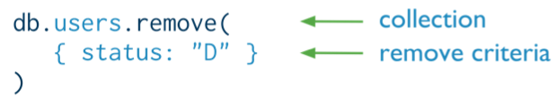
MongoDb – Delete Query on Collection
Syntax in NoSQL Format
Default behavior: Remove method deletes all matching records
unless flag is set to delete a single document

Slide 111
MongoDb – Delete Query on Collection
Syntax in NoSQL Format

Slide 112
MongoDb – Operators
AND operator
find({field1:"some value",field2:"some value"})

Slide 113
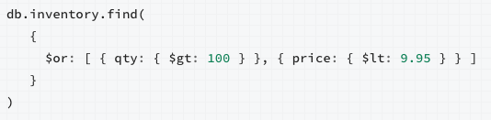
MongoDb – Operators
OR operator
find ({ $or: [ set1,set2,set3 ] } )
find ({ $or: [ {field1:"some value"},{field2:"some value"} ] } )

Slide 114
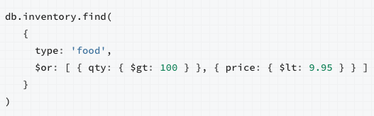
MongoDb – Operators
Mix of AND and OR operator in single query

Slide 115
MongoDb – Operators
NOT operator
find( {field1:{$ne: "some value"}} )
> operator
find( {field: {$gt: value} )
< operator
find( {field: {$lt: value} )

Slide 116
MongoDb – Operators
<= operator
find( {field: {$lte: value} )
>= operator
find( {field: {$gte: value} )
LIKE Operator
find( {field: /regex pattern/} )

Slide 117
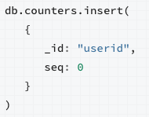
MongoDb – Auto Increment Field
No default behavior
Need to write custom method for same in DB

Slide 118
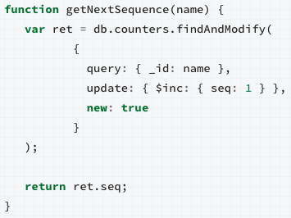
MongoDb – Auto Increment Field

Slide 119
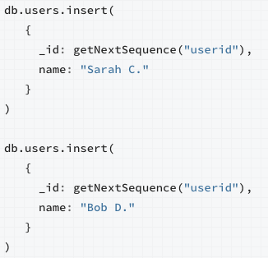
MongoDb – Auto Increment Field

Slide 120
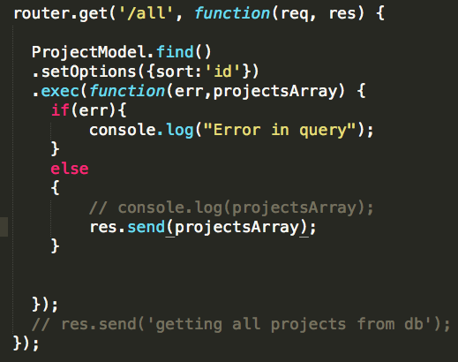
MongoDb – Get Data from DB

Slide 121
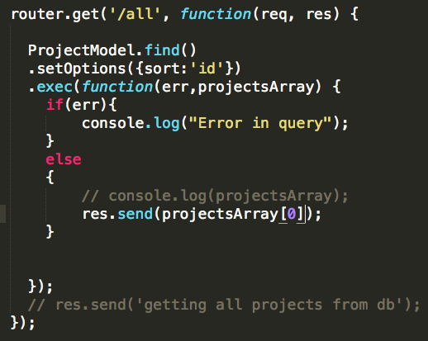
MongoDb – Get Data from DB

Slide 122
Express – Session Management
Can be stored in-memory
Can’t be shared by multiple processes
Sessions are destroyed on server restart
Limited amount of memory

Slide 123
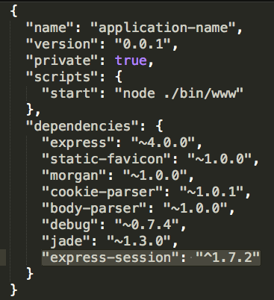
Express – Basic Session

Slide 124
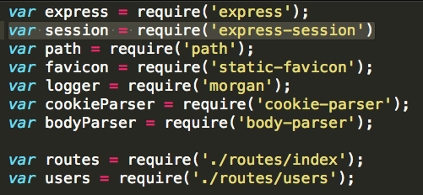
Express – Basic Session

Slide 125

Express – Basic Session

Slide 126
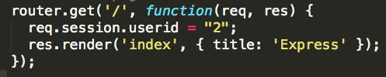
Express – Basic Session

Slide 127

Express – Basic Session

Slide 128
Express – Session Management
Store centrally
MongoDb
connect-mongo

Slide 129
Express – Passport
Local authentication
Facebook authentication
Requires 2 packages
passport
passport-local
Works on strategy

Slide 130
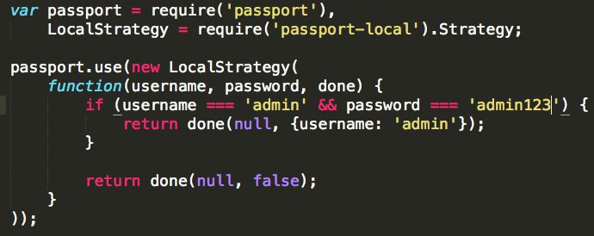
Express – Passport

Slide 131

Express – Passport

Slide 132

Express – Passport

Slide 133

Express – Passport

Slide 134

Express – Passport

Slide 135


Slide 136
Angular.Js
ng-app
ng-model="variableName”
{{variableName}}

Slide 137

Angular.Js

Slide 138

Angular.Js

Slide 139

Angular.Js

Slide 140
Angular.Js
ng-bind
ng-class
ng-show & ng-hide
ng-switch
ng-view
ng-if

Slide 141
Angular.Js - Filters
currency
date
number
uppercase
lowercase
filter
orderBy
limitTo

Slide 142
Dependency Injection
What is Object?
Own structure
Own functionality
Object knows – What it does
Add the object on which current object is dependent
Responsibility lies with object owner
Know the actions

Slide 143

Dependency Injection

Slide 144

Dependency Injection

Slide 145

Dependency Injection

Slide 146

Dependency Injection

Slide 147
Angular.Js - Partials
Reusable unit of view
Include in container view
ng-include
Set the attribute “src” = $scope.variable
Return the name of partial view

Slide 148

Angular.Js - Partials

Slide 149

Angular.Js - Partials

Slide 150

Angular.Js - Partials

Slide 151
Angular.Js - Modules

Slide 152
Angular.Js - Modules

Slide 153

Angular.Js - Modules

Slide 154

Angular.Js - Modules

Slide 155

Angular.Js – Configure Routers

Slide 156

Angular.Js – Configure Routers

Slide 157
Angular.Js – Configure Routers
Specify ng-app directive to give the name of module to load.
Include the Angular module written in JS file.
All JS files to be included once in HTML
Create placeholders for Views
Configure module to serve angular routes using routeProvider

Slide 158

Angular.Js – Route with Param

Slide 159

Angular.Js – Route with Param

Slide 160

Angular.Js – Route with Param

Slide 161
Angular.Js – Route with Param
$routeParam.<paramName>

Slide 162
Angular.Js – Services
Connecting View-Controller to Middleware
Create A service Layer
Add Dependent Objects
Add ngResource as dependency

Slide 163

Angular.Js – Services

