Slide 1
Software Engineering Project
UNEET MEENA: B16CS037
SANCHIT TALIYAN: B16CS031

Slide 2
Key features of the project
Simulator for solving a given Boolean expression.
Restricted within the registered users
Useful for generating truth table as an output for an given boolean expression.
Taking a Boolean expression as input

Slide 3
Key features of the project
Truth table is generated only for the truth cases.
Backtracking algorithm is used for generating all the possible 2 to the power n cases.

Slide 4
List of use cases
User: Login
User: Register To The System
User: Logical Expression
System: Valid Input
System: Decoding
System: Truth Table

Slide 5
Structure of the database/ file system :
A logic circuit simulation system stores the following information.
Registered Account: It includes User’s name and the password user give. This information is used for logging in user so that, user can give input expression.
LOGIN DATABASE: New User uses this option to create a new account following which Registered Account will be updated.

Slide 6
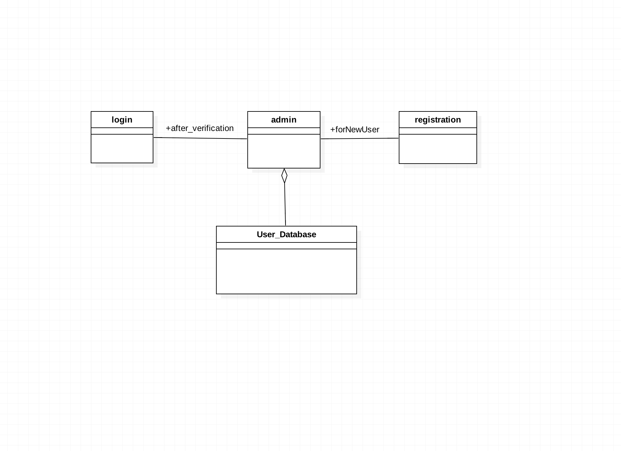
Structure of the database/ file system :

Slide 7
Things that could not be implemented
False cases can not be shown in the truth table.
Input independence is not given to the user.

Slide 8
Statistics of Unit Testing
In unit testing, all the major unit tests are tested like checking for valid expression, admin processing, etc.

Slide 9
Statistics for system testing
All the possible paths were tested in system testing

Slide 10
GROUP:6
CROSS TESTING PROJECT
EXAM GRADE MANAGEMENT

Slide 11
List of Use cases tested
Login
Register
Modify Profile
View Profile
Select Courses
Put Marks
Modify Grades
View Stats

Slide 12
Statistics of the test cases
Total 17 functions were tested
All the functions were correct according to the given input in the report, but there was a common error for input.
If function takes input as string then it fails for any input other than strings.

Slide 13
Conclusion
We learn how to use git.
We learn backtrack algorithm during this project.
We get a good practice of making uml diagrams.

Slide 14
Thank you

