Slide 1
CHINOOK MUSIC STORE
Sanchit Vashishtha
19-06-2024

Slide 2
PROBLEM STATEMENT
To help the music store analyse key trends like Customer demographics, purchase behaviour analysis, churn rate, etc. in order to achieve sustainable growth the near-to-mid-term
As a data analyst at Chinook, the objective is to analyze music record sales data to gain insights and make recommendations for the company's strategy in the physical music market.

Slide 3
Chinook Music Store data snapshot
Total number of countries: .Chinook has sold music to a total of 59 customers in 24 countries with over 300 albums, ~3500 tracks covering 25 genres in its repository
Data cleaning & pre-processing (SQL):
Addressing missing value fields to enhance data integrity
Data base schema created by altering tables to build foreign keys
A dashboard was created in PowerBI to view the correlation between key aspects of the data

Slide 4
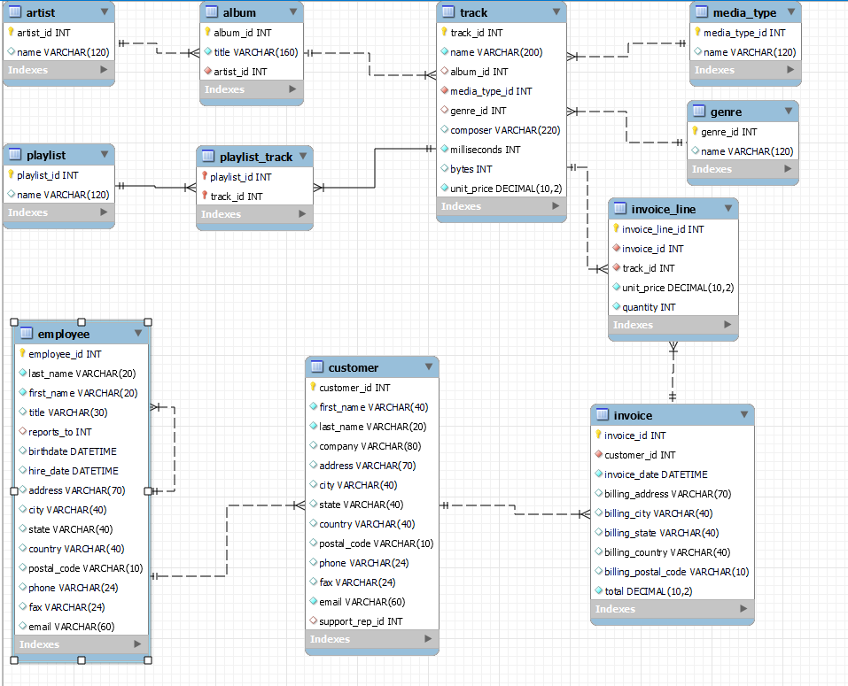
Methods Utilized
Data cleaning: Utilized TRIM, remove duplicates for increasing data efficacy
Deriving insights: CTEs, JOINS, SubQuery, WINDOW Functions
Analytics: Charts utilized to summarize and visualized data
Dashboard was created to create a represent the summary of the data

Slide 5
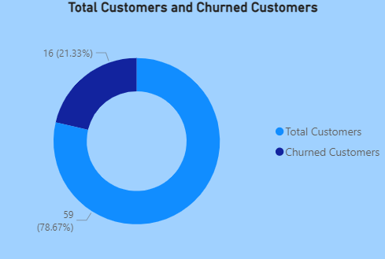
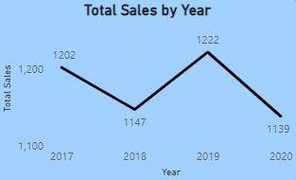
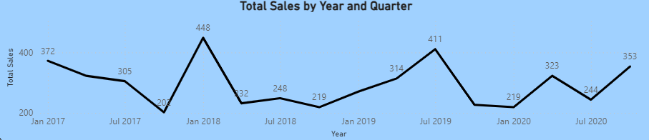
STRUGGLING WITH SALES
The music store is struggling with increasing their sales revenue
Total sales lower than before
Struggling to onboard new customers

Slide 6
INSIGHTS AND RECOMMENDATIONS

Slide 7
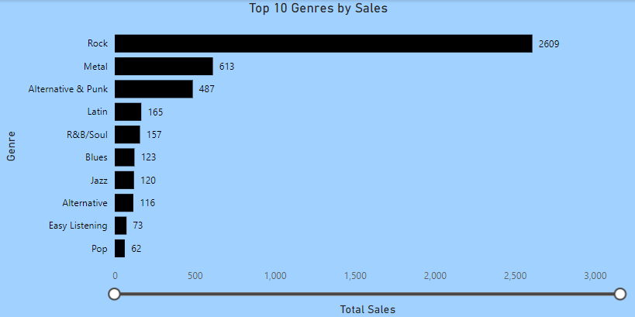
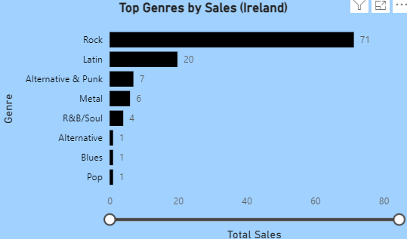
ROCK n ROLL
Rock is the most popular genre sold by Chinook store, followed by Metal, Alternative & Punk and Latin
Country-wise analysis suggests that some countries have customers with a taste for niche music
For example, Latin in Ireland is quite popular

Slide 8
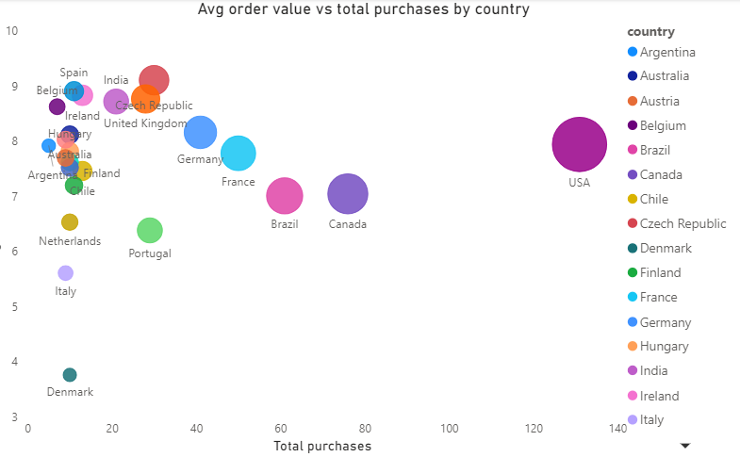
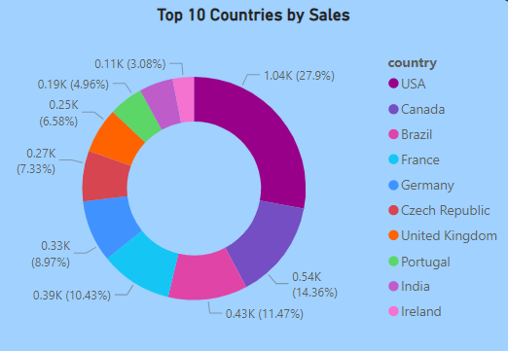
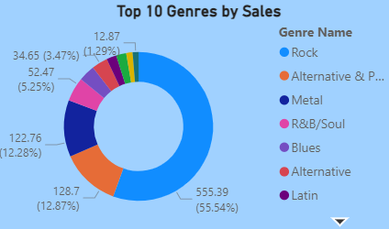
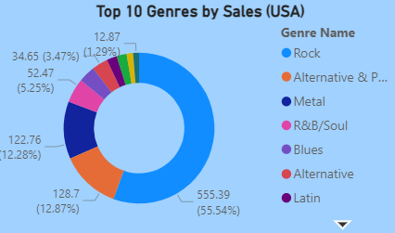
AMERICAN DOMINANCE
North America is the biggest market for Chinook with both USA (~28%) and Canada (~14%) leading the global sales chart
Rock contributes more than half the sales in the largest market – USA
However, average order value lags behind many other markets

Slide 9
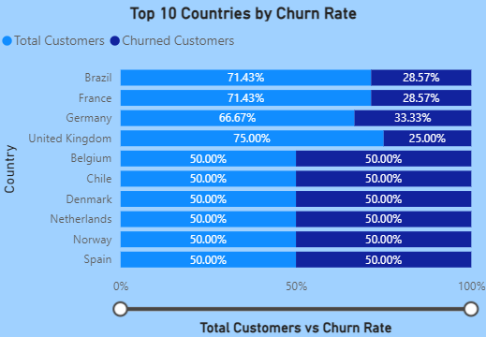
CHURN RATE
Churn rate stand at ~21% of the total customers
Customers who have not made any purchase for past 6 months
Three of the largest market by sales revenue – Brazil (~11.5%, 3rd largest), France (France ~10%, 4th largest) & Germany (~9%, 5th largest) – are also with highest churn rate
Targeted promotions, coupled with loyalty programs can help arrest the churn rate

Slide 10
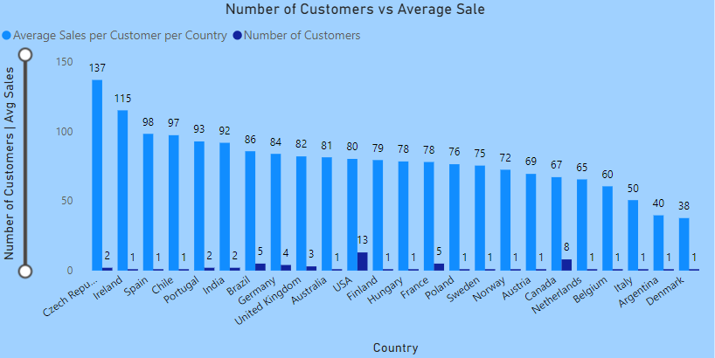
THE NEW FRONTIER
The USA has the largest market with 13 customers, followed by Canada, Brazil and France.
However, many countries with lesser customers are spending more on average
To maximize revenue, countries like Czech Republic, Ireland, Spain, Chile, India & Brazil show great potential as next investment opportunity

Slide 11
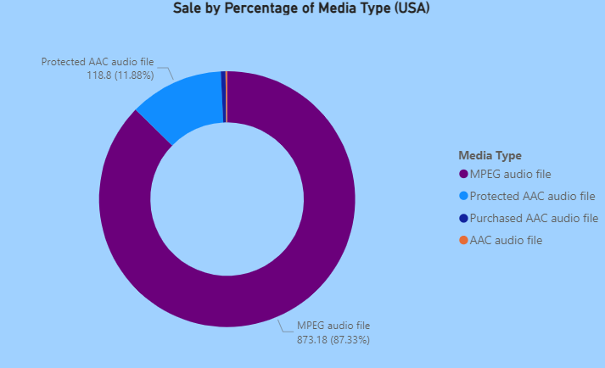
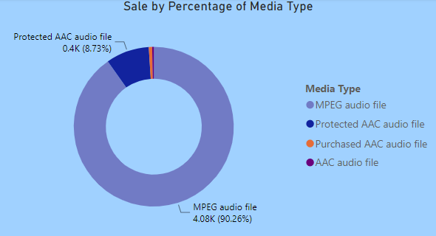
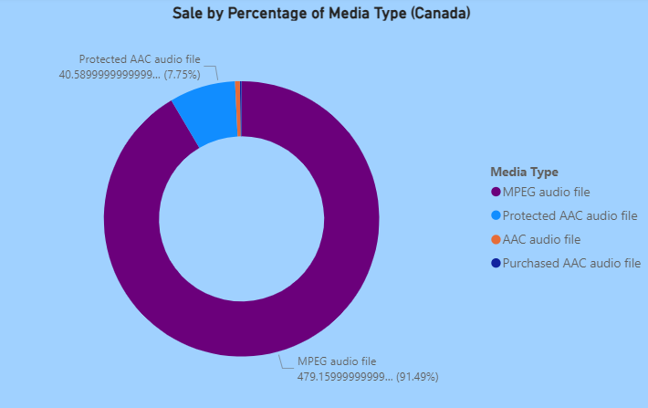
TARGETING AUDIENCE WITH APPLE DEVICES
MPEG still proves to be king of media type making about 90% of the total sales and is compatible with most android devices
AAC comes second with about 9%, and is mostly used with Apple devices
Higher end apple device owners could be targeted for increased sales (due to high spending appetite)
Store could consider increasing the catalogue of songs supported by AAC type
Especially for markets where Apple products dominate
USA > 50% smartphone market (Counterpoint)
Canada ~60% smartphone market (StatCounter)

Slide 12
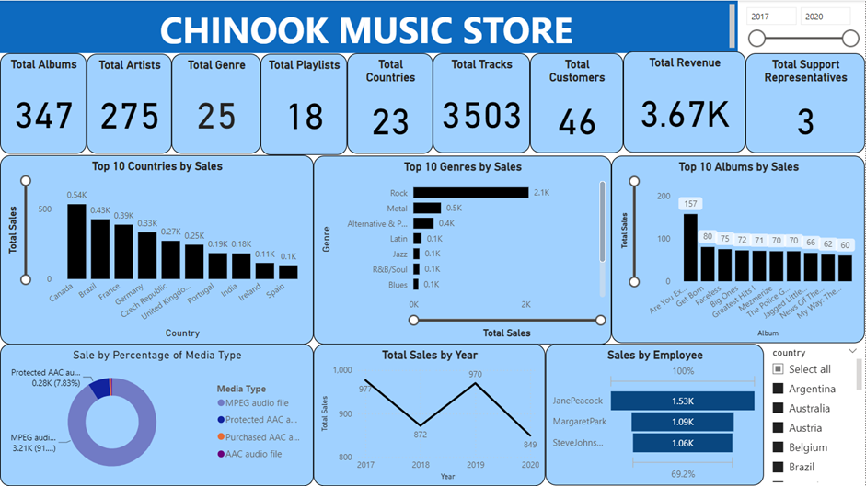

Slide 13


Microsoft Power BI

Slide 14
REFERENCES
https://www.counterpointresearch.com/insights/apple-iphone-market-share-quarter/#:~:text=Apple%20iPhone%20Shipments%3A%20Quarterly%20(Mn%20Units),-Apple%20iPhone%20Shipments&text=The%20US%20and%20China%20became,and%2022%25%20shares%2C%20respectively.&text=Apple%20captured%2052%25%20of%20the,vendor%20in%20both%20these%20countries
https://gs.statcounter.com/vendor-market-share/mobile/canada

