Slide 1
Best Buy Revenue Distribution 2021

Slide 2




Scarce Prophets for Best Buy Sanchita Porwal, Sri Ravi Teja Kolipakula, Suraj Shourie & Paul Jordan GT MSA Project Week Final Presentation | January 20, 2022
Sanchita
Feature engineering
Modeling
Insights & recommendations
Ravi
Problem formulation
Feature engineering
Modelling
Suraj
Feature engineering
Modelling
Visualizations
Paul
Data exploration
Feature engineering
Insights & recommendations

Slide 3

Our highly accurate machine-learning model forecasts slow-selling SKU sales
Business Opportunity
Approach
Recommendations
Best Buy stocks hundreds of slow-selling SKUs
These SKUs put a constraint on working capital
Moreover, sales are difficult to predict
Accurate sales forecasts would have a large impact on operations, working capital, and customer satisfaction
Data exploration → Tableau
Internal & external data used for feature creation
Feature selection → evaluating the best combination of features
Best model → LightGBM with lag features (recommended model)
Performance → RMSE of 3.39 for our LightGBM model within 3 seconds
Stock inventory in anticipation of promotions
Constantly adjust prices and promotions according to inflation and consumer sentiment
Incorporate seasonality of products during the order process
Utilize discounting strategies for pushing sales of slow-selling SKUs

Slide 4
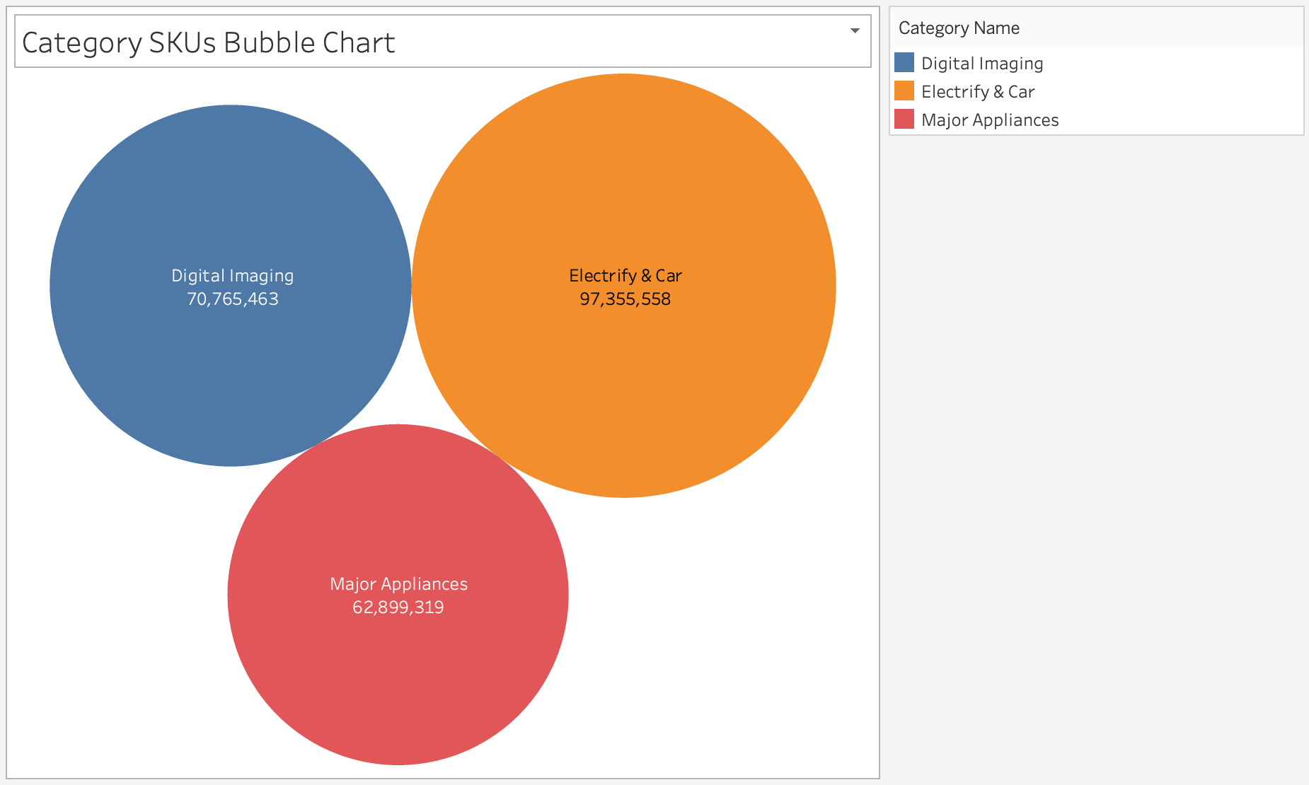
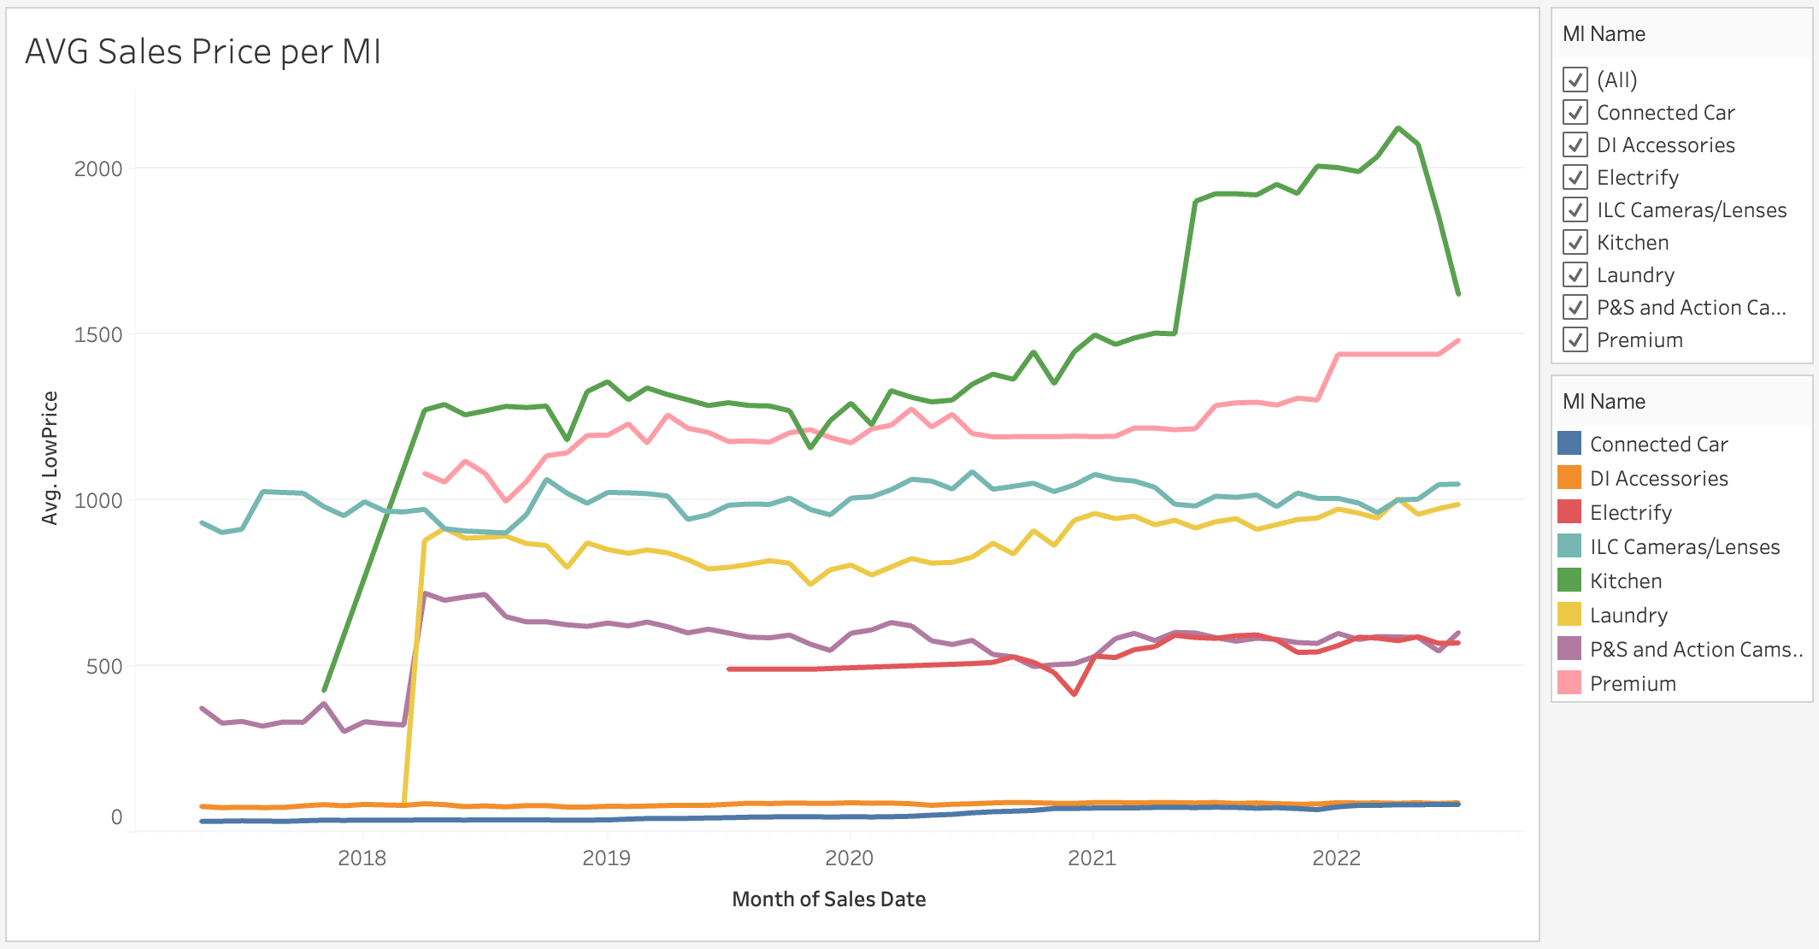
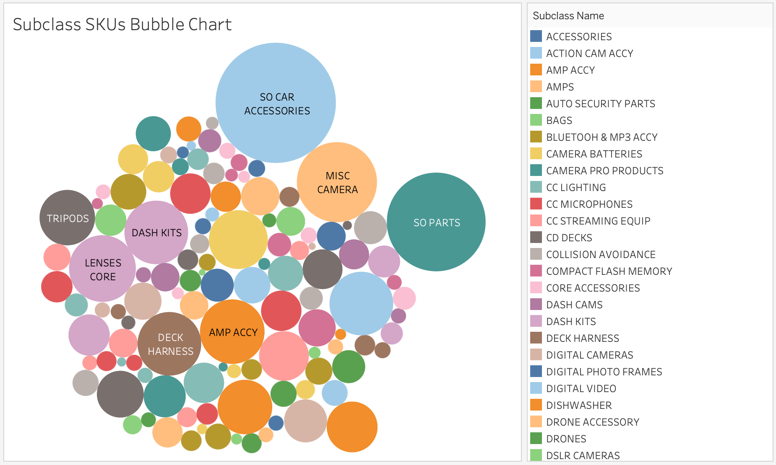
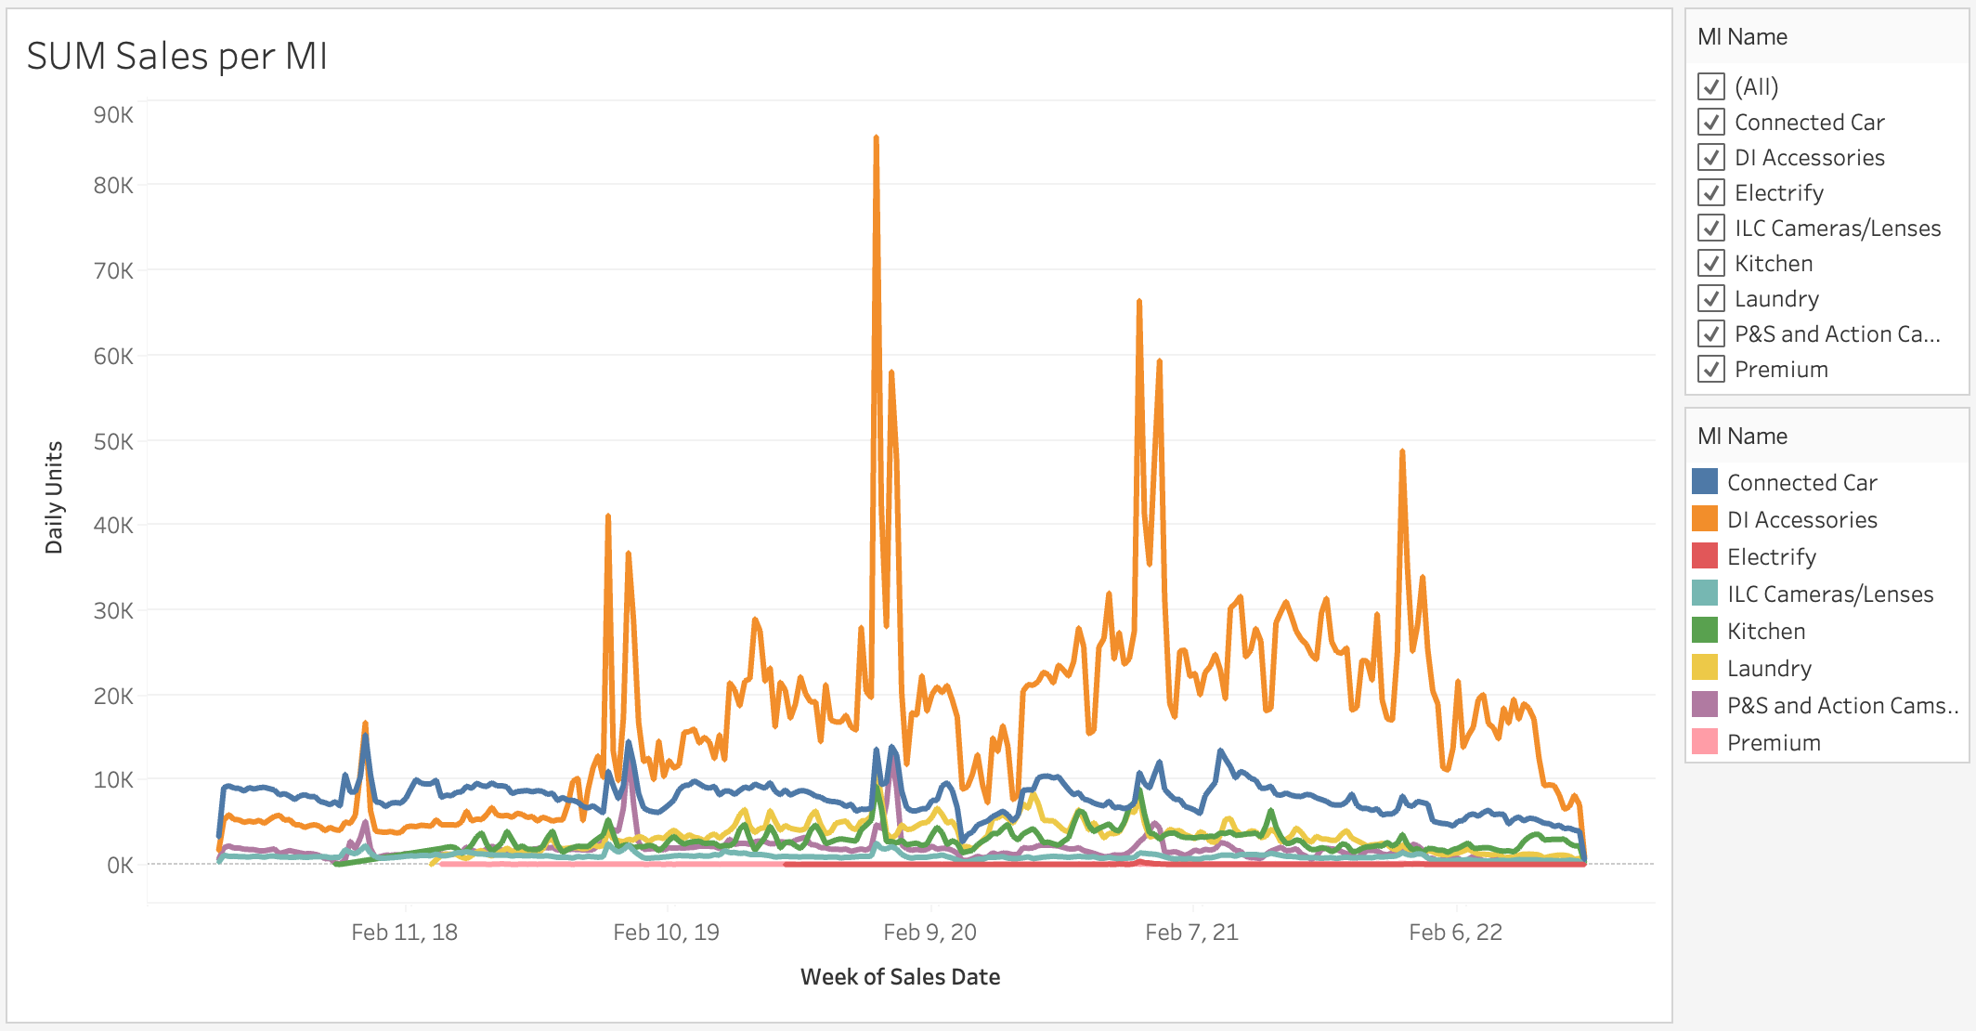
The EDA offers various insights such as high spikes in sales around holidays
SKUs are similarly distributed across categories → possibility to create one model per category
Sizes of subclasses vary strongly
Avg sales prices follow different trends per MI, going up on average
Sales see high spikes for holidays – yet smaller spikes in past years
A dynamic Tableau dashboard has been created for you to explore the data and can easily be refreshed for updated feeds

Slide 5



A wide variety of features were explored for the model
Feature Category | Current Data | Lag Feature | Internal vs. External | Used in Final Model
Previous sales
Amount of discount (%)
# of days on which promotion happened
Price of product
Avg. price of product
Price elasticity (stdev in price)
Time since last xx% promotion
Seasonal index
Ratio of competitor to Best Buy price
Inventory level status
U.S. inflation
U.S. consumer sentiment
Global supply chain pressure index
U.S. holidays
U.S. unemployment rate
U.S. major weather events
U.S. COVID-19 cases
U.S. personal consumption expenditures
Key Take-Aways
All the data was easily accessible and available to the public without any restrictions
Of a few features, we incorporated lag features to account for historic changes and patterns
Several external features were highly important to our model performance (GSCPI and USIR)

Slide 6



Rigorous methods were used to create a strong performing model
Feature engineering
A combination of internal and external features capturing lag variables and market trends were used for modelling
Different lag periods were used to capture different seasonality patterns observed during the EDA process
Feature selection
Various stepwise feature selection methods were used to explore the optimum combination of features
L1 regularization was also used in the LightGBM regression method to select features further
Modelling process
Various models were evaluated:
Croston’s time series
Extreme Gradient Boosting (XGBoost)
Light Gradient Boosting (LightGBM)
Monotonicity inputs didn’t improve the performance
Insights were generated using SHAP* and feature importance plots
*SHAP (SHapley Additive exPlanations) is a method used to explain the predictions of machine learning models. It assigns a "score" or "importance" to each feature (or input variable) of the model

Slide 7

Using LightGBM, our model took <3 seconds and returned an RMSE of 3.39
Primary model: LightGBM
Description: LightGBM modelling with lag-based features
Runtime to predict on the validation dataset: 3 seconds
RMSE value on the validation dataset: 3.39
Secondary model: Time Series
Description: Time series modelling (Croston’s method)
Runtime to predict on the validation dataset: 40 seconds
RMSE value on the validation dataset: 5.92
Significant lift in baseline performance with near 0 runtime!

Slide 8



Best Buy can plug our strong model directly into their forecasting process
Insights
Recommendations
Next steps
LightGBM is extremely fast and has extremely low RMSE
Most important features are most recent sales, day of the week, and promotional discount
External features such as the global supply chain pressure index and the inflation rate also played important roles
The higher the recent sales, the higher the predicted sales. Similar for promotional discount
The more the supply chain pressure, the lower the predicted sales
Leverage LightGBM for further SKU predictions in contrast to XGBoost, Time Series, or similar models
Stock inventory in anticipation of promotions
Constantly adjust prices and promotions according to inflation and consumer sentiment
Incorporate seasonality of products during the order process
Utilize discounting strategies for pushing sales of slow-selling SKUs
Improve capturing competitor prices to boost data quality
The entire model pipeline is Python based & can easily be implemented in any system
For model lifecycle management, we recommend constantly updating data and collecting user feedback
To improve our modelling process
Combine other internal data sources such as location, source of sales (offline vs. online), etc.
Explore additional methods of feature selection
Add models at a more granular level, such as Category name instead of an overall model

Slide 9
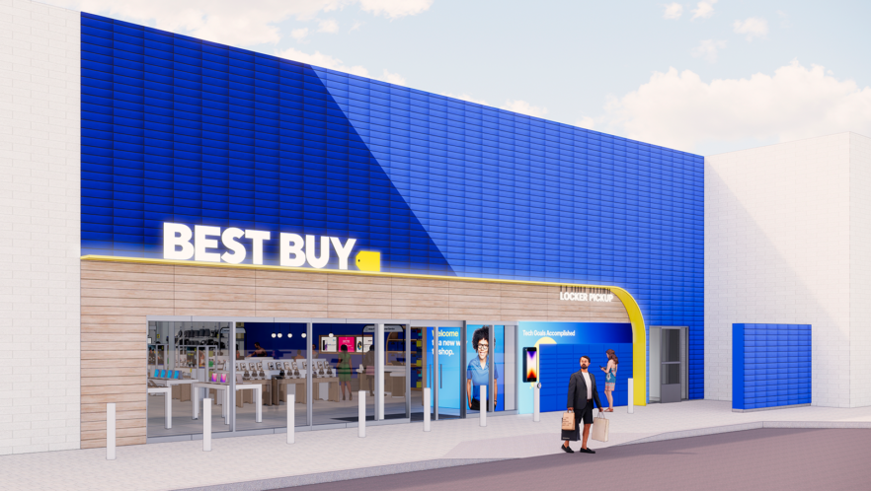

Q&A
Time for Your Questions
THANK YOU! ☺
BEST BUY INTERNAL USE ONLY. DO NOT COPY, PUBLISH OR DISTRIBUTE. THE MATERIAL IN THIS DOCUMENT IS CONFIDENTIAL TO BEST BUY.
SAMPLE FOOTER TEXT
9

Slide 10
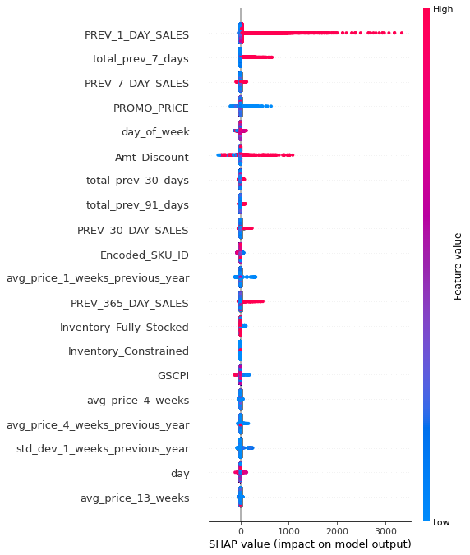
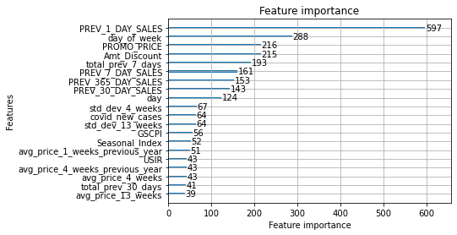
SHAP & feature importance plot

