Slide 1
Infosys Springboard Internship AgroBot: A multilingual farming assistant
Sanchita H
Notes:
ID=d924773e-9a16-4d6d-9803-8cb819e99682 Recipe=text_billboard Type=TextOnly Variant=0 FamilyID=AccentBoxWalbaum_Zero

Slide 2
Project Objectives
To develop an AI-powered plant disease detection system to assist farmers in early disease identification .
To create a multilingual NLP interface supporting all major Indian languages .
To provide accurate, real-time diagnosis through both image analysis and text-based symptom description .
To deliver actionable treatment recommendations in the farmer's native language .
To bridge the digital literacy gap through an intuitive, easy-to-use interface .
To reduce crop losses through early disease detection .

Slide 3
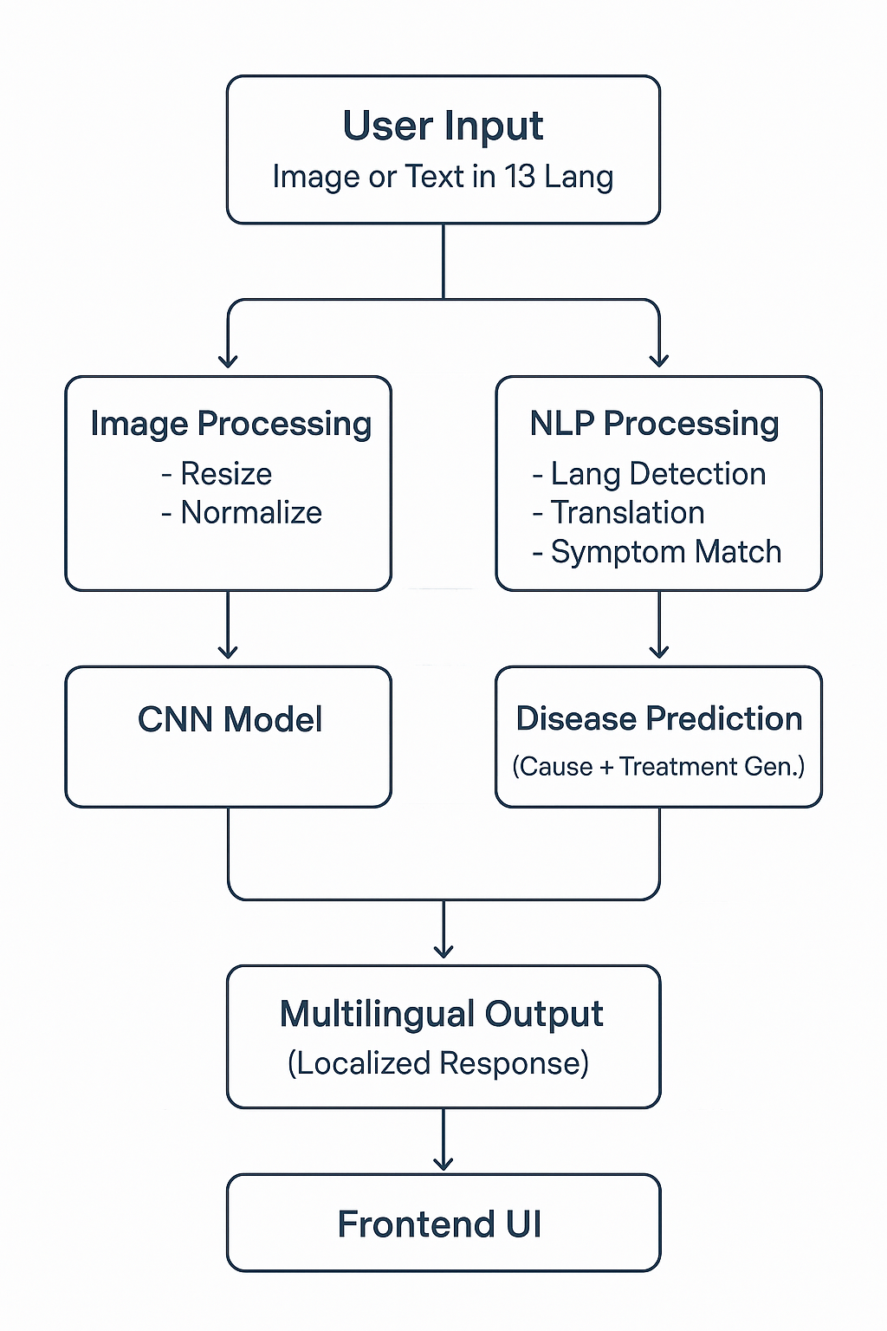
Methodology and Workflow
Dataset: PlantVillage dataset containing 54,000+ images across 38 disease classes covering 14 plant species.
Split: Data is split into two parts:
80% training
20% validation
Preprocessing:
Resized images to 128 x 128
Normalized pixel values to [0,1]
Model:
Convolutional Neural Network trained on plant disease images
Multi-layer architecture with pooling and dropout layers
NLP System:
Deep Translator API for multilingual support
Script-based language detection using Unicode ranges
Fuzzy symptom matching with 60% threshold
Workflow

Slide 4
Methodology and Workflow
Dual Input Architecture:
Image Analysis: CNN-based classification for uploaded plant images
Text Analysis: NLP-based diagnosis from symptom descriptions in 13 languages
Backend Integration:
Flask REST API for model serving
TensorFlow for inference
Real-time translation pipeline
Symptom Matching Algorithm:
Pattern recognition on normalized symptom text
Confidence-based disease ranking
Multilingual Translation:
Auto-detection of 12 Indian languages + English
Bidirectional translation
Deployment:
Web-based interface with responsive design

Slide 5
Key Analysis
Problem Analysis:
Language Barrier: 70% of Indian farmers speak regional languages, not English .
Accessibility Gap: Limited access to agricultural experts in rural areas .
Time-Critical Decisions: Disease spreads rapidly so early detection is crucial .
Solution Analysis:
Multilingual Support:
Automatic language detection for 12 Indian languages
Real-time translation using Deep Translator API
2. Dual Detection Approach:
Combined image and text analysis approach for higher reliability
3. Accessibility Features:
Simple drag-and-drop interface with zero learning curve
4. Smart Diagnosis Engine:
Symptom matching
Contextual treatment recommendations

Slide 6
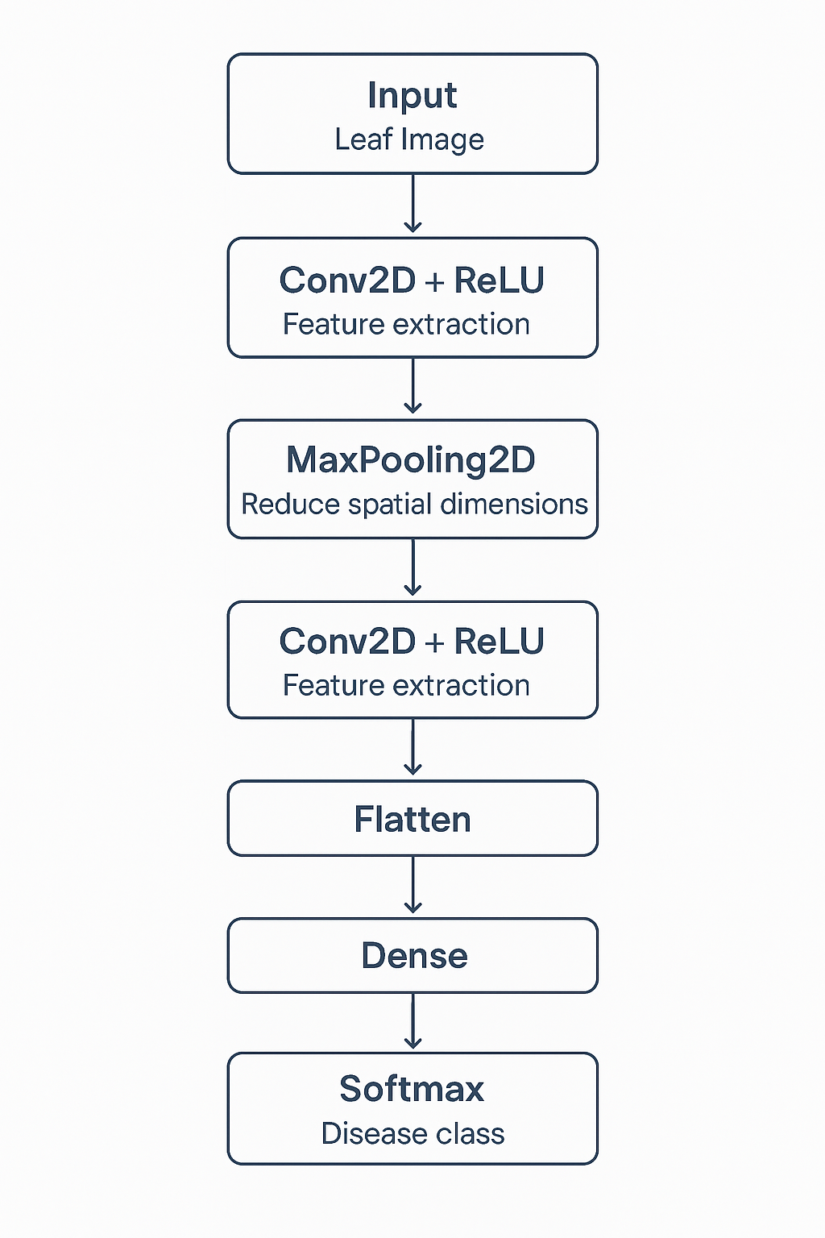
Model Architecture
Convolutional Neural Network Architecture:
Conv2D + ReLU layers for feature extraction
MaxPooling2D to reduce spatial dimensions
Stacked convolution blocks for deeper representation
Flatten layer to convert features into 1D
Dense layers for classification
Softmax output layer to predict the disease class
Training Pipeline:
Loss Function: Sparse Categorical Crossentropy
Optimizer: Adam
Metrics: Accuracy
Prediction Pipeline:
Takes a new uploaded leaf image
Preprocesses: resizing and normalization
Passes through the trained CNN
CNN architecture

Slide 7
PROJECT SUMMARY AND OUTCOMES
Project Summary:
Developed a comprehensive AI-powered plant disease detection system that democratizes agricultural knowledge by providing instant, accurate diagnosis in farmers' native languages. The system combines cutting-edge Convolutional Neural Network with advanced NLP to offer dual input methods - image upload and text-based symptom description.
Key Features Delivered:
Dual detection system
Support for 13 languages (12 Indian + English)
38 plant disease classifications
Detailed treatment recommendations

Slide 8
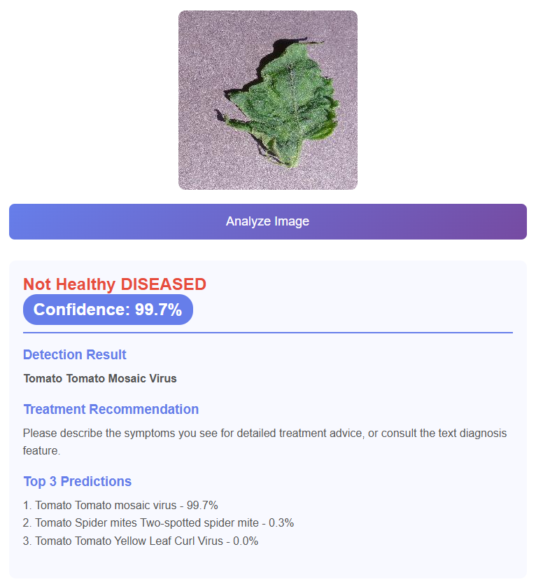
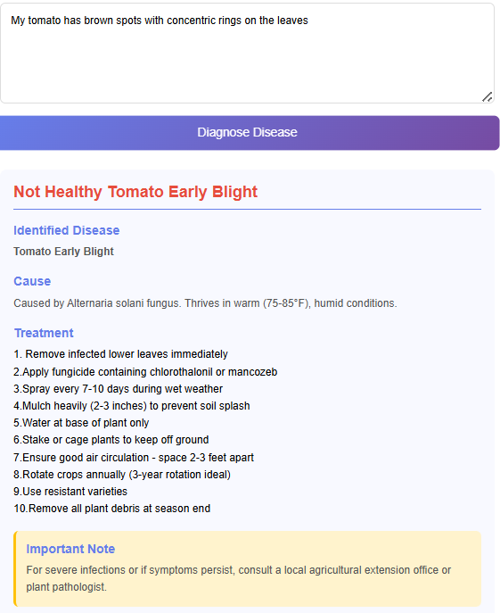
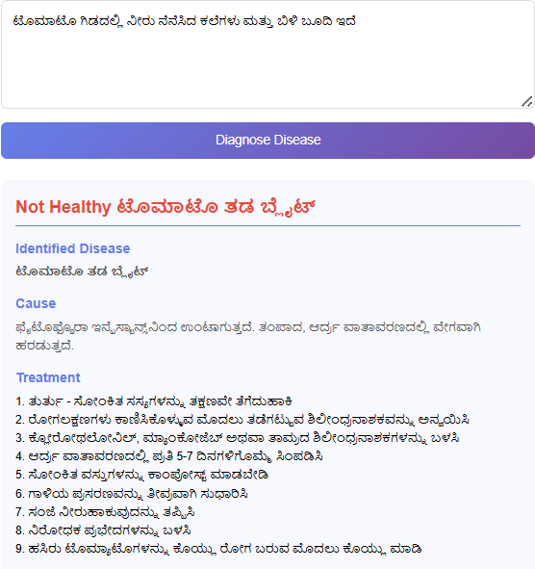
PROJECT SUMMARY AND OUTCOMES
Outcomes:
Image based Analysis
Text based Analysis
Multilingual text analysis

Slide 9
Future Enhancements
Planned Improvements
Support for 20+ Plant Species: Expand the model to detect diseases across more crops for wider agricultural impact.
ONNX Model for Mobile Deployment: Convert the model to ONNX format to enable efficient, on-device prediction on Android/iOS.
Voice-Based Symptom Input: Allow farmers to describe symptoms using speech in their native language for easier usability.
Offline Mode: Enable predictions without internet by using lightweight, device-optimized models.
In-App Farmer Advisory System: Provide actionable guidance, prevention tips, and agricultural best practices directly within the system.

Slide 10
Learning Outcomes
By completing this project, I learned:
Deep Learning for Image Classification
Data Preprocessing & Augmentation
Building Custom CNN Models in TensorFlow
Model Training, Validation & Evaluation
Real-World Application Understanding

