Slide 1

Technical Society that aims to strengthen peer to peer learning and create healthy competitive environment amongst its students.
Visit: https://innogeeks.in/
Code: https://github.com/SanchitaMishra170676/INNOGEEKS-2.0

Slide 2
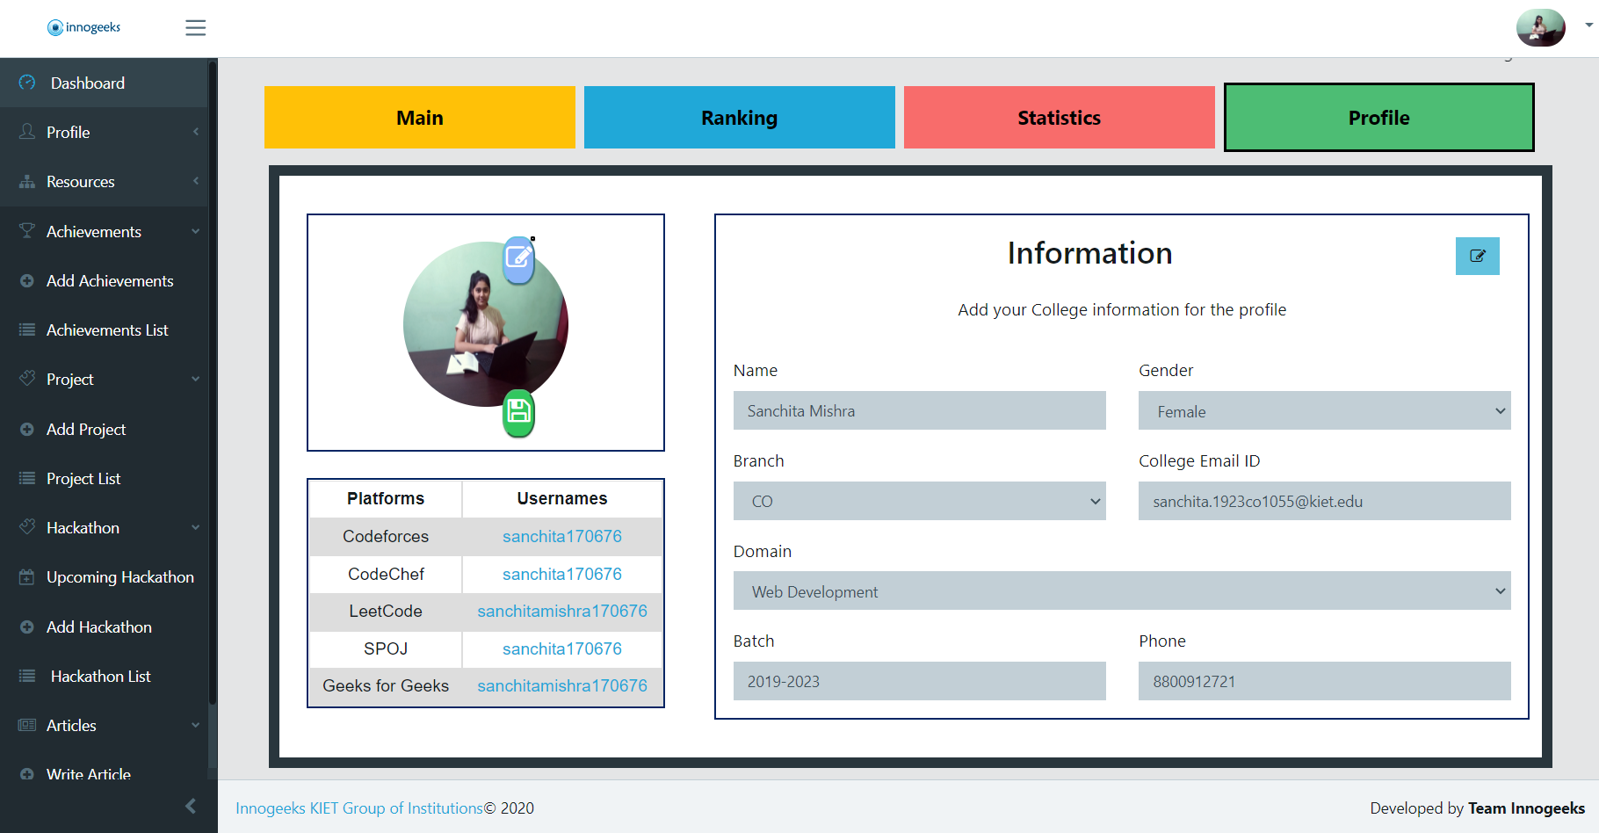
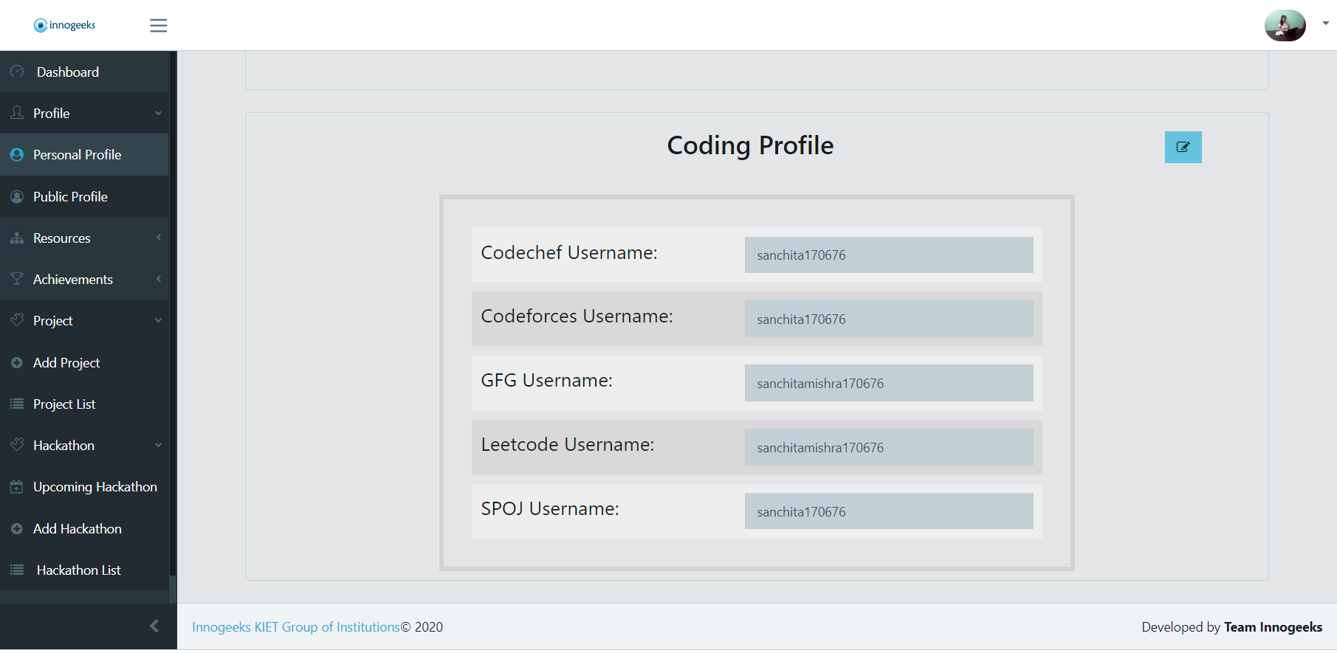
Member Portal collects all the required information to track their progress.

Slide 3
Quantitative Analysis of Student’s Problem Solving Approach
For the purpose of placements students practice problem solving on different platforms.
Their data is collected through scrapping and analysis is being done for them to easily understand where they stand in the competition.
A rank list is generated in the end.

Slide 4
Collection of user IDs on different platform.
(Done using Innogeeks portal)
Data Cleaning
Analysis of no of students registered on different platforms
Quantitative Analysis of the questions being solved and its distribution
Analysis of students who are actually using the platforms
Collection of data via scrapping the platforms
Finding out the outliers and removing them before individual analysis
Individual Analysis: Mean Difference, Percentile
& Z-Score
Quantitative Ranking of students based on their percentile and other factors
Output: Rank list

Slide 5
Libraries & Modules Used
Libraries & Modules | Purpose
Selenium web driver | Used for browser automation, webdriver protocol to control web browsers
Selenium webdriver By | Using it to extract data via XPATH
Selenium WebDriverWait | To wait for certain interval before giving exception (5 sec)
Selenium expected conditions | To check if the element is present in the DOM
Options | To add option for browser – eg: to make it headless
Re | Regex
Numpy | To perform mathematical operations
Pandas | For easy analysis
Matplotlib | To plot graphs
scipy | Get optimised stats

