Slide 1
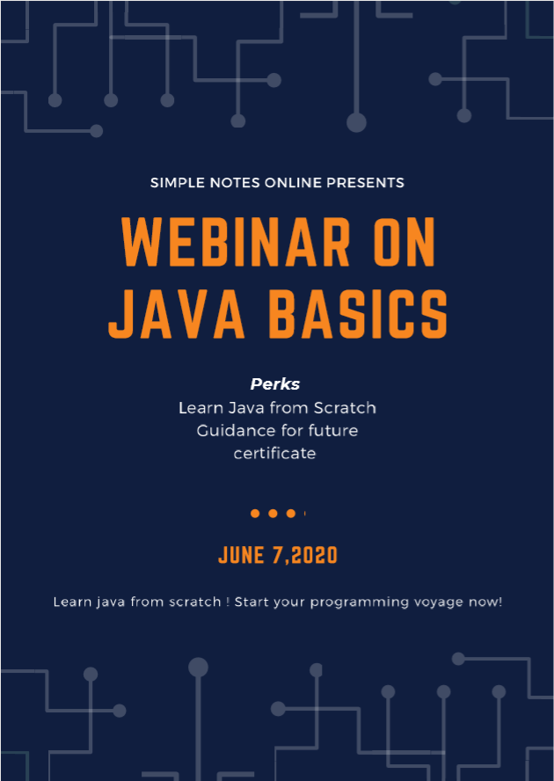

Slide 2
Points to be covered :
Package → Class → objects
Basic snippet understanding
Features of Java
Creating methods and calling
Features of Oops:
Classes
Objects
Data Abstraction
Encapsulation
Inheritance
polymorphism
Dynamic Binding

Slide 3
Package
Class A
Class B
Class C
Class D
Object

Slide 4
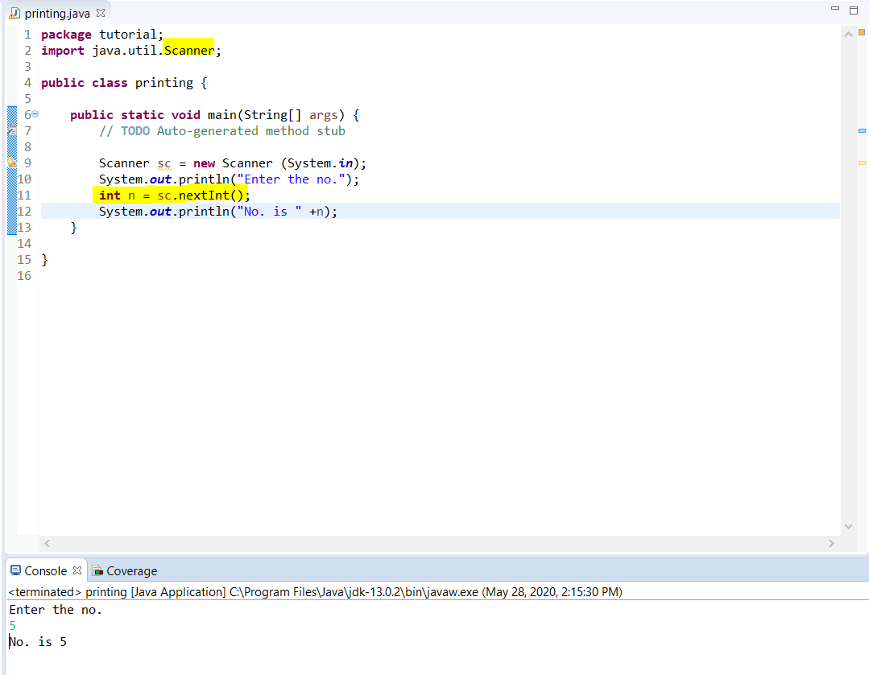

Slide 5
Scanner sc = new Scanner (System.in);
Class
Object
Creates instance
System input
Objects?
Class ?

Slide 6
What is Java?
Java is a high level programming language developed by sun microsystems in 1995, by a team of five members lead by James Gosling.
It is :
Interpreted and compiled both
Platform independent
Object oriented
Multithreading
Dynamic

Slide 7
Compiler
Other Languages
Byte Code
Interpreted and compiled both
Byte Code
Java
Compiler
Interpreter
JVM Byte Code
Platform Independent

Slide 8
What is Java?
Java is a high level programming language developed by sun microsystems in 1995, by a team of five members lead by James Gosling.
It is :
Interpreted and compiled both
Platform independent
Object oriented
Multithreading
Dynamic

Slide 9
Functions / Methods
A method is a block of code which only runs when it is called. You can pass data, known as parameters, into a method. Methods are used to perform certain actions, and they are also known as functions.
-W3 Schools
Class
P = (a+b+c) X 100
300
Function
Func.
To calculate % of 3 no.
Main
P = (a+b+c)/3
Call the function

Slide 10
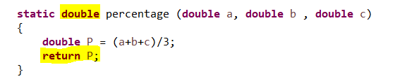
Writing a fuction :
Return type
Parameters
No need to crate object for calling
Function Name
Returning a double value to main

Slide 11
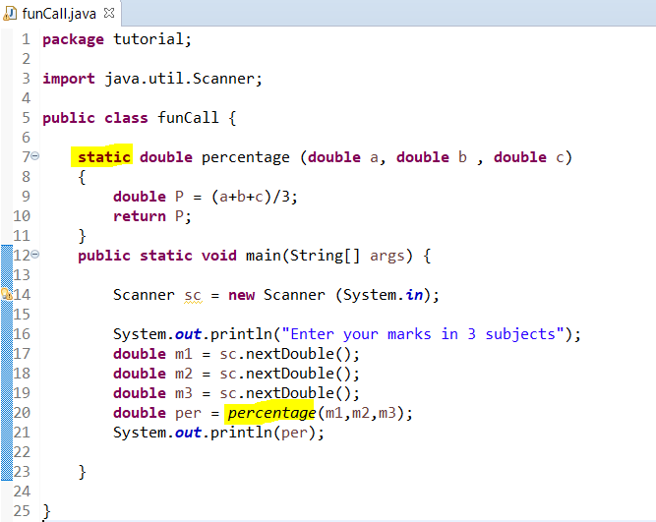
Calling a static function :

Slide 12
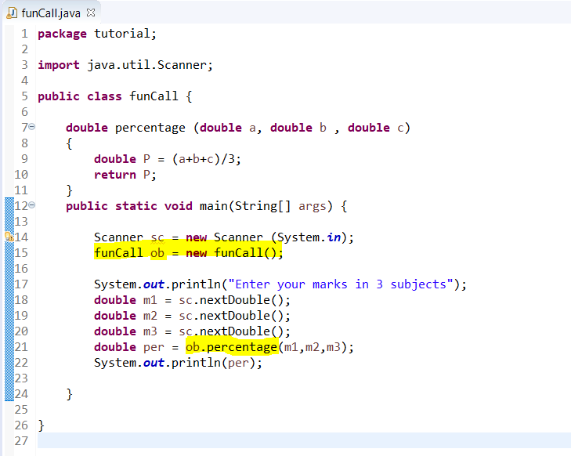
Calling a non-static function
Createing object of funCall class
Calling a fuction using object

Slide 13
Features of Oops:
Classes
Objects
Data Abstraction
Encapsulation
Inheritance
polymorphism
Dynamic Binding

Slide 14
Classes and Objects
A class is a blue print o fobjects. Objects are an instance of class with its data and functions (characteristic and behaviour).
Ch. X
Class Apartment
Characteristics
Name
No. of flats
No. of rooms
Ch. Y
Ch. Z
Behaviour
Made of
cement and bricks
Ch.W

Slide 15
Apartment
Object - Gaur
Object - Panchsheel
Characteristics
Name : Gaur Homes
No. of flats : 50
No. of rooms : 100
Characteristics
Name : panchsheel
No. of flats : 70
No. of rooms : 170
Behaviour
Made of
cement and bricks
Behaviour
Made of
cement and bricks

Slide 16
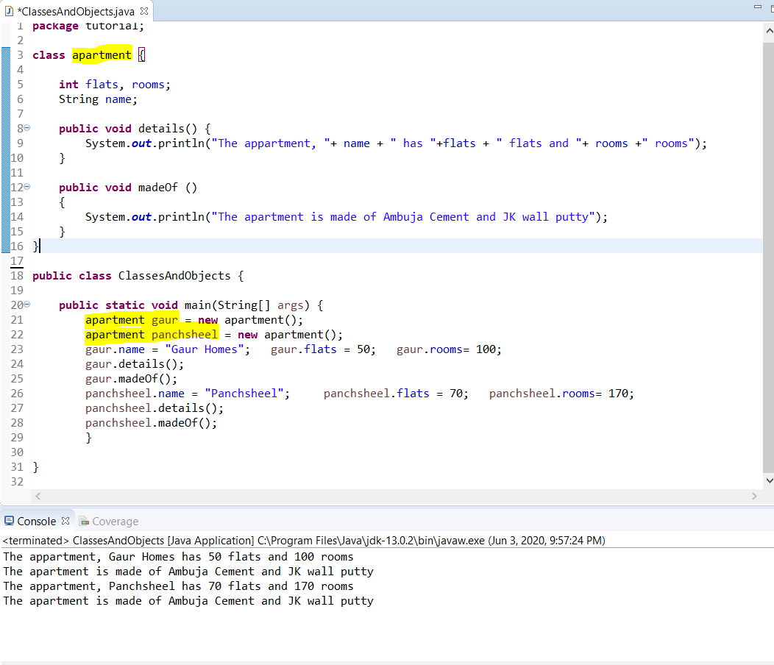
Charateristics
Behaviour

Slide 17
Features of Oops:
Classes
Objects
Data Abstraction
Encapsulation
Inheritance
polymorphism
Dynamic Binding

Slide 18
Journey Ahead
Days Weeks | 1 | 2 | 3 | 4 | 5 | 6
Week 1 | Variables and Data Types | Operators | Conditional If- else & nesting | Conditional Switch Case | For -loop | Nested – For Loop
Week 2 | While loop & nesting | Do-while & mixed | Arrays | Arrays | Arrays | Arrays
Week 3 | Strings | Strings | Strings | Methods | Constructor & this keyword | Access specifiers & static
Week 4 | Final keyword | Oops : Classes & objects | Encapsula-tion | Inheritance | polymorphism | Data Abstraction & Interface

Slide 19
Made easy for you!
Structured Course
+ Regular assignments
+ Daily practice questions
+ Hacker rank and codechef beginner level selected questions
+ Personal doubt clearing
Course price :500/-
Discount : -150/-
Total price : 350/-
Contact : 8800912721 (Sanchita Mishra)

Slide 20
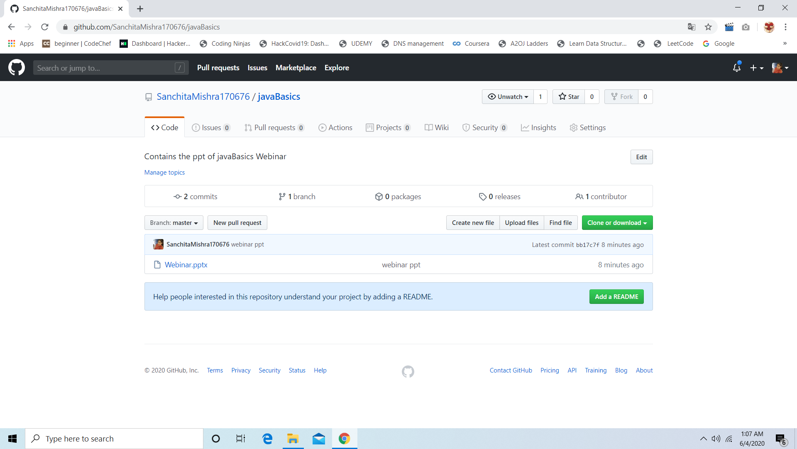
All the best!
Whatsapp :
8800912721
Mail : sanchitamishra170676@gmail.com
PPT available at :
https://github.com/sanchitamishra170676/javabasics
sanchitamishra170676/javabasics
Certificate link:
https://forms.gle/ZvXpGKU7X5GUWBag6

