Slide 1
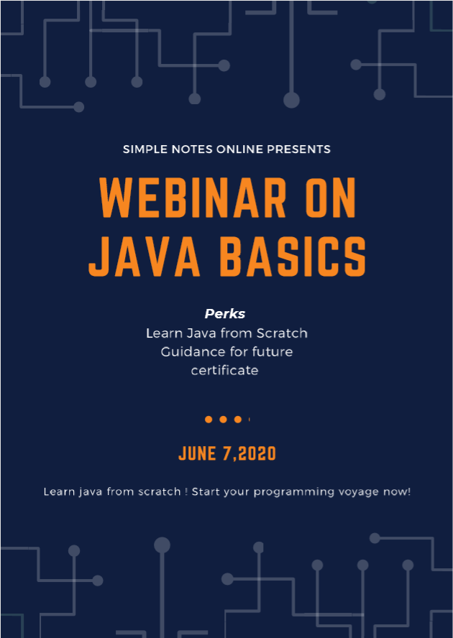

Slide 2
Points to be covered :
Package → Class → objects
Basic snippet understanding
Features of Java
Creating methods and calling
Features of Oops:
Classes
Objects
Data Abstraction
Encapsulation
Inheritance
polymorphism
Dynamic Binding

Slide 3
Package
Class A
Class B
Class C
Class D
Object

Slide 4
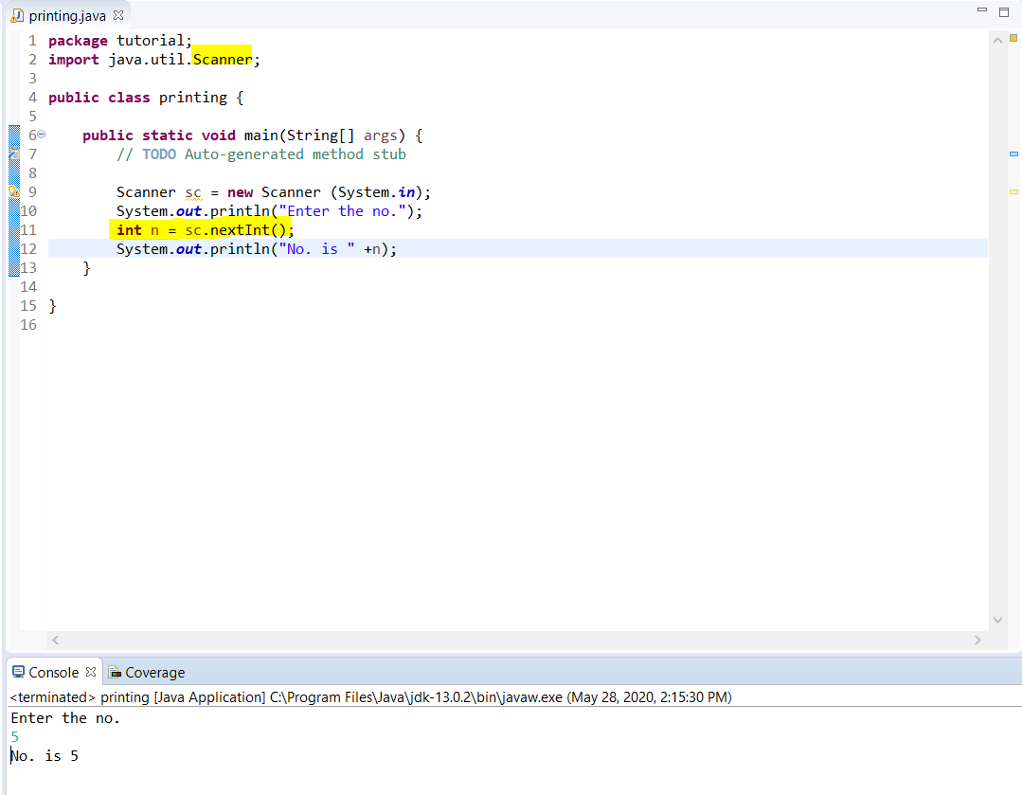

Slide 5
Scanner sc = new Scanner (System.in);
Class
Object
Creates instance
System input
Objects?
Class ?

Slide 6
What is Java?
Java is a high level programming language developed by sun microsystems in 1995, by a team of five members lead by James Gosling.
It is :
Interpreted and compiled both
Platform independent
Object oriented
Multithreading
Dynamic

Slide 7
Compiler
Other Languages
Byte Code
Interpreted and compiled both
Byte Code
Java
Compiler
Interpreter
JVM Byte Code
Platform Independent

Slide 8
What is Java?
Java is a high level programming language developed by sun microsystems in 1995, by a team of five members lead by James Gosling.
It is :
Interpreted and compiled both
Platform independent
Object oriented
Multithreading
Dynamic

Slide 9
Functions / Methods
A method is a block of code which only runs when it is called. You can pass data, known as parameters, into a method. Methods are used to perform certain actions, and they are also known as functions.
-W3 Schools
Class
P = (a+b+c) X 100
300
Function
Func.
To calculate % of 3 no.
Main
P = (a+b+c)/3
Call the function

Slide 10
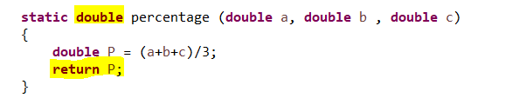
Writing a fuction :
Return type
Parameters
No need to crate object for calling
Function Name
Returning a double value to main

Slide 11
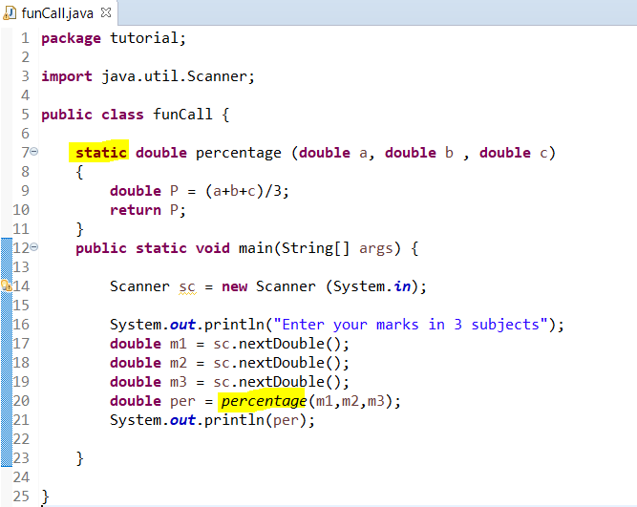
Calling a static function :

Slide 12
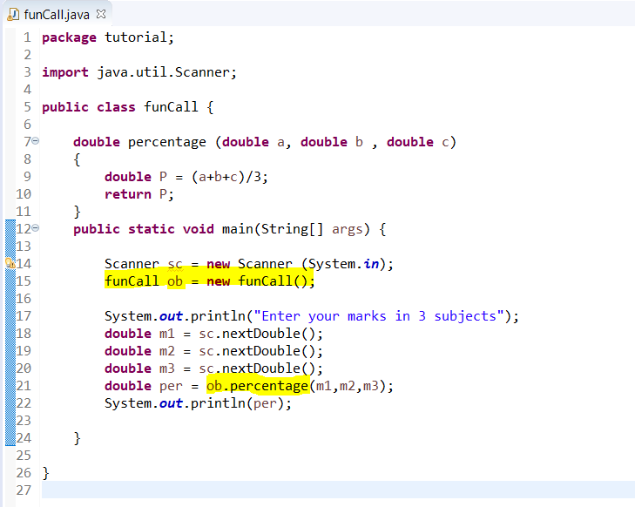
Calling a non-static function
Createing object of funCall class
Calling a fuction using object

Slide 13
Features of Oops:
Classes
Objects
Data Abstraction
Encapsulation
Inheritance
polymorphism
Dynamic Binding

