Slide 1
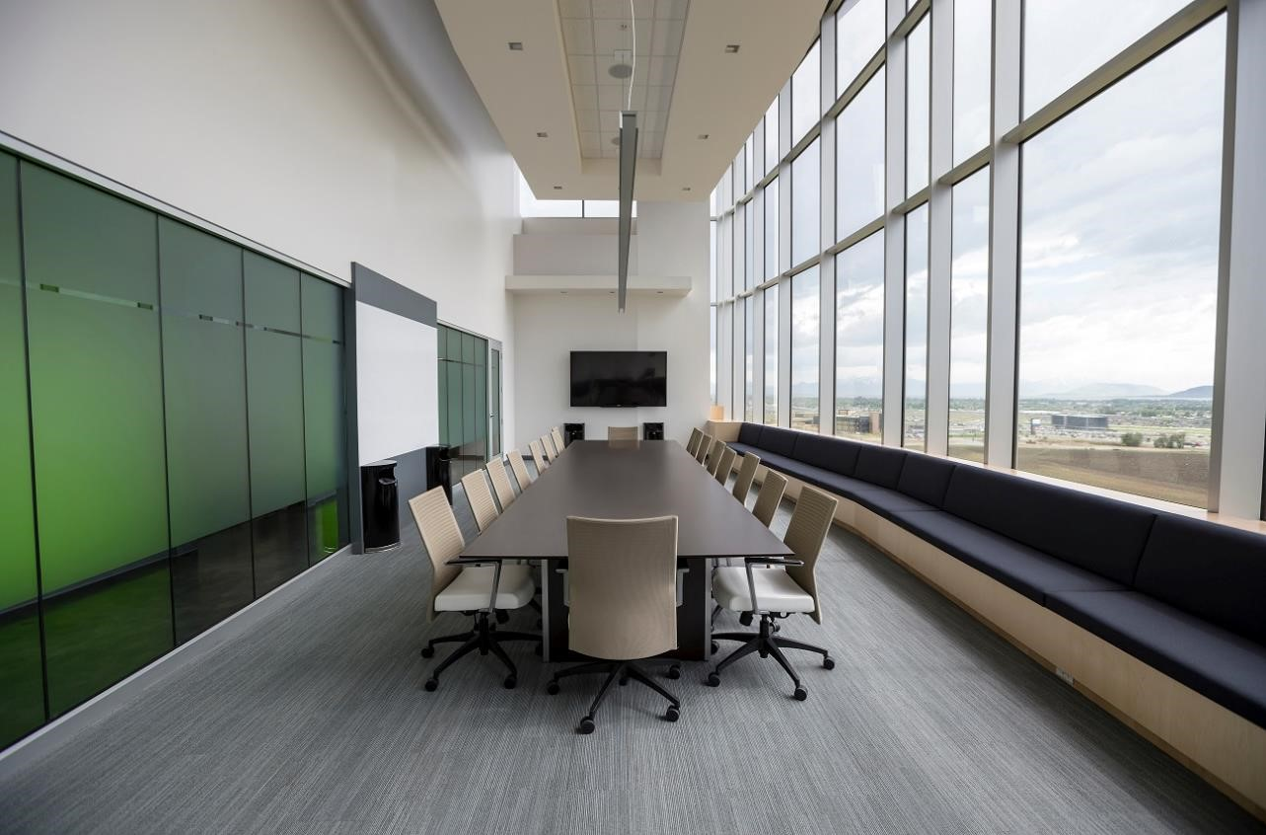

Presents:
Kissan-Tech

Slide 2
Ideology
We believe that nothing is more satisfying than easing the work of our farmers.
The farmers spend hours and hours taking care of their farms.
We tend to help them by our idea which will not only save their time but will also decrease their work.
We have created an automatic plant watering system which will help farmers in irrigation by saving their time, and effort.
The project will also save electricity and water.

Slide 3
Technology Used
Arduino UNO Microcontroller
Soil Moisture Sensor
Relay Module
Water Pump
DHT Sensor
HTML
CSS
Bootstrap
JS
Express JS

Slide 4
Team Members
Anish
Ankit Dagar
Lakshit Sharma
Sanchit Bajaj
Vaibhav Chopra

