Slide 1


Introduction to
Robotic Process Automation
Credential Builder
Automation
220701243
G.R.Sanchitha
N.Dhuraimurugan
Computer Science and Engineering

Slide 2
Abstract
The Credential Builder Project automates the design, creation, and distribution of certificates using Robotic Process Automation (RPA). It eliminates manual processes, ensuring accuracy and consistency in certificate generation. The system integrates user data with predefined templates for seamless customization. Automated workflows save time, reduce errors, and enhance scalability for bulk operations.
Certificates are securely distributed via email or other digital channels, streamlining the entire process. The project demonstrates the efficiency of RPA in handling repetitive tasks and improving operational productivity. Comprehensive testing ensures reliable performance across various scenarios. Future enhancements include dynamic template support and QR code integration for verification.

Slide 3
Need for the Proposed System
Manual certificate builder is inefficient, error-prone, and difficult to scale. Automation ensures accuracy, consistency, and faster processing for large-scale requirements.
Organizations struggle with timely,secure and professional certificate distribution.An automated system addresses these challenges

Slide 4
Advantages of the Proposed System
Automates the entire certificate creation process, reducing manual effort.
Ensures consistent and professional certificate design.
Minimizes errors in data handling and template usage.
Scalable for generating certificates in bulk efficiently.
Facilitates secure and reliable certificate distribution via email.
Saves time by streamlining repetitive tasks.
Provides an audit trail for tracking certificate generation and delivery.

Slide 5
Literature Survey
Automated Document Generation
Advantages: Improved speed and accuracy in repetitive tasks.
Disadvantages: Requires robust design templates.
RPA in Document Management
Advantages: Reduces manual intervention and errors.
Disadvantages: Initial setup and integration challenges.

Slide 6
Main Objective
Automate the process of creating and distributing certificates using predefined templates.
Ensure consistency, accuracy, and scalability for high-volume certificate generation.
Provide a secure, efficient, and user-friendly solution to streamline certificate management.

Slide 7
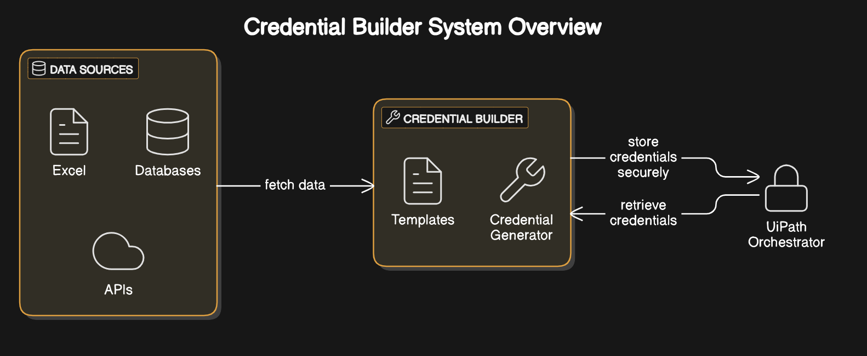
Architecture

Slide 8
System Requirements
Hardware:
PC with 8GB RAM or above.
500GB Hard Disk.
Modern processor (Intel i5 or higher).
Software:
RPA Tool: UiPath Studio.
PDF Generation Tools: Python Libraries (ReportLab, FPDF).
SMTP or email APIs for distribution.

Slide 9
Functional Description
Module 1: User Input Module
Short Description: Collects recipient details and certificate parameters.
Diagram: Data Flow Diagram (DFD).
Module 2: Certificate Generation Module
Short Description: Generates certificates using predefined templates.
Diagram: Activity Diagram.

Slide 10
Process Design
.
Main Process: The main process involves automating the entire workflow for certificate generation and distribution. It starts with collecting recipient data and ensuring its accuracy. Finally, certificates are securely distributed via email or other digital channels, ensuring reliable delivery.
Sub-Processes:
Distribution: Automate delivery via email or other digital channels with logging and tracking.
Certificate Design: Apply predefined templates for consistent and professional formatting.
Data Collection: Gather user details and validate inputs for accuracy

Slide 11
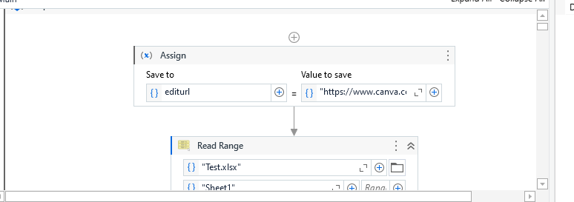
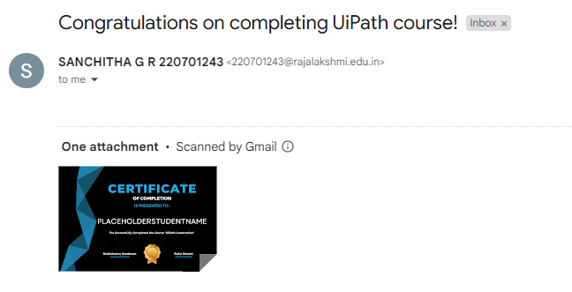
Implementation

Slide 12
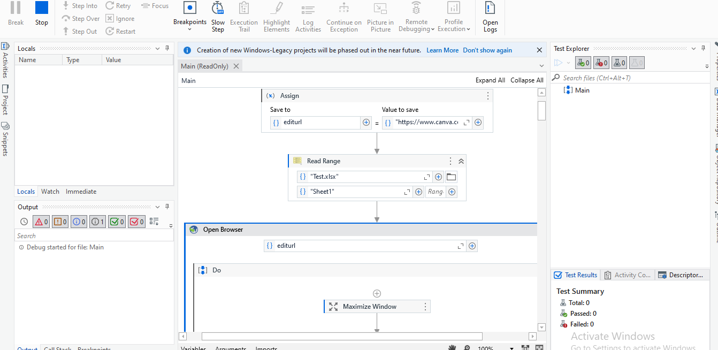
Testing

Slide 13
Conclusions
The project effectively automates certificates, ensuring accuracy and consistency in design and content.
It reduces manual effort and errors, streamlining the process for high-volume certificate management.
Secure distribution and robust logging enhance reliability and scalability for diverse organizational needs.

Slide 14
Future Enhancement
Integrate QR codes for certificate verification and authenticity checks.
Support dynamic and customizable certificate templates for diverse requirements.
Enable multi-language certificate generation for global applicability.
Incorporate blockchain technology for enhanced security and traceability.
Develop a user portal for recipients to download and verify their certificates.
Integrate with third-party platforms like LinkedIn for direct certificate sharing.
Introduce advanced analytics for tracking certificate usage and engagement.

Slide 15
References
Vaswani, A., et al. (2017). Attention Is All You Need.
Advances in Neural Information Processing Systems.
UiPath Documentation: Automating Document Processing.
Retrieved from UiPath Official Website.
ReportLab User Guide: Creating PDFs with Python.
Retrieved from ReportLab Documentation.
RPA in Education and Credentialing Systems. Journal of
Automation and Education Technology, 2021.
Official SMTP Documentation for Secure Email
Automation. Retrieved from SMTP Documentation.
Online tutorials and resources on PDF generation using
FPDF and Python libraries.

Slide 16
Thank You

