Slide 1


Online News Popularity

Slide 2

Table of contents
Dataset Information
Business Problem and Motivation
What’s better from past?
How Business Analytics will address the problem
EDA and Feature Engineering
Approach
Results
Insights and Limitations

Slide 3
Dataset Information
Dataset Name: Online News Popularity
DatasetLink: https://archive.ics.uci.edu/dataset/332/online+news+popularity#
This dataset compiles a diverse range of attributes related to articles published by Mashable over a two-year period. The primary objective is to forecast the level of social media shares an article is likely to receive (popularity).
For each instance of the dataset, it has 61 attributes which includes 1 target attribute (number of shares), 2 non-predictive features (URL of the article and Days between the article publication and the dataset acquisition) and 58 predictive features.
The rest of 58 variables measure the article from the title, words choice, time the article was posted, etc., which could potentially be explanatory variables for number of shares.
Number of Attributes | Attributes Characteristics | Number of Instances | Missing Values? | Outliers?
61 | Numeric and text | 39797 | No | Many

Slide 4
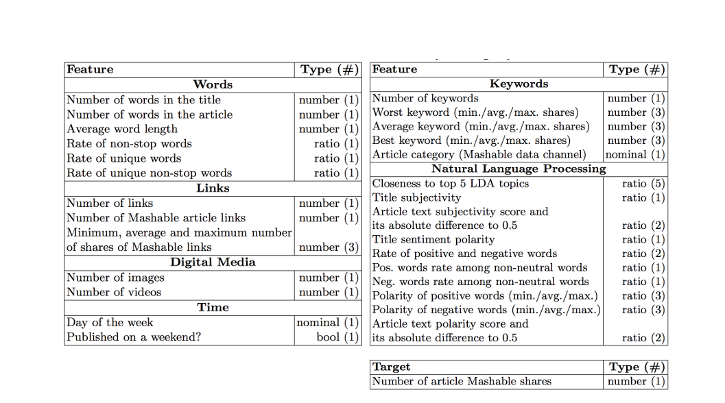

Dataset Information

Slide 5
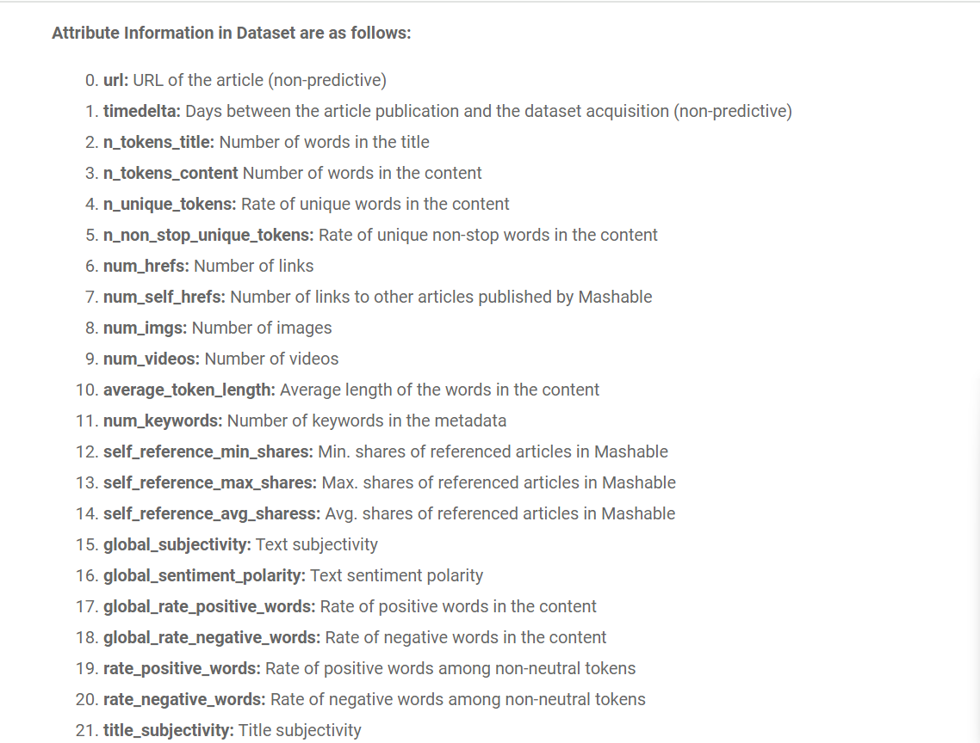
What exactly we have in our Data ?

Slide 6
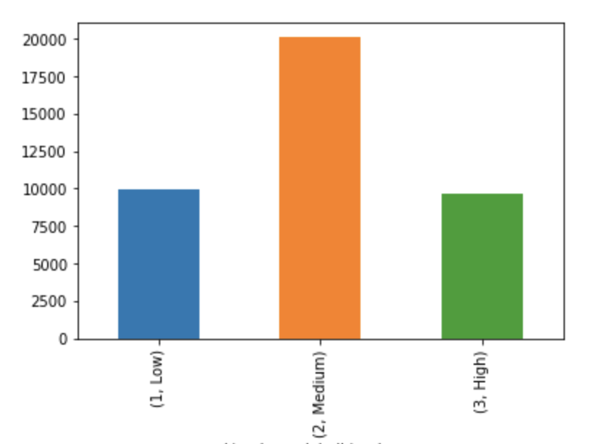
Business Problem
To Predict Article Popularity, based on number of shares. It’s a multi classification problem. Because this model objective is to predict the level of popularity of articles based on number of shares, this model can be applied basically in most of the websites which interest to share their own content
Some examples:
Blogs sites
Newspaper sites
Magazine sites
To achieve this, we will implement and compare three classification algorithms: Random Forest (RF), Support Vector Classifier, and XGboost. The selection of the best model will be based on the evaluation metrics discussed in the following section.

Slide 7
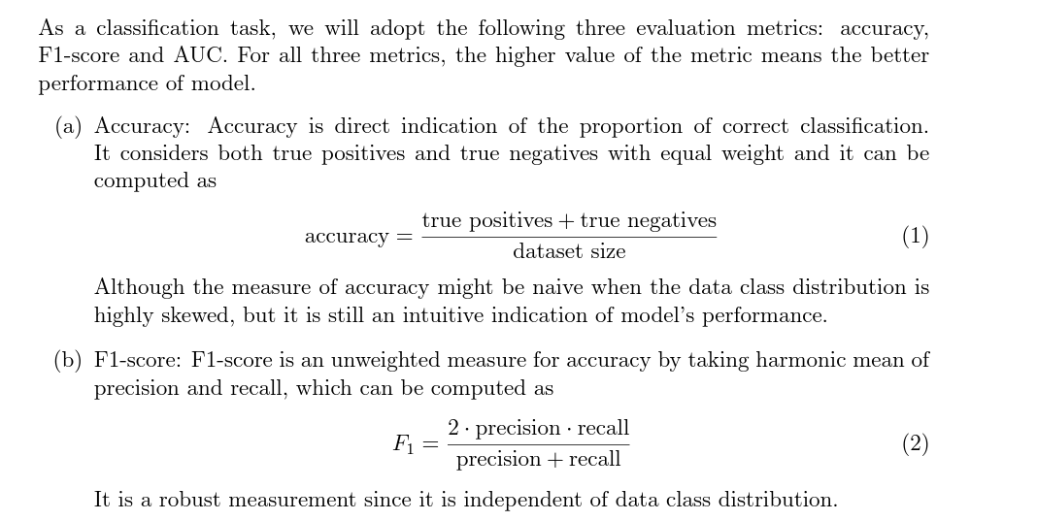
Metrics Used:

Slide 8
The Process
Data Extraction
Data Cleaning
Missing Values
Outliers
Data Exploration
Target Classification
Feature Analysis
Modeling
Feature Selection
Class Balance
Model Selection
Evaluate Predictions
Model Tuning

Slide 9
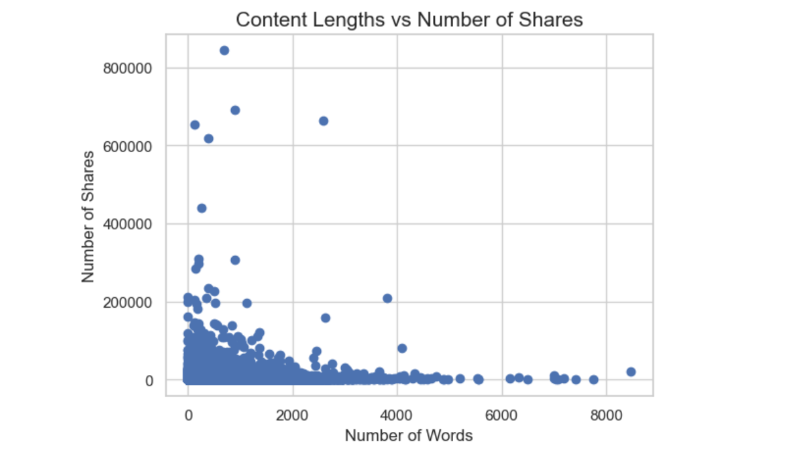
Data Visualization
Do Number of Words in an Article have its weight?

Slide 10
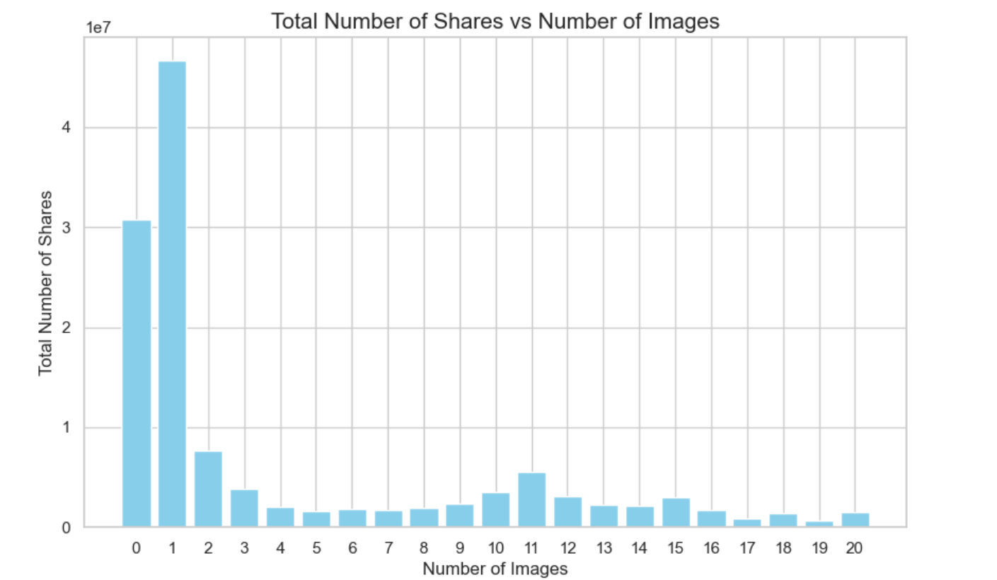
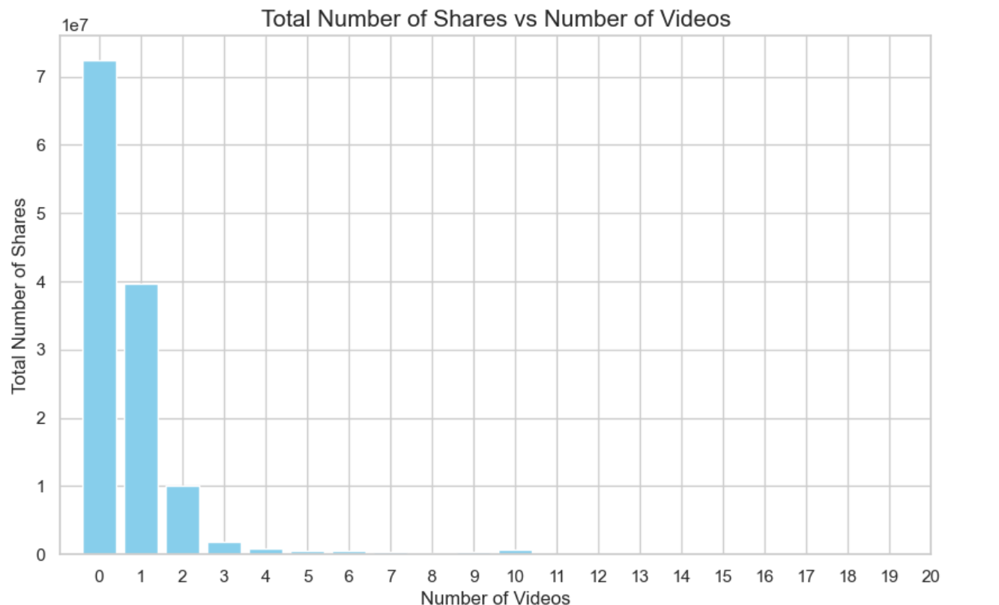
Viral Articles has how many number of Images/Videos?

Slide 11
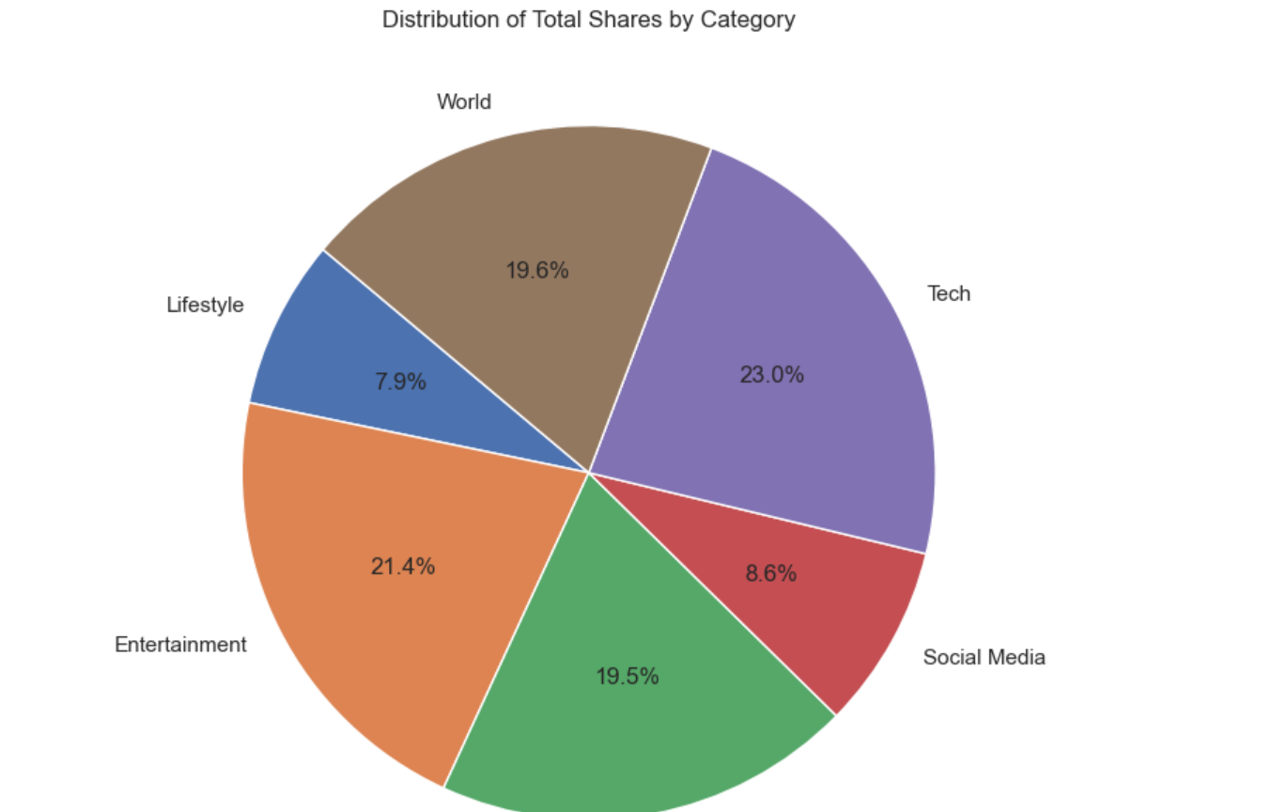
Which Category has More hits?

Slide 12
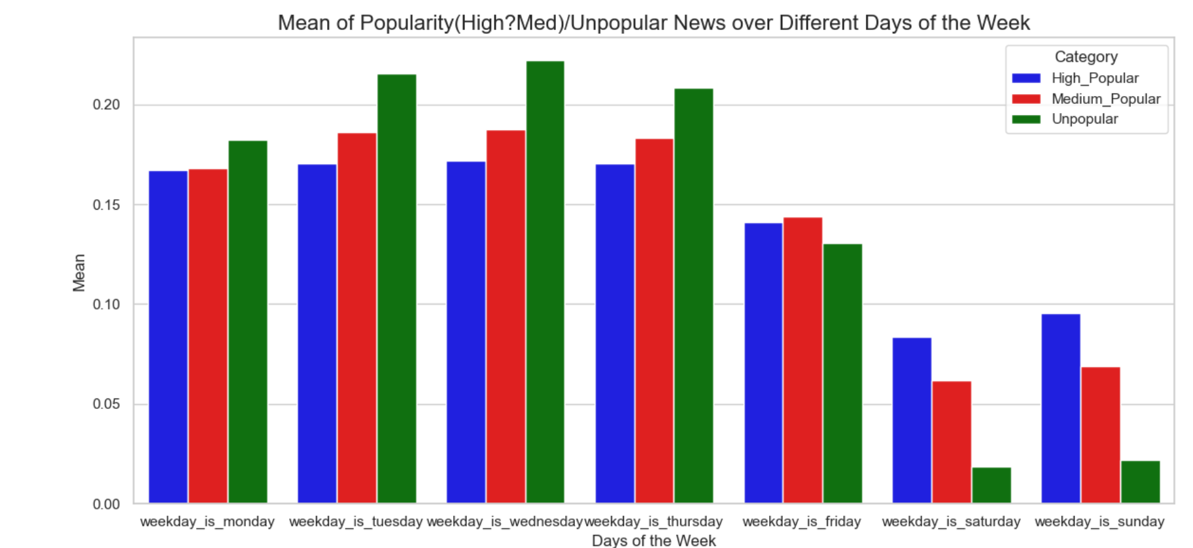
Are Saturday and Sunday’s Better?

Slide 13
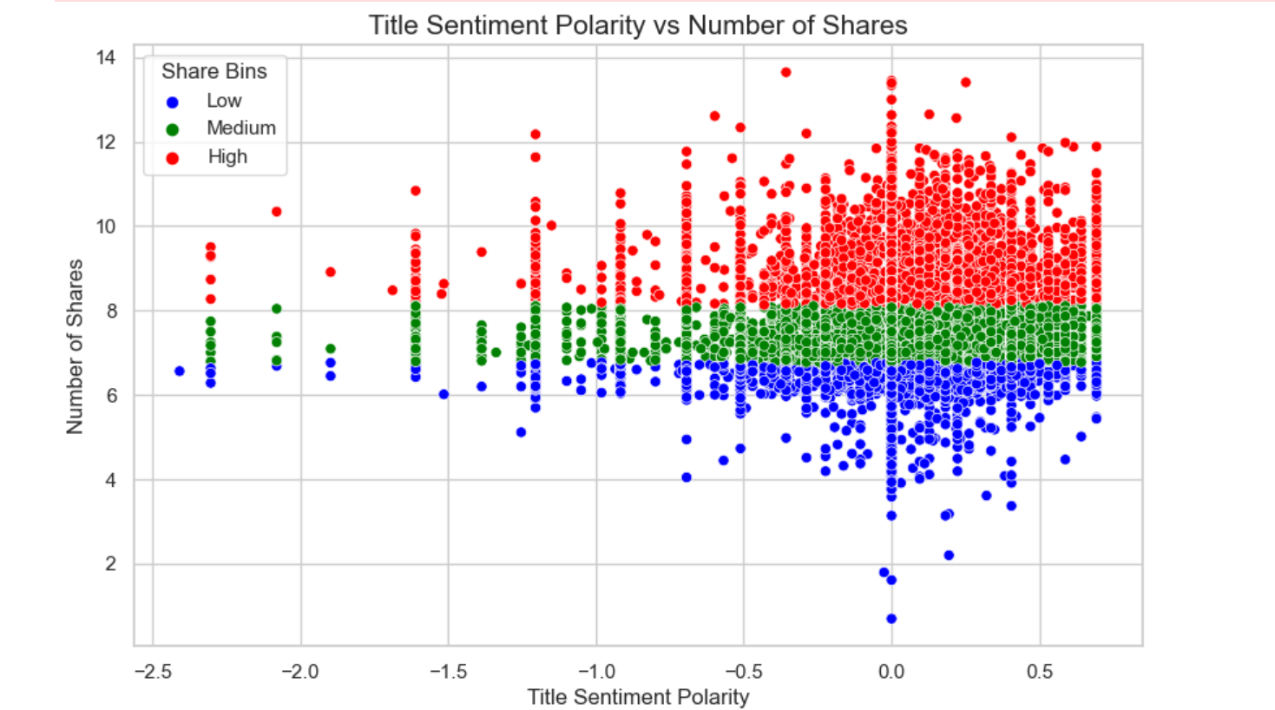
Is Neutral Sentiment the Better Choice?

Slide 14
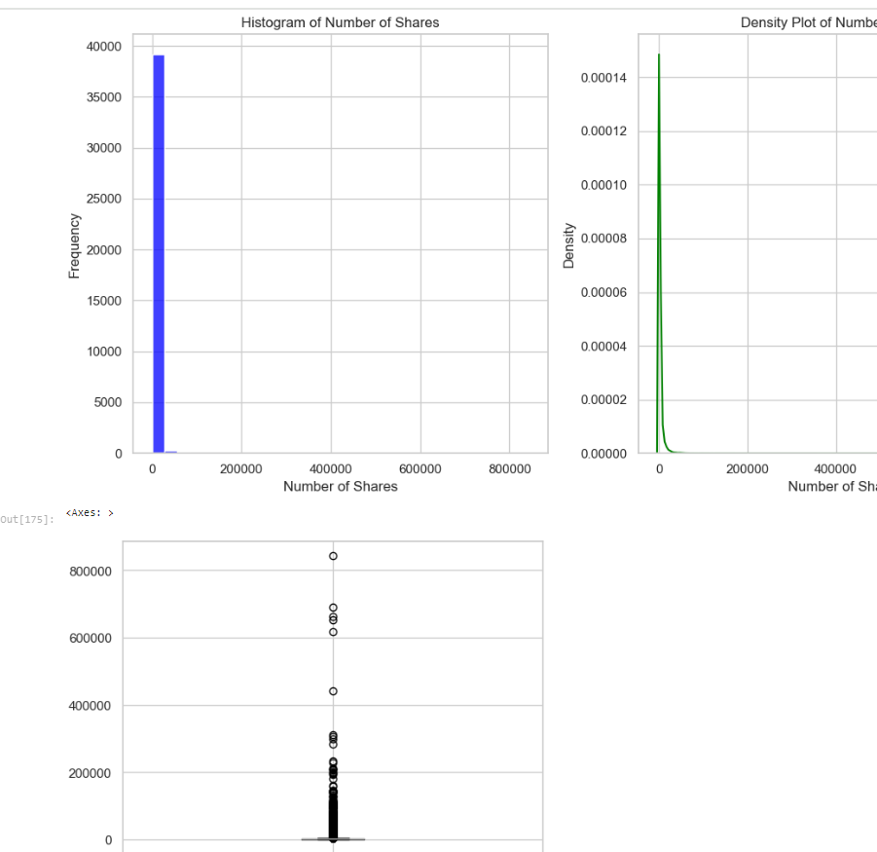
Visualization of Target Distribution
Need Scaling?

Slide 15
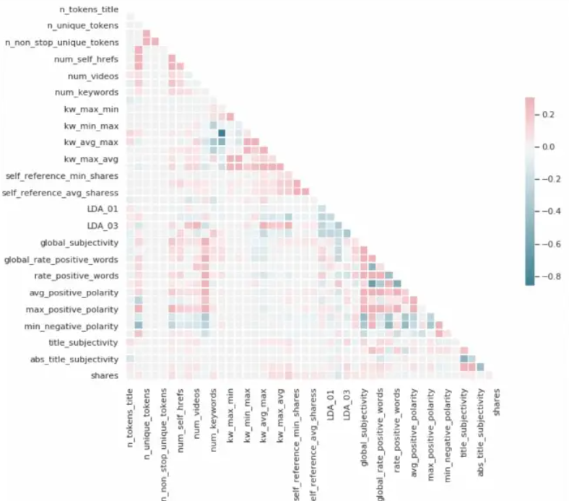
Handling Multi-Collinearity : So can Drop: n_non_stop_unique_tokens: 0.99 correlation with n_unique_tokens2. n_non_stop_words: 0.99 correlation with n_unique_tokens3. kw_avg_min: 0.93 correlation with kw_max_min4. kw_min_min: 0.85 correlation with kw_max_max5. is_weekend: same as the summation of Sunday and Saturday

Slide 16
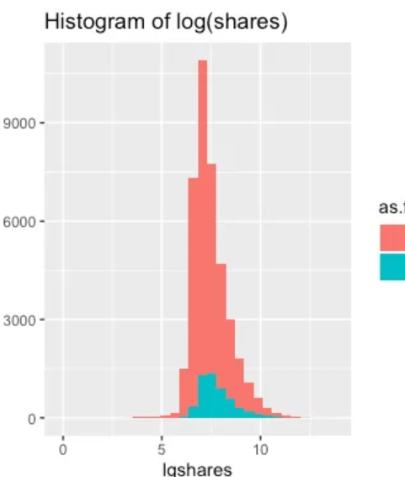
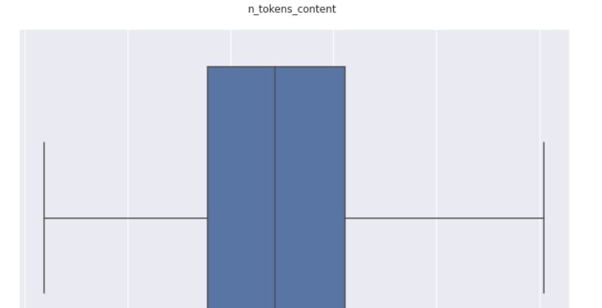
Scaling Via Log Transformation:

Slide 17
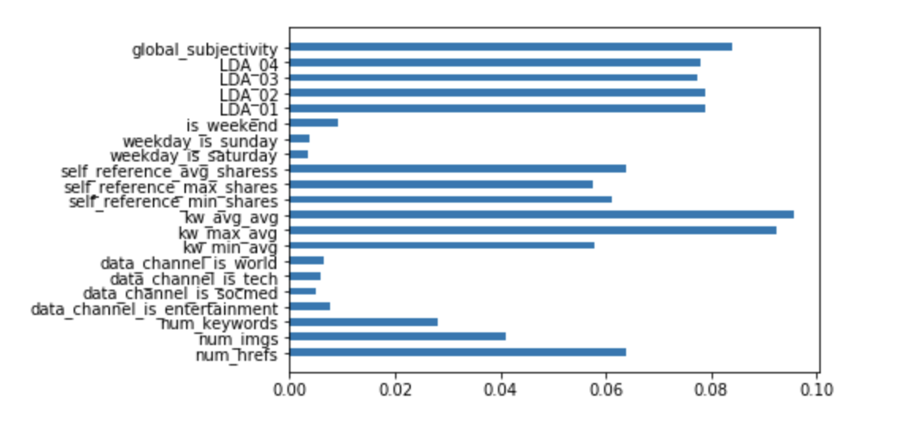
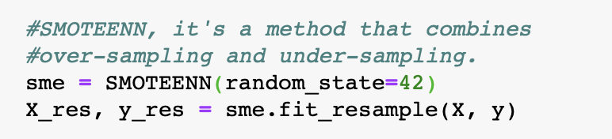
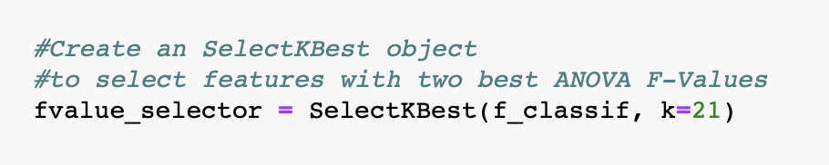
Feature Engineering and Dimensionality Reduction:
Feature Analysis
Feature Selection
Class Balance
SelectKBest Technique for Feature Selection
Check feature importance using Random Forest

Slide 18
The Process
Classification Models:
Random Forest
Support Vector Classification
XG-Boost
Evaluate predictions:
Training accuracy score vs Test accuracy score
Model Tuning:
Grid Search
Modeling
Model Selection
Evaluate Predictions
Model Tuning

Slide 19
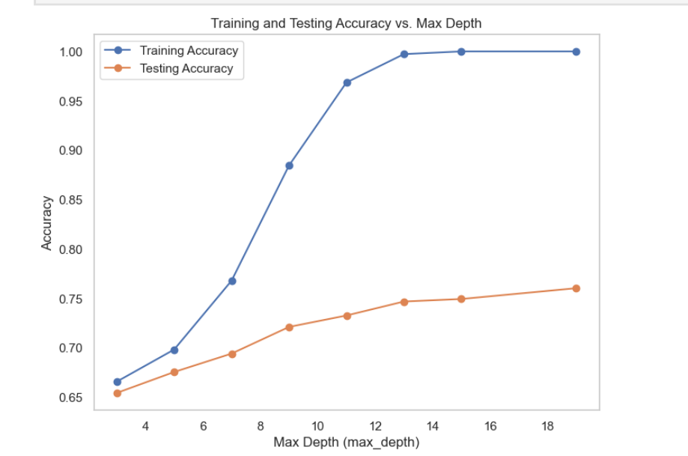
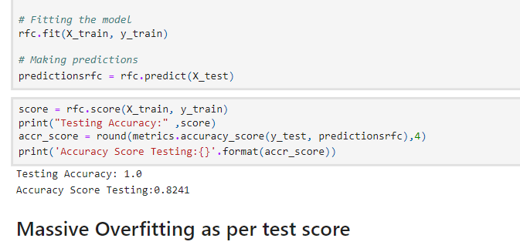
Got Overfitting with 100% training accuracy with Random Forest when Max_Depth=None , So will Optimize:

Slide 20
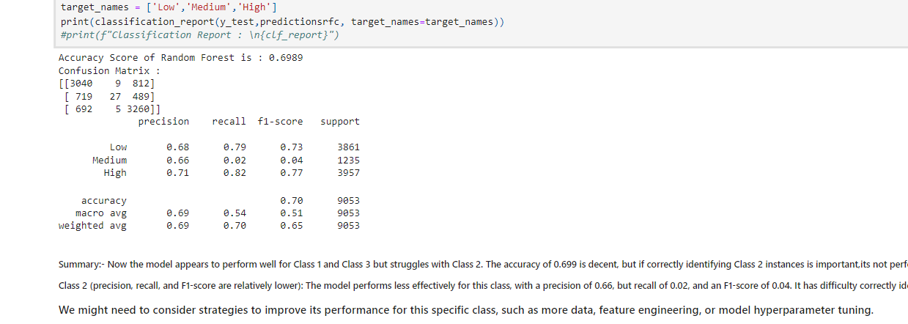
Optimized Random Forest, But Identifying Class 2 is difficult: Very Bad Recall and F1 score.

Slide 21
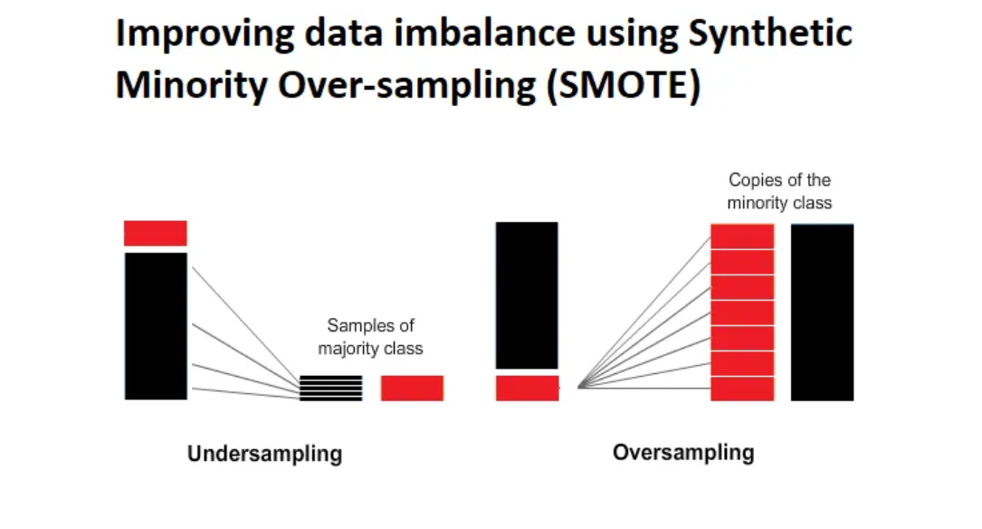
Class Balancing USING SMOTE:

Slide 22
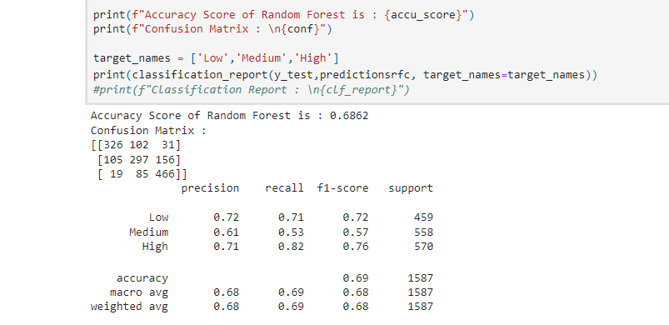
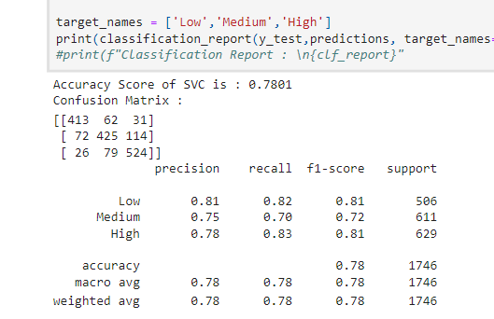
SVC performs better: After Class Balancing and can predict each class effectively.

Slide 23
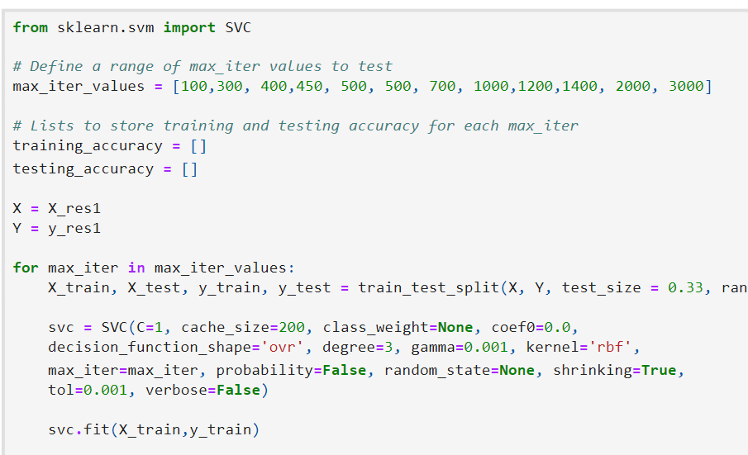
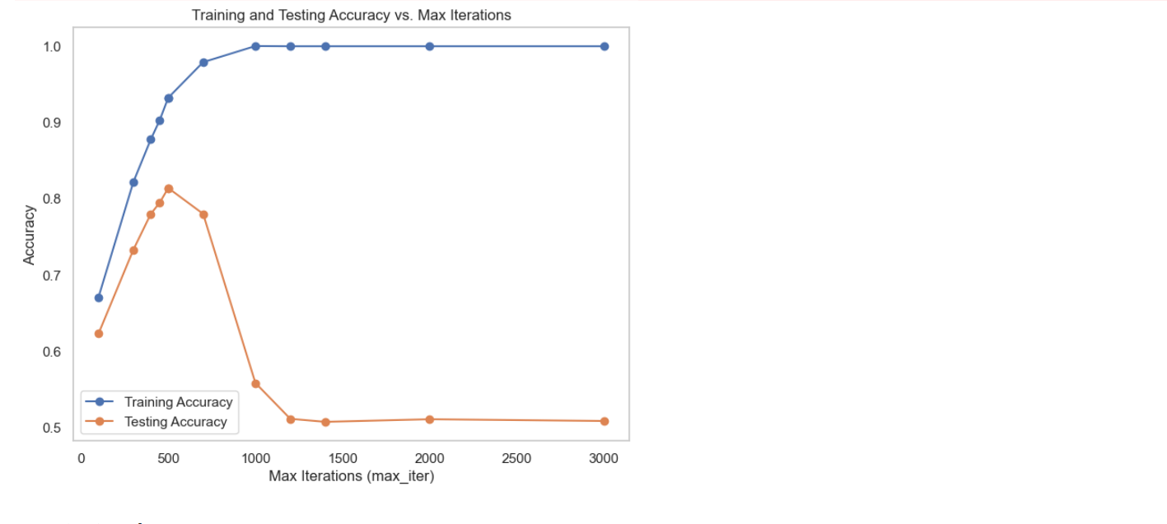
Hyper-Parameter Tuning:

Slide 24
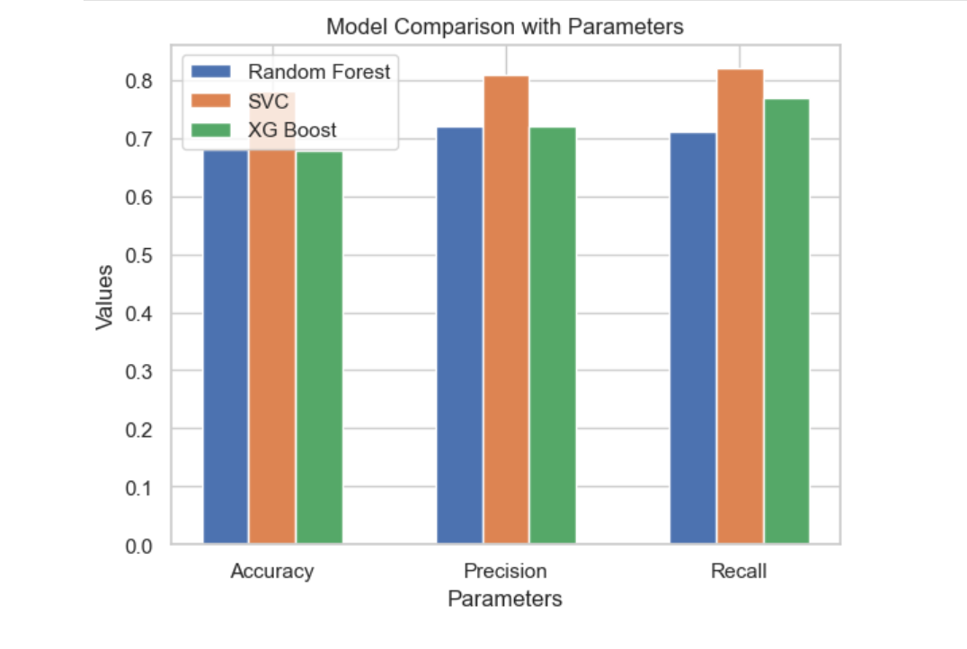
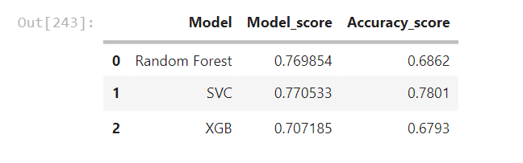
Results: SVC stands out

Slide 25
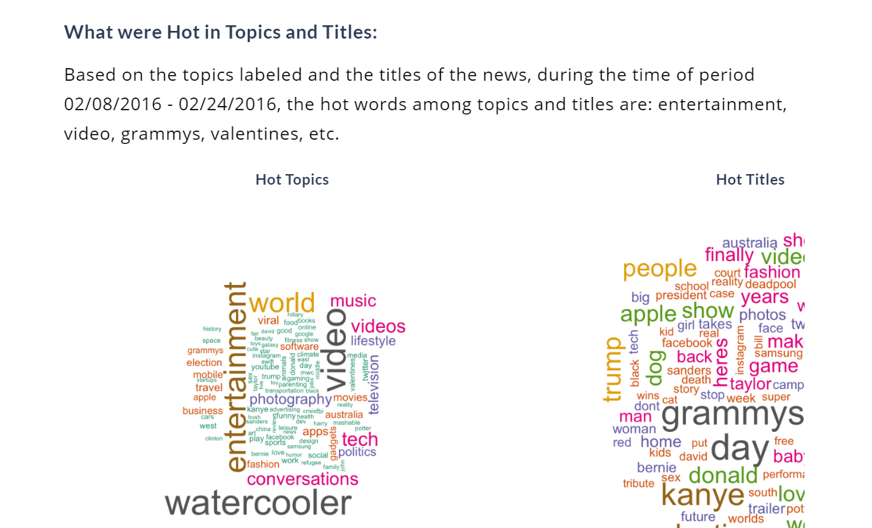
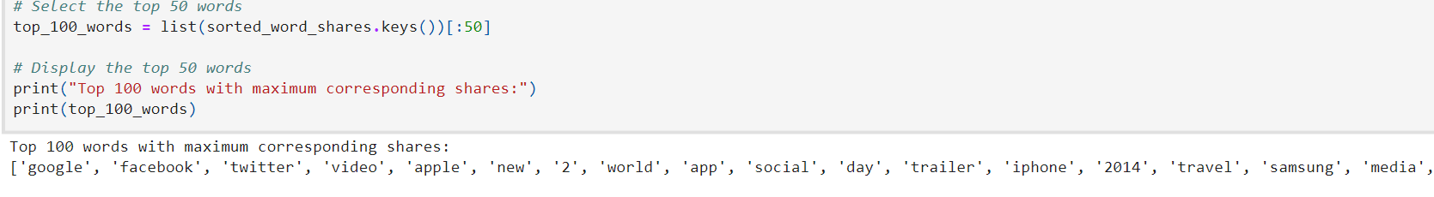
Conclusion: Max Accuracy is still 78 %, Data ain’t Good yet. Need some Semantic Analysis.

Slide 26
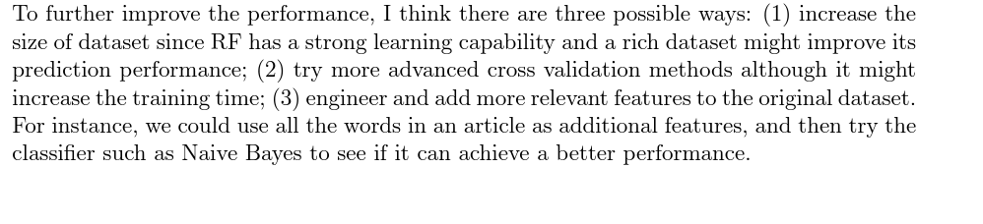
Applications and Future Improvements
The project can be applied to predict the popularity of online news articles before they are published, aiding in editorial decisions and content strategy and improving the business profitability.
Future improvements could include:
Utilizing more complex models or ensembles of different models.
Exploring the impact of additional features, like reader engagement metrics.
Applying the model to different types of content beyond news articles, such as blogs or social media posts.

Slide 27
Anything Missing:
The more I delve into this with a fresh perspective, the more apparent it becomes that insufficient data isn't the sole reason for the struggle to achieve higher prediction rates. It's the essence of trust that demands attention - the intangible yet vital factor waiting to be captured. Regardless of content, when a publisher embodies trust, the articles naturally garner more popularity.
Consider renowned publications like The New York Times or The Washington Post; their very names command a level of trust that significantly influences an article's viewership and shareability. Hence, a publisher should strive to evolve into a brand, meticulously crafting and nurturing trust. It's intriguing how the top 100 buzz words in article headlines also echo this sentiment, emphasizing the significance of trust in captivating an audience.

Slide 28
Thank you

