Slide 1
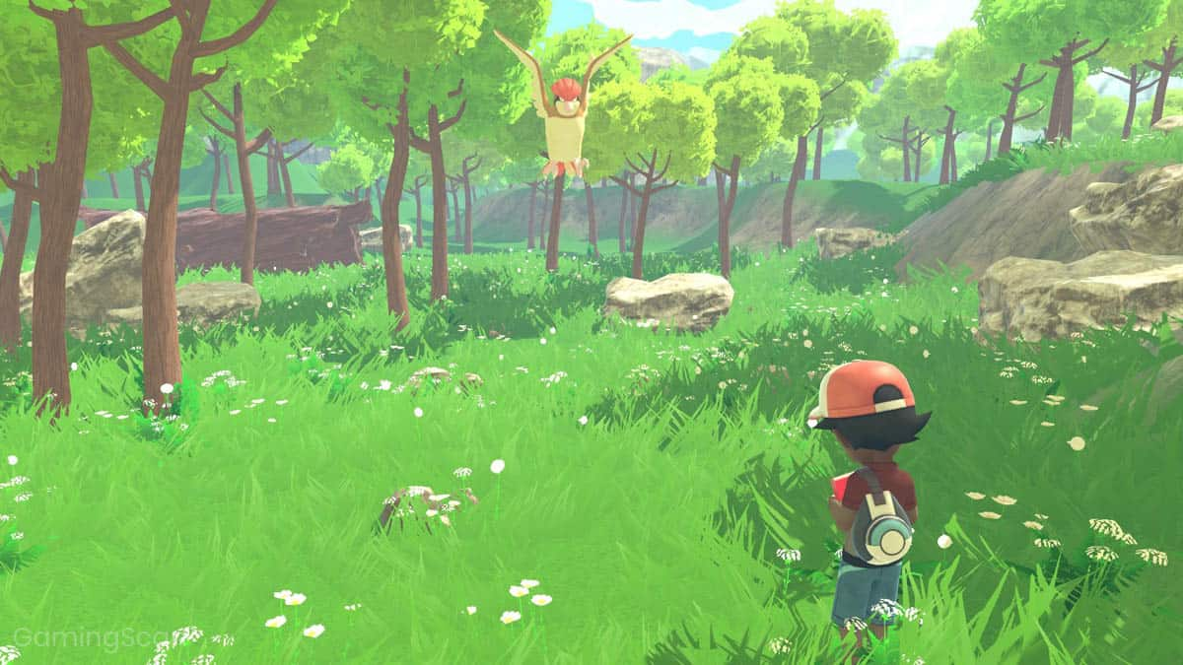

Adventure
Game
Sahil :17/cs34
Sanchit : 17/cs35
Shivam : 17/cs37

Slide 2

Objective
Implementation of Java.io and JavaFX.
A seamless interaction of a 2d adventure game.
You can travel to different locations and interact with things.

Slide 3

What is java.io?
Java I/O (Input and Output).
File handling.
Streams:
Sequence of data.
These are of two types :
OutputStream.
InputStream.

Slide 4

What is javaFX?
Used to build Rich Internet Applications.
To develop GUI Applications.
Alternative to Swing.

Slide 5
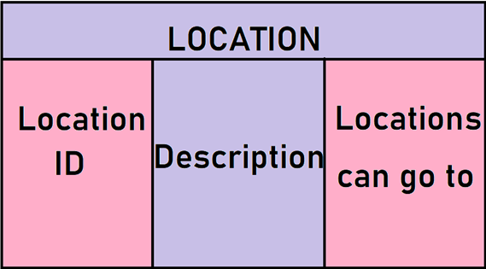
Methodology
Location Class :
To store following :
Location ID.
Description.
Locations to go to.

Slide 6

Java.io(Locations)
Following tasks are performed :
To import files.
To load data into the class.
To encrypt the file.

Slide 7
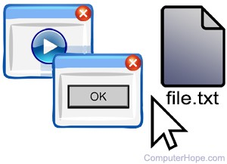
Main class
Following are the tasks:
Handles the main processes.
To add the dictionary.
To Implement GUI.

Slide 8
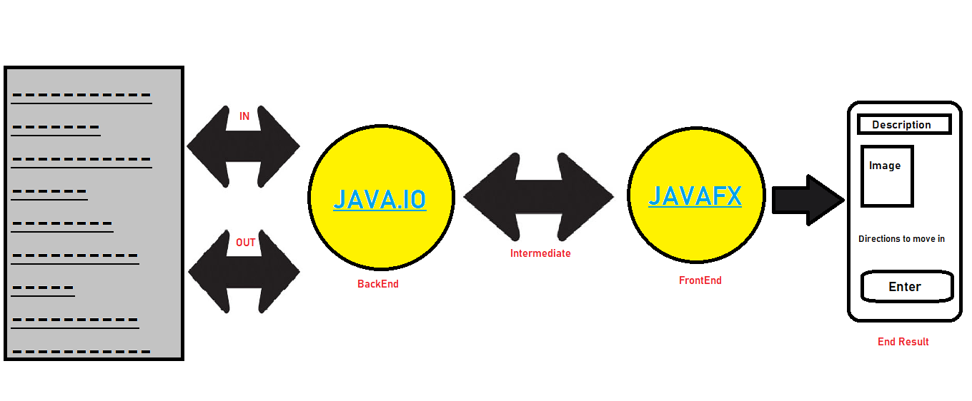
Diagram

Slide 9
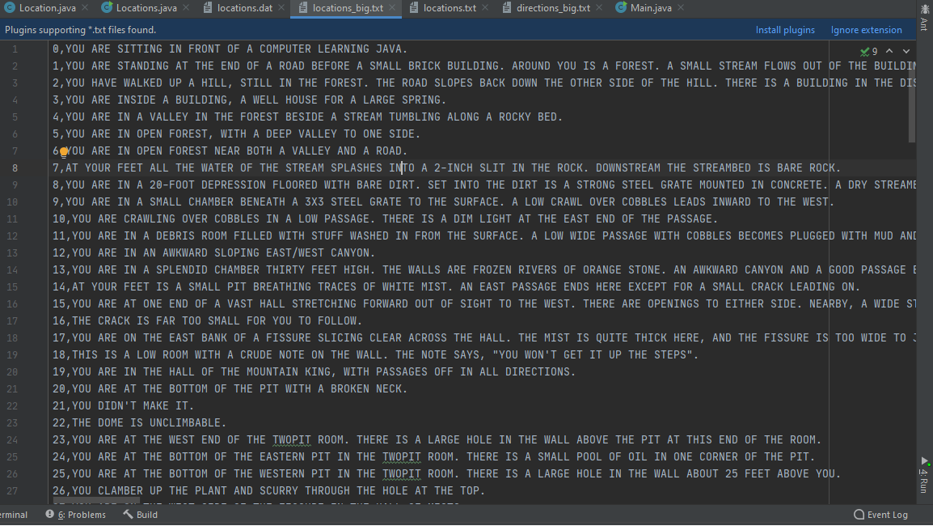
Code
Locations.txt

Slide 10
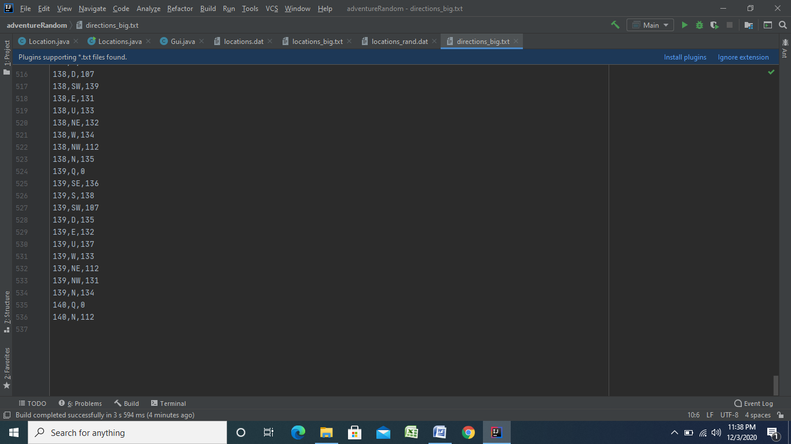
Directions.txt

Slide 11
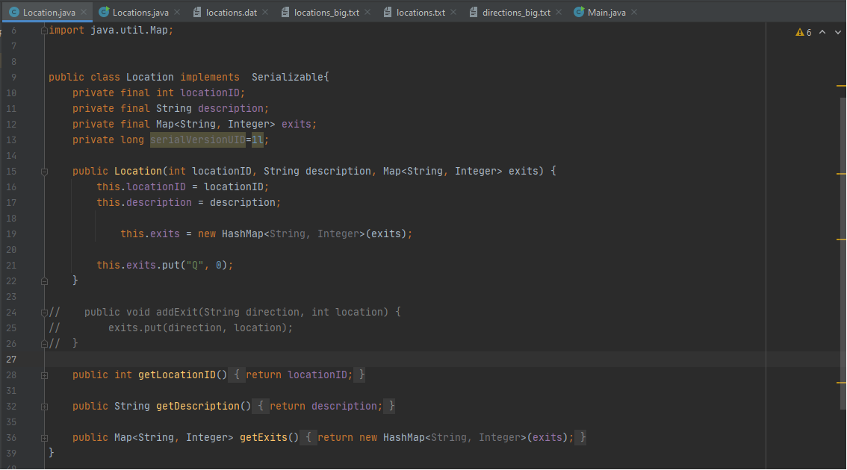
Locations class

Slide 12
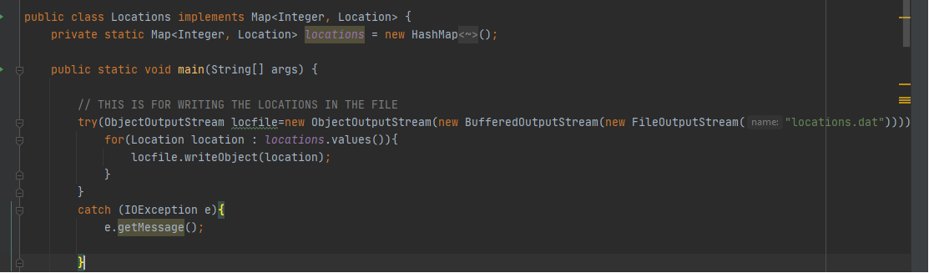
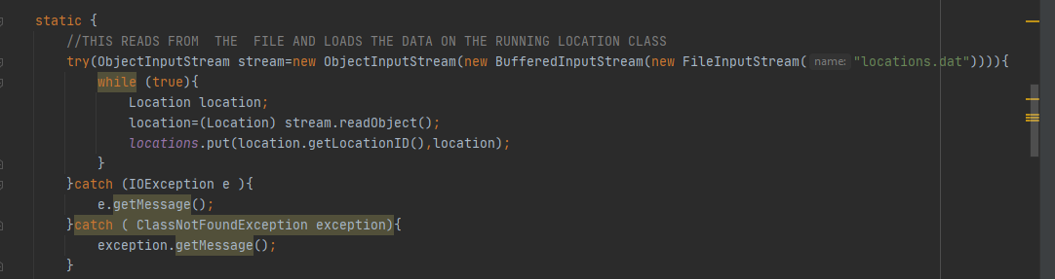
Writing the Data into the File:
Reading the data From the File:

Slide 13
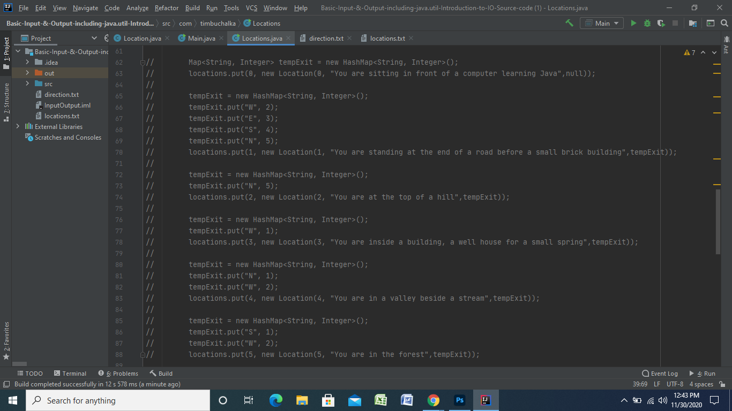
Code Junk:

Slide 14
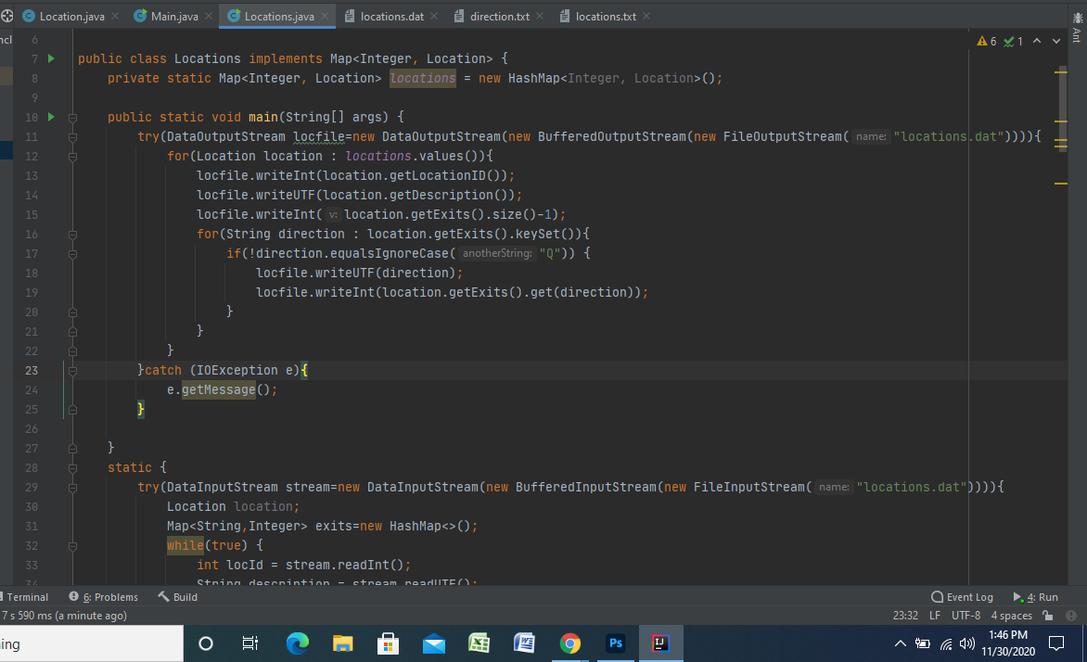
Code Junk:

Slide 15
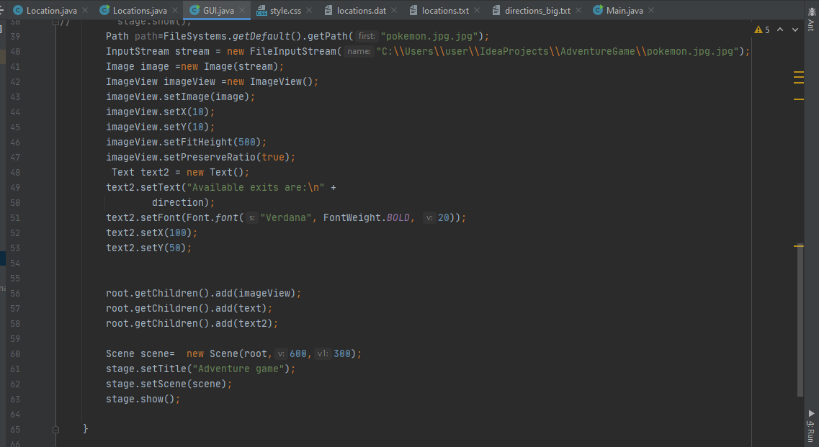
GUI :

Slide 16
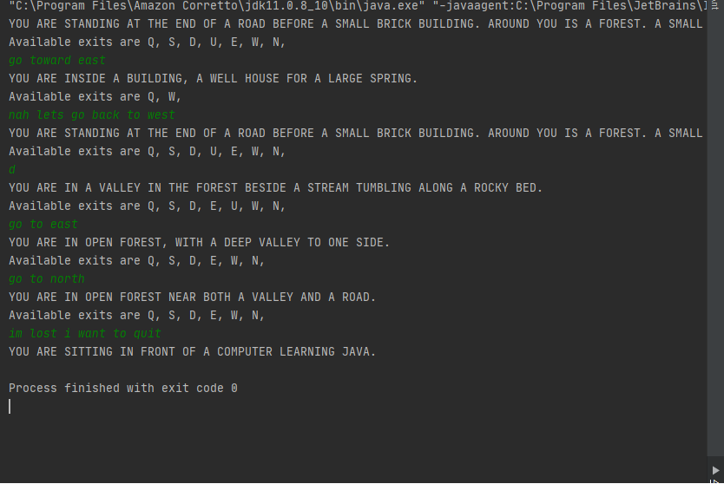
Result

Slide 17
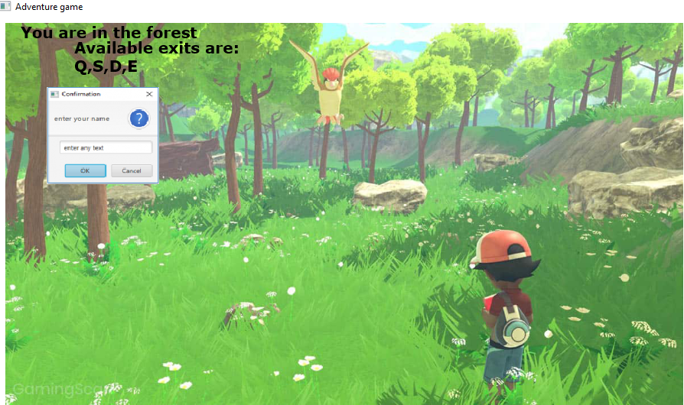
END RESULT

Slide 18

Future Scope
At its peak we can interact with things and move around in 2-D in a location.
Another idea :
Use the java.io part to make a Virtual World Map.

Slide 19


