Slide 1
Habit Tracker (official name: TBD)
Ben Lafene, Sam Jansen, Spencer Snider
The purpose of our project is to create a fun, interactive, and social habit tracking app that will help users build good habits and break bad habits
Our goals for this project include creating a clear and clean user interface, implementing a robust and rewarding social network system, and motivating users through an adorable virtual pet

Slide 2
Member Info
Ben LaFene: 5th year Computer Science major. lafenebp@mail.uc.edu
Sam Jansen: 5th year Computer Science major. jansensd@mail.uc.edu
Spencer Snider: 5th year Computer Science major. snidersc@mail.us.edu
Advisor: John Gallagher, gallagj9@ucmail.uc.edu

Slide 3
Project Abstract
We plan to create a habit tracking app that will be easy and rewarding to build into a user's daily life. First, we aim to create a fluid user experience which saves time and avoids frustration. We also aim to provide social network to all users, utilizing accountability as a primary method of motivation. Our final big feature is the implementation of a virtual pet. We aim to create a virtual pet who encourages you to workout, and provides a medium for you to interact with your friends. In summary, we hope to create a new habit tracking experience which will integrate seamlessly into users lives.

Slide 4
User Stories
As a user, I want to connect with my friends that are also on the app so that we can all hold each other accountable for our habit goals.
As a user, I want the UI to be clean and intuitive so that I don't have trouble navigating the app
As a person trying to build better habits, I want a system that is going to give me meaningful rewards for staying on task so that I feel more motivated and can effectively build good habits and break bad ones.

Slide 5
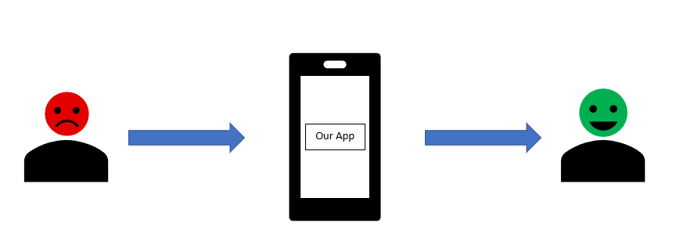
Design Diagram 1

Slide 6
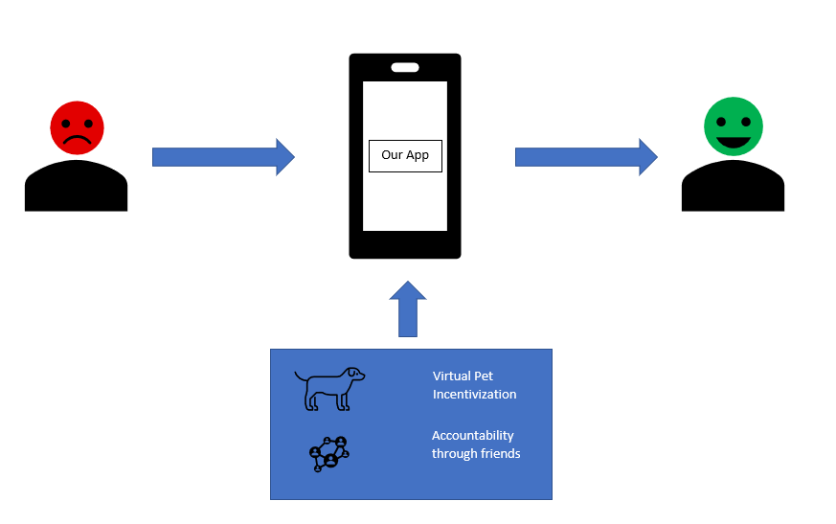
Design Diagram 2

Slide 7
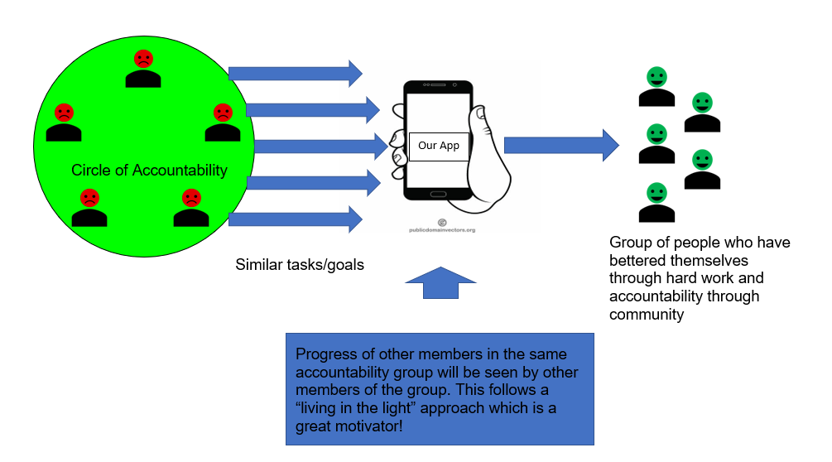
Design Diagram 3

Slide 8
Major Constraints
Legal Constraint
Avoiding “gambling”
Loot Boxes and their relation to slot machines
Virtual Pet Constraint
Commissioning an artist (necessary commitment for life of project)
Continually introducing new pets AND cosmetics
Security/Technical Constraint
Lack of expertise with TLS

Slide 9
Current Project Progress
Accomplishments so far:
Preliminary research of market complete
Existing apps, their pros and cons
Examined existing monetization models
How can we be better?
Dev environment setup
VS Code, Android studio, Flutter & Dart installation
Learning Flutter and Dart

Slide 10
Expected Accomplishments at End of Term
Ultimate Goal: working prototype with all core functionality
Likely very ‘bare bones’
Secondary Goals:
Decide on UI theme/color schemes
Make decisions on user settings
Make final decision on monetization model

Slide 11
Division of Work
Spencer - Social networking features, cloud storage
Sam - Virtual Pet experience, back end
Ben - Fluid UI & core habit tracking

Slide 12
Expected Demo
We plan on having a version ready with at least most of our desired core features.
By the time we are ready to demo this project, we would like to have:
A UI which allows you to create a task and mark it as complete
A social network system which allows users to track tasks as part of a group
A virtual pet which provides incentivization

Slide 13
Thanks :D

