Slide 1
Git
Created by:-
Virendra kumar Gour

Slide 2
Agenda
What is git and git-hub?
Difference between git and other version control system.
Git and git-hub example.
Useful command in git.
Branches in git- hub.

Slide 3
What is Git and Git Hub:-
Git is a revision control system, a tool to manage your source code history.
GitHub is a hosting service for Git repositories.
GitHub is the service for projects that use Git.
GitHub is the central repository system.

Slide 4
Difference between git and other version control system:-
GIT is distributed, SVN is not:- GIT like SVN do have centralized repository or server. But, GIT is more intended to be used in distributed mode which means, every developers checking out code from central repository/server will have their own cloned repository installed on their machine.
GIT stores content as metadata, SVN stores just files:- Every source control systems stores the metadata of files in hidden folders like .svn, .cvs etc., whereas GIT stores entire content inside the .git folder. If you compare the size of .git folder with .svn, you will notice a big difference. So, the .git folder is the cloned repository in your machine, it has everything that the central repository has like tags, branches, version histories etc.

Slide 5
Difference between git and other version control system:-
GIT branches are not the same as SVN branches:-Branches in SVN are nothing but just another folder in the repository. If you need to know if you had merged a branch, you need to explicitly run commands like svn propget svn:mergeinfo to verify if it was merged or not.
Whereas, working with GIT branches is much more easier & fun. You can quickly switch between branches from the same working directory. It helps finding un-merged branches and also help merging files fairly easily & quickly.
GIT does not have a global revision no. like SVN do:
This is one of the biggest feature miss in GIT from SVN .As we already know, SVN’s revision no. is a snapshot of source code at any given time.

Slide 6
Difference between git and other version control system:-
GIT’s content integrity is better than SVN’s:GIT contents are cryptographically hashed using SHA-1 hash algorithm. This will ensure the robustness of code contents by making it less prone to repository corruption due to disk failures, network issues etc.

Slide 7

Set user name and email id :-

Slide 8
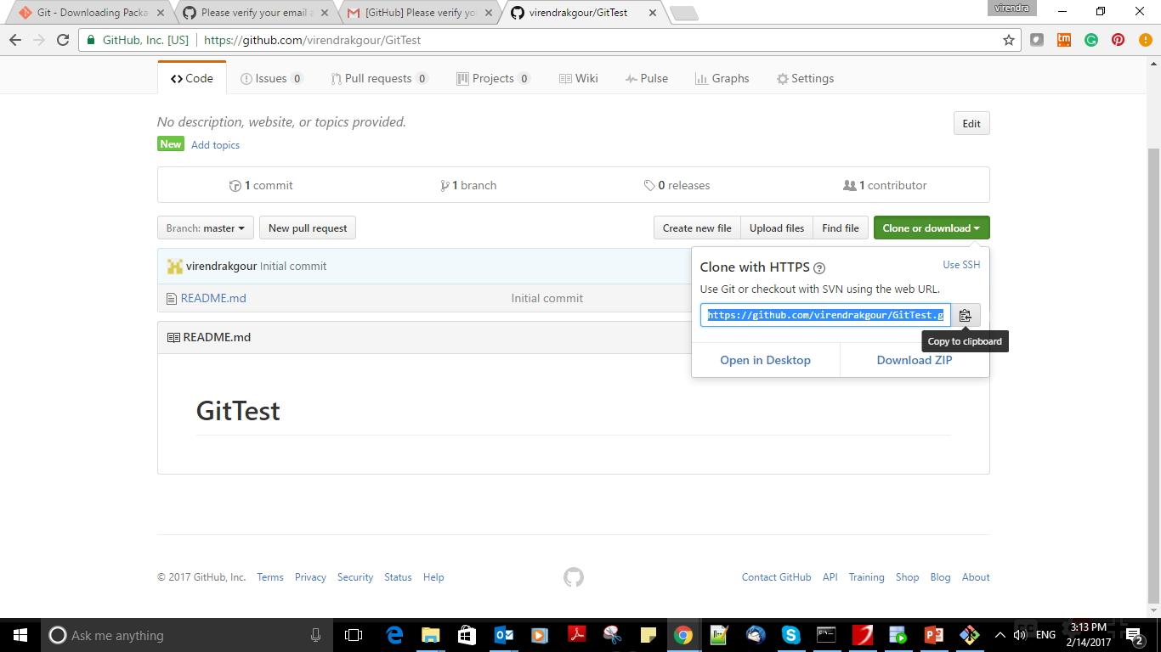
Clone repository into local machine :-

Slide 9

Clone repository into local machine :-

Slide 10

Add new file in git repository:-

Slide 11

Committing the file:-

Slide 12
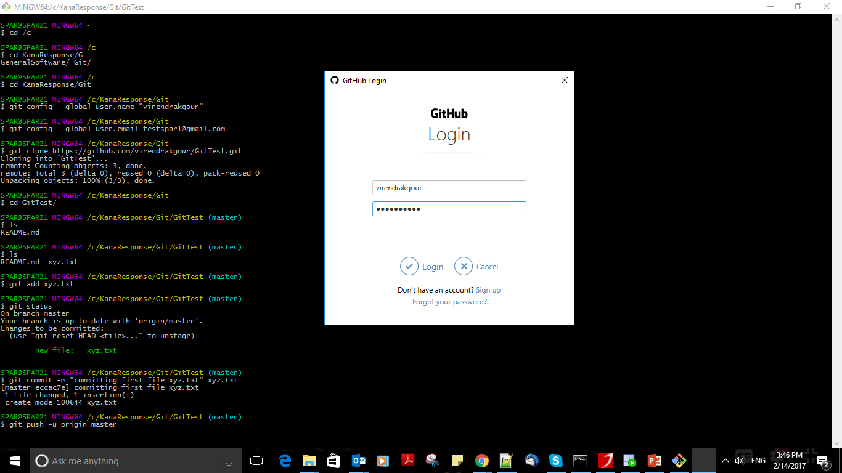
Transfer file to git-hub repository:-

Slide 13


Slide 14
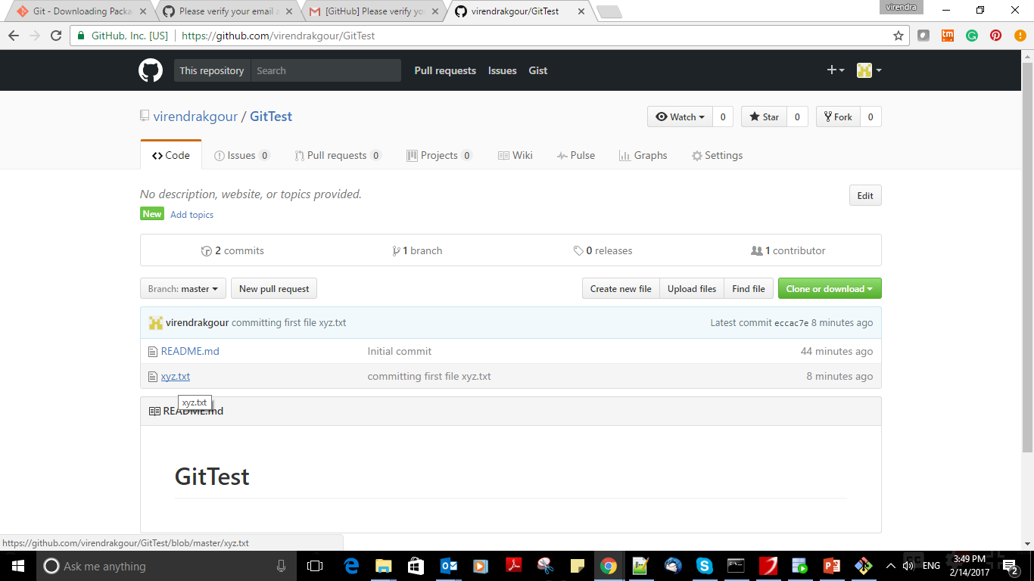
Newly pushed file in git-hub repository:-

Slide 15
Useful command in git:-
git config --global user.name “github_user_name”
git config --global user.email github_Email_id
git clone url_name
git add xyz.txt
git status
git commit –m “any comment” xyz.txt
git push –u origin master

Slide 16
Thank you

