Slide 1
EDUCATION
Team - 20
Phase 1
Chethan Bhaskar
Nagaraj Hegde
Sandeep Nagendra
Shashank Ravindranath
Sudhindra Manohar Bellur Vasudeva

Slide 2
List of Datasets
SAT Scores
Average SAT scores of students
Gender Proportion
Male and Female gender census of various schools across USA.
On Campus Crime
Arrests for different crimes that includes drugs, liquor, weapons.
School Profile
Consists of statistics of the students in various schools, categorized based on secondary, primary, enrollment rate etc
Progress Report
Consists of student growth rating based on different subjects.

Slide 3
Use cases
User filters out best schools in multiple states based on:
School Profile
Better Sat Scores acceptance
Lesser On Campus crime rate
Better Student Progress report based on different subject scores.
Better gender ratio.
User can view different charts.
User can import / export data set.

Slide 4
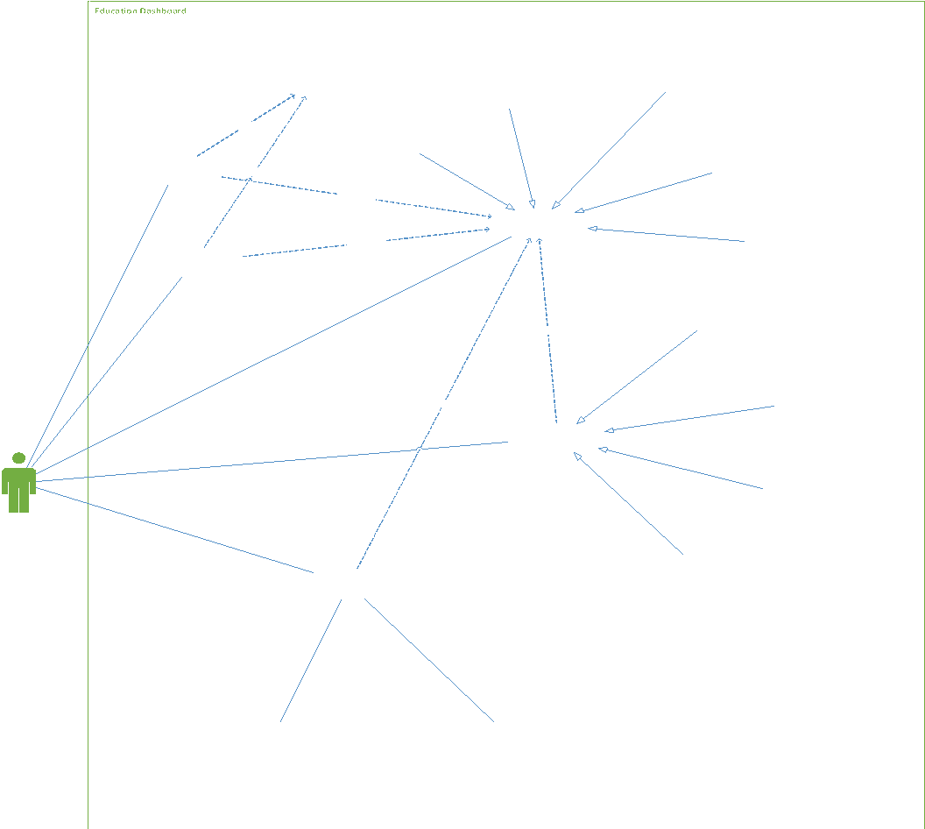
Use Case Diagram

Slide 5
Thank you

