Slide 1
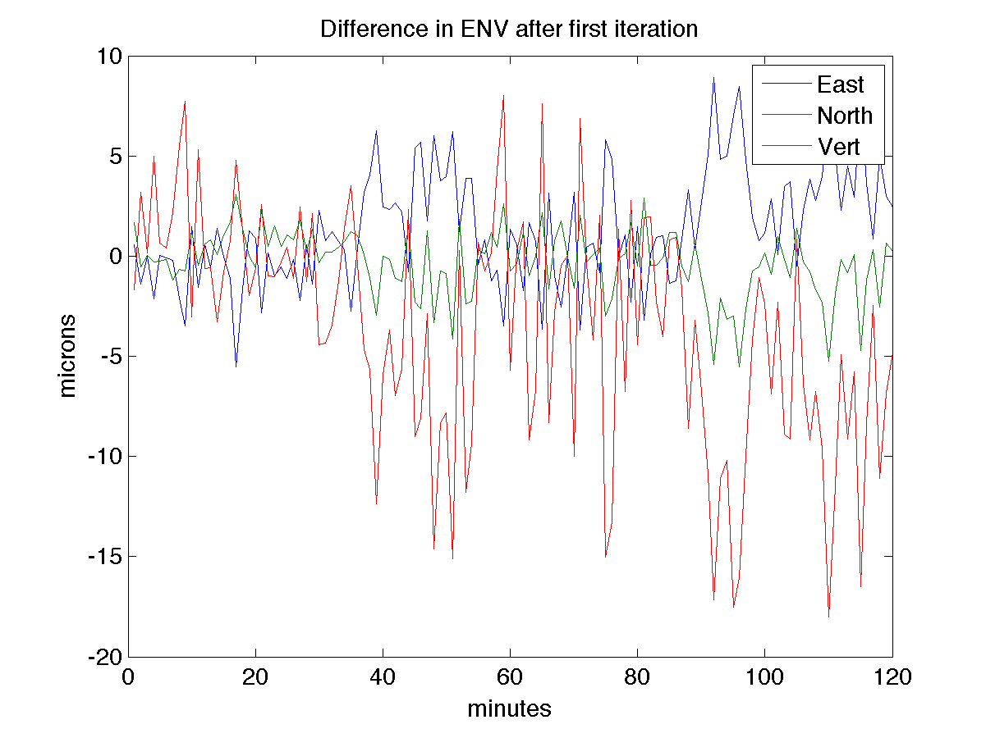

Slide 2
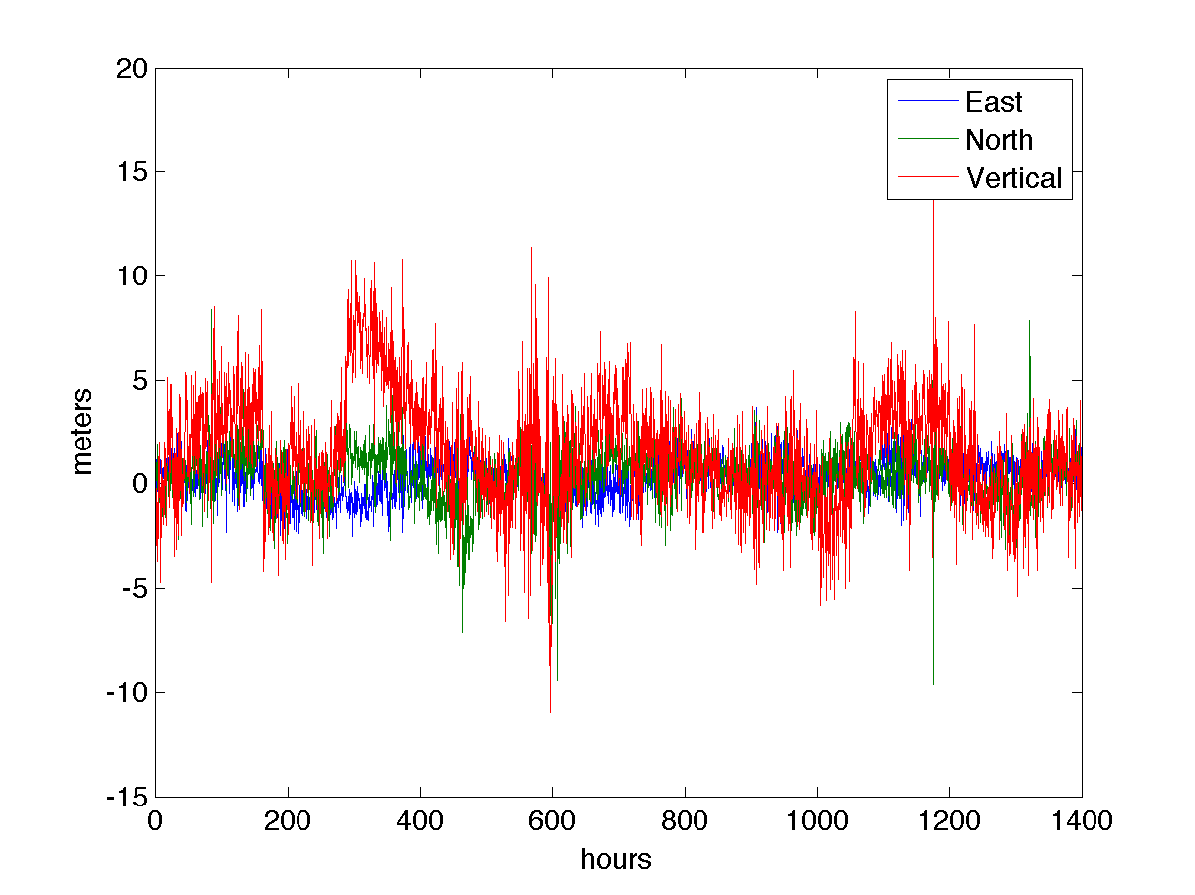
Position Solutions using elevation cutoff of 10 degrees
minutes

Slide 3
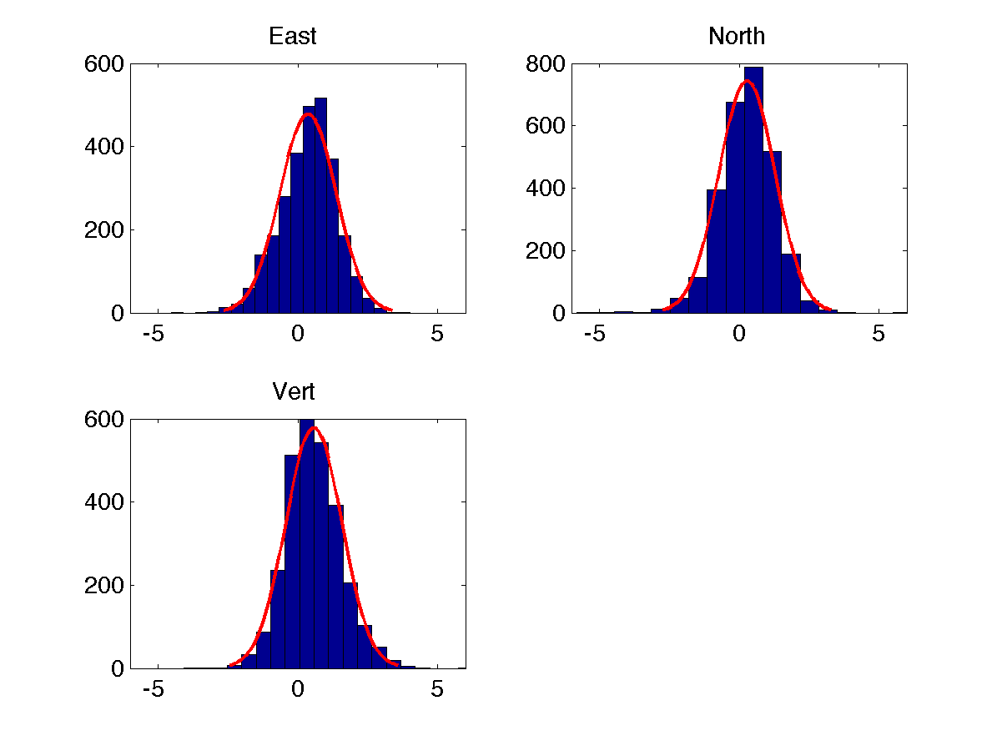
Standard deviations wrt RINEX header
Note: these don’t quite agree with the ariori coordinates. Nor should they.

Slide 4
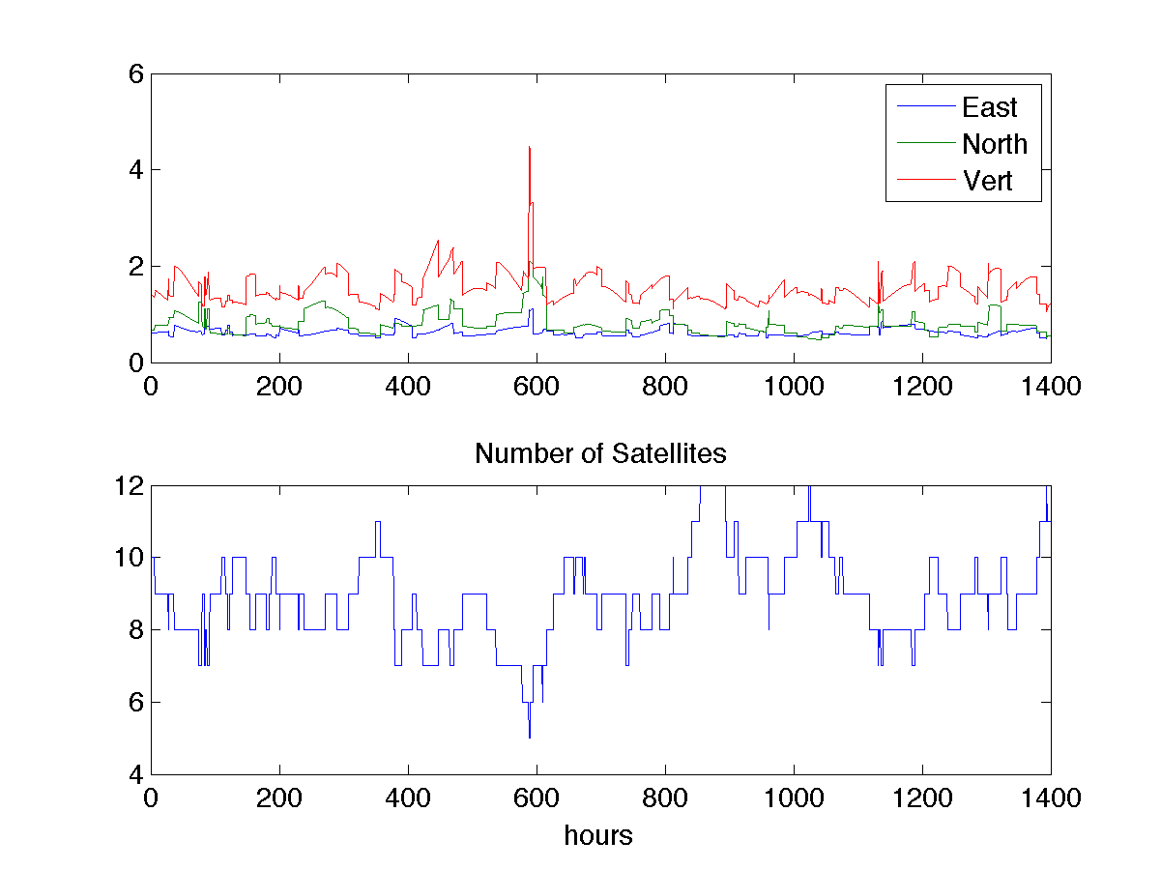
Standard Deviations Assuming 1 meter data error
minutes

Slide 5
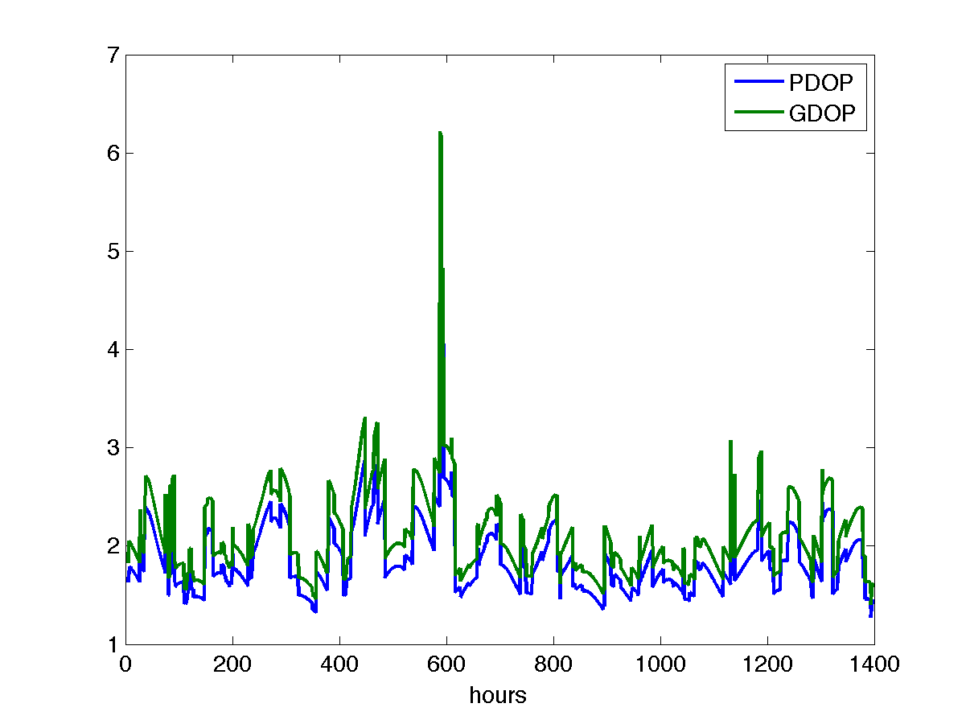
PDOP and GDOP are dimensionless
minutes

Slide 6
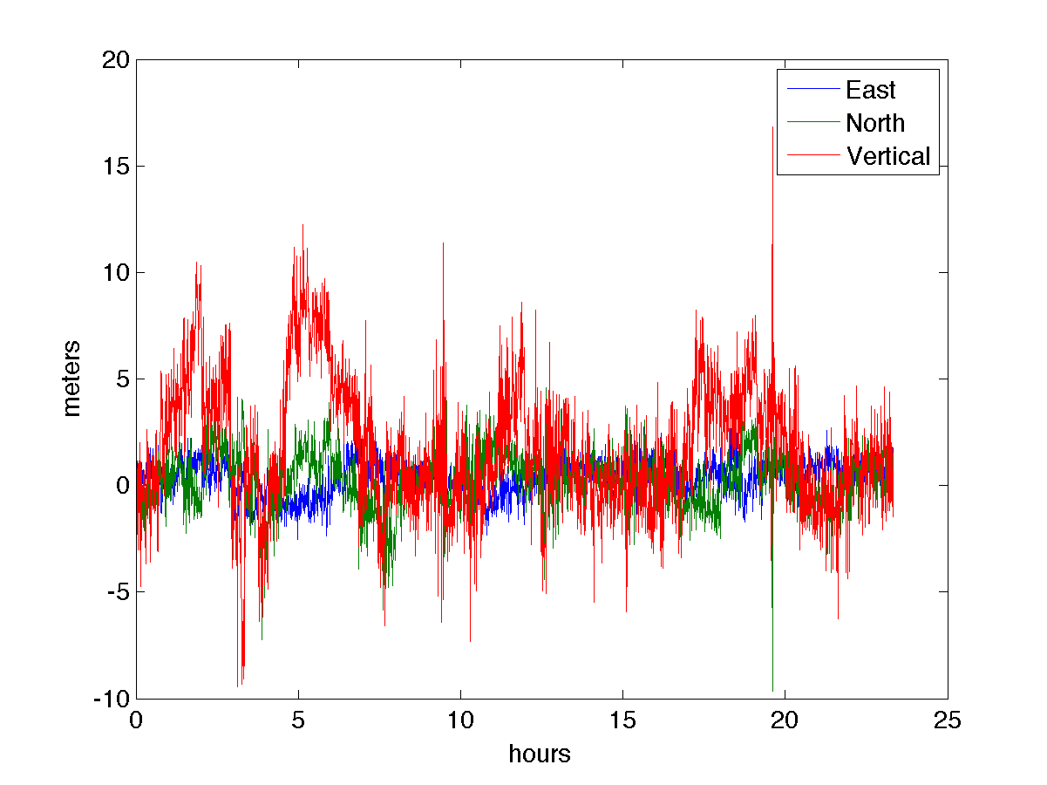
Use 15 degrees instead of 10 degree cutoff

Slide 7
Compare to this – our 10 degree cutoff solution
minutes

Slide 8
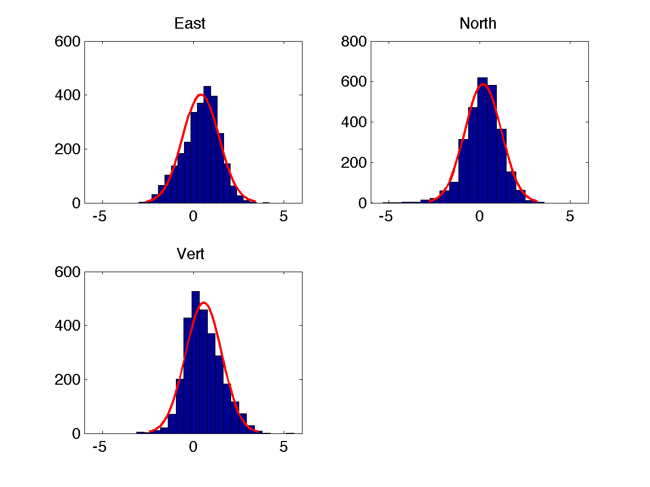
Standard deviations again, wrt
RINEX header coordinates.

Slide 9
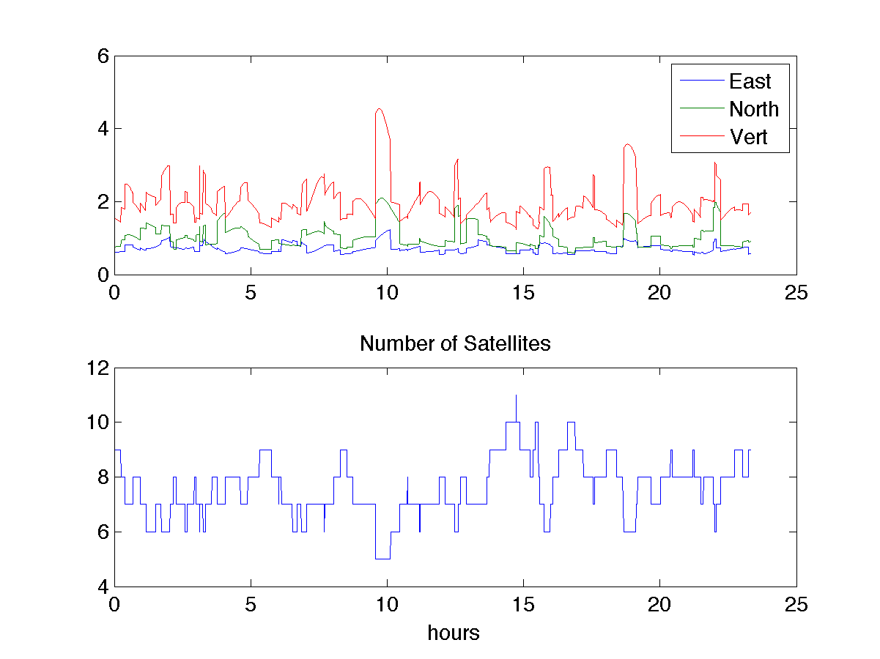
Standard deviations – 15 degree elev. Cutoff – assuming obs error of 1 meter

Slide 10
Standard Deviations Assuming 1 meter data error – 10 degrees
minutes

Slide 11
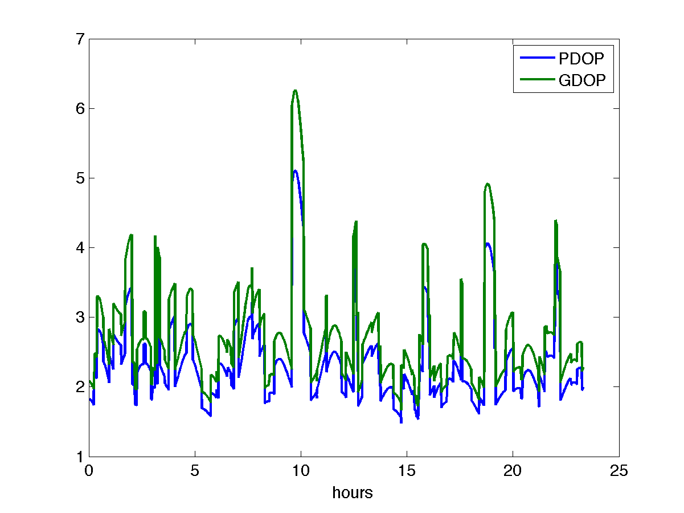
PDOP and GDOP, 15 degree cutoff

Slide 12
minutes

Slide 13
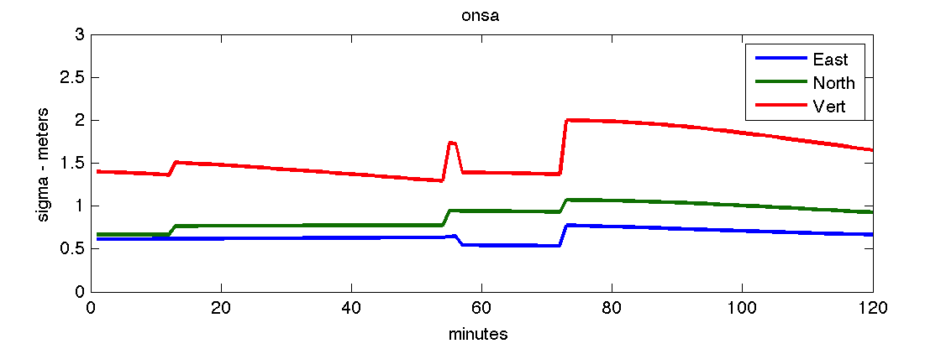
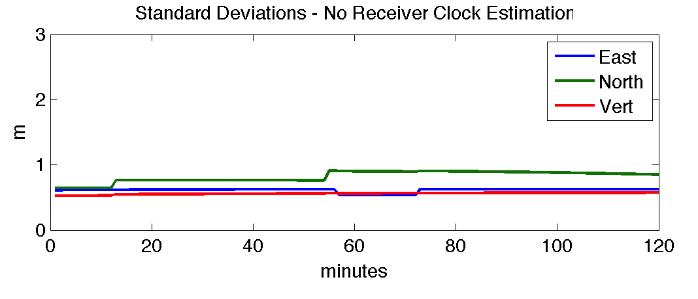
Standard deviation – assuming a receiver clock is estimated each epoch

