Slide 1
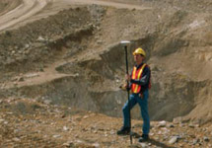
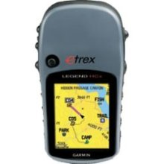
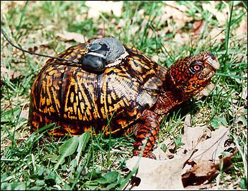
Where are we so far?
ASEN 5090
ASEN 5090 LECTURE NOTES – LARSON, AXELRAD

Slide 2
So far
General background on GPS, history on navigation
Stories
Basics about signal structure (2 main frequencies, called L1 and L2), civilian codes and encrypted military codes. Carriers.
Not emphasized, but there are multiple codes on one carrier, i.e. C/A, P, and the navigation message. Your receiver is smart enough to figure them all out (depending on its encryption status).
Satellites are defined by their PRN (pseudo random noise)
Learned how to generate actual PRN codes
The “distance” between a satellite and receiver is the time shift to line up the received code and an internally generated-code.
Normal people think of latitude,longitude,height, but geodesy and GPS like in a Cartesian frame, specifically a Earth-Centered, Earth-Fixed Reference Frame

Slide 3
Homeworks
Red and blue buses, odometers and bad clocks
Generate C/A codes, determine shifts, correlation properties
Satellite visibility (be able to compute azimuth and elevation angle).
Next: design an experiment, run around with a receiver and test it! Will have two weeks. Try to work in groups of two on campus (but it is not required).
After that, we will start putting together the GPS measurement model, which will be described here. Lectures will pick off one or more of these terms …

Slide 4
GPS Measurement Equation
GPS receiver measures “Pseudorange” by measuring the transit time of the signal:
time of signal reception, (based on receiver clock, can be significantly in error)
time of transmission, encoded in signal by GPS satellite clock (known precisely)

Slide 5
Pseudorange Measurement Model
Measured pseudorange to a satellite is comprised of:
true range
satellite clock error (known)
receiver clock error
relativity
ionosphere and troposphere delays (estimated or measured)
other errors (satellite ephemeris and clock mis-modeling, measurement errors, multipath, receiver noise)

Slide 6
How are C/A or P codes used to measure time delay?
The GPS receiver has the codes for all 32 PRN signals. It can generate them internally and timetag them.
The GPS receiver compares the signal it receives with the codes it generates.
When it finds a match, that identifies which satellite transmitted it.
The amount the codes are shifted by (in time) to make that match determines the transit time (how long it took to get to you) Δτ.
This is what you did with the extra credit.
The signal strength and code rate (chipping rate) impact how precisely Δτ can be determined.

Slide 7
Ranging Accuracy – “Signal in space” contribution
User Range Error (URE)
A measure of the accuracy of the pseudorange along the line-of-sight direction from a particular satellite to the user
Indication of signal quality
Composite of several factors
stability of particular satellite’s clock
predictability of the satellite’s orbit

Slide 8
Position Solution
The position solution involves an equation with four unknowns:
Receiver position (x, y, z) (in what reference frame)
Receiver clock correction (correction to what?)
Position accuracy of ~1 m implies knowledge of the receiver clock to within ~3 ns
GPS accuracy is based almost entirely on knowing satellite orbits and satellite clocks.
Requires simultaneous measurements from at least four satellites
The receiver makes a range measurement to the satellite by measuring the signal propagation delay
A data message modulated on the ranging signal provides the precise location of the satellite and corrections for the satellite clock.

