Slide 1
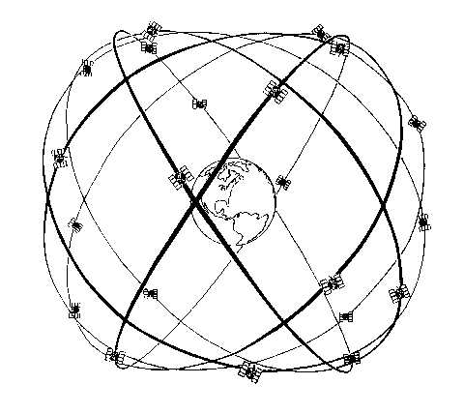
ORBITS IN GNSS
ASEN 5090
ASEN 5090 LECTURE NOTES – LARSON, AXELRAD

Slide 2
Outline
Kepler’s Laws: 2-body motion
Orbital Elements
GPS Constellation
Orbital Perturbations
GPS Broadcast Ephemeris
GPS Precise Orbits

Slide 3
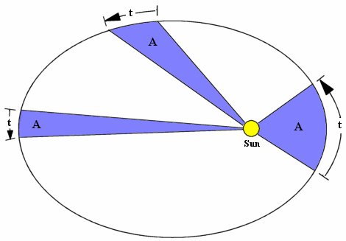
KEPLER’S LAWS
Planet’s Orbit
Describe motion of an object under a central force
Planets take the path of an ellipse, with the Sun at one focus.
The line joining the planet to the sun sweeps out equal areas in equal times.
The square of the orbital period is proportional to the cube of its mean distance to the sun.

Slide 4
KEPLERIAN ORBITAL ELEMENTS

Slide 5
KEPLERIAN ELEMENTS: SIZE & SHAPE
Satellite Location
Central Body

Slide 6
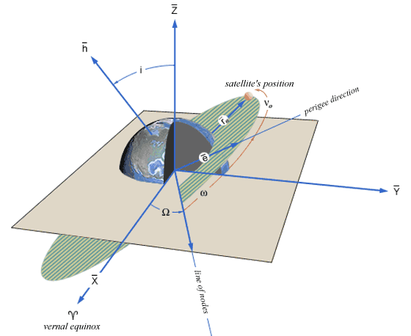
KEPLERIAN ELEMENTS:
ORIENTATION

Slide 7
KEPLERIAN ORBITAL ELEMENTS
Size and shape of the orbit:
Orientation of the orbit:
Position within the orbit (pick one):

Slide 8
KEPLER’S EQUATION
Auxiliary Circle
Satellite Location
Elliptical Orbit
Center
Earth
Periapsis

Slide 9



OTHER STUFF
Auxiliary Circle
Satellite Location
Elliptical Orbit
Center
Periapsis
ae

Slide 10
POSITION WITHIN ORBIT PLANE
Solve Kepler’s equation for E iteratively
Then compute the true anomaly
And the distance from the focus

Slide 11
GPS CONSTELLATION

Slide 12
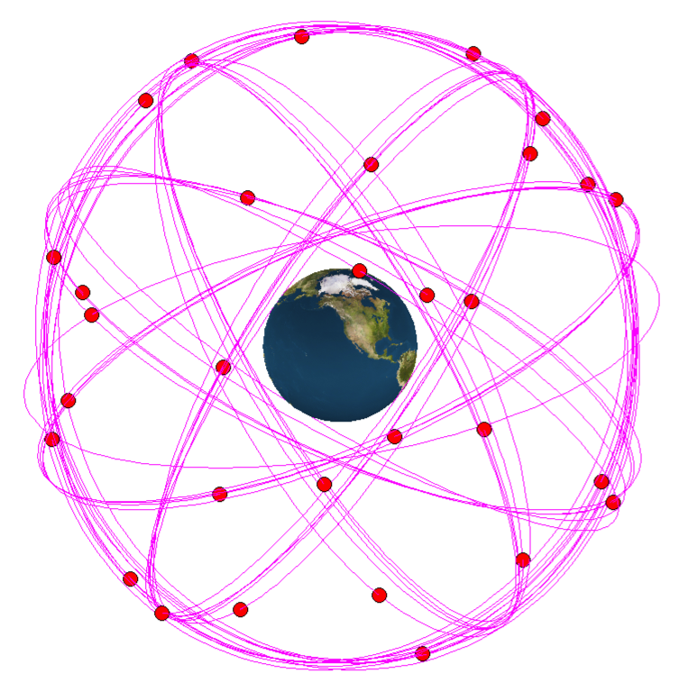
CONSTELLATION
32 active satellites
6 orbital planes
5-6 slots per plane

Slide 13
NOMINAL GPS 24-SATELLITE CONSTELLATION
Slot | RAAN (deg) | Argument of Latitude (deg) | Slot | RAAN (deg) | Argument of Latitude (deg)
A1 | 272.847 | 268.126 | D1 | 92.847 | 135.226
A2 | 272.847 | 161.786 | D2 | 92.847 | 265.446
A3 | 272.847 | 11.676 | D3 | 92.847 | 35.136
A4 | 272.847 | 41.806 | D4 | 92.847 | 167.356
B1 | 332.847 | 80.956 | E1 | 152.847 | 197.046
B2 | 332.847 | 173.336 | E2 | 152.847 | 302.596
B3 | 332.847 | 309.976 | E3 | 152.847 | 66.066
B4 | 332.847 | 204.376 | E4 | 152.847 | 333.686
C1 | 32.847 | 111.876 | F1 | 212.847 | 238.886
C2 | 32.847 | 11.796 | F2 | 212.847 | 345.226
C3 | 32.847 | 339.666 | F3 | 212.847 | 105.206
C4 | 32.847 | 241.556 | F4 | 212.847 | 135.346
Semimajor axis = 26559.7 km, inclination = 55 deg, eccentricity = 0
Defined Epoch: 0000Z, 1 July 1993; Greenwich Hour Angle: 18 h 36 min 14.4 s referenced to FK5/J2000.00 coordinates

Slide 14
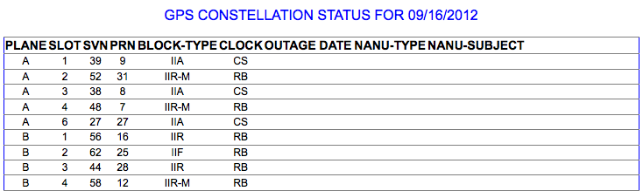
CURRENT CONSTELLATION STATUS
http://www.navcen.uscg.gov/?Do=constellationStatus

Slide 15
PERTURBATIONS

Slide 16
Keplerian Elements are fine and good, but we have learned some things since Kepler was around

Slide 17
ORBITAL PERTURBATIONS FOR THE GPS ORBIT (central force is ~0.5 m/s²)
Source | Acceleration m/s² | Perturbation | Type
Earth oblateness (J₂ ) | 5 x 10⁻⁵ | 2 km @ 3 hrs | secular + 6 hr
Sun & moon | 5 x 10⁻⁶ | 5-150 m @ 3 hrs | secular + 12hr
Higher Harmonics | 3 x 10⁻⁷ | 5-80 m @ 3 hrs | Various
Solar radiation pressure | 1 x 10⁻⁷ | 100-800 m @2 days | Secular + 3 hr
Ocean & earth tides | 1 x 10⁻⁹ | 0-2m @2 days | secular + 12hr
Earth albedo pressure | 1 x 10⁻⁹ | 1-1.5m @2 days

Slide 18
GPS BROADCAST EPHEMERIS

Slide 19
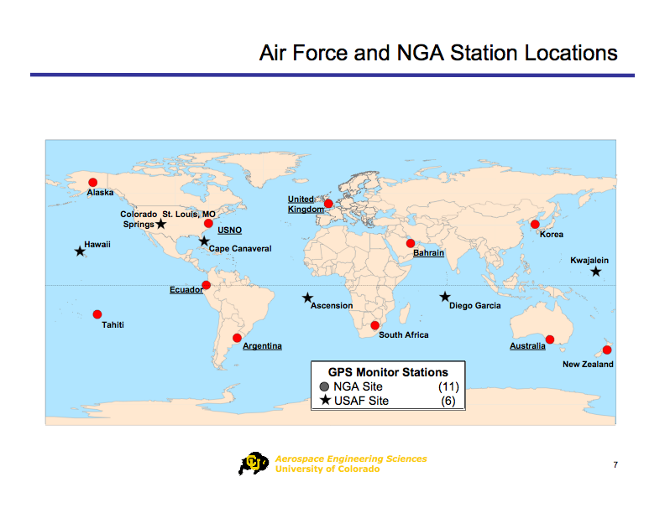

Slide 20
GPS SATELLITE ORBIT DETERMINATION
Control segment collects range measurements at monitoring stations
Uses precise orbit determination software including high-fidelity models of perturbations to estimate position and velocity (and clocks and many other parameters) of the satellites
Representation of the orbit in the broadcast message is a quasi-Keplerian parameterization that fits best over a 2 hour segment
toe – time of ephemeris, IODE – issue of data ephemeris
Keplerian elements
2 drift rates & Δn
6 coefficients for harmonic corrections

Slide 21
BROADCAST EPHEMERIS
M₀ Mean anomaly at reference time
Δn Mean motion difference
√a Square root of semi-major axis
Ω₀ Longitude of ascending node at weekly epoch
I₀ Inclination angle at reference time
ω Argument of perigee
Ω Rate of right ascension
e Eccentricity
IDOT Rate of inclination angle
C_{uc} Cosine term, argument of latitude
C_{rc} Cosine term, radius
C_{ic} Cosine term, inclination
C_{us} Sine term, argument of latitude
C_{rs} Sine term, radius
C_{is} Sine term, inclination
t_{oe} Ephemeris reference time
.

Slide 22
WGS84 (GPS) gravitational parameter for GPS ephemeris users
WGS84 (GPS) earth rotation rate
Computed mean motion
Time from reference epoch (seconds)
Corrected mean motion
Mean anomaly
Kepler’s Equation
True anomaly
Argument of latitude
Argument of latitude correction
Radius correction
Inclination correction
Corrected argument of latitude
Corrected radius
Corrected Inclination

Slide 23
ECEF GPS SATELLITE POSITION
Positions in orbital plane:
Corrected longitude of ascending node:
Earth-fixed coordinates (ECEF):

Slide 24
GPS PRECISE EPHEMERIS

Slide 26
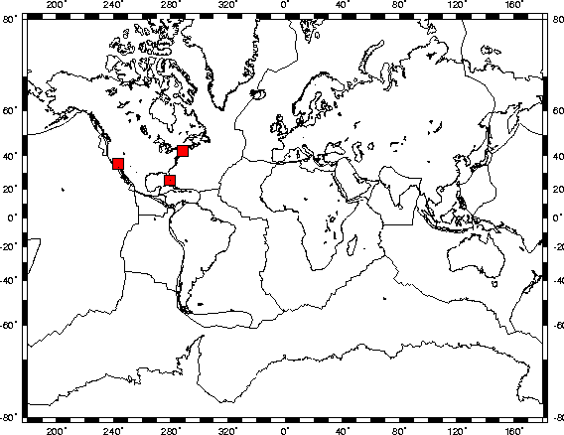
First Civilian Global Tracking Network

Slide 27
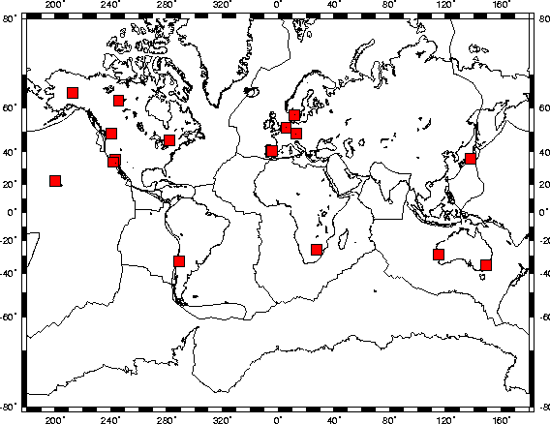
1991

Slide 28
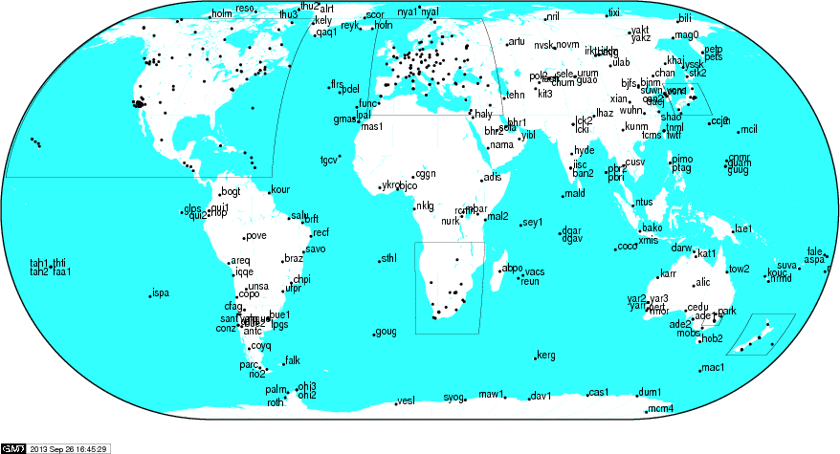
Today

Slide 29
What do you need to do to make a 1 cm (radial precision) orbit instead of a 1 meter orbit?

Slide 30
Source | Acceleration m/s² | Perturbation | Type
Earth oblateness (J₂ ) | 5 x 10⁻⁵ | 2 km @ 3 hrs | secular + 6 hr
Sun & moon | 5 x 10⁻⁶ | 5-150 m @ 3 hrs | secular + 12hr
Higher Harmonics | 3 x 10⁻⁷ | 5-80 m @ 3 hrs | Various
Solar radiation pressure | 1 x 10⁻⁷ | 100-800 m @2 days | Secular + 3 hr
Ocean & earth tides | 1 x 10⁻⁹ | 0-2m @2 days | secular + 12hr
Earth albedo pressure | 1 x 10⁻⁹ | 1-1.5m @2 days
ASEN 5090 Axelrad and Larson
30

Slide 31
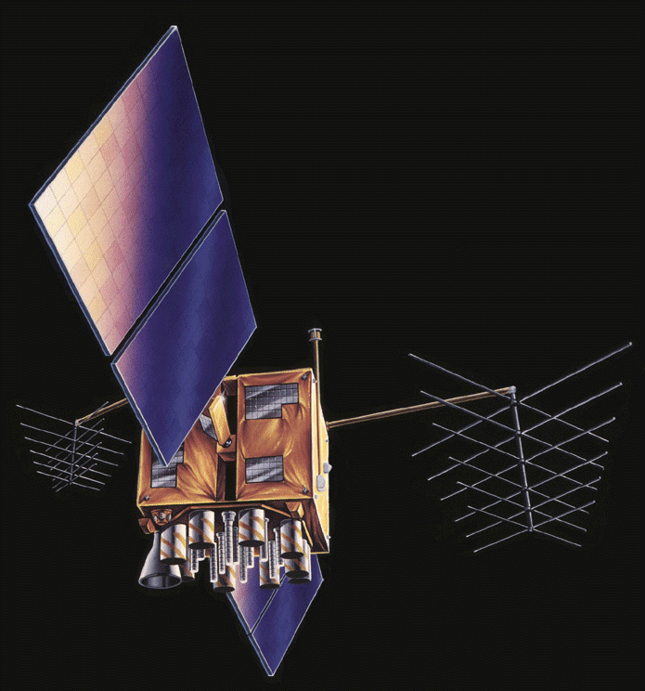

Slide 32
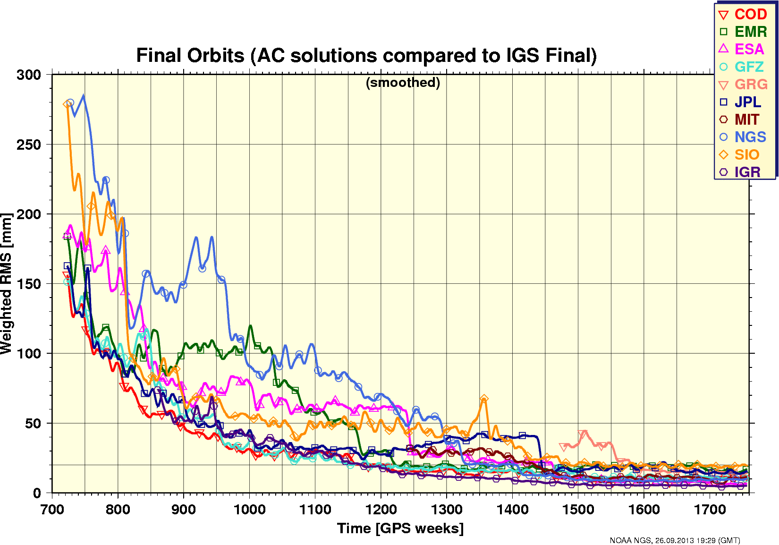

Slide 33
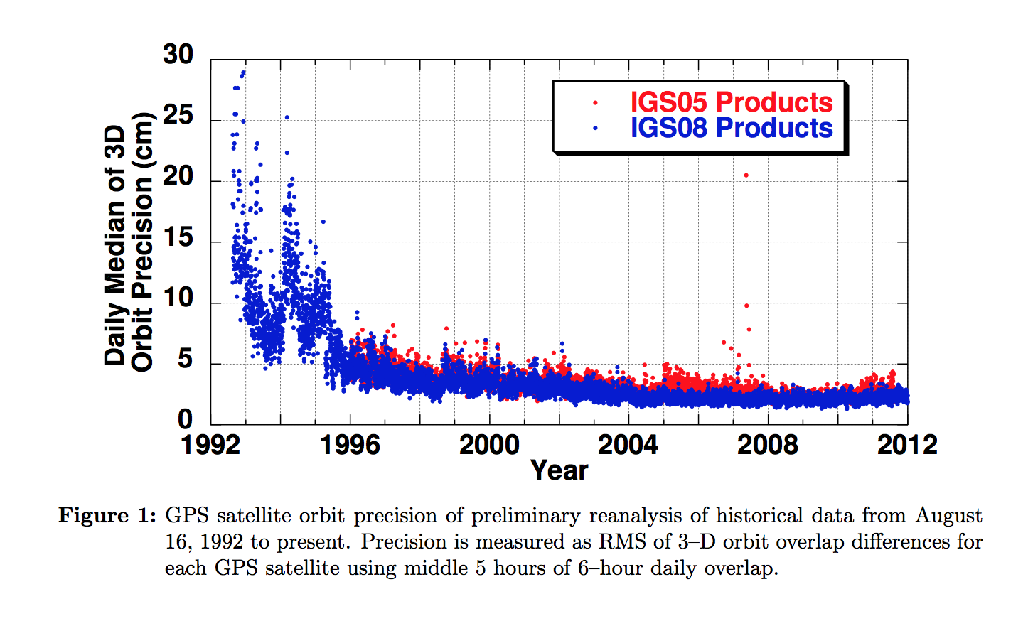

Slide 34
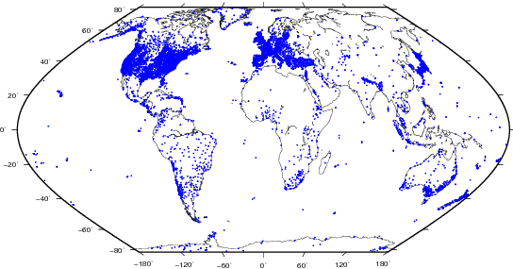
FYI: All sites (nearly)

Slide 35
GPS DISPOSAL ORBITS
Satellites no longer actively transmitting are transitioned to LADO (Launch and disposal operations) system
When a GPS satellite is no longer useful it is boosted to a disposal/parking orbit 500 km above the constellation
Over long term, resonance effects of sun, moon produce an increase in eccentricity which causes satellites to cross through operational constellations
Recommendation was made to carefully circularize satellite orbits after boosting to disposal orbit but there are logistics issues with how much fuel is left and what to do with it.
Simulations* show that non-operational GLONASS satellites will cross the GPS operational altitude within 40 years.
*C.C. Chao, R.A. Gick, “Long-term evolution of navigation satellite orbits: GPS/GLONASS/GALILEO,” Advances in Space Research, 34 (2004) 1221-1226

