Slide 1
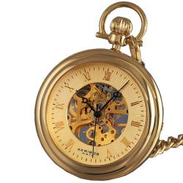
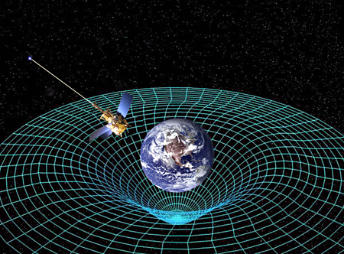
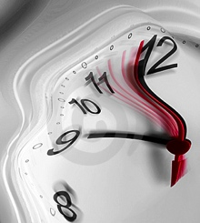
Time, Clocks, and Relativity
ASEN 5090
ASEN 5090 LECTURE NOTES – LARSON, AXELRAD

Slide 2
Outline
Overview on significant figures on Wednesday.
Goal
May delay midterm (lost time from the flood and my cold)
Will upload homework 5 (done individually)
Observable equation

Slide 3
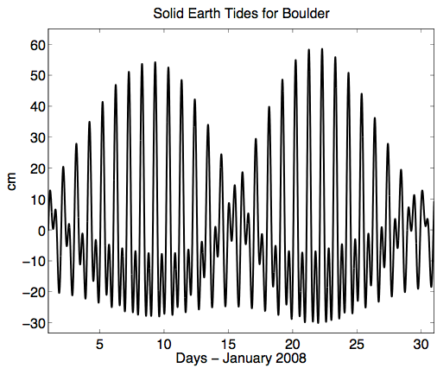
Tides

Slide 4
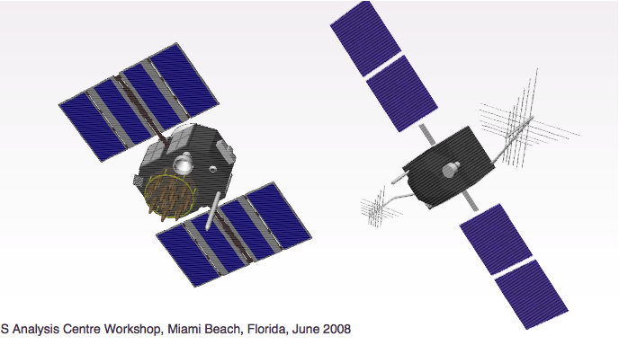
Low Bidder

Slide 5
Outline for Clocks and Relativity
Time Systems and Leap Seconds
Clocks
Relativistic Corrections

Slide 6
TIME SYSTEMS

Slide 7
TIME SYSTEMS
UTC (Coordinated Universal Time): an atomic timescale that is the primary time standard for civil time around the world. Time at Greenwich. Kept by atomic clocks around the world. USNO and NIST keep UTC for the United States.
UT1: mean solar time at 0deg longitude. Based on rotation rate of Earth. Computed from observations of quasars. UTC is kept to within 0.9 seconds of UT1 through leap seconds.
GPS: an atomic timescale used by GPS satellites. It has a constant offset with TAI of 19 seconds. The difference between GPS and UTC grows with the introduction of leap seconds to UTC.
TAI (International Atomic Time): atomic time standard based on passage of proper time on Earth’s geoid. This is the basis for UTC. TAI is a weighted average of over 200 atomic clocks in over 50 national laboratories.

Slide 8
COORDINATED UNIVERSAL TIME (UTC)
Coordinated Universal Time (UTC) uses the SI second for interval, but is adjusted by leap seconds to stay close to UT1.
Set UTC = UT1 on Jan 1, 1958
Leap seconds are introduced usually at the end of June or December to keep UTC-UT1 < .9 sec http://hpiers.obspm.fr/iers/bul/bulc/bulletinc.dat
UTC is determined based on cooperation between 65 labs and 250 clocks (but dominated by the US contribution).
In the US we have UTC(NIST) and UTC(USNO). They are NOT the same.

Slide 9
GPS TIME
Defined like UTC, it is based on a group or ensemble of clocks. These include clocks located at the MCS in Colorado Springs and the GPS satellite clocks (but not weighted very heavily)
GPS Time done more quickly than UTC (daily) and it does not have leap seconds
GPS Time steered to remain within 1 microsec of UTC(USNO) modulo 1 sec (but in reality it is much much much better).
As of July 2012 – GPST-UTC(USNO) = +16s
Correction from GPST to UTC(USNO) given in the navigation message.

Slide 10
LEAP SECONDS
Leap Second: a 1-second adjustment applied to UTC on occasion to keep UTC within 0.9 seconds of UT1 (mean solar time).
One mean solar day is slightly longer than 24 hours. Without leap seconds, UTC would slowly drift apart from UT1.
Irregularly spaced and unpredictable
2008 Dec 31 23 59 58
23 59 59
23 59 60
2009 Jan 01 00 00 00
00 00 01
positive leap second

Slide 11
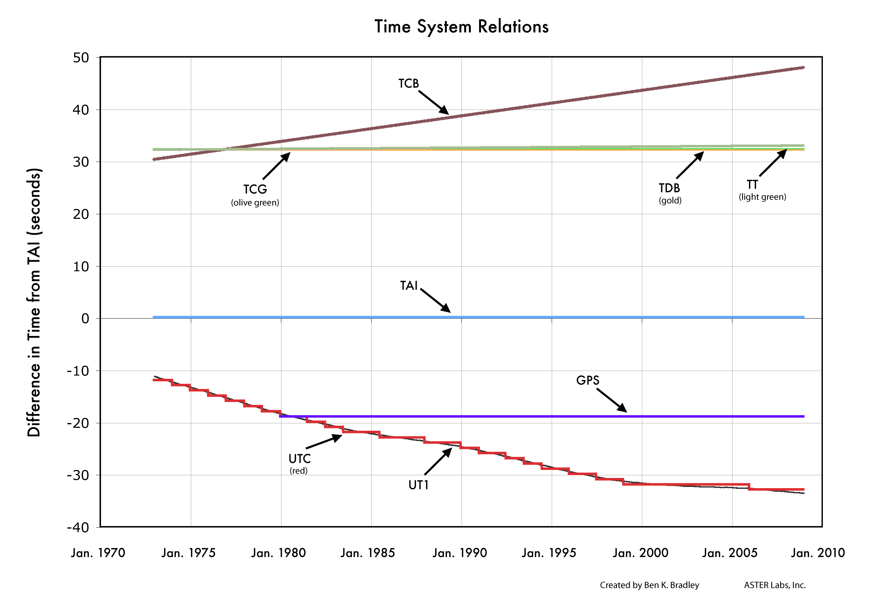
TIME SYSTEM RELATIONS
Image Credit: B.K. Bradley, ASTER Labs Inc.

Slide 12
CLOCKS

Slide 13
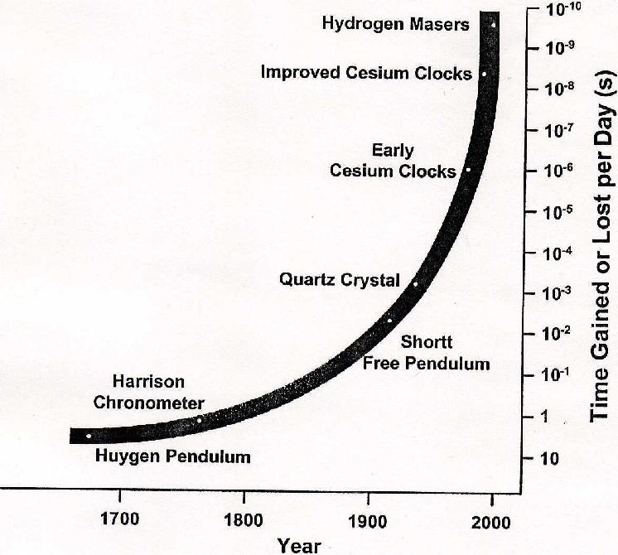
CLOCK HISTORY

Slide 14
ATOMIC CLOCKS
GPS satellites use atomic clocks: a precision clock that depends for its operation on an electrical oscillator regulated by the natural vibration frequencies of an atomic system (as a beam of cesium atoms)
Types of atomic clocks on GNSS satellites (taken from How Things Work)
Cesium atomic clocks employ a beam of cesium atoms. The clock separates cesium atoms of different energy levels by magnetic field. Not used on modern satellites.
Hydrogen atomic clocks maintain hydrogen atoms at the required energy level in a container with walls of a special material so that the atoms don't lose their higher energy state too quickly.
Rubidium atomic clocks, the simplest and most compact of all, use a glass cell of rubidium gas that changes its absorption of light at the optical rubidium frequency when the surrounding microwave frequency is just right.
You do not need to use an atomic clock for your ground receiver, but you can if you want to.
Useful info:
1 millisec ~ 300 km
1 microsec ~ 300 meters
1 nanosec ~ 300 mm

Slide 15
Why is Cs so frequently used in atomic clocks?
The SI unit of time, defined as the duration of 9,192,631,770 periods of radiation corresponding to the transition between two hyperfine levels of cesium-133 in a ground state at a temperature of absolute zero and at rest.
Continuous time scale based on SI second – International Atomic Time (TAI): This drifts off from UT1!

Slide 16
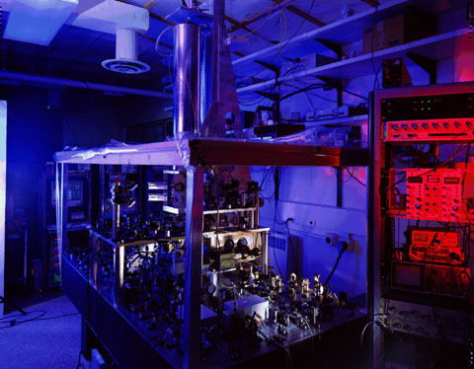
NIST-F1 Cesium Fountain Atomic Clock
The Primary Time and Frequency Standard for the United States
Right here across Broadway Avenue.

Slide 17
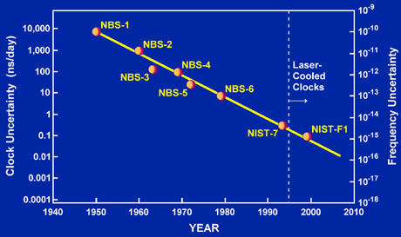
http://tf.nist.gov/timefreq/cesium/fountain.htm
As of the summer of 2010, the uncertainty has been reduced to about 3 x 10-16,
This means it would neither gain nor lose a second in more than 100 million years!

Slide 18
CLOCK HISTORY

Slide 19
UTC(NIST) and UTC(USNO)
Both NIST and USNO have a group of clocks that keep track of time for the Unites States
Both clock ensembles contribute to TAI and UTC which are paper clocks (note real-time)
The two ensembles are generally within 20 ns of each other
USNO keeps track of official time for the Department of Defense
But more importantly, who defines time for GPS?

Slide 20
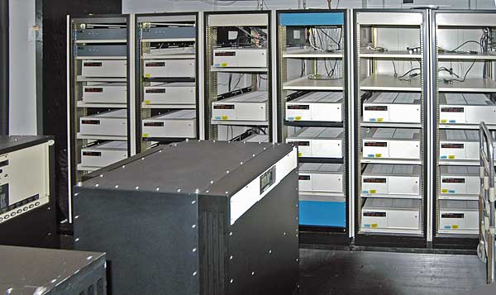
GPS MASTER CLOCK AT USNO
http://tycho.usno.navy.mil/mc_to.html
The atomic clock timescale of the USNO is based on an ensemble of ~ 30 cesium-beam frequency standards and a dozen hydrogen masers.
Frequency data from this ensemble are used to steer the frequency of another such maser, designated Master Clock 2 (MC #2), until its time equals the average of the ensemble.
The reference of the actual Master Clock is called UTC (USNO).
UTC (USNO) is usually kept within
10 nanoseconds of UTC.
The Alternate Master Clock lives at
the GPS Master Control Station in
Colorado Springs (Schriever AFB).

Slide 21
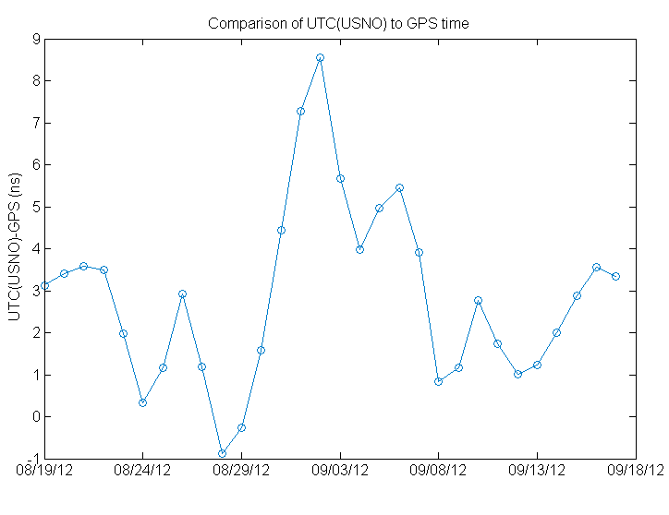
UTC(USNO) versus GPS Time
GPS time is based on the clocks at all the GPS monitoring stations and the satellite clocks
It is steered to UTC(USNO)

Slide 22
GPS SATELLITE CLOCKS
GPS has flown both rubidium (Rb) and cesium (Cs) oscillators onboard, which are very stable.
After Block II-A, only rubidium clocks were used due to better short term performance. They are now going back to launching Cs as well.
Clocks are constantly monitored by the control segment.
Part of the navigation or data message includes clock correction information.
Precise vs. Broadcast Satellite Clocks
Precise vs. Broadcast Satellite Clocks-Residual

Slide 23
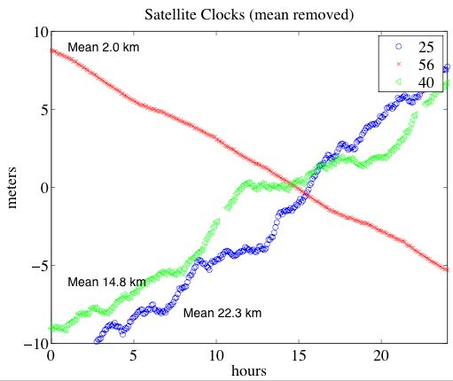
OTHER EXAMPLES

Slide 24
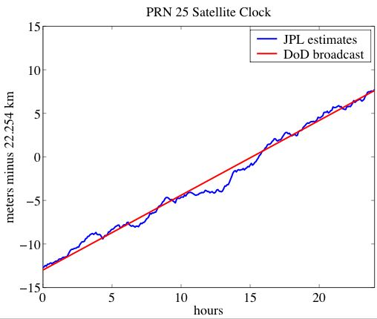
Clock Model in Broadcast Message
Three parameters (a_{f0}, a_{f1}, and a_{f2}) in the navigation message for satellite clock corrections.
Δt = a_{f0} + a_{f1}(t-toe) + a_{f2}(t-toe)², where toe is time of ephemeris.
a_{f0} can be up to 1 ms
a_{f1} ~ 10⁻¹¹
a_{f2} is always zero due to
resolution issues in the
broadcast message

Slide 25
BROADCAST CLOCK CORRECTION
Example: January 1 in 1995, at hour 4, PRN 1
Here is the navigation file entry:
1 95 1 1 4 0 0.0-0.651767477393D-04-0.216004991671D-11 0.000000000000D+00
0.162000000000D+03-0.243750000000D+01 0.507914013800D-08 0.202024096651D+01
-0.763684511185D-07 0.329352484550D-02 0.481866300106D-05 0.515357784653D+04
0.144000000000D+05 0.800937414169D-07 0.158705269528D+01 0.409781932831D-07
0.954013052302D+00 0.283531250000D+03-0.124439152688D+01-0.818248369043D-08
0.782175437889D-10 0.100000000000D+01 0.782000000000D+03 0.000000000000D+00
0.320000000000D+02 0.000000000000D+00 0.139698386192D-08 0.418000000000D+03
0.880800000000D+04 0.000000000000D+00 0.000000000000D+00 0.000000000000D+00
The values you need are:
clock bias (a0) of -0.651767477393D-04 sec, clock drift (a1) of -0.216004991671D-11 sec/sec
toe is 14400
If you want the satellite clock correction at t=toe
clock correction = c* -0.651767477393D-04 = -19.53949740921 km
At t=14400 + 3600 = 1800 (i.e. 1 hour later)
clock correction = c*(-0.651767477393D-04 + -0.216004991671D-11*3600) = -19.541828649 km

Slide 26
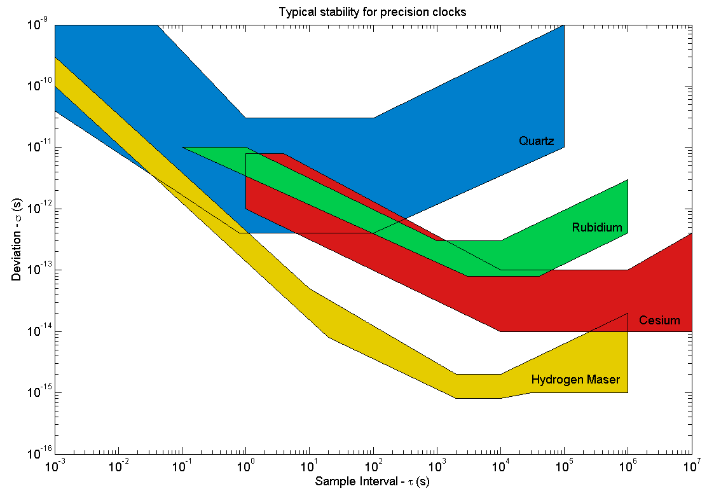
CLOCK STABILITY
Minute
Hour
Month
Day

Slide 27
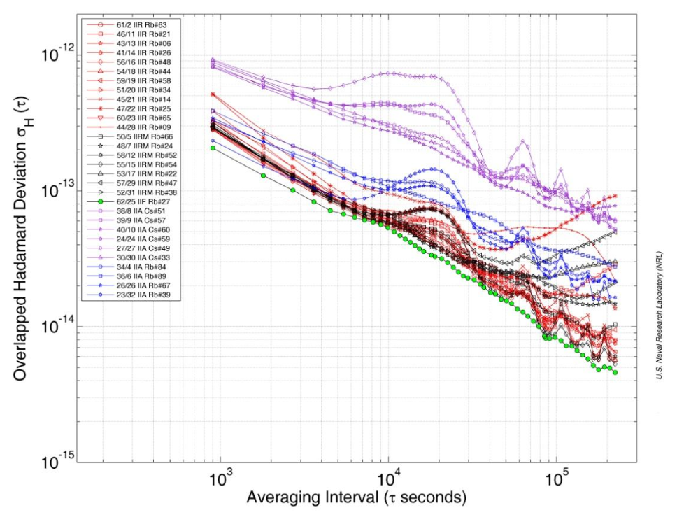
Block IIA Cesium clocks much noisier
From “GPS Block IIF Atomic Frequency Standard Analysis”
Vannicola et al., 42nd Annual PTTI Meeting

Slide 28
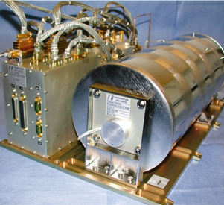
ADVANCES IN SATELLITE CLOCK TECHNOLOGY
The Hydrogen Maser has been chosen as the Master clock in the Galileo
Navigation Payload. The Passive
Maser can guarantee stability
performances within the Galileo
requirements for more than
eight hours without any
correction/upload from ground.
The newest GPS Block II-F satellites,
however, may provide nearly equivalent
performance (using updated Rubidiums).
See “Flight Characterization of New
Generation GNSS Satellite Clocks”,
Montenbruck et. al, ION GNSS 2011

Slide 29
RECEIVER CLOCKS
Receiver clocks are of three classes:
Clocks which are allowed to drift
Clocks that are steered to keep synchronization with GPS Time
Clocks that are allowed to drift with respect to GPS Time, within some tolerance - and then reset internally.
As a general rule, no geodetic quality receivers are allowed to drift very much - because there is a lot to be gained by synchronizing observations. Steering and resetting class receivers are more common.

Slide 30
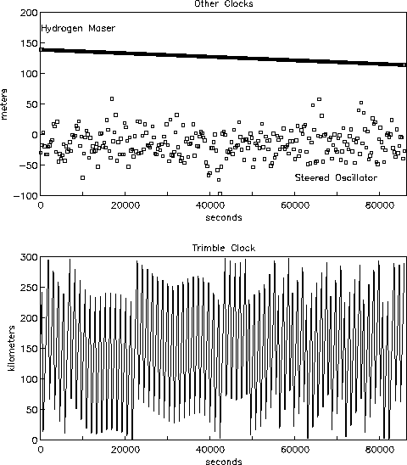
STEERING AND RESETING CLOCKS

Slide 31
CLOCK AND TIMING REVIEW
SI second is defined via Cs atoms.
GPS satellites use Cs and Rb atomic clocks. Galileo is launching H masers.
GPS time does not have leap seconds, so differs from UTC by an integer number of seconds (currently 16).
Timing between satellites is coordinated by the Master Control Station, whose time is coordinated with UTC (USNO).
Master Control Station broadcasts linear corrections for satellite clocks every ~2 hours. This doesn’t mean atomic clock behavior is linear.

Slide 32
CLOCK AND TIMING REVIEW
Receivers are usually built with an inexpensive oscillator; the receiver steers the oscillator to stay within 1 millisec of GPS time. (1 millisec = 300 km).
You can typically tell how tight the steering is by examining the scatter on the receiver clock solutions.
With the appropriate receiver, you can use an external oscillator (i.e. Rb, Cs, H). This could be helpful for position solutions.
This external timing piece might not agree very well with GPS time.
Cables?

Slide 33
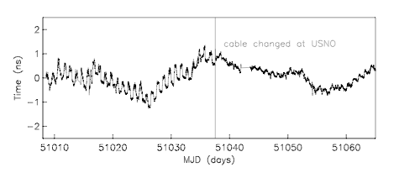
CABLES

Slide 34
HISTORICAL TIMING ISSUE: SELECTIVE AVAILABILITY
From 1990 (1991) thru May 1, 2000, the DoD intentionally dithered the GPS signals.
This is known as selective availability (SA)
Instead of f₀=10.23 MHz, there was an unknown frequency added to this.
With special "keys" the effects of SA could be removed in real-time.
Since time <=> position, the impact of SA was degraded positions in real-time.
In September 2007, announced that future satellites would not have SA capability

Slide 35
RELATIVITY

Slide 36
RELATIVISTIC EFFECTS ON GPS CLOCKS
Sagnac Effect – rotation of receiver during transit time of signal (being careful about coordinate frame)
According to special relativity, a clock aboard a satellite traveling at constant speed appears to lose time relative to a clock on the Earth.
According to general relativity, a clock on a satellite would run faster than one on the Earth due to the difference in gravitational potential.
Average net effect for GPS is that the clock gains 38.4 μsec/day.
Recall a μsec is ~ 300 meters.
To compensate, the fundamental frequency, which we define as 10.23 MHz, is set 0.00455 Hz lower.

Slide 37
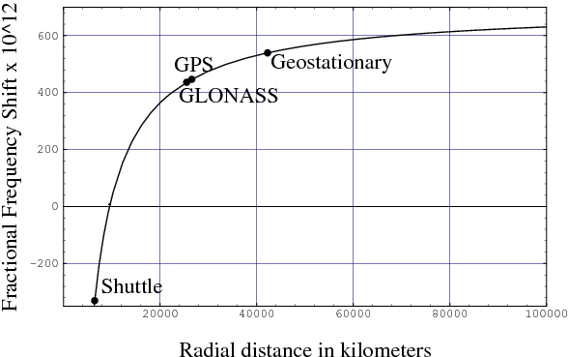
Net frequency shift of a clock in a circular orbit
http://www.livingreviews.org/lrr-2003-1 Figure 2

Slide 38
RELATIVISTIC CORRECTION FOR ELLIPTICAL ORBIT
GPS orbits are nearly but not exactly circular. An additional relativity correction (or effect?) that compensates for the eccentricity of the orbit is

Slide 39
This is for GRACE – GPS correction is much smaller

Slide 40
RELATIVISTIC CORRECTIONS

