Slide 1
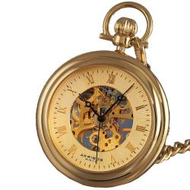
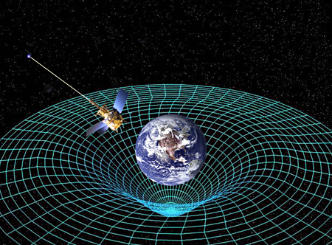
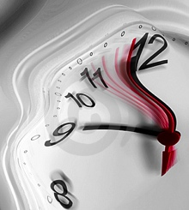
Time, Clocks, and Relativity
ASEN 5090
ASEN 5090 LECTURE NOTES – LARSON, AXELRAD

Slide 2
From the news
Revnivykh also said that Russia was studying ways to extend the constellation for more coverage, including the possibility of adding six satellites spread over three planes. However, the design of the navigation message however, is currently limiting what Roscosmos can do. The current message is only structured for a 24-satellite constellation due to a limited number of reserved subframes and would have to be changed. Introduction of CDMA signals are planned, initially on the GLONASS L3 and later on the GNSS band centered at 1575 MHz.
That is not an immediate issue, Revnivykh added, because the GLONASS program has lost a total of six planned satellites in launch failures over the past two years and is now working to catch up. A decision on whether to go to more that 24 satellites would not therefore come up before 2020. Even then, he said, it is not sure that Russia would elect to do expand the system.
“Perhaps we don’t need more that 24 (satellites) when we have four global systems,” Revnivykh said. “Perhaps we can find a way to work together because it’s not so cheap.”

Slide 3
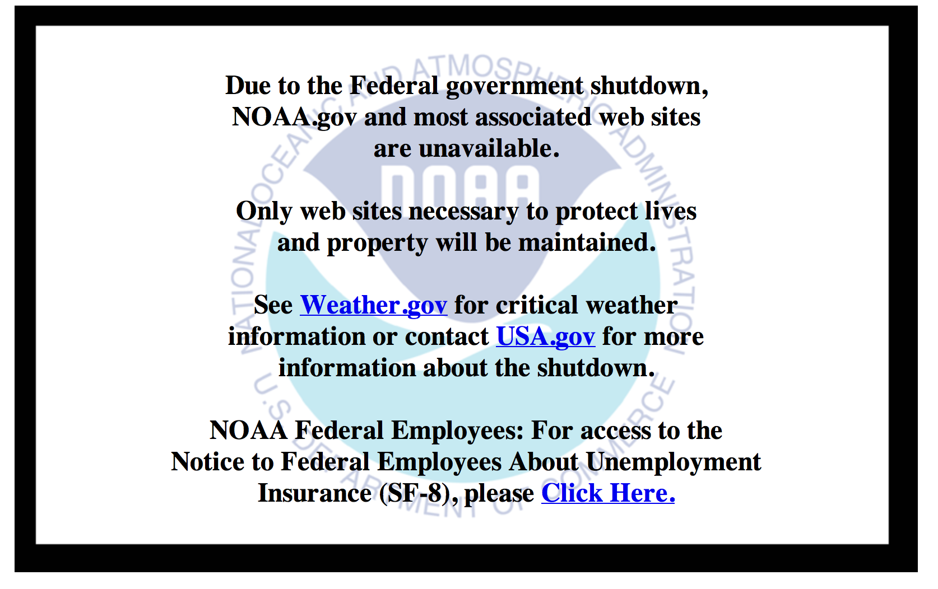
And when I went to pick up some slides to show you today

Slide 4
Announcements
Midterm delayed one week

Slide 5
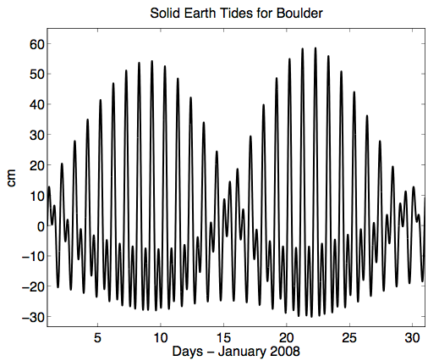
Tides

Slide 6
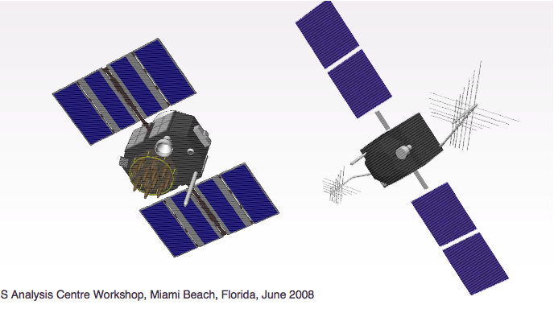
Low Bidder

Slide 7
Outline for Clocks and Relativity
Time Systems and Leap Seconds
Clocks
Relativistic Corrections

Slide 8
TIME SYSTEMS

Slide 9
TIME SYSTEMS
UTC (Coordinated Universal Time): an atomic timescale that is the primary time standard for civil time around the world. Time at Greenwich. Kept by atomic clocks around the world. USNO and NIST keep UTC for the United States.
UT1: mean solar time at 0deg longitude. Based on rotation rate of Earth. Computed from observations of quasars. UTC is kept to within 0.9 seconds of UT1 through leap seconds.
GPS: an atomic timescale used by GPS satellites. It has a constant offset with TAI of 19 seconds. The difference between GPS and UTC grows with the introduction of leap seconds to UTC.
TAI (International Atomic Time): atomic time standard based on passage of proper time on Earth’s geoid. This is the basis for UTC. TAI is a weighted average of over 200 atomic clocks in over 50 national laboratories.

Slide 10
COORDINATED UNIVERSAL TIME (UTC)
Coordinated Universal Time (UTC) uses the SI second for interval, but is adjusted by leap seconds to stay close to UT1.
Set UTC = UT1 on Jan 1, 1958
Leap seconds are introduced usually at the end of June or December to keep UTC-UT1 < .9 sec http://hpiers.obspm.fr/iers/bul/bulc/bulletinc.dat
UTC is determined based on cooperation between 65 labs and 250 clocks (but dominated by the US contribution).
In the US we have UTC(NIST) and UTC(USNO). They are NOT the same.

Slide 11
GPS TIME
Defined like UTC, it is based on a group or ensemble of clocks. These include clocks located at the MCS in Colorado Springs and the GPS satellite clocks (but not weighted very heavily)
GPS Time done more quickly than UTC (daily) and it does not have leap seconds
GPS Time steered to remain within 1 microsec of UTC(USNO) modulo 1 sec (but in reality it is much much much better).
As of July 2012 – GPST-UTC(USNO) = +16s
Correction from GPST to UTC(USNO) given in the navigation message.

Slide 12
LEAP SECONDS
Leap Second: a 1-second adjustment applied to UTC on occasion to keep UTC within 0.9 seconds of UT1 (mean solar time).
One mean solar day is slightly longer than 24 hours. Without leap seconds, UTC would slowly drift apart from UT1.
Irregularly spaced and unpredictable
2008 Dec 31 23 59 58
23 59 59
23 59 60
2009 Jan 01 00 00 00
00 00 01
positive leap second

Slide 13
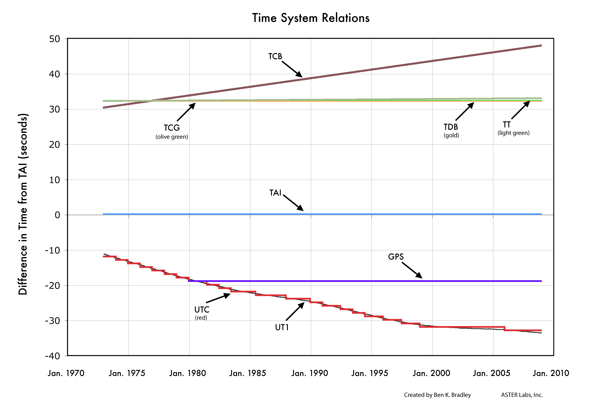
TIME SYSTEM RELATIONS
Image Credit: B.K. Bradley, ASTER Labs Inc.

Slide 14
CLOCKS

Slide 15
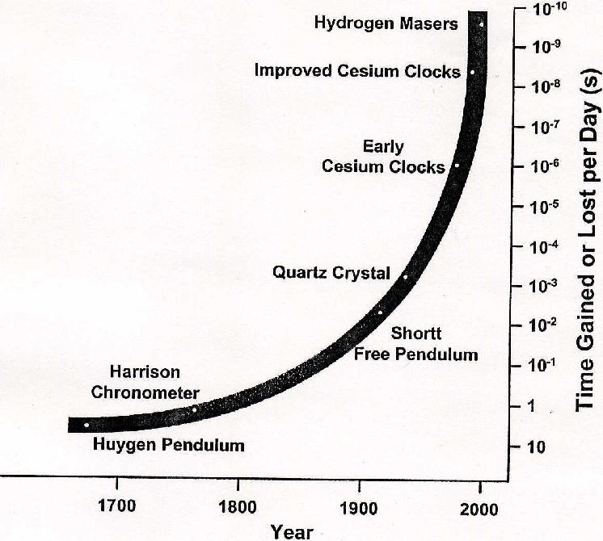
CLOCK HISTORY

Slide 16
ATOMIC CLOCKS
GPS satellites use atomic clocks: a precision clock that depends for its operation on an electrical oscillator regulated by the natural vibration frequencies of an atomic system (as a beam of cesium atoms)
Types of atomic clocks on GNSS satellites (taken from How Things Work)
Cesium atomic clocks employ a beam of cesium atoms. The clock separates cesium atoms of different energy levels by magnetic field. Not used on modern satellites.
Hydrogen atomic clocks maintain hydrogen atoms at the required energy level in a container with walls of a special material so that the atoms don't lose their higher energy state too quickly.
Rubidium atomic clocks, the simplest and most compact of all, use a glass cell of rubidium gas that changes its absorption of light at the optical rubidium frequency when the surrounding microwave frequency is just right.
You do not need to use an atomic clock for your ground receiver, but you can if you want to.
Useful info:
1 millisec ~ 300 km
1 microsec ~ 300 meters
1 nanosec ~ 300 mm

Slide 17
Why is Cs so frequently used in atomic clocks?
The SI unit of time, defined as the duration of 9,192,631,770 periods of radiation corresponding to the transition between two hyperfine levels of cesium-133 in a ground state at a temperature of absolute zero and at rest.
Continuous time scale based on SI second – International Atomic Time (TAI): This drifts off from UT1!

Slide 18
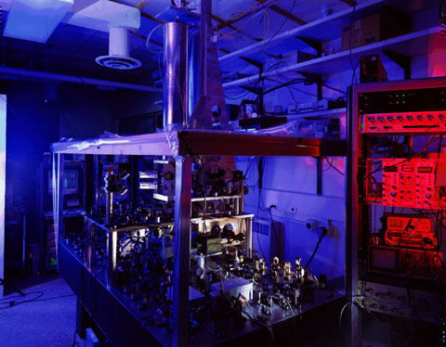
NIST-F1 Cesium Fountain Atomic Clock
The Primary Time and Frequency Standard for the United States
Right here across Broadway Avenue.

Slide 19
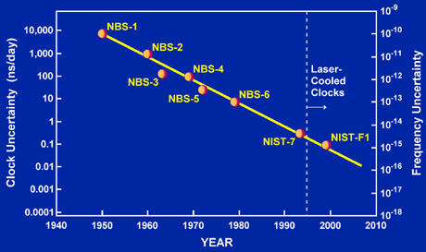
http://tf.nist.gov/timefreq/cesium/fountain.htm
As of the summer of 2010, the uncertainty has been reduced to about 3 x 10-16,
This means it would neither gain nor lose a second in more than 100 million years!

Slide 20
CLOCK HISTORY

Slide 21
UTC(NIST) and UTC(USNO)
Both NIST and USNO have a group of clocks that keep track of time for the Unites States
Both clock ensembles contribute to TAI and UTC which are paper clocks (note real-time)
The two ensembles are generally within 20 ns of each other
USNO keeps track of official time for the Department of Defense
But more importantly, who defines time for GPS?

Slide 22
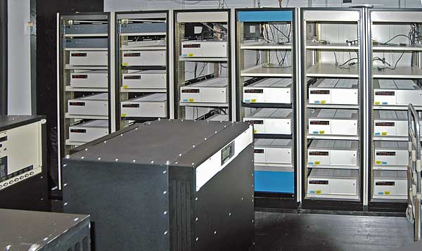
GPS MASTER CLOCK AT USNO
http://tycho.usno.navy.mil/mc_to.html
The atomic clock timescale of the USNO is based on an ensemble of ~ 30 cesium-beam frequency standards and a dozen hydrogen masers.
Frequency data from this ensemble are used to steer the frequency of another such maser, designated Master Clock 2 (MC #2), until its time equals the average of the ensemble.
The reference of the actual Master Clock is called UTC (USNO).
UTC (USNO) is usually kept within
10 nanoseconds of UTC.
The Alternate Master Clock lives at
the GPS Master Control Station in
Colorado Springs (Schriever AFB).

Slide 23
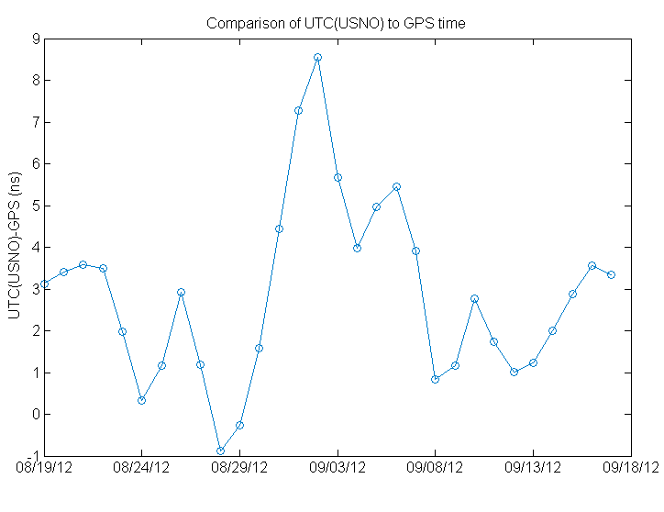
UTC(USNO) versus GPS Time
GPS time is based on the clocks at all the GPS monitoring stations and the satellite clocks
It is steered to UTC(USNO)

Slide 24
GPS SATELLITE CLOCKS
GPS has flown both rubidium (Rb) and cesium (Cs) oscillators onboard, which are very stable.
After Block II-A, only rubidium clocks were used due to better short term performance. They are now going back to launching Cs as well.
Clocks are constantly monitored by the control segment.
Part of the navigation or data message includes clock correction information.
Precise vs. Broadcast Satellite Clocks
Precise vs. Broadcast Satellite Clocks-Residual

Slide 25
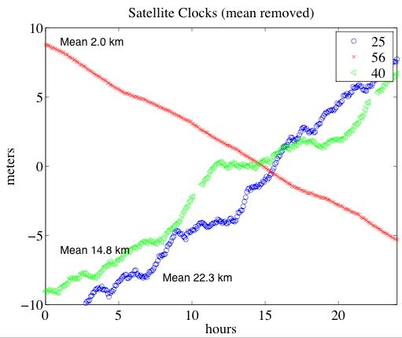
OTHER EXAMPLES

Slide 26
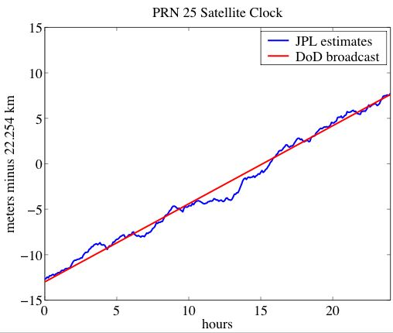
Clock Model in Broadcast Message
Three parameters (a_{f0}, a_{f1}, and a_{f2}) in the navigation message for satellite clock corrections.
Δt = a_{f0} + a_{f1}(t-toe) + a_{f2}(t-toe)², where toe is time of ephemeris.
a_{f0} can be up to 1 ms
a_{f1} ~ 10⁻¹¹
a_{f2} is always zero due to
resolution issues in the
broadcast message

Slide 27
BROADCAST CLOCK CORRECTION
Example: January 1 in 1995, at hour 4, PRN 1
Here is the navigation file entry:
1 95 1 1 4 0 0.0-0.651767477393D-04-0.216004991671D-11 0.000000000000D+00
0.162000000000D+03-0.243750000000D+01 0.507914013800D-08 0.202024096651D+01
-0.763684511185D-07 0.329352484550D-02 0.481866300106D-05 0.515357784653D+04
0.144000000000D+05 0.800937414169D-07 0.158705269528D+01 0.409781932831D-07
0.954013052302D+00 0.283531250000D+03-0.124439152688D+01-0.818248369043D-08
0.782175437889D-10 0.100000000000D+01 0.782000000000D+03 0.000000000000D+00
0.320000000000D+02 0.000000000000D+00 0.139698386192D-08 0.418000000000D+03
0.880800000000D+04 0.000000000000D+00 0.000000000000D+00 0.000000000000D+00
The values you need are:
clock bias (a0) of -0.651767477393D-04 sec, clock drift (a1) of -0.216004991671D-11 sec/sec
toe is 14400
If you want the satellite clock correction at t=toe
clock correction = c* -0.651767477393D-04 = -19.53949740921 km
At t=14400 + 3600 = 1800 (i.e. 1 hour later)
clock correction = c*(-0.651767477393D-04 + -0.216004991671D-11*3600) = -19.541828649 km

Slide 28
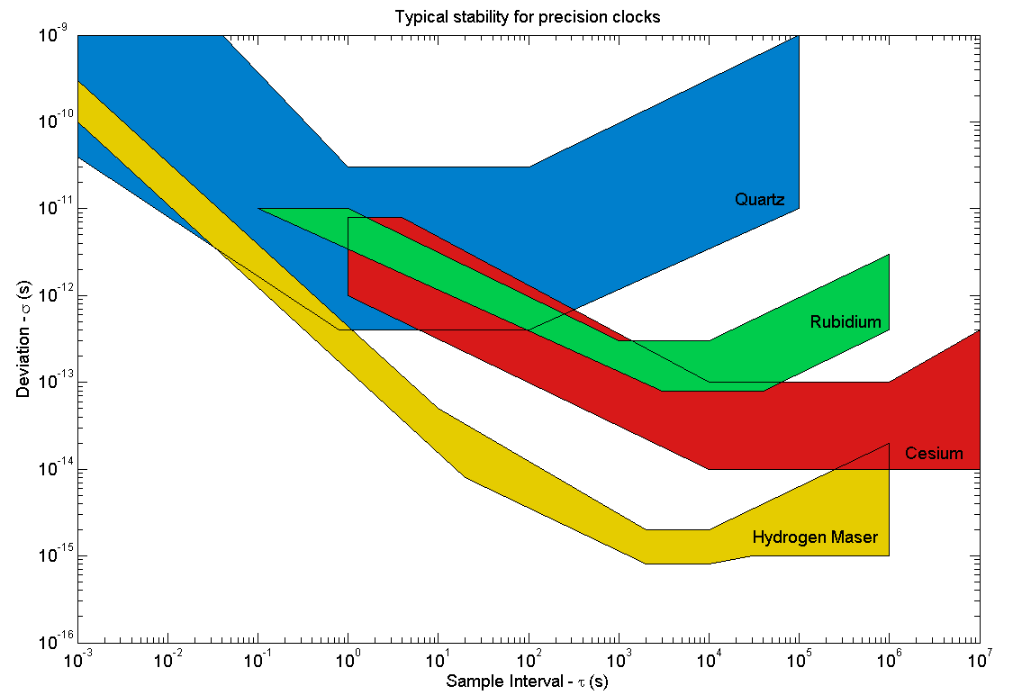
CLOCK STABILITY
Minute
Hour
Month
Day

Slide 29
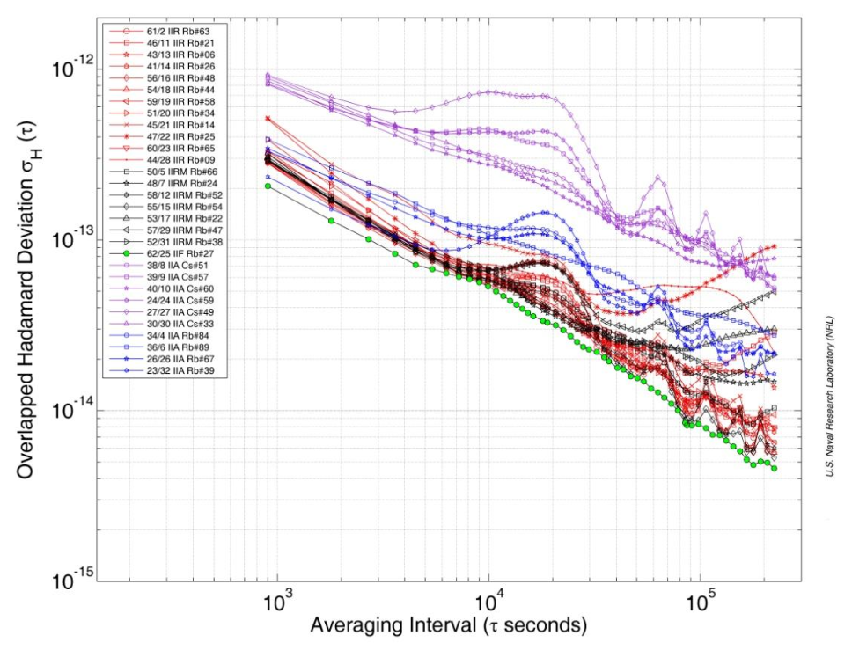
Block IIA Cesium clocks much noisier
From “GPS Block IIF Atomic Frequency Standard Analysis”
Vannicola et al., 42nd Annual PTTI Meeting

Slide 30
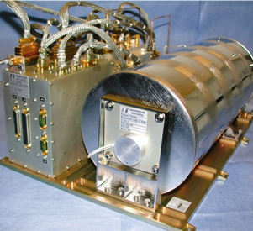
ADVANCES IN SATELLITE CLOCK TECHNOLOGY
The Hydrogen Maser has been chosen as the Master clock in the Galileo
Navigation Payload. The Passive
Maser can guarantee stability
performances within the Galileo
requirements for more than
eight hours without any
correction/upload from ground.
The newest GPS Block II-F satellites,
however, may provide nearly equivalent
performance (using updated Rubidiums).
See “Flight Characterization of New
Generation GNSS Satellite Clocks”,
Montenbruck et. al, ION GNSS 2011

Slide 31
RECEIVER CLOCKS
Receiver clocks are of three classes:
Clocks which are allowed to drift
Clocks that are steered to keep synchronization with GPS Time
Clocks that are allowed to drift with respect to GPS Time, within some tolerance - and then reset internally.
As a general rule, no geodetic quality receivers are allowed to drift very much - because there is a lot to be gained by synchronizing observations. Steering and resetting class receivers are more common.

Slide 32
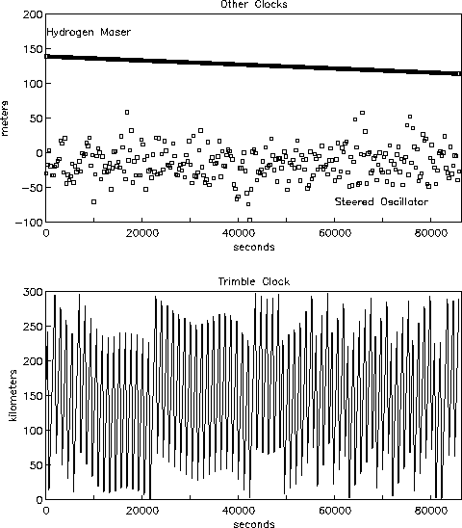
STEERING AND RESETING CLOCKS

Slide 33
CLOCK AND TIMING REVIEW
Receivers are usually built with an inexpensive oscillator; the receiver steers the oscillator to stay within 1 millisec of GPS time. (1 millisec = 300 km).
You can typically tell how tight the steering is by examining the scatter on the receiver clock solutions.
With the appropriate receiver, you can use an external oscillator (i.e. Rb, Cs, H). This could be helpful for position solutions. Why?
Cables

Slide 34
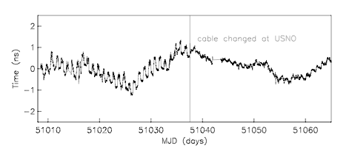
Why do cables show up in time?

Slide 35
HISTORICAL TIMING ISSUE: SELECTIVE AVAILABILITY
From 1990 (1991) thru May 1, 2000, the DoD intentionally dithered the GPS signals.
This is known as selective availability (SA)
Instead of f₀=10.23 MHz, there was an unknown frequency added to this.
With special "keys" the effects of SA could be removed in real-time.
Since time <=> position, the impact of SA was degraded positions in real-time.
In September 2007, announced that future satellites would not have SA capability

Slide 36
What clocks look like today

Slide 37
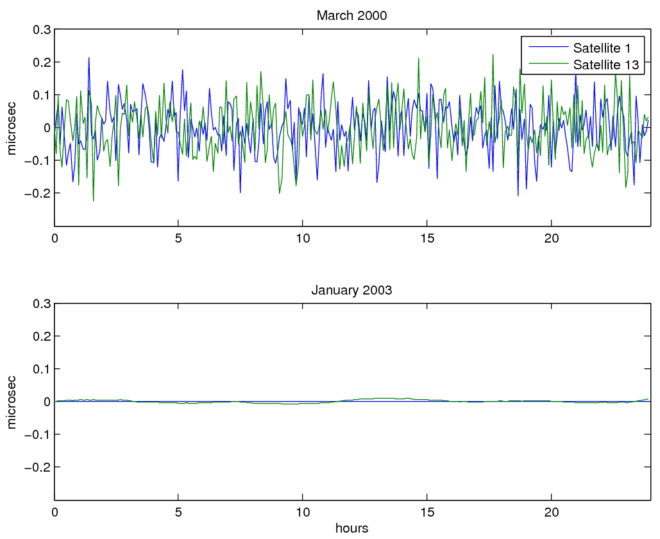

Slide 38
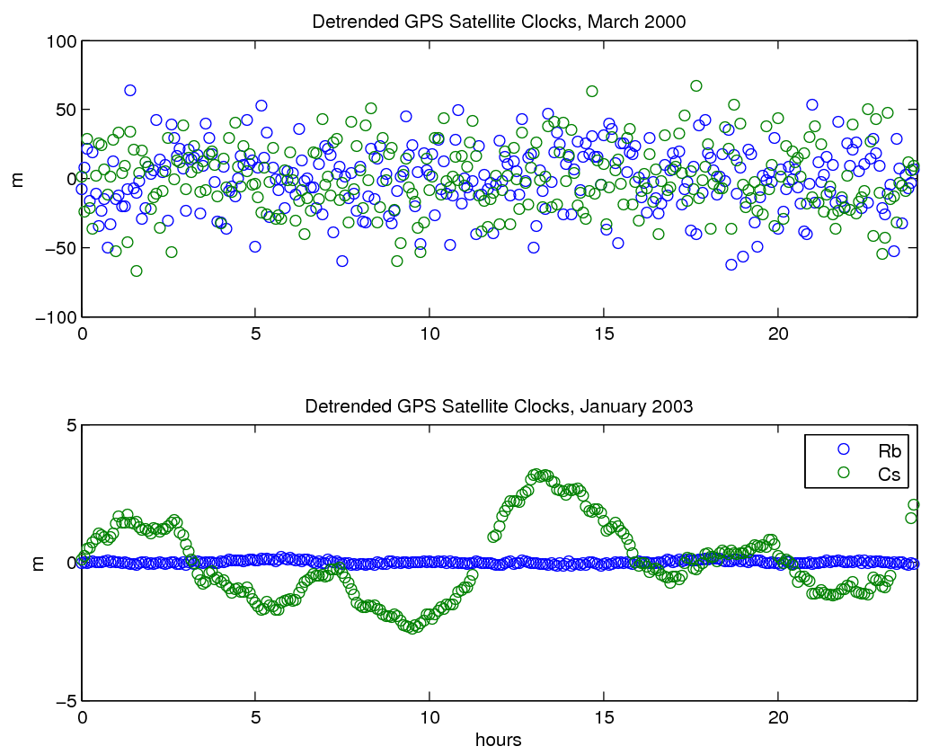

Slide 39
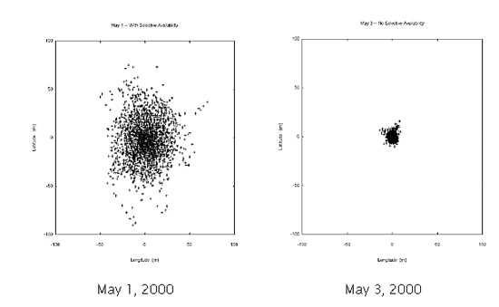
Horizontal Position Solutions
-100 -50 0 50 100
-100 -50 0 50 100
-100 -50 0 50 100
meters
-100 -50 0 50 100
meter
With SA on With SA Off

Slide 40
RELATIVITY

Slide 41
RELATIVISTIC EFFECTS ON GPS CLOCKS
Sagnac Effect – rotation of receiver during transit time of signal (being careful about coordinate frame)
According to special relativity, a clock aboard a satellite traveling at constant speed appears to lose time relative to a clock on the Earth.
According to general relativity, a clock on a satellite would run faster than one on the Earth due to the difference in gravitational potential.
Average net effect for GPS is that the clock gains 38.4 μsec/day.
Recall a μsec is ~ 300 meters.
To compensate, the fundamental frequency, which we define as 10.23 MHz, is set 0.00455 Hz lower.

Slide 42
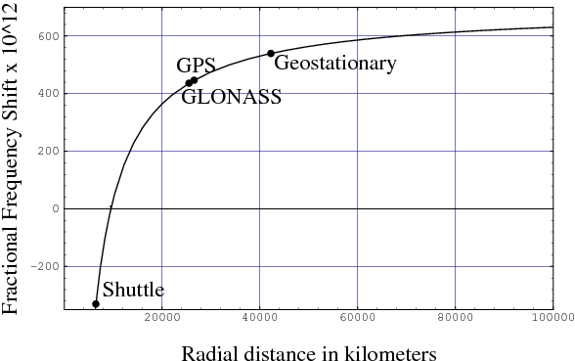
Net frequency shift of a clock in a circular orbit
http://www.livingreviews.org/lrr-2003-1 Figure 2

Slide 43
RELATIVISTIC CORRECTION FOR ELLIPTICAL ORBIT
GPS orbits are nearly but not exactly circular. An additional relativity correction (or effect?) that compensates for the eccentricity of the orbit is

Slide 44
This is for GRACE – GPS correction is much smaller

Slide 45
RELATIVISTIC CORRECTIONS

Slide 46
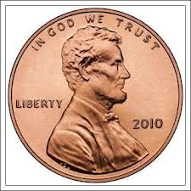
My on the stats question
Homework problem on standard deviation was vague to the point of uselessness.

Slide 47
My on the statistics question
The problem on standard deviation was vague to the point of uselessness.
Standard deviations of the data were 0.3. There were 100 points, so the standard deviation of the mean was 0.03. Which means you could report the mean to two decimal points.
The general rule is that experimental uncertainties should be rounded to
one significant digit. All of the following are appropriate notations:
13.2 +- 0.6 mm, 43 +- 11 cm, 8.76 +- 0.02 volts
The reported value of the mean (or other value) should be of the same
order of magnitude as the experimental uncertainty.

Slide 48
Deciphering Sig Figs in a GPS File
2.11 OBSERVATION DATA G (GPS) RINEX VERSION / TYPE
teqc 2012Jun6 gpsops 20120921 00:08:49UTCPGM / RUN BY / DATE
30.0000 INTERVAL
1 1 WAVELENGTH FACT L1/2
7 L1 L2 P1 P2 C1 S1 S2 # / TYPES OF OBSERV
Linux 2.4.21-27.ELsmp|Opteron|gcc -static|Linux x86_64|=+ COMMENT
2.10 OBSERVATION DATA GPS COMMENT
soc2rnx ver 1.20 gpsops 21-Sep-2012 00:08:49COMMENT
S1, if present, is the SNR for the C/A data stream on L1. COMMENT
SNR is mapped to RINEX snr flag value [1,4-9] COMMENT
SNR: >316 >100 >31.6 >10 >3.2 >0 bad=0 COMMENT
L1 & L2: 9 8 7 6 5 4 1 COMMENT
GGN USNO OBSERVER / AGENCY
KW-0201 AOAD/M_T NONE ANT # / TYPE
-1248596.2520 -4819428.2840 3976506.0340 APPROX POSITION XYZ
0.0000 0.0000 0.0000 ANTENNA: DELTA H/E/N
RT920013101 ASHTECH Z-XII3T IL01-1D04-MCF-12MX REC # / TYPE / VERS
AMC2 MARKER NAME
40472S004 MARKER NUMBER

Slide 49
12 9 20 0 0 0.0000000 0 9G05G30G12G25G21G26G15G02G29
111012537.21748 86503277.54548 21124981.8904 21124983.3004 21124981.7864
234.000 191.000
128782894.66848 100350281.01048 24506591.3794 24506596.1784 24506591.8014
210.000 136.000
126123246.54848 98277827.37848 24000476.6484 24000482.7314 24000476.5244
213.000 152.000
117042505.63448 91201914.08748 22272479.6324 22272485.0854 22272479.5274
225.000 170.000
123080616.07448 95906963.00048 23421472.1504 23421473.8994 23421472.4254
213.000 148.000
120878810.84948 94191278.25748 23002473.3194 23002478.1154 23002473.2854
217.000 153.000
125074507.40348 97460630.80848 23800905.1314 23800910.2374 23800905.2514
212.000 147.000
120358756.46948 93786046.15548 22903508.7984 22903510.0154 22903508.9474
220.000 161.000
106860967.74948 83268283.87248 20334968.0214 20334969.3044 20334968.1204
240.000 207.000

Slide 50
| OBS. RECORD | DESCRIPTION | FORMAT |
+-------------+-------------------------------------------------+------------+
| EPOCH/SAT | - Epoch : | |
| or | - year (2 digits, padded with 0 if necessary) | 1X,I2.2, |
| EVENT FLAG | - month,day,hour,min, | 4(1X,I2), |
| | - sec | F11.7, |
| | | |
| | - Epoch flag 0: OK | 2X,I1, |
| | 1: power failure between | |
| | previous and current epoch | |
| | >1: Event flag | |
| | - Number of satellites in current epoch | I3, |
| | - List of PRNs (sat.numbers with system | 12(A1,I2), |
| | identifier, see 5.1) in current epoch | |
| | - receiver clock offset (seconds, optional) | F12.9 |
| | | |
| | If more than 12 satellites: Use continuation | 32X, |
| | line(s) | 12(A1,I2) |

Slide 51
- Observation | rep. within record for | m(F14.3, |
| | - LLI | each obs.type (same seq | I1, |
| | - Signal strength | as given in header) | I1) |
| | | |
| | If more than 5 observation types (=80 char): | |
| | continue observations in next record. | |
| | | |
| | This record is (these records are) repeated for | |
| | each satellite given in EPOCH/SAT - record. | |
| | | |
| | Observations: | |
| | Phase : Units in whole cycles of carrier | |
| | Code : Units in meters | |
| | Missing observations are written as 0.0 | |
| | or blanks. | |

Slide 52
My on the shifting codes
Yes, mathematically “negative” shifts happen. But in the real world, it takes a finite positive amount of time for the signal to travel from the satellite to the receiver.
The time shift that you see in the cyclic correlation should be positive.
If the use the convention in the book, xshifted = [x(101:1023) x(1:100)], and
you follow the stated inputs, you will see a spike at 100.

