Slide 1
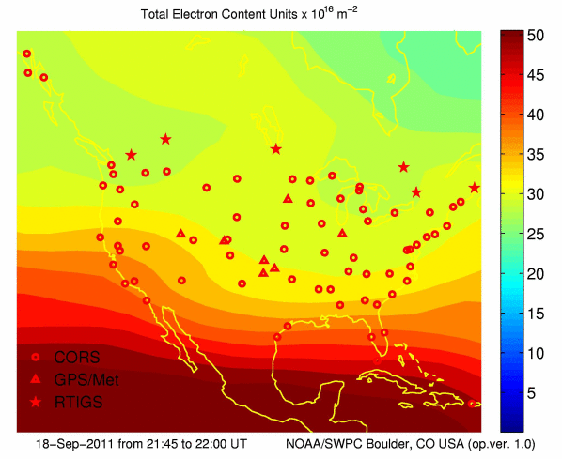
IONOSPHERIC EFFECTS ON GNSS
ASEN 5090 Lecture 13
ASEN 5090 LECTURE NOTES – LARSON, AXELRAD

Slide 2
Homework4 Comments
If possible, take photos!
Write down enough so that someone else should be able to repeat what you did.
Use the visibility code to look at the expected satellite geometry
Provide quantitative results.
Abstract should be a summary of the report – objectives, what you actually did, key results, key conclusions. Keep it short and direct. For these reports, 5 sentences should be about right.
Conclusions should describe what you learned from the experiment. How did the results compare with what you expected? What was surprising?
Recommendations should provide 1) advice to me on how to improve the assignment and 2) advice to hypothetical future students as to what you would do differently if repeating this exercise.
2

Slide 3
Measurements in your RINEX file
(At least) Two kinds of RINEX files
L1 pseudorange –called C1 or P1
L2 pseudorange – P2 or C2
L1 Phase
L2 Phase
Doppler - boring
Signal to noise ratio (SNR) – interesting, but not for this class
L5 phase and pseudorange – not used in this class

Slide 4
Homework 5

Slide 5
Homework 6

Slide 6
Outline
Characteristics of the Ionosphere
Effect on GPS Observations – code delay, phase advance
Total Electron Content (TEC) & Vertical TEC
Maps
Determining ΔI_{ρ}
Ionosphere free pseudorange
Klobuchar model
WAAS model

Slide 7
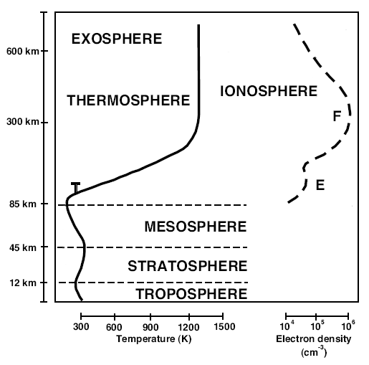
Characteristics of the Ionosphere
Ionosphere causes the E-field polarization to rotate, delays the code (modulation), and advances the carrier phase
From Wikipedia article on ionosphere

Slide 8
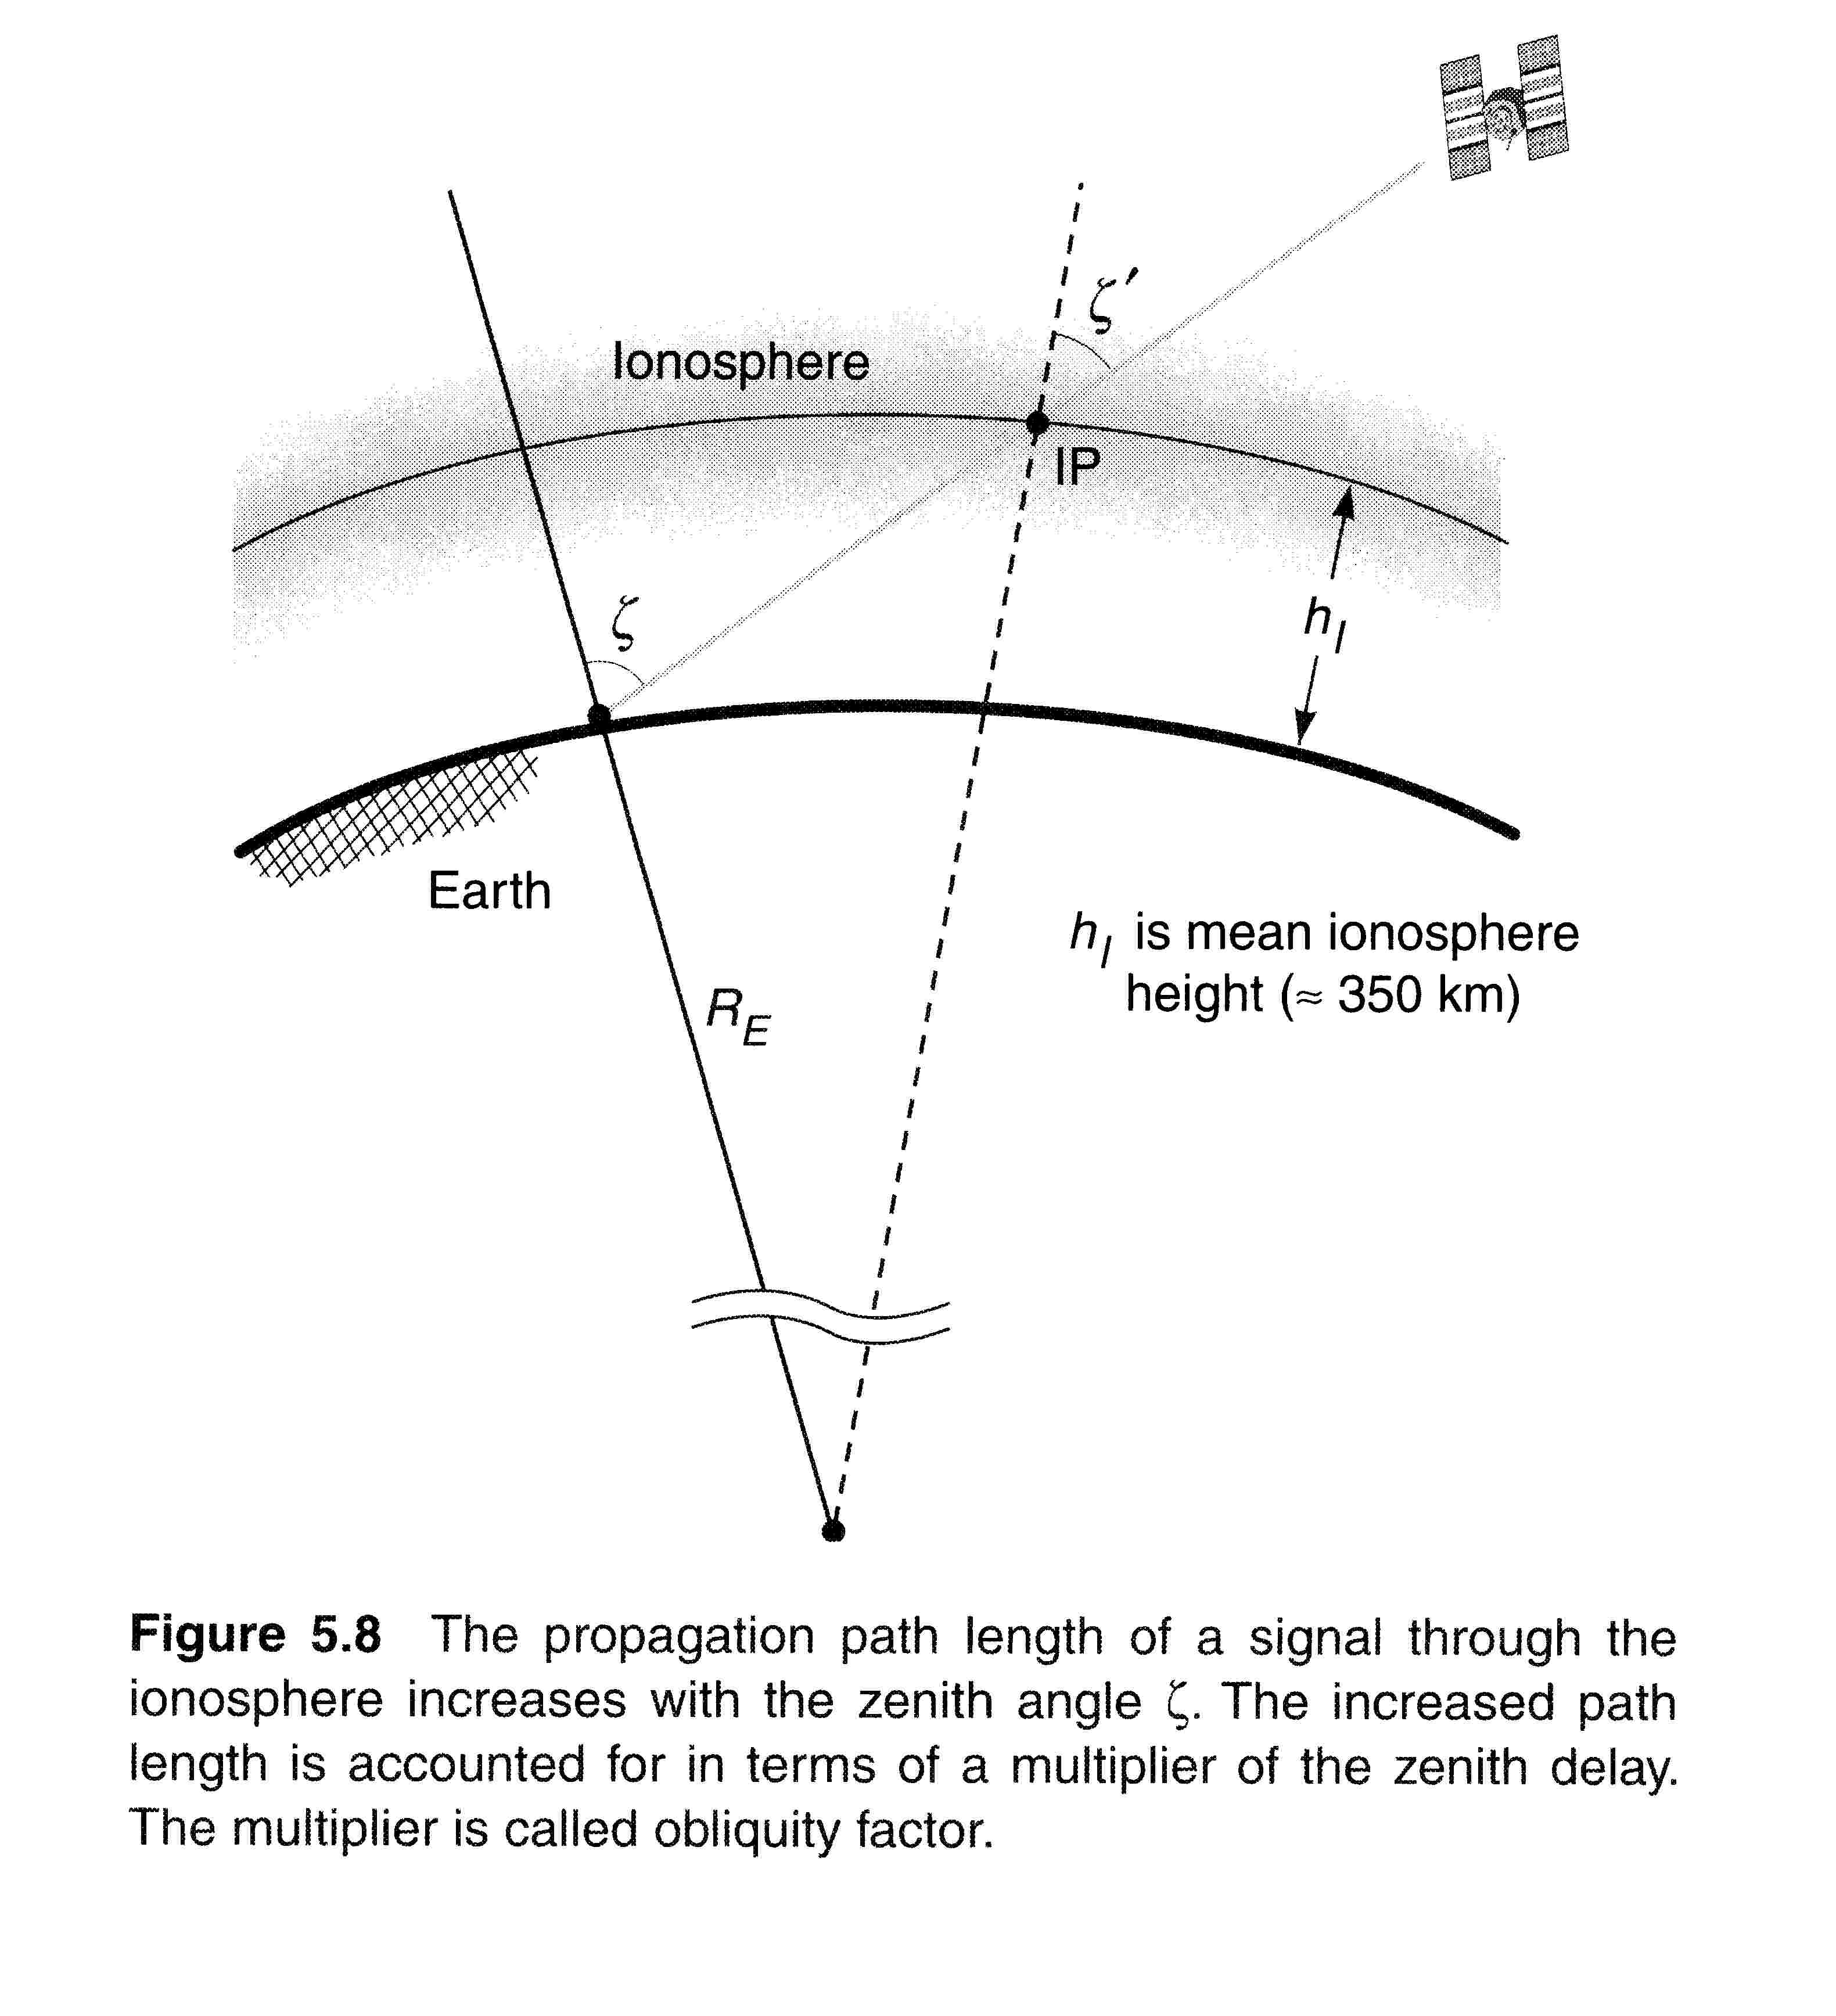
IONOSPHERE
Total Electron Content (TEC) is the number of electrons along the signal path
10¹⁶ electrons/m² = 1 TEC unit (TECU)
From Misra & Enge

Slide 9
Effect on GNSS Observations
I in m
TEC in el/m²
f in Hz
Pseudorange is longer – “group delay”
Carrier Phase is shorter – “phase advance”

Slide 10
Effect on GNSS Observations

Slide 11
Calculate Ionosphere Free Pseudorange

Slide 12
Ionosphere-free Pseudorange
99% correct
≈
Ionosphere-free pseudoranges are more noisy than individual pseudoranges.

Slide 13
Estimating the Ionospheric Delay
Where frequencies are expressed in Hz, pseudoranges are in meters, and TEC is in electrons/m²

Slide 14
IONOSPHERIC ZENITH DELAY
The total or slant ionospheric delay depends on the length of the ray path through the ionosphere and how active the ionosphere is in the region it is passing through.
To compare the activity levels the total delay can be approximated as the product of a zenith delay and a geometrical obliquity factor which depends on the satellite zenith angle (compliment of the elevation angle).
Zenith delay is modeled as applying to an observer on the surface of the Earth directly below the IP (ionospheric pierce point) shown by the blue dot in the figure
GPS measurements at stations around the globe are used to observe TECV

Slide 15
Vertical Delay & Vertical Total Electron Content (TECV)
The TEC along the path for a satellite at zenith angle ζ, is related to the vertical TEC by the geometrical obliquity factor:
Iono zenith delay (Iz) ~ 1-3 m at night, 5-20 m or more mid-afternoon
OF ranges from 1 (ζ=0) to ~3 (ζ=85 deg)
1 TECU ~ 0.16 m

Slide 16
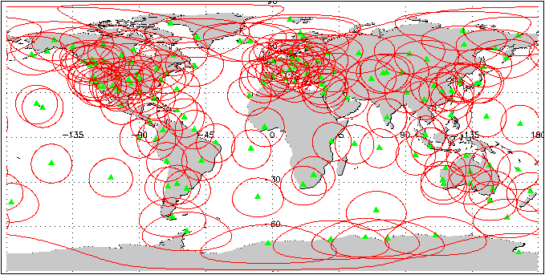
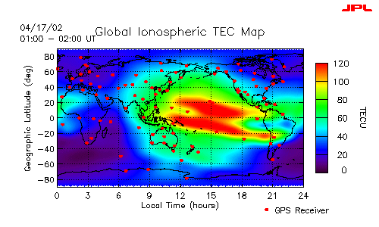
Global Ionospheric Maps (GIMs) are generated using data from carefully sited GPS receivers (JPL network shown at right).
Generated by:
JPL (NASA, California)
Center for Orbit Determination (CODE, U. of Bern, Switzerland)
GSD, Canada
UPCG
Others
Updated (at least) daily, used for GPS and research applications
Calculates TECV from ranging error
Global Ionospheric Maps
Images courtesy NASA/JPL

Slide 17
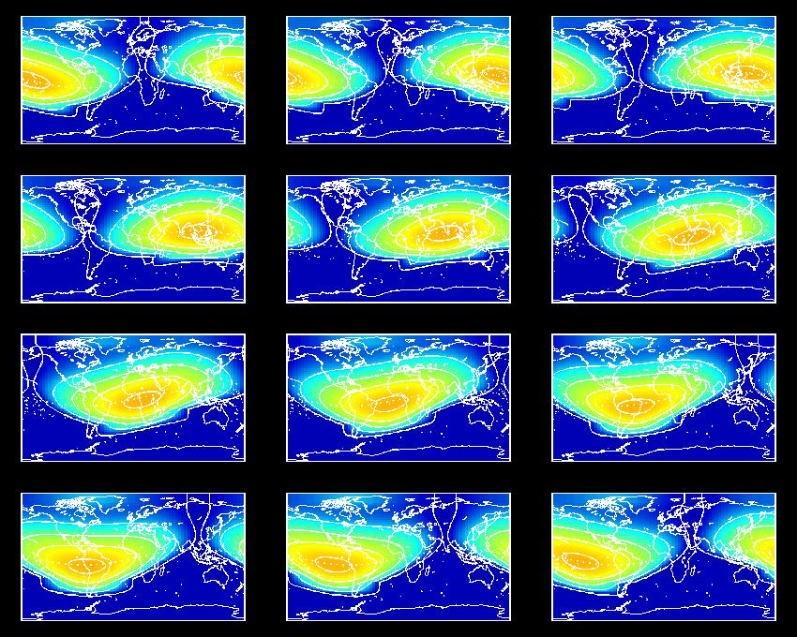
TECV Maps
2-hourly snapshots of the Earth's TEC (01:00, 03:00, etc)
Dark blue indicates low TEC and red indicates high TEC (up to 75 TECU ).

Slide 18
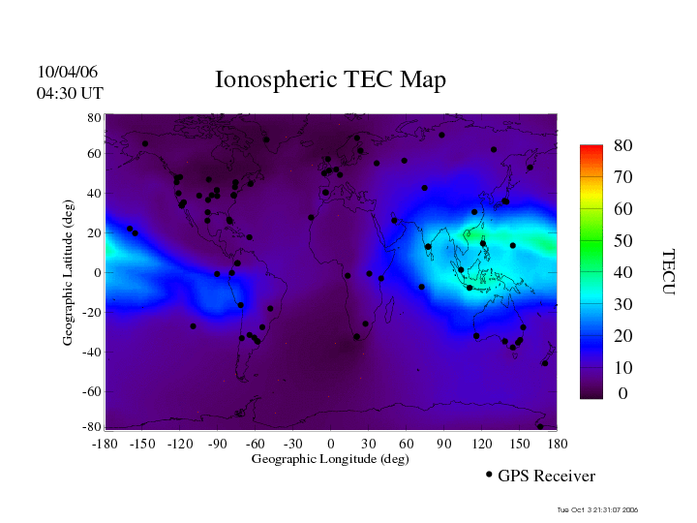
Global Ionospheric Maps (TECV)
http://iono.jpl.nasa.gov/

Slide 19
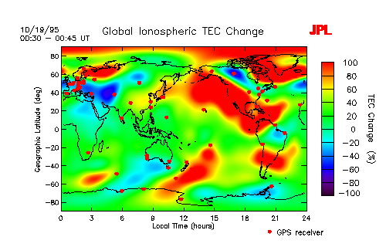
Ionospheric Storms
Solar activity such as flares and coronal mass ejections often produce large variations in the particle and electromagnetic radiation incident upon the earth.

Slide 20
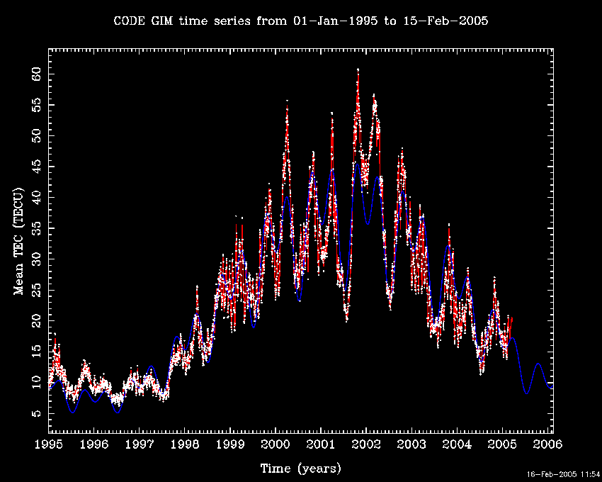
Drivers

Slide 21
Klobuchar Model – Broadcast Model
50-70% correct
Representation of zenith delay:
t is local time at the ionospheric pierce point, expressed in geomagnetic coordinates
A1 – A4 are computed from the α’s and β’s in the nav message
The obliquity factor is approximated as:

Slide 22
Klobuchar Model
A3
A1
From Misra & Enge: Figure 5.10

Slide 23
Where is the Klobuchar Model stored?
2 NAVIGATION DATA RINEX VERSION / TYPE
CCRINEXN V1.6.0 UX CDDIS 14-OCT-07 02:51 PGM / RUN BY / DATE
IGS BROADCAST EPHEMERIS FILE COMMENT
0.1118E-07 0.0000E+00 -0.5960E-07 0.0000E+00 ION ALPHA
0.9011E+05 0.0000E+00 -0.1966E+06 0.0000E+00 ION BETA

Slide 24
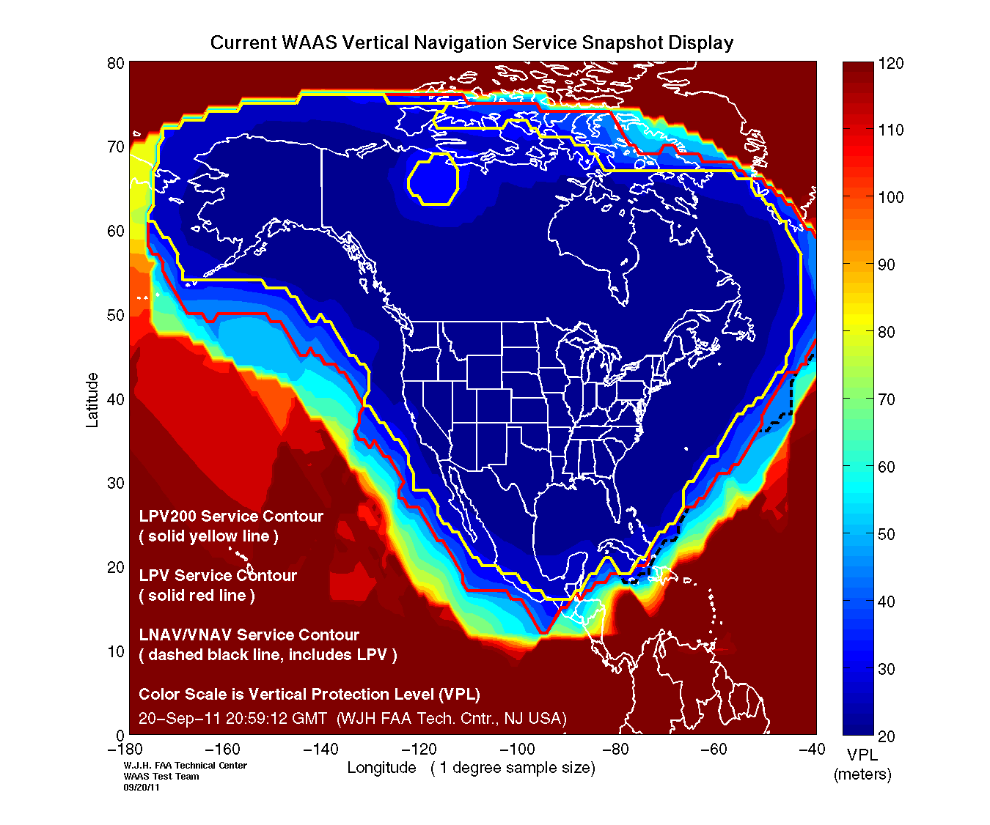
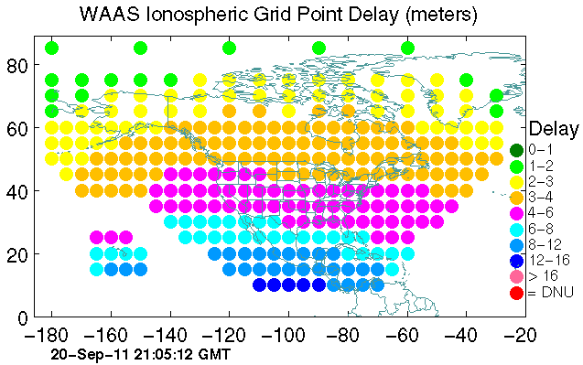
WAAS (Wide Area Augmentation System)
~90-95% correct; guaranteed 7.6 m, actual ~ 1 m accuracy
WAAS supplies correction parameters for a number of points (organized in a grid pattern) across the WAAS service area.
Data are collected from Air Traffic Control centers
For each satellite observation the user receiver interpolates to its pierce point location based on the four closest grid points
Receiver then calculates total delay based on measured delays, using interpolation
Images taken from www.nstb.tc.faa.gov (public domain)

Slide 25
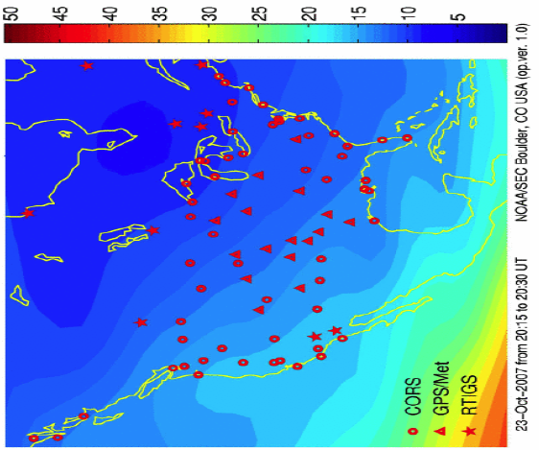
US Space Weather Center Center – Right Here in Boulder
http://www.swpc.noaa.gov/ustec/index.html

Slide 26
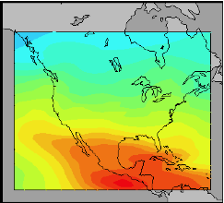
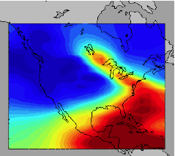

Quiet
Disturbed
TEC

Slide 27
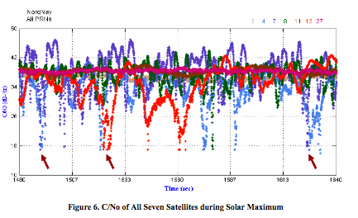
Ionospheric Scintillation
Rapid variations in the phase and amplitude of a radio signal that has passed through the ionosphere
Caused by small scale variations in the ionospheric plasma density
Described by S4 intensity-scintillation index: standard deviation of the intensity normalized by the mean intensity.
Primary influence on GPS is the potential for receiver tracking loops to lose lock on the signal.
Seo, et al.
http://waas.stanford.edu/~wwu/papers/gps/PDF/SeoIBSS07.pdf

Slide 28
SUMMARY OF IONOSPHERIC EFFECTS
Region of the Earth's atmosphere from ~ 100 to ~ 1000 km above the Earth's surface which includes active electrons
Term describing it: total electron content (TEC).
Depends on: Time of day (where the sun is), Season, Latitude, Solar (Sunspot) Cycle
Delay on L1 (m) is approximately 40.3 TEC/f₁²
Delay on L2 (m) is approximately 40.3 TEC/f₂²
Corrected in the receiver by dual frequency measurements or the Klobuchar model.
Severe scintillation can cause receivers to lose lock. Not a very common occurrence.

Slide 29
LINKS
http://www.swpc.noaa.gov/ustec/index.html
http://www.cx.unibe.ch/aiub/ionosphere.html

