Slide 1
Tropospheric delay in GPS
ASEN 5090

Slide 2
ASEN 5090

Slide 3
Outline
Part I: What is tropospheric delay?
Part II: What can be done about it?

Slide 4
Common questions:
Is it due to neutral or ionized gases in the atmosphere?
Does it vary with time?
Does it affect L1 and L2 frequencies differently?
How big is it, in meters?

Slide 5
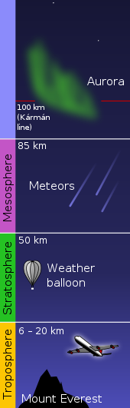
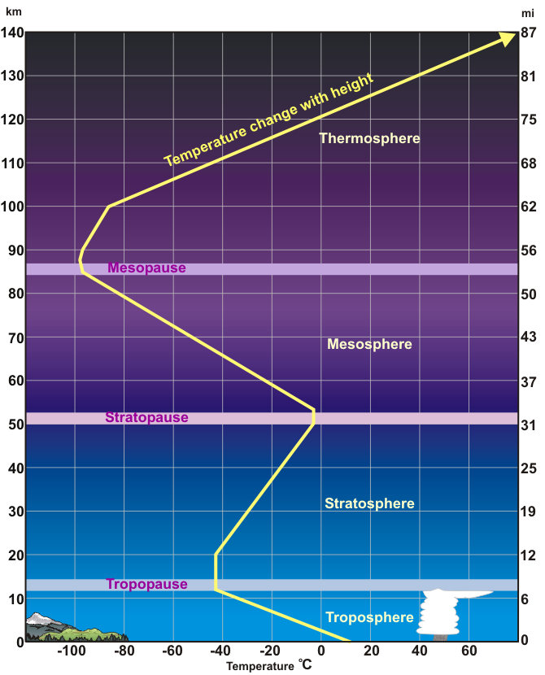
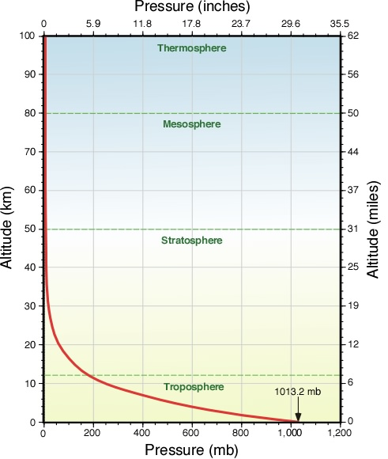
Earth’s (neutral) atmosphere
Up to Karman line
Outer space ~ 100 km
Layers based on temperature
Neutral atm. = tropo + strato + mesosphere
So “neutral atm delay”
Pressure decreases exponentially
Humidity zero above ~ 15 km
Images credit: NOAA National Weather Service

Slide 6
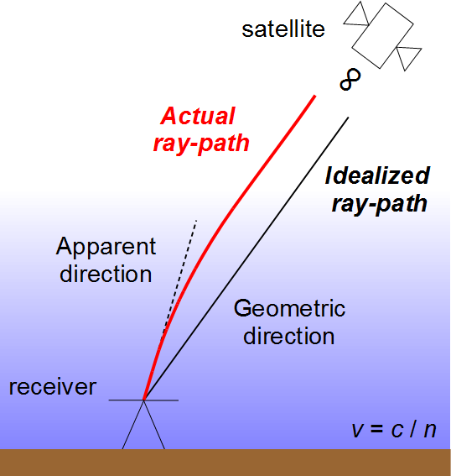
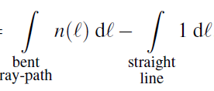

Effect on ranging measurements
Signal experiences a propagation delay.
Compared to vacuum, speed equals v = c / n
Slant delay:
Refractivity:
“dry” or hydrostatic +
“wet”
(Frequency-independent in L band)

Slide 7
Modeling slant delays
Decomposition:
zenith delay
redundant over all sat.
mapping function
assumed known
Separation:
“dry” delay
larger & more stable
predictable from surface
“wet” delay
smaller & more variable

Slide 8
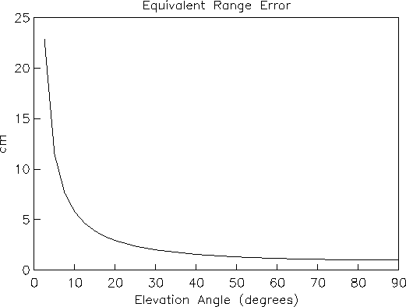
Total slant delay
meters

Slide 9
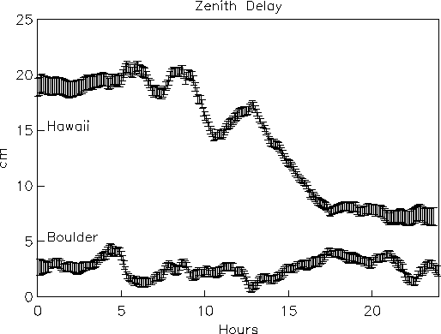
Wet zenith delay

Slide 10
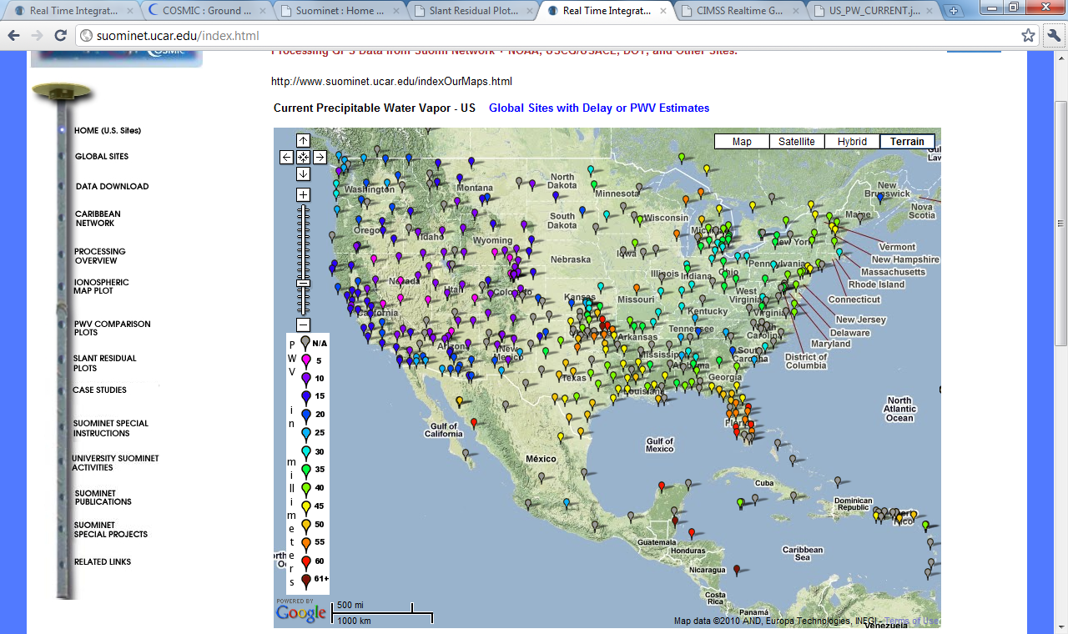

Slide 11
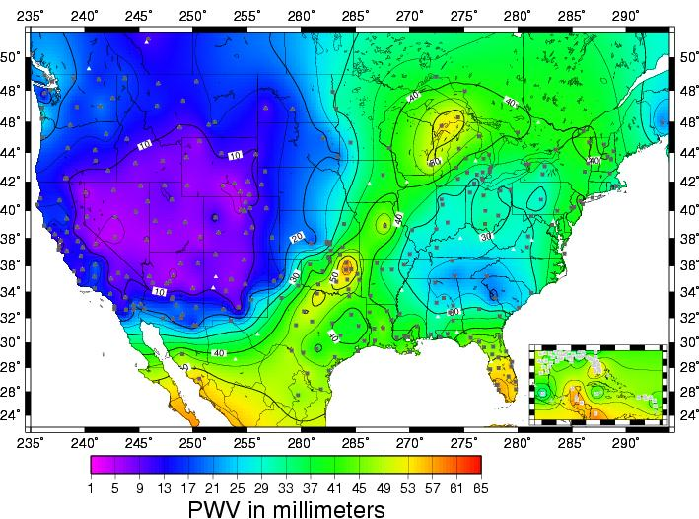
Suominet: Real-time WV from GPS
http://suominet.ucar.edu/

Slide 12
Part II – How to mitigate the delay?

Slide 13
Avoid the delay
Since delay increases with decreasing elev. angle…
Raise the cutoff elevation angle!
Also helps against multipath & antenna-gain noise.
Don’t raise too much otherwise observation geometry is poor (“dilution of precision”)

Slide 14
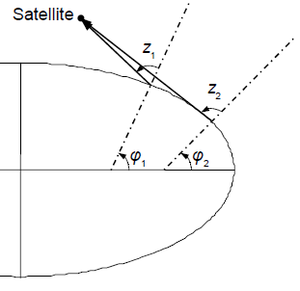
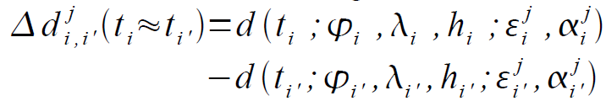
Eliminate the delay via differencing
Observations from same satellite collected at difference receivers are subject to similar delay.
Apply across-receiver differencing:
More effective the closer the two receivers are.
~ < 30 km horizontally
< 100 m vertically

Slide 15
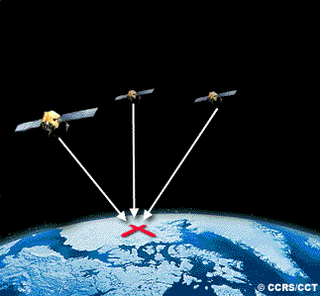
Estimate the delay based on GPS observations
Recall separation of slant delay:
Assume mapping function k is known.
Zenith delay is the same for different satellites!
Estimate it along with receiver position & clock.
Requires carrier-phase data (pseudorange too noisy).
Hard to do for rovers.

Slide 16
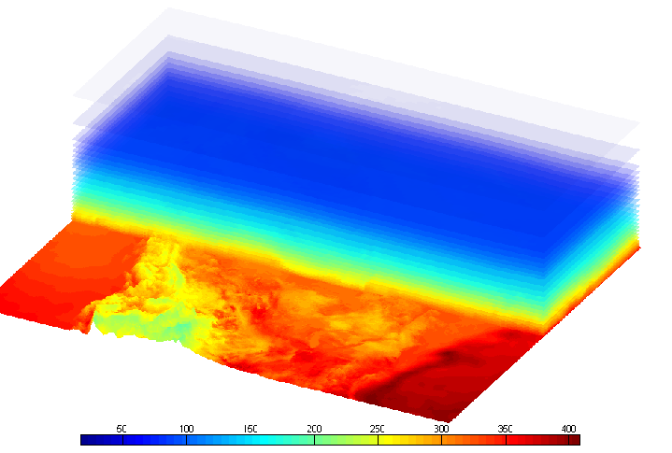
Predict the delay using atm. models
Use weather or climate models to obtain pressure, temperature, and humidity.
Thus refractivity:
Then ray-trace signal and integrate delay:

Slide 17
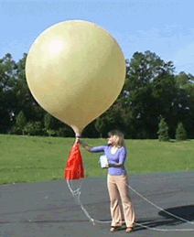
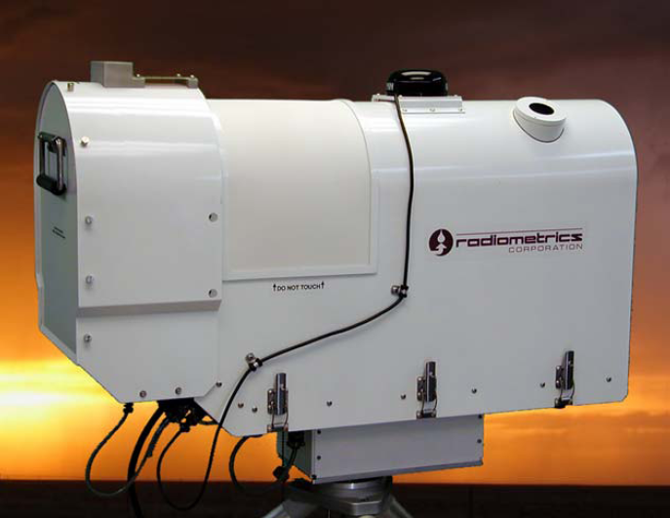
Measure the delay using atm. sensors
Radiosondes: vertical profile of pressure, temperature, humidity.
Plug into ray-tracing to get total zenith delay.
Radiometers: integrated sky brightness temperature
Plug into empirical regression to get slant wet delay.
Surface met package: near-ground pressure, temperature.
Plug into Saastamoinen model to get dry zenith delay.
Drawbacks: bulky, costly, laborious.

Slide 18
Interpolate the delay known nearby
“Near things are more related than distant things”
Given delays estimated or measured nearby, interpolate at the desired location.

Slide 19
Summary of mitigation strategies
(1) avoid the delay, discarding or down-weighting low-elevation obs., or selecting sites in dry locations
(2) eliminate the delay via observation differencing
(3) estimate the delay based on the GPS observations
(4) predict the delay using external atmospheric models
(5) measure the delay using external atmospheric sensors
(6) interpolate the delay available at nearby locations

