Slide 1
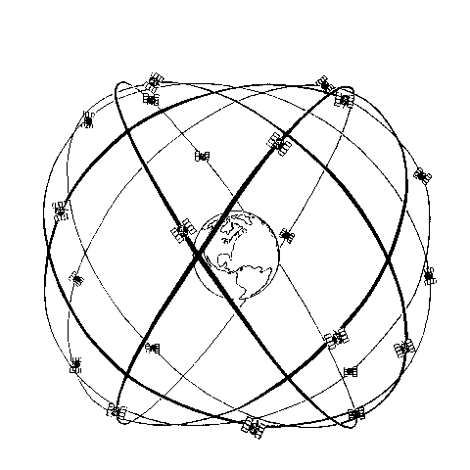
Data Overview, Introduce Carrier Phase Data
ASEN 5090
ASEN 5090 LECTURE NOTES – LARSON, AXELRAD

Slide 2
Homework 6
Course code to read RINEX files had a bug in it. New code was emailed.
Questions?
Wednesday I will review for the midterm. Bring your questions about both the midterm and the homeworks.
I will change the due date of Homework 5 until 5 p.m. (usually homework is due before class).

Slide 3
BASIC GPS MEASUREMENT: PSEUDORANGE
Receiver measures difference between time of transmission and time of reception based on correlation of received signal with a local replica

Slide 4
PSEUDORANGE OBSERVABLE MODEL (relativity left out for simplicity)

Slide 6
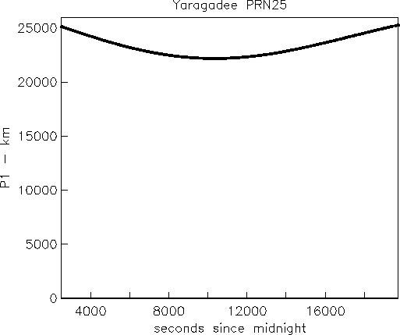

Slide 7
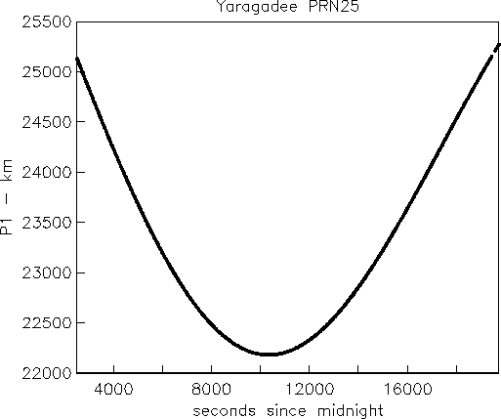

Slide 8
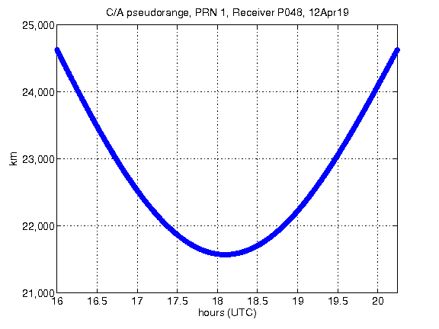

Slide 9
Take home message on plotting pseudorange:

Slide 10
PSEUDORANGE minus GEOMETRIC RANGE
Difference is typically dominated by ??
How can you tell?

Slide 11
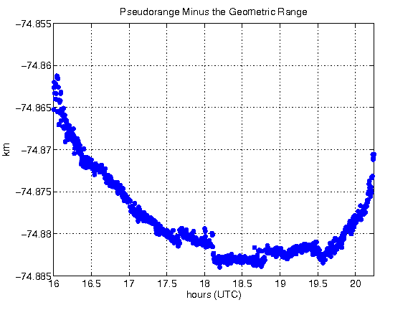

Slide 12
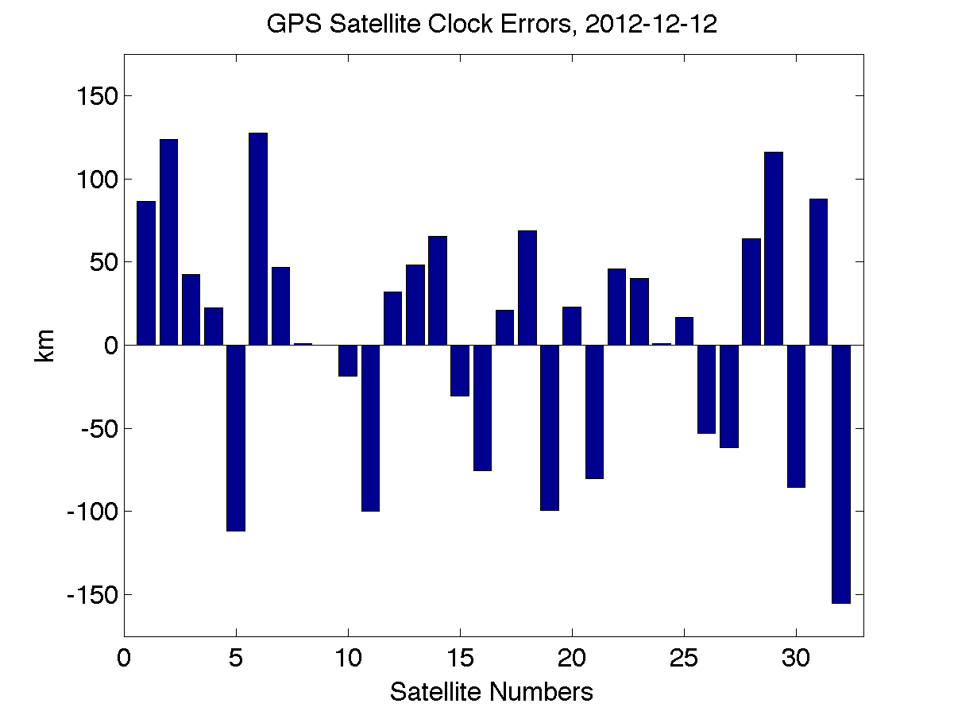

Slide 13
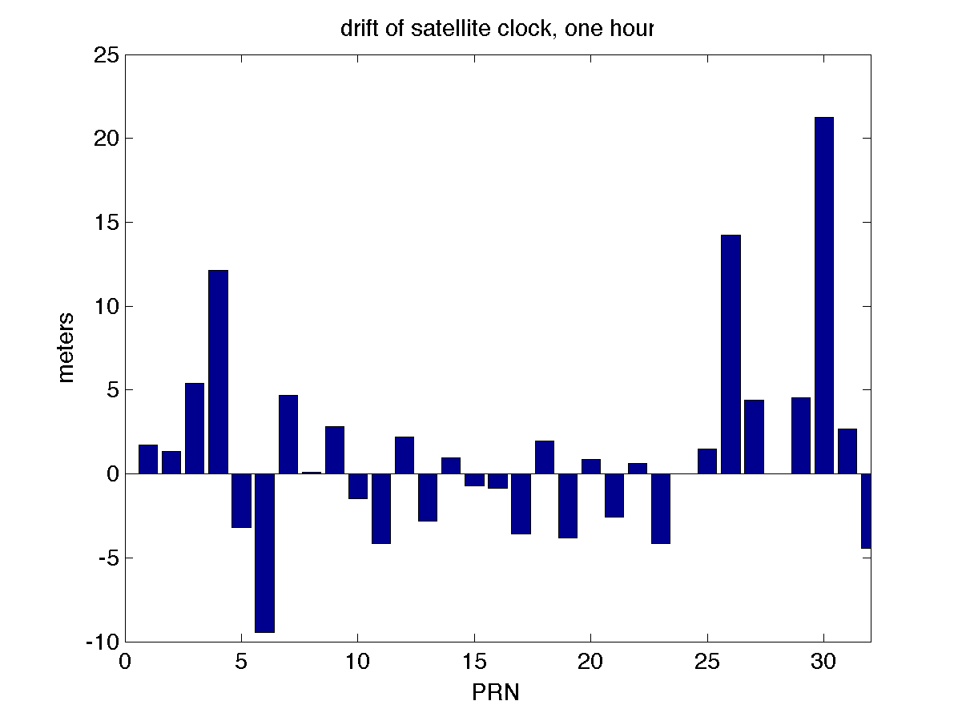
How much does it drift?

Slide 14
Examples

Slide 15
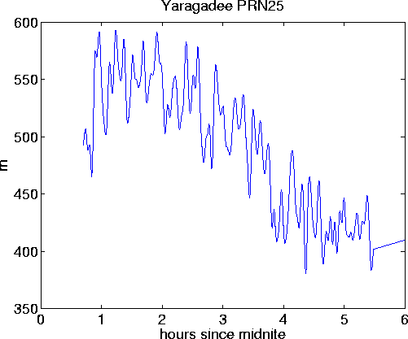
Large constant removed (data circa late 1990s)

Slide 16
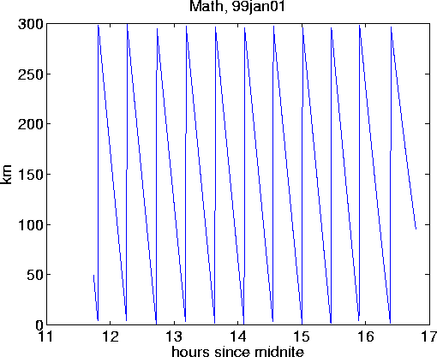
Large constant removed (data circa late 1990s)

Slide 17
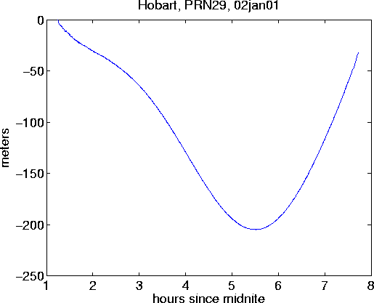
Large constant removed (data after Selective Availability turned off)

Slide 18
Go back to my original (noisier example)

Slide 19
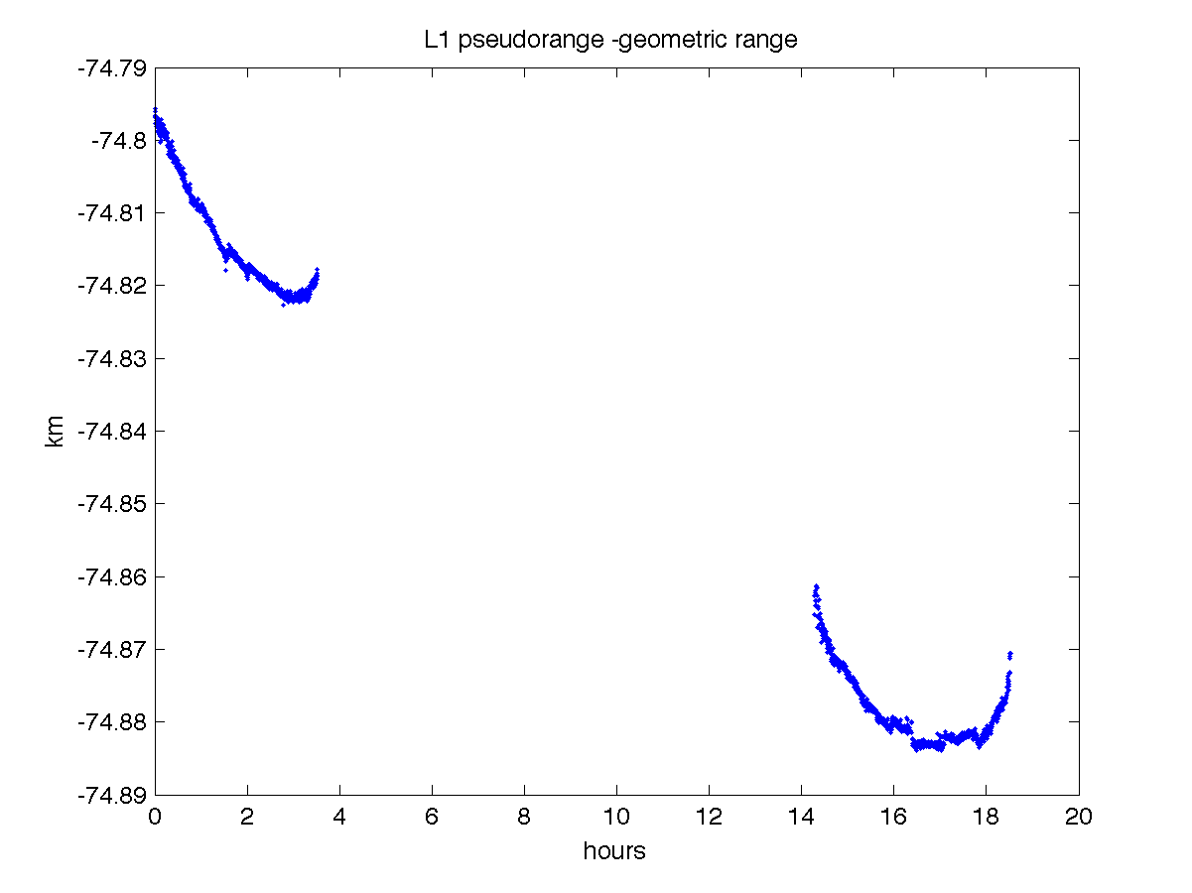
Pseudorange – Geometric Range

Slide 20
Remove more terms

Slide 21
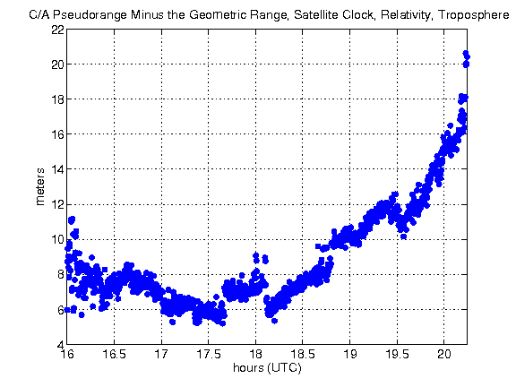

Slide 22
L1 PSEUDORANGE - L2 PSEUDORANGE
Differencing pseudoranges on two frequencies removes ???

Slide 23
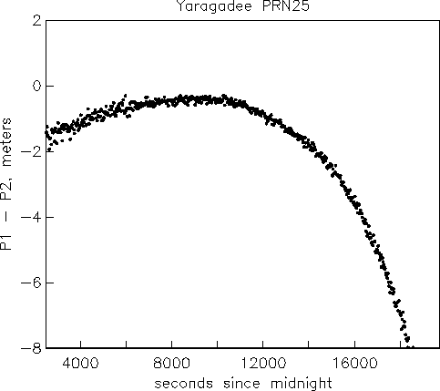

Slide 24
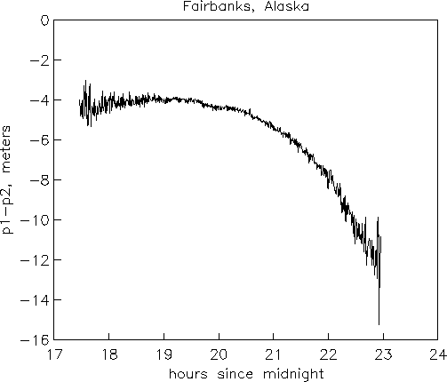

Slide 25
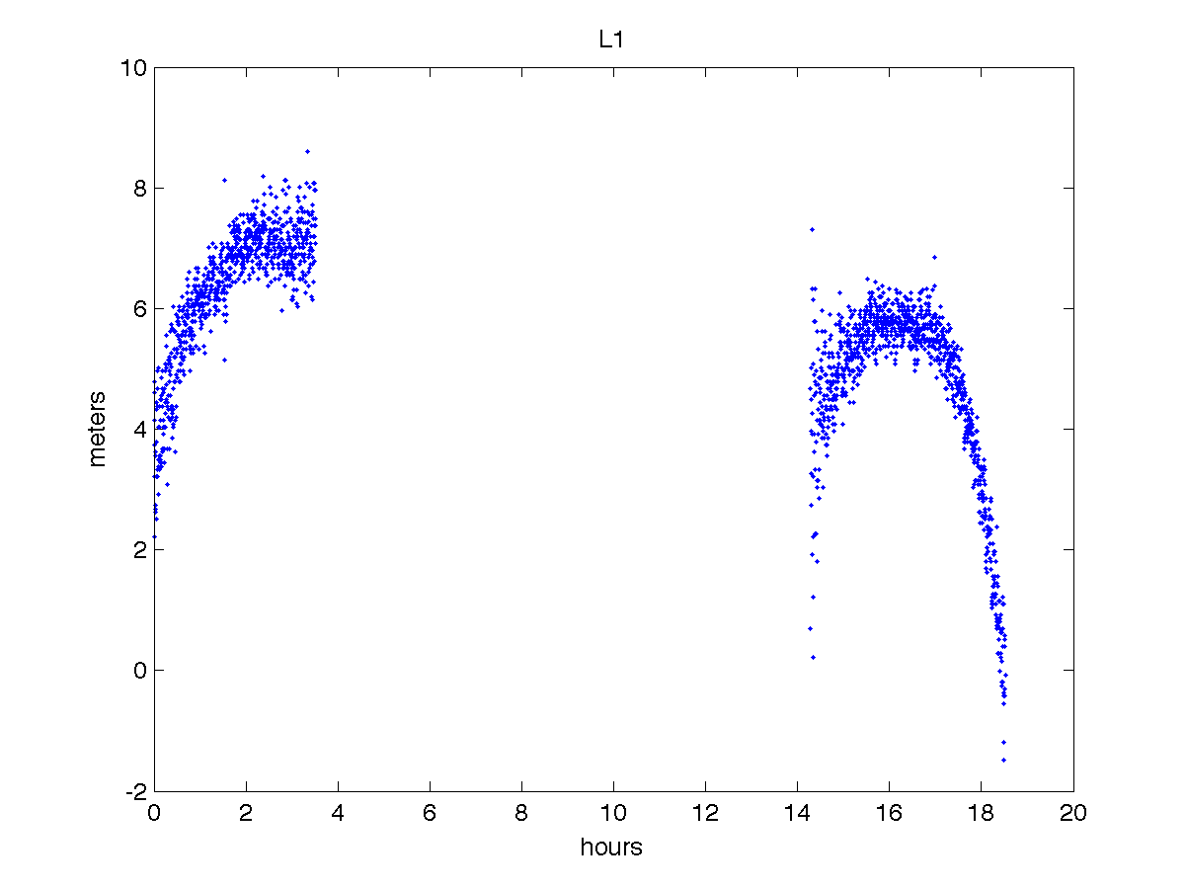
L1 pseudorange minus L2 pseudorange
Only ionosphere, multipath, and noise, no clocks or troposphere!

Slide 26
CARRIER PHASE MEASUREMENT
Receiver accumulates changes in the carrier frequency of the received signal
This accumulation provides a measure of the change in range to the satellite (ADR or accumulated delta range).
This means that carrier phase data have an unknown bias that must be estimated for the data to be used.
Precision of the observation is ~1% of the wavelength, ~2 mm (a little better)
Implications?

Slide 27
CARRIER PHASE MEASUREMENT

Slide 28
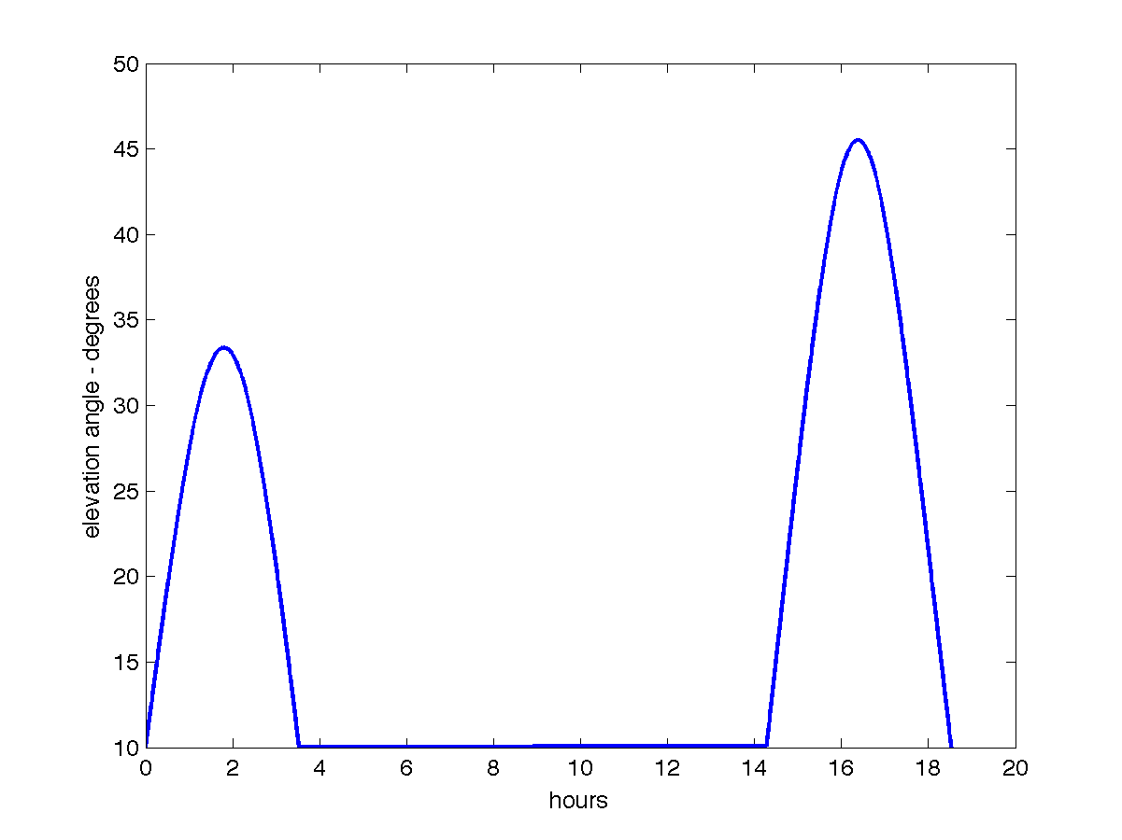
Elevation Angle

Slide 29
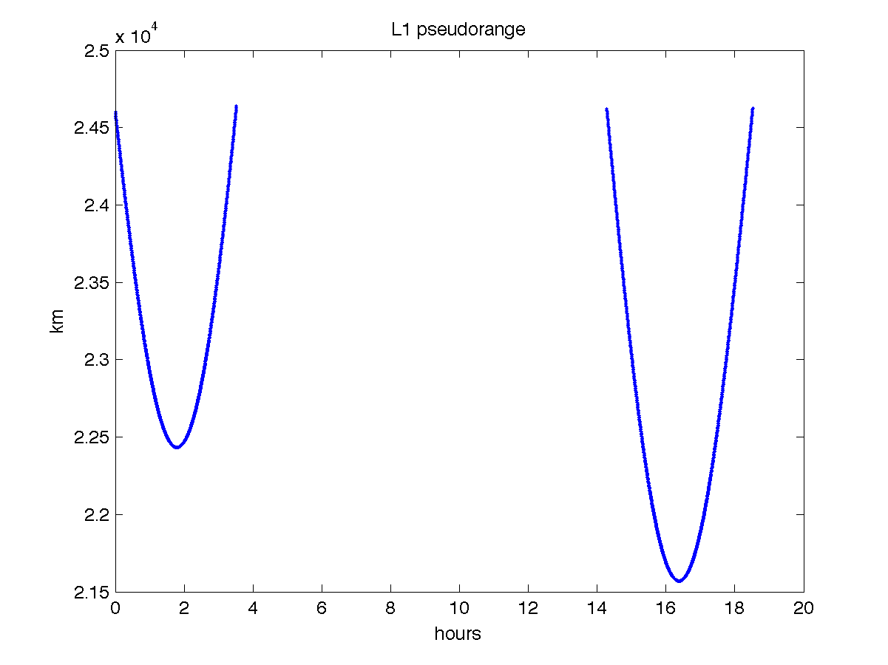
L1 Pseudorange

Slide 30
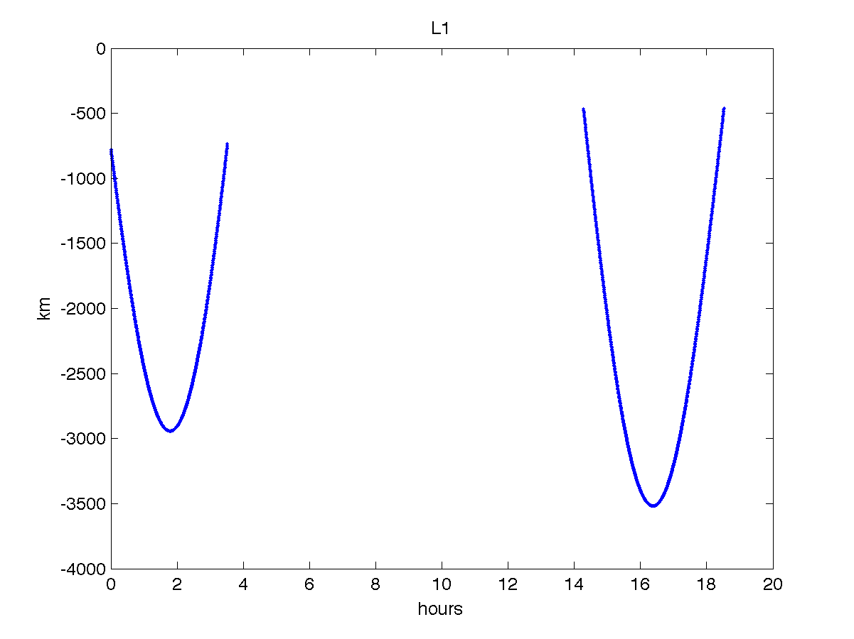
L1 Phase

Slide 31
Subtract geometric range, satellite clock, troposphere, relativity

Slide 33
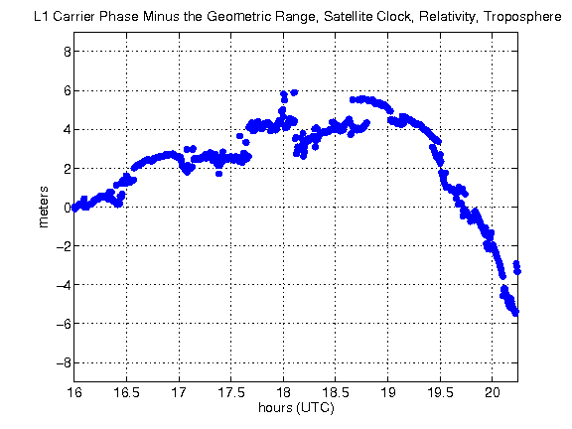
Compare with this with previous slide.

Slide 34
Why are these offset?

Slide 35
Because the absolute value of carrier phase means nothing.
It only accurately measures range change.

Slide 36
L1 minus L2 phase would tell you what?

Slide 37
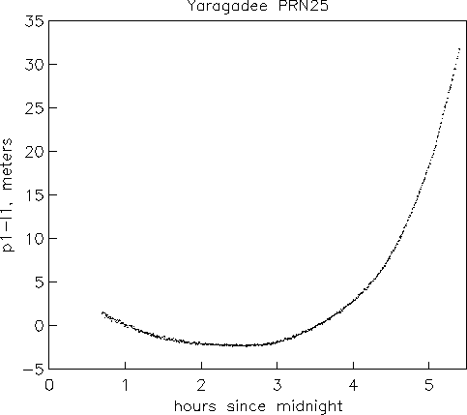

Slide 38
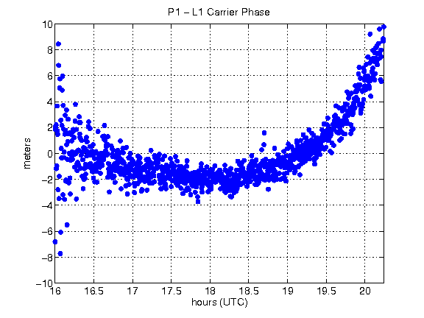

Slide 39
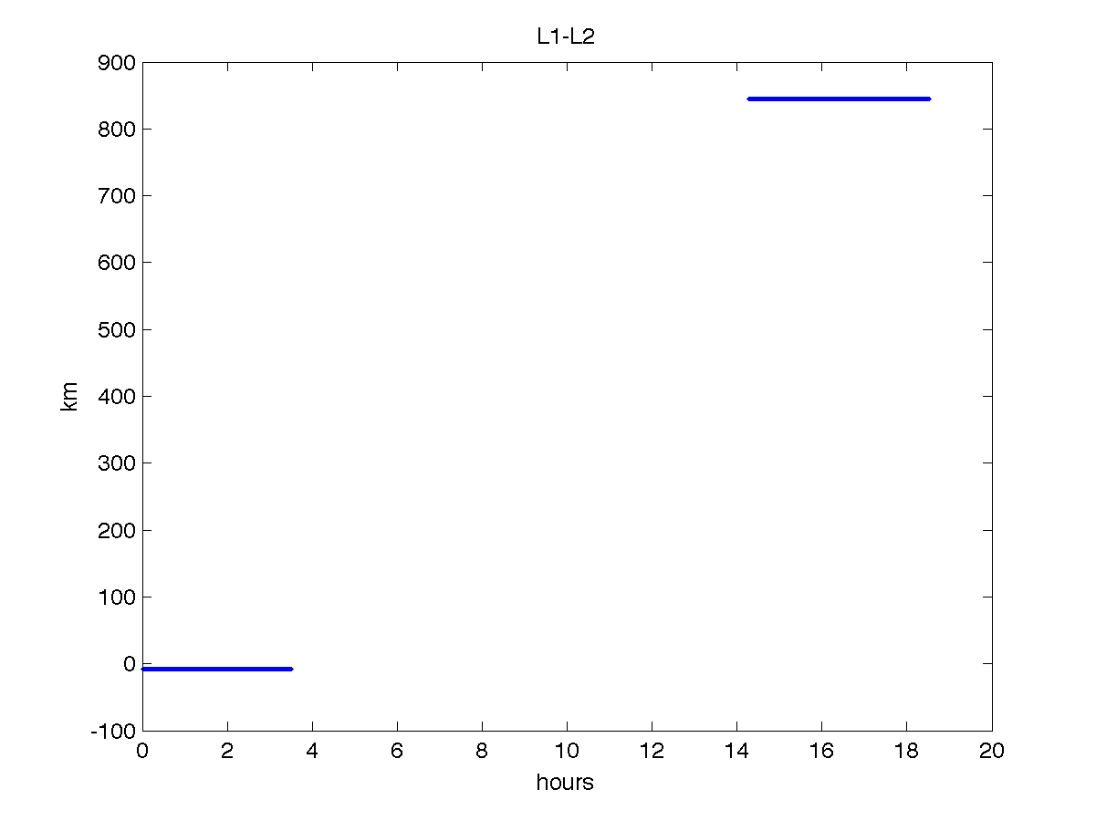
Our case with two satellite arcs

Slide 40
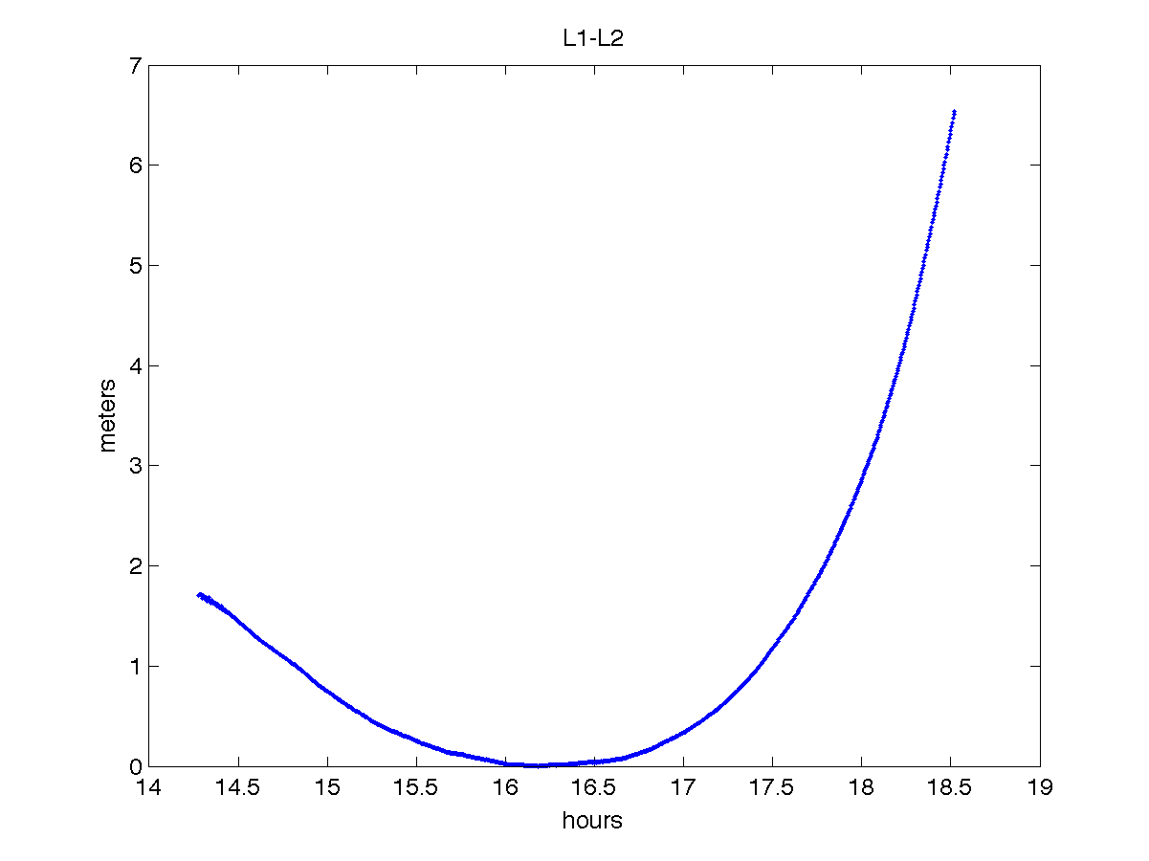
L1 – L2

Slide 41
L1 CARRIER PHASE –L2 CARRIER PHASE would tell you what?

