Slide 1
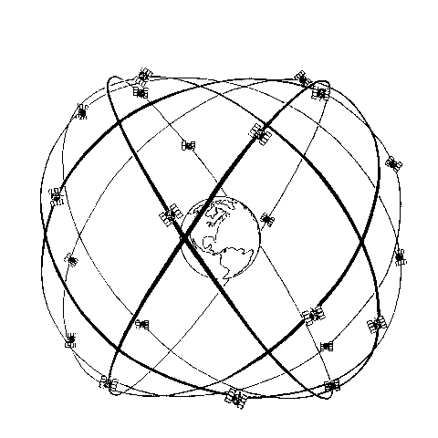
Midterm review
ASEN 5090
ASEN 5090 LECTURE NOTES – LARSON, AXELRAD

Slide 2
Questions on Homework 5 or Homework 6?
Due 5 pm on Friday (CAETE one week later).
Kepler’s equation, while loops

Slide 3
Some Rules
The exam is open note. You can use pdf files on your computer which I guess means you could download my lectures, but I think you will waste a lot of time looking for answers in them.
You are not allowed to use the internet during the exam.
If you use the internet or communicate (traditional or electronic) with other students during the exam, you’ll receive a 0.
CU has an honor code. You will be reminded of that before you take the exam. I have some sympathy for stressed out undergrads – I don’t have this sympathy for graduate students and will report cheating to the honor council. This is graduate school! You should be able to do poorly on an exam and recover from it.

Slide 4
Statistics
Computing things like mean and standard deviation and standard deviation of the mean only make sense if the errors in what you are measured are randomly distributed.
So what? Who cares? (I found this on the web)
What does it hurt to report a number with excessive significant figures? First of all, it shows that the engineer doesn’t understand what numbers are. Numbers are merely our way of quantifying the world. As measurements are never perfect, numbers used in engineering are never perfect! Don’t fool yourself. Engineers must recognize and acknowledge uncertainty. False confidence is evil! Avoid it! Excessive significant figures communicate a level of precession that is not present. Miscommunication is evil! Avoid it!

Slide 5
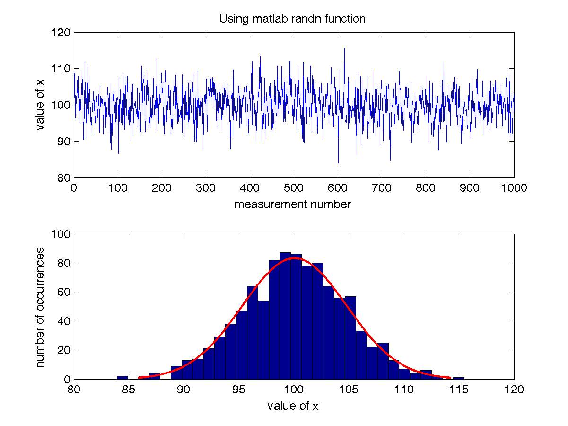

Slide 6
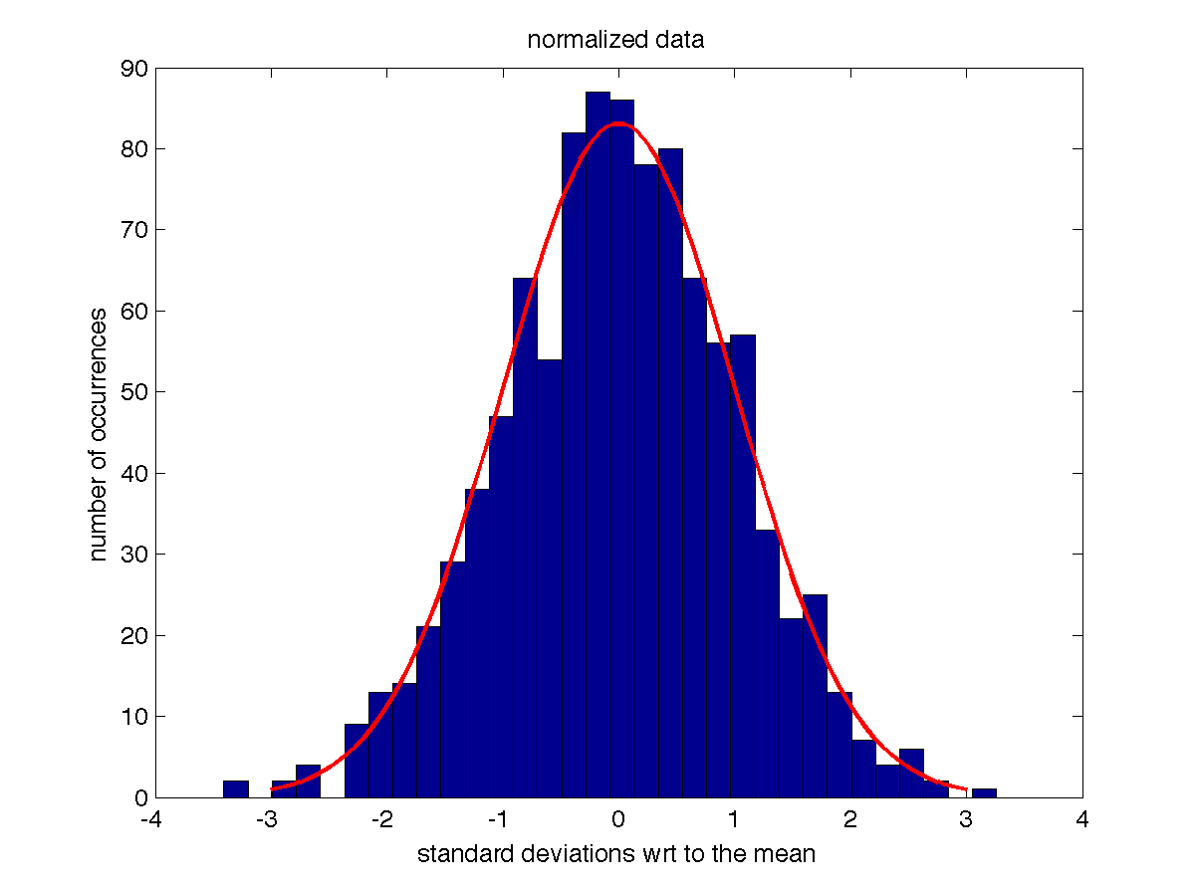

Slide 7
Matlab reported the following
sigma =
4.734983362066172
mn =
100.0557211224126
My question to you: would you report these numbers to me as valid
mean and observation standard deviations?
I would say you really only know the mean was ~100 and the obs standard
dev was 5 (units unknown)
Standard deviation of the mean is 5/sqrt(N) where N is number of obs.

Slide 8
Remember – you’ll get different answers
Nobs Mean DataSig MeanSig
20 99.59 4.50 1.01
100 98.55 4.74 0.47
1000 100.17 4.85 0.15
10000 100.06 5.03 0.05
Nobs Mean DataSig MeanSig
20 100.03 6.03 1.35
100 100.40 4.35 0.43
1000 100.08 4.67 0.15
10000 100.02 4.95 0.05
Nobs Mean DataSig MeanSig
20 101.80 4.12 0.92
100 100.83 4.68 0.47
1000 99.63 5.10 0.16
10000 100.03 4.99 0.05
Nobs Mean DataSig MeanSig
20 98.60 4.11 0.92
100 99.63 4.39 0.44
1000 100.23 5.15 0.16
10000 100.02 5.01 0.05

Slide 9
BASIC GPS MEASUREMENT: PSEUDORANGE
Receiver measures difference between time of transmission and time of reception based on correlation of received signal with a local replica

Slide 10
PSEUDORANGE IS ITSELF BASED ON …

Slide 11
PSEUDORANGE OBSERVABLE MODEL (relativity left out for simplicity) - How big?

Slide 12
General information about the GPS constellation

Slide 13
More particularly about the GPS Signal Structure

Slide 14
General information about GPS Orbits

Slide 15
How is GPS different/same as GLONASS?

Slide 16
Control Segment

Slide 17
General historical information that shows you watched the video on day 2 of class…

Slide 18
General Principles of Positioning
Also talk about Geometry of satellites in the sky …

Slide 19
PRN codes (but not too much)

