Slide 1
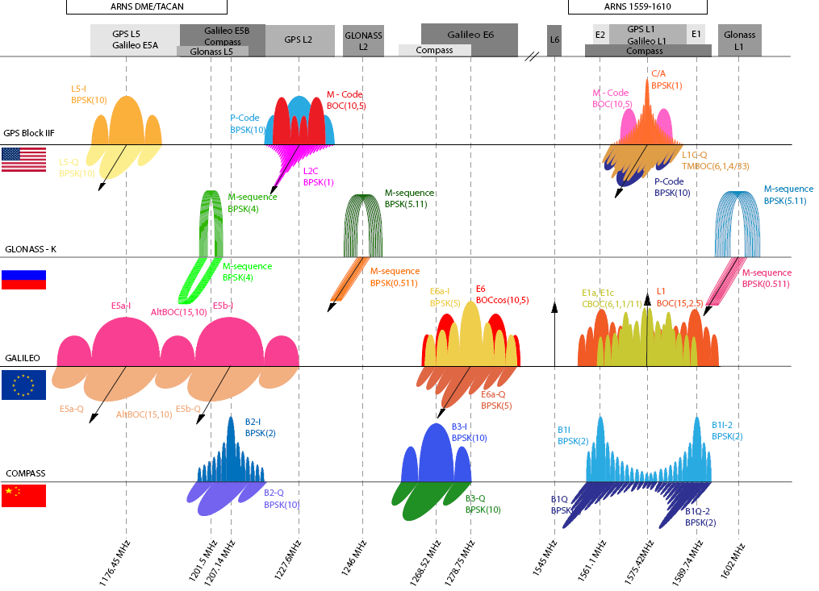
Signal Structure
ASEN 5090
Courtesy He Lin, University of Colorado
ASEN 5090 LECTURE NOTES – LARSON, AXELRAD

Slide 2
Outline
L1 and L2 carriers
PRN Codes, CDMA, BPSK
Navigation Message
Correlation properties
Spectrum
Signal power
Reading Assignment
Ch 2, problems 2-1 and 2-2 (See assignment page)
Questions to think about
What features of GPS are enabled by the codes?
Why 2 frequencies?
Would there be an advantage to substantially increasing the GPS signal power? Any downsides?

Slide 3
SIGNAL COMPONENTS
Base frequency is f₀ = 10.23 MHz = 10,230,000 Hz (cycles/sec)
L1 = 154 f₀ = 1575.42 MHz
L2 = 120 f₀ = 1227.6 MHz
C/A code chip rate = f₀ /10 = 1.023 Mcps (MHz), 1 ms long
P code chip rate = f₀ = 10.23 Mcps (MHz), 37 weeks long, each satellite gets a 1 week segment
Navigation Data rate = 50 bps, 20ms per bit, 6 s per frame, 30 s for individual satellite data, 12.5 min for all

Slide 4
PROPERTIES OF CODES
Protect against interference
Reduce noise effects
Permit many signals to be transmitted at the same frequency without interfering (known as : code division multiple access - CDMA)
Permit high resolution ranging
Enable communications security (known as : low probability of detection - LPD)
Key characteristics of codes are their type, length, chip rate.

Slide 5
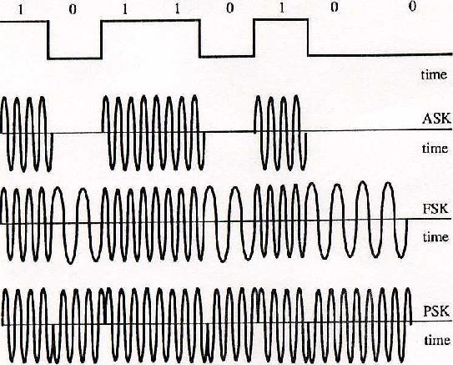
PRN CODES (pseudo random noise codes)
In GPS, a pseudo random noise code used to modulate a carrier tone
Types of modulation: amplitude (AM), frequency (FM), phase (PM)
5
Leick, GPS principles

Slide 6
PRN CODES (pseudo random noise codes)
GPS uses BPSK - (Biphase phase-shift keying) sequence of "1's" and 0's" that specify when phase of carrier should be reversed (1) or left alone (0).
Can consider as a sequence of 0's and 1's or 1 and -1's
In terms of phase-shift keying, 0 corresponds to "don't shift" and 1 corresponds to "shift"
In terms of digital amplitude modulation, multiplying by a "1" leaves the carrier alone (i.e don't shift) and multiplying by a "-1" inverts it (i.e. shifts it by 180 deg).
These codes enable a GPS receiver to measure the transit time of a signal from a GPS satellite to the receiver antenna.
Reference - Spread Spectrum Systems, Robert C. Dixon, Wiley 1984.
6

Slide 7
CORRELATION FUNCTION Rxy(τ)
Correspondence between a code and a phase-shifted replica of another code
Cross correlation – correspondence between different codes: Rxy(τ)
Autocorrelation - correspondence of code w/phase shifted version of itself Rx(τ)
Simple idea: Compare shifted code replica with the original reference. Number of bits which agree minus the number of bits which disagree is the correlation.
Note: these equations should be NORMALIZED.
7

Slide 8
CORRELATION CALCULATION - EXAMPLES
100111101110100010011011111111101
000010001010011100001110010010001
Every time the numbers agree, add 1.
Every time the numbers disagree, subtract 1.
8

Slide 9
This example: codes for 2 different satellites
100111101110100010011011111111111
000010001010011100001110010010001
14 agree
19 disagree
Total score: -5
Perfect agreement would be 33
9

Slide 10
This example: same satellite codes, but shifted
Not so good - score of -3.
01100010101011001000100100000110000011110000
11000101010110010001001000001100000111100001
But if you recognize they are shifted by 1:
01100010101011001000100100000110000011110000
11000101010110010001001000001100000111100001
Agreement is perfect

Slide 11
CALCULATING AUTOCORRELATION(τ)
SHIFT | CODE | AGREE | DISAGREE | AUTOCORRELATION
REF | 1110010 | - | - | -
0 | 1110010 | 7 | 0 | 7
1 | 0111001
2
3
4
5
6
7
11

Slide 12
CALCULATING AUTOCORRELATION(τ)
SHIFT | CODE | AGREE | DISAGREE | AUTOCORRELATION
REF | 1110010 | - | - | -
0 | 1110010 | 7 | 0 | 7
1 | 0111001 | 3 | 4
2 | 1011100 | 3 | 4
3 | 0101110 | 3 | 4
4 | 0010111 | 3 | 4
5 | 1001011
6 | 1100101
7 | 1110010
12

Slide 13
GENERATING PRN CODES
Tapped feedback shift register
Epoch state
XOR Logic Table
A | B | Y
0 | 0
1 | 0
0 | 1
1 | 1
13

Slide 14
GENERATING A CODE
Example: Generate the PRN code for a 3 stage shift register tapped at [3,2] starting from an all ones state. (The PRN Code is made up of the third stage bit values.)
Shift | Stage |  |  | Code
T | 1 | 2 | 3
0 | 1 | 1 | 1
1
2
3
4
5
6
7
14

Slide 15
GENERATING A CODE
Example: Generate the PRN code for a 3 stage shift register tapped at [3,2] starting from an all ones state. (The PRN Code is made up of the third stage bit values.)
Shift | Stage |  |  | Code
T | 1 | 2 | 3
0 | 1 | 1 | 1
1 | 0 | 1 | 1 | 1
2 | 0 | 0 | 1 | 1
3 | 1 | 0 | 0 | 1
4 | 0 | 1 | 0 | 0
5 | 1 | 0 | 1 | 0
6 | 1 | 1 | 0 | 1
7 | 1 | 1 | 1
15

Slide 16
MAXIMAL LENGTH CODES
Maximal length codes are the longest codes that can be generated by a given number of shift register stages. For an n-stage shift register, the longest code is 2^{n} - 1 chips (i.e. 1's or 0's). Maximal length codes have many interesting properties, especially their autocorrelation function.
For a maximal length code, the autocorrelation function for a phase shift other than 0 or (2^{n} - 1) is -1. For any code, the autocorrelation for a 0 shift is equal to the number of chips in the code.
16

Slide 17
Why is maximal length code 2^{n} -1?
17

Slide 18
GPS C/A CODES (From Misra & Enge, Problem 2.1)
18

Slide 19
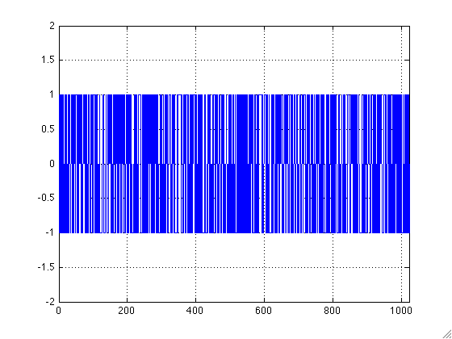
PRN 5 CODE SEQUENCE
19

Slide 20
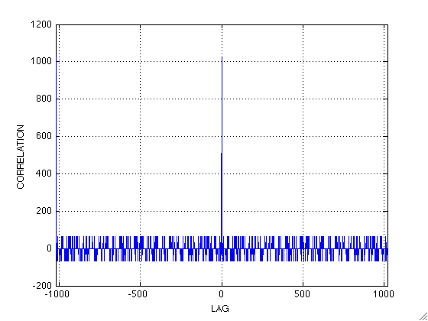
Autocorrelation of PRN 5 C/A Code
20

Slide 21
Computing a cyclic correlation
function P = cyc_corr(x,y)
% Function to compute the cyclic correlation
% for ASEN 5090
% P. Axelrad, University of Colorado, 9/2009
%
% define the inputs! What do they mean?
Y = [y y y]'
n = length(x)
for i = 1:2*n % sweep the lag from –n to + n
Rxy(i) = x*Y(i:i+n-1);
lag(i) = i-1-n;
end
plot(lag,Rxy),grid,xlim([-n n])
xlabel('LAG'),ylabel('CORRELATION')
21

Slide 22
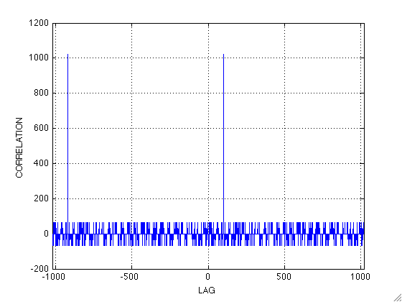
Cross correlation between shifted PRN5 & reference PRN 5
yshifted = [y(101:1023) y(1:100)];
P = cyc_corr(yshifted,y);
22

Slide 23
IMPACT OF CORRELATION PROPERTIES
What makes a useful code?
For ranging:
For CDMA:
For acquisition:
23

Slide 24
NAVIGATION MESSAGE (from Misra & Enge)
Misra & Enge Fig. 4.13
24

Slide 25
SIGNAL SPECTRUM
What frequencies are present in the signal
25

Slide 26
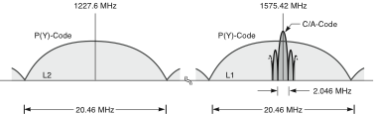
LEGACY GPS SPECTRUM
PRN codes have a sinc² spectrum
Main lobe is 2x chipping rate
Side lobes are 1x chipping rate
Power density is very low
26

Slide 28
SIGNAL POWER
dB
GPS Satellites transmit 27W toward the earth
GPS Signal level on the ground:
L1 C/A: -158.5 dBW ~10⁻¹⁶ Watts
L1 P(Y): -161.5 dBW
L2 P(Y): -164.5 dBW
Spread spectrum signal is “sub-thermal” or below the noise floor
After correlation in the receiver the recovered or despread carrier is above the noise (typical SNR’s 6-15 dB).
Processing gain for spread spectrum is signal BW/ data BW
28

Slide 29
DECIBELS
RdB = 10 log10 (R)
29

Slide 30
GPS LEGACY SIGNAL GENERATION
90 deg shift
L1 CARRIER 1575.42 MHz
Σ
C/A CODE 1.023 Mcps
NAVIGATION DATA 50 bps
Σ
P(Y) CODE 10.23 Mcps
L2 CARRIER 1227.6 MHz
30

