Slide 1
idealo
Product Analyst Case Study
User Journey Analysis and Feature Improvement
Sandeep Uprety

Slide 2
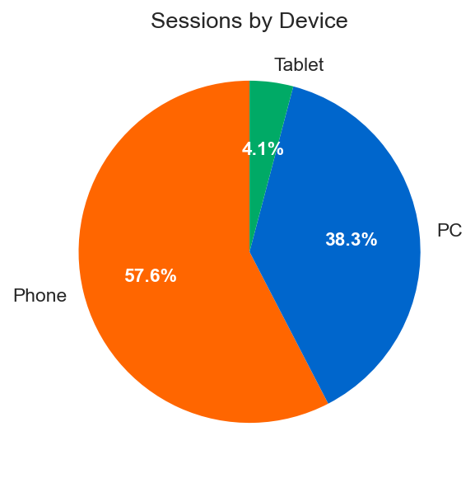
Executive Summary
70.2%
25.3%
47.8%
Sessions from Google
Conversion Rate
Bounce Rate
57.5%
2.68%
27%
Mobile Traffic
Homepage -> OOP
Top Category (Electronics)
KEY INSIGHTS
• 78% of users land directly on product pages
• PC converts 5pp better than mobile
• Homepage has 64% bounce rate
Conversion by Device
PC: 28.5%
Phone: 23.4%
Tablet: 24.3%
Traffic share by device
OOP = OffersOfProduct (Product page)

Slide 3
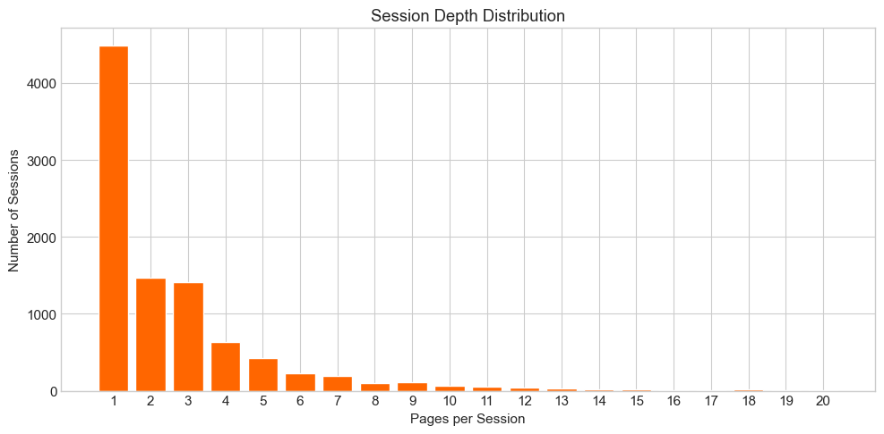
Q1
Most Typical User Flows
2.84
Single Product Page Visit
Browse Multiple Products
35.4%
7.4%
OOP -> Exit
OOP -> OOP -> OOP
Avg pages/session
47.8%
Homepage Only
Product -> Convert
6.5%
7.7%
Bounce rate
Home -> Exit
OOP -> GoToShop
“Pages per Session” How many pages users view before leaving

Slide 4
Q1
Top 3 Learnings from User Flow
1
2
3
Product pages are the real landing pages
High bounce rate signals opportunity
Users who compare are more likely to convert
78% of users land directly on product pages from Google. Only 12% start at homepage.
48% leave after just one page. Most common journey is single product page visit.
Conversion journeys show 2-3 product pages before clicking to shop.
Product pages must work as both landing AND conversion pages.
Users may not find what they need or lack incentive to explore.
Helping users compare products could improve conversion.

Slide 5
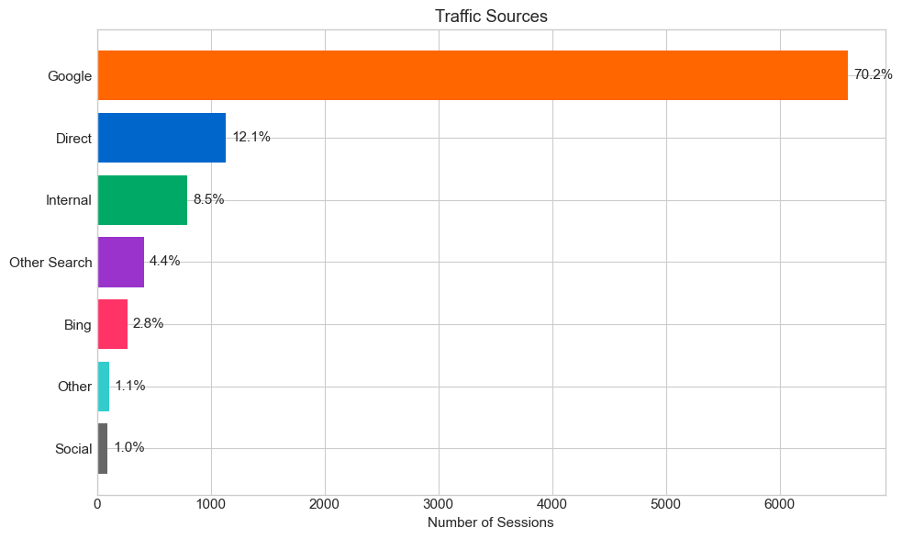
Q2
Sessions from Google
70.2%
from Google
6,600 out of 9,405 sessions
Key Insight: Heavy SEO dependency. Social channels underutilized (only 1%).

Slide 6
Q3
Homepage to Product Page Journey
Total Sessions
SHARE OF TOTAL SESSIONS
9,405
100%
2.68%
↓
Landed on Homepage
Landed on home and viewed OOP
1,130
12.0%
↓
Homepage -> OOP Conversion Rate
Homepage AND saw OOP
22.3%
252
2.68%

Slide 7
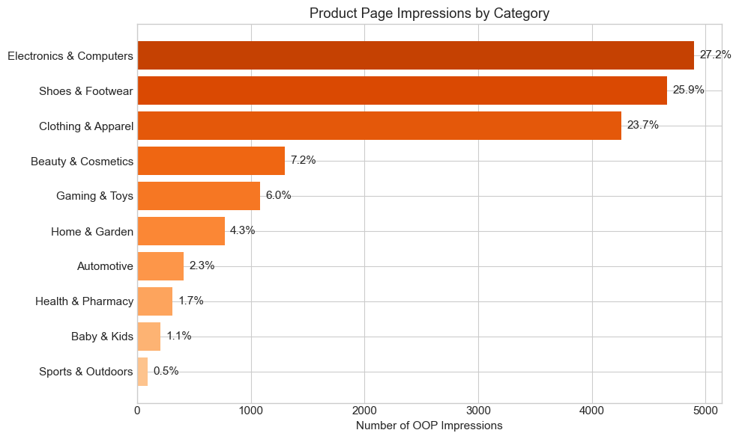
Q4
OOP Impressions by Root Category
TOTAL OOP IMPRESSIONS
17,984
TOP 3 CATEGORIES
77%
Of all product page views

Slide 8
SQL Queries
Q1
Most Typical User Flows:
Q2
Sessions from Google
WITH ordered_pages AS (
SELECT
session_id,
page_template,
ROW_NUMBER() OVER (PARTITION BY session_id ORDER BY trace_time) AS page_order
FROM sessions
),
journey_paths AS (
SELECT
session_id,
GROUP_CONCAT(page_template, ' -> ') AS journey
FROM ordered_pages
GROUP BY session_id
)
SELECT
journey,
COUNT(*) AS sessions,
ROUND(COUNT(*) * 100.0 / (SELECT COUNT(*) FROM journey_paths), 1) AS percentage
FROM journey_paths
GROUP BY journey
ORDER BY sessions DESC
LIMIT 15
WITH first_touch AS (
SELECT
session_id,
http_referer_apexdomain,
ROW_NUMBER() OVER (PARTITION BY session_id ORDER BY trace_time) AS rn
FROM sessions
)
SELECT
SUM(CASE WHEN http_referer_apexdomain LIKE '%google%' THEN 1 ELSE 0 END) AS google_sessions,
COUNT(*) AS total_sessions,
ROUND(SUM(CASE WHEN http_referer_apexdomain LIKE '%google%' THEN 1 ELSE 0 END) * 100.0 / COUNT(*), 2) AS google_share_pct
FROM first_touch
WHERE rn = 1

Slide 9
Q3
Homepage to OOP
Q4
OOP Impressions by Category
WITH landing_page AS (
SELECT
session_id,
page_template,
ROW_NUMBER() OVER (PARTITION BY session_id ORDER BY trace_time) AS rn
FROM sessions
),
home_landings AS (
SELECT session_id
FROM landing_page
WHERE rn = 1 AND page_template = 'MainProductCategory'
),
oop_views AS (
SELECT DISTINCT session_id
FROM sessions
WHERE page_template = 'OffersOfProduct'
),
total AS (
SELECT COUNT(DISTINCT session_id) AS total_sessions
FROM landing_page
WHERE rn = 1
)
SELECT
COUNT(DISTINCT h.session_id) AS home_and_oop_sessions,
(SELECT total_sessions FROM total) AS total_sessions,
ROUND(COUNT(DISTINCT h.session_id) * 100.0 / (SELECT total_sessions FROM total), 2) AS share_pct
FROM home_landings h
INNER JOIN oop_views o ON h.session_id = o.session_id
SELECT
CAST(root_category_id AS INTEGER) AS root_category_id,
COUNT(*) AS oop_impressions,
ROUND(COUNT(*) * 100.0 / SUM(COUNT(*)) OVER(), 1) AS share_pct
FROM sessions
WHERE page_template = 'OffersOfProduct'
AND root_category_id IS NOT NULL
GROUP BY root_category_id
ORDER BY oop_impressions DESC

Slide 10
Most Important Homepage KPIs
Bounce Rate
Homepage -> OOP
Search Usage
64%
22%
17%
% leaving without interaction
% reaching a product page
% using search bar
Key Problem Identified
64% of homepage visitors exit without taking any action. Current homepage doesn't effectively guide users to products.

Slide 11
Proposed Feature: Popular Comparisons
Addresses 64% Bounce
Helps Research Users
Gives browsers actionable content
Meets undecided users where they are
Differentiates
Works for Everyone
Highlights comparison functionality
No login required
THE PROBLEM
THE SOLUTION
Add 'Popular Comparisons' section:
- iPhone 16 vs Samsung Galaxy S25
- Top 5 Noise-Cancelling Headphones
- PS5 vs Xbox Series X
Homepage shows deals and categories but doesn't highlight idealo's core value: price comparison.

Slide 12
Success Metrics
Comparison CTR
TARGET
Of homepage visitors clicking
5-10%
OOP Conversion
TARGET
Improvement from 22% baseline
+2-3pp
Bounce Reduction
TARGET
Reduction from 64% baseline
-5-10pp
A/B Test Plan
- 50/50 split between control and treatment
- 2-3 weeks duration
- Statistical significance required
- Monitor daily for issues

Slide 13
Implementation Plan & My Role
AS PRODUCT ANALYST
Before Launch
• Analyze data for comparisons
• Define success metrics
PHASE 1
Discovery & Planning
Define scope, analyze data for comparisons
During Test
PHASE 2
A/B Test Design
• Monitor results daily
• Check statistical significance
• Flag issues early
50/50 split, 2-3 weeks duration
PHASE 3
Launch & Monitor
Roll out if positive, continue tracking
After Launch
• Build dashboards
• Report insights
• Identify optimizations

Slide 14
Summary
TASK 1: KEY FINDINGS
70.2%
47.8%
25.3%
Google
Bounce
Convert
• 78% land on product pages (bypassing homepage)
• 2.68% land on homepage and view product
• Electronics, Shoes, Clothing = 77% of views
TASK 2: PROPOSAL
Popular Comparisons
Homepage section with head-to-head comparisons to reduce 64% bounce rate
5-10%
-5-10pp
+2-3pp
CTR
Bounce
Conv
Thank You
Sandeep Uprety

