Slide 1
Celebrating the Journey of
Mangalika Pieterzs

Slide 2
Years of Dedication
0
Years of valuable service

Slide 3
Achievements
No achievements added.

Slide 4
Special Memories
Special memories will appear here.

Slide 5
Farewell Message
Wishing you all the best for the future!

Slide 6


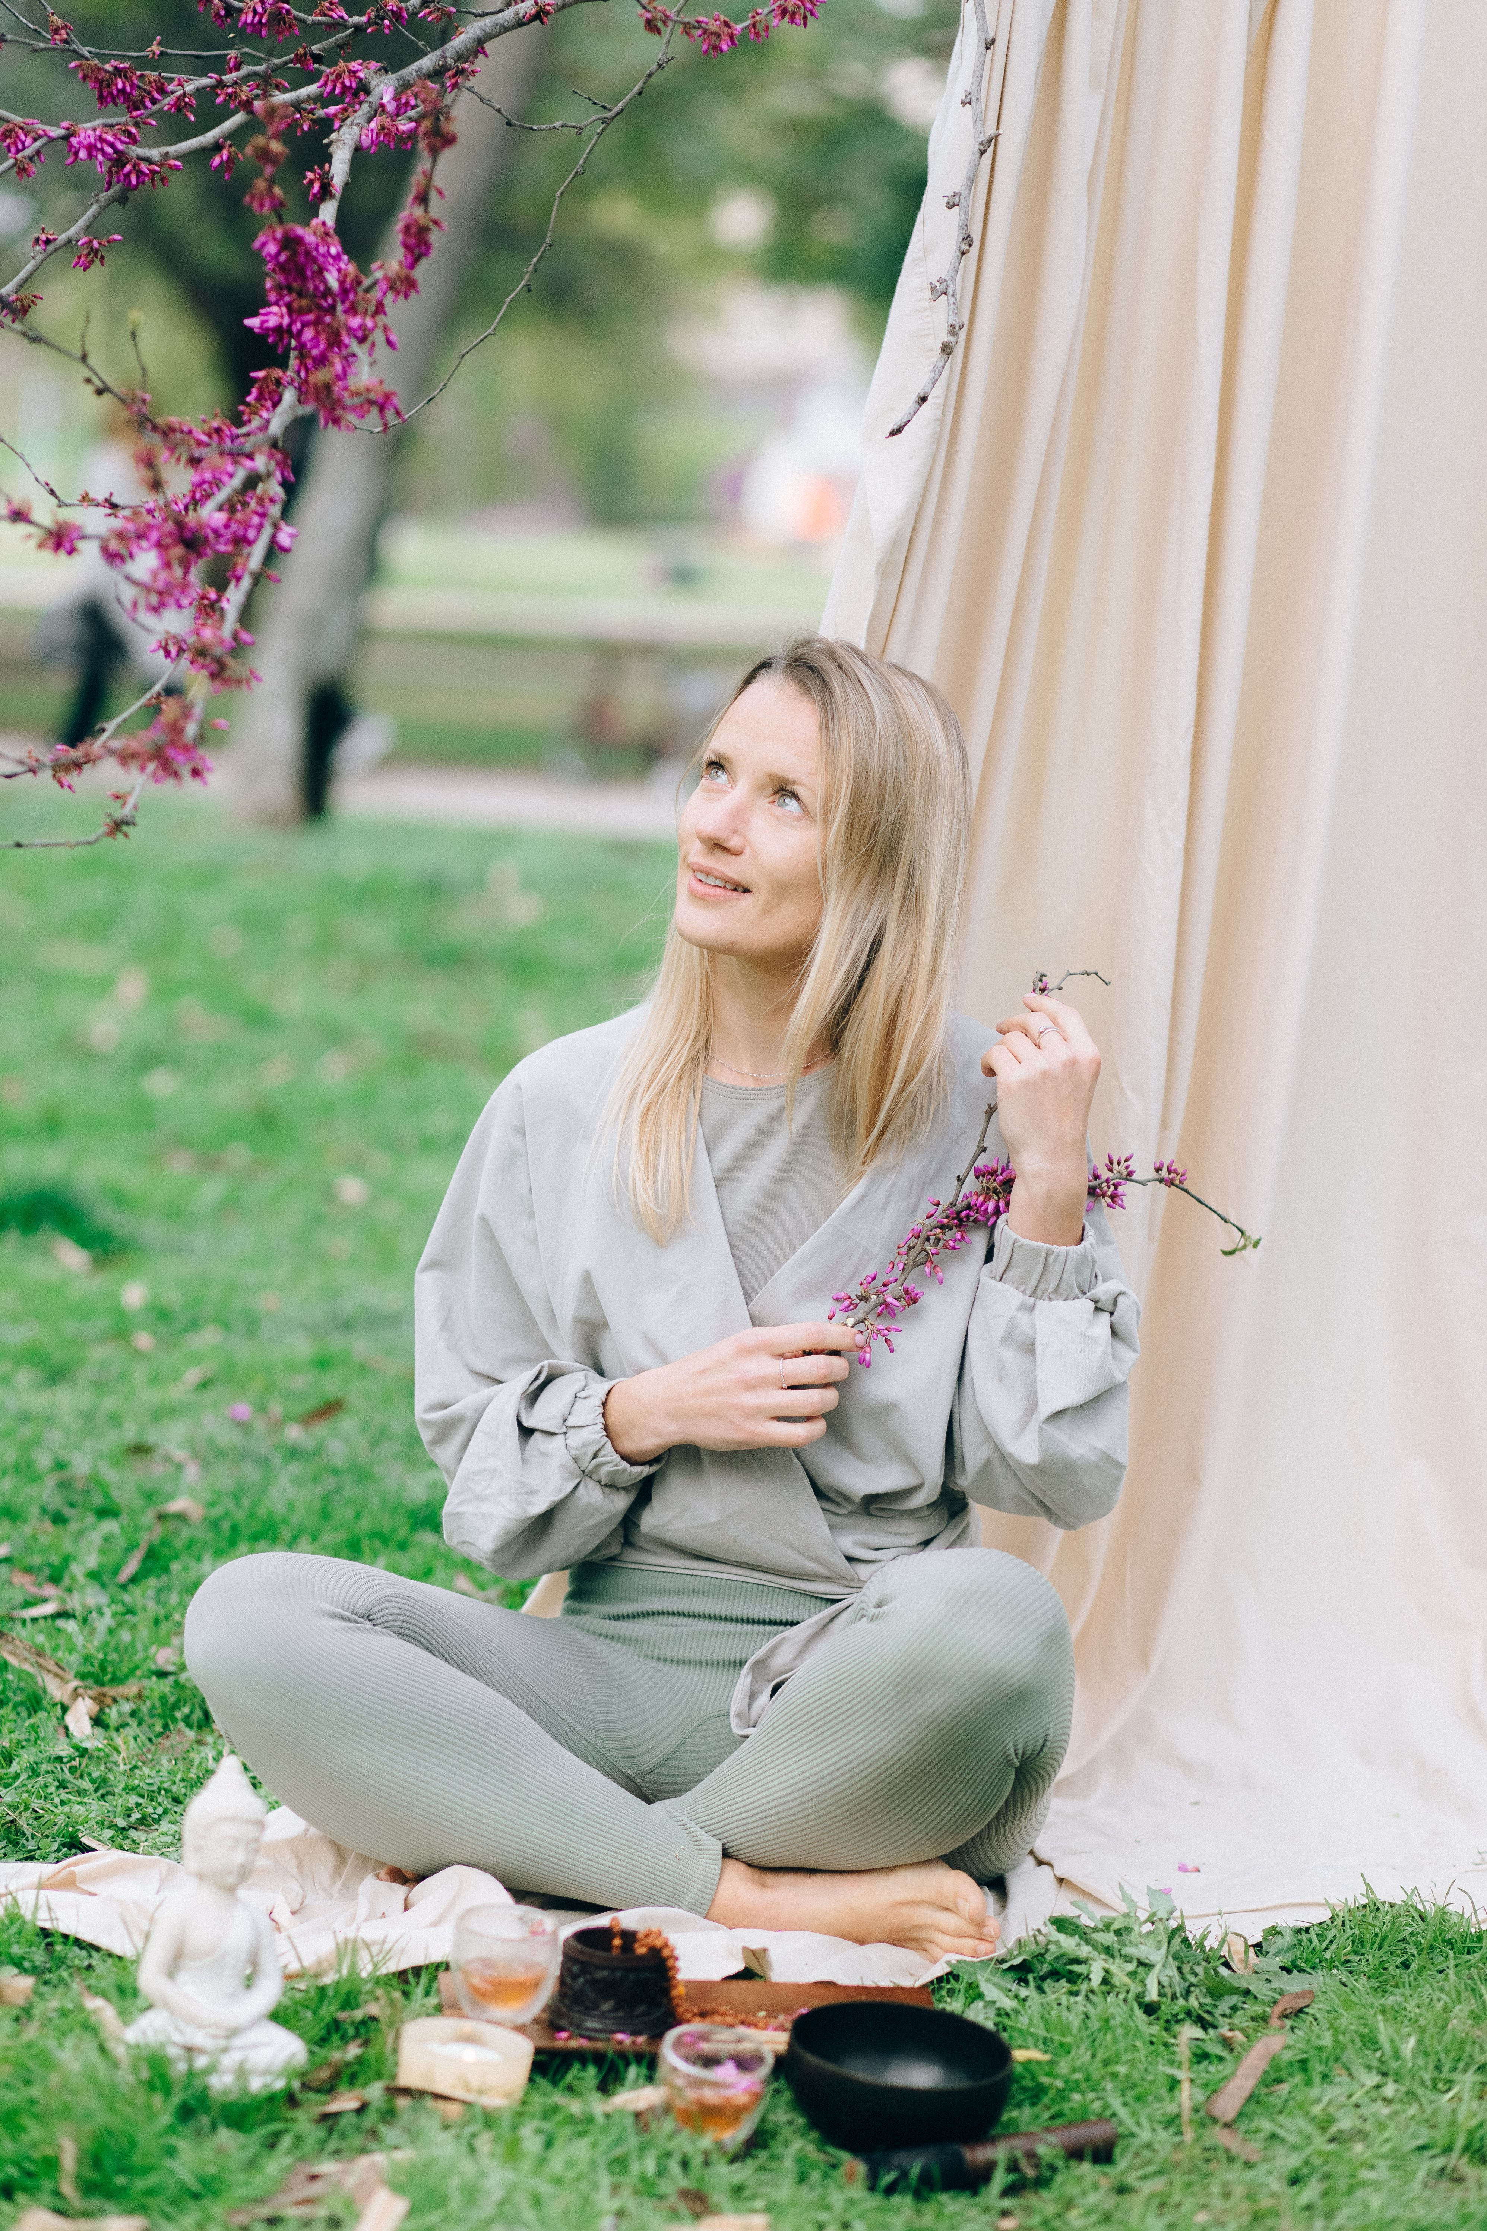
Memorable Moments

