Slide 1


SafeSight AI: Bridging the Analytical Gap through a Predictive Full-Stack Framework for Proactive Hospitality Safety Management
Sandali Silva
Computing Studies & Information Systems

Slide 2
Introduction
Why Workplace Safety Still Fails?
Hospitality = high-risk, high-pressure environment
In the high-pressure environment of luxury hospitality, workplace injuries are often viewed as inevitable operational costs.
Current safety management relies on "lagging indicators"—analyzing accidents after they happen.
The Exigency: for all the institutions in the hospitality industry, a slip in the kitchen or a repetitive injury in housekeeping isn't just a WorkSafeBC claim; it represents a failure in proactive care.
The Goal: SafeSight moves the needle from "What happened?" to "What will happen?"

Slide 3
Research Context
The Digital Imperative in Workplace Safety
Regulatory requirements (e.g., WorkSafeBC frameworks)
Many organizations use:
Paper-based logs
Fragmented digital tools
Result:
Delayed reporting
Poor data visibility

Slide 4
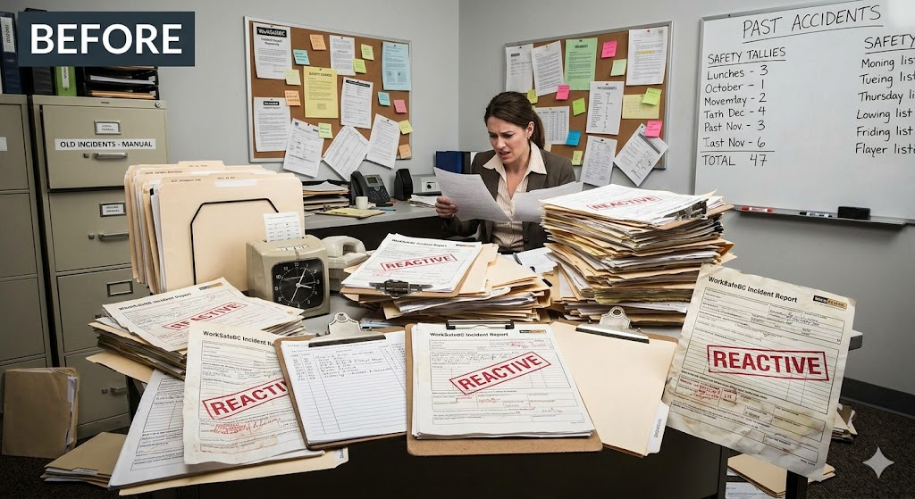
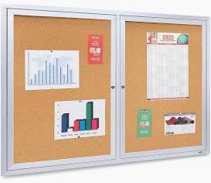
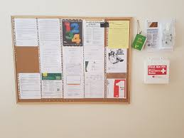
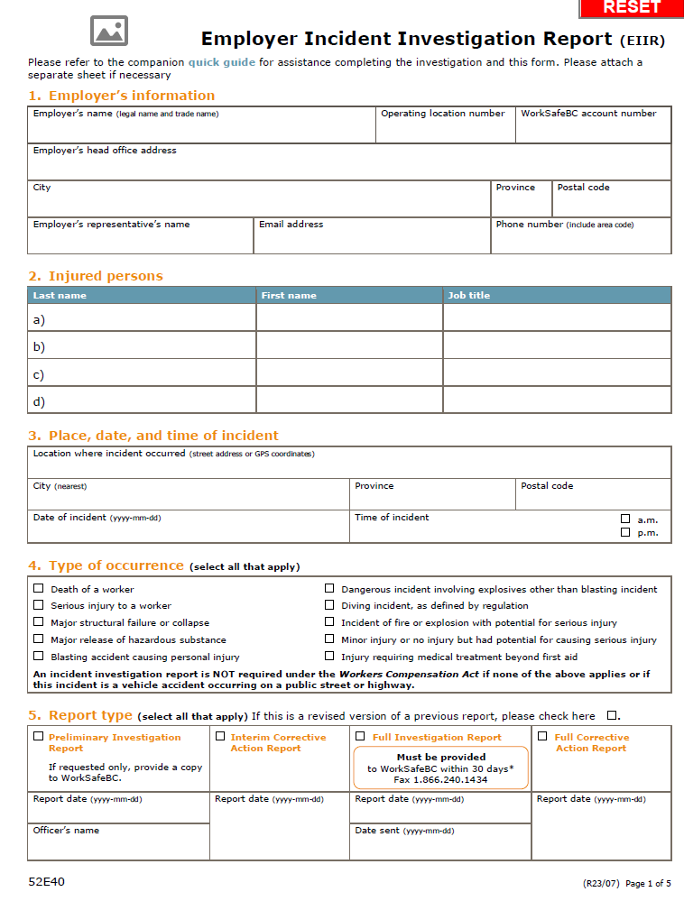
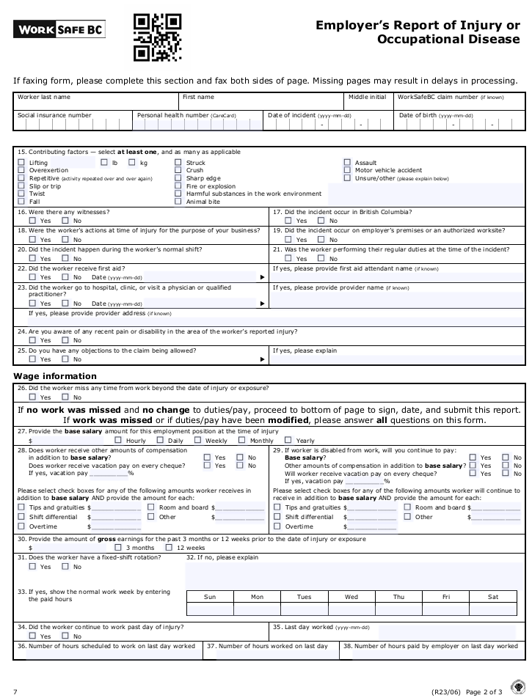
Research Context contd.
Source - Image generated by Gemini 3 Flash (Google), March 2026, from user-defined prompt.
Source – WorkSafe, BC

Slide 5
Problem Statement
Data silos between staff, managers, and HR
Manual compliance processes → errors & fatigue.
No predictive insight → repeated incidents.
Safety management is reactive, fragmented, and inefficient
Reporting delays → active hazards remain unresolved

Slide 6
The Novelty of SafeSight
AI-Prescriptive Logic: Unlike standard trackers, SafeSight uses a Random Forest Classifier to suggest immediate "Strategic Actions.
"Heuristic Dashboarding: Utilizes pre-attentive attributes (color-coding and urgency markers) to reduce cognitive load for managers during high-stress shifts.
Compliance Bridge: Direct data-mapping from a SQL backend to WorkSafeBC official report formats.

Slide 7
Methodology
Research Design
Mixed-Methods Approach
Applied Design Research (ADR)
Evolutionary Prototyping Model
Evaluation
Quantitative → Time efficiency
Qualitative → User Acceptance (TAM model)

Slide 8
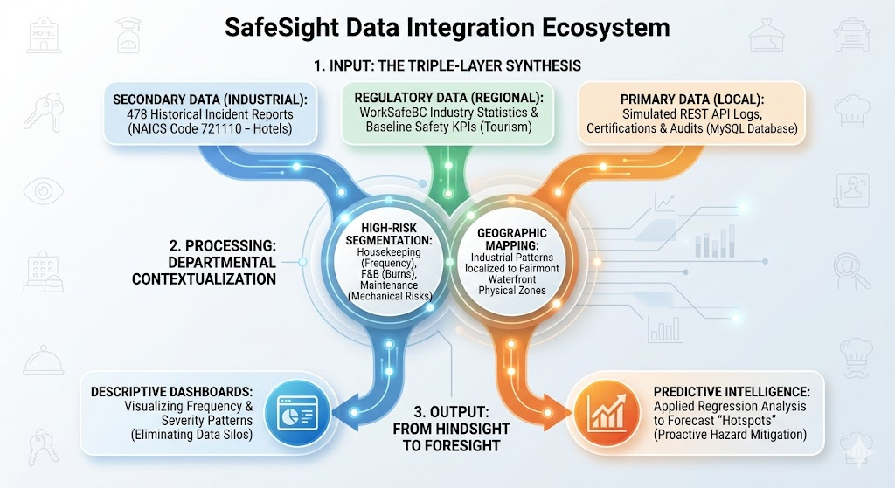

Slide 9

Introducing SafeSight: The Future of Proactive Safety
The Vision: From Hindsight to Foresight
Strategic Shift: SafeSight is a full-stack, role-based safety platform designed to transition organizations from reactive reporting to proactive prevention.
Integrated Ecosystem: By digitizing incident management and providing real-time visibility, it bridges the critical "Information Gap" in high-pressure environments.
Core Pillars of the Platform
Real-Time Reporting: A streamlined portal that reduces the time between an incident and management notification by an estimated 70%.
Role-Based Intelligence: Tailored dashboards for HR Personnel (compliance-focused) and Department Managers (hazard-focused).
Predictive Analytics: An advanced engine using regression models to forecast "hotspots" before accidents recur.
Regulatory Excellence
WorkSafeBC Automation: Features an automated engine that maps internal data directly onto mandatory legal templates, such as Form 7 and form 52E40
Administrative Relief: Aims to reduce the compliance burden by 50%, allowing managers to focus on staff safety rather than paperwork.

Slide 10
Full-Stack Framework & Tech Stack
Layer | Technology | Purpose / Description
Frontend | React.js (SPA), Recharts, HTML, CSS | Builds an interactive single-page application with data visualization and modern UI styling.
Backend | Node.js & Express.js | Provides RESTful API architecture for handling client-server communication.
Database | MySQL | Ensures structured relational data storage with ACID compliance and strong data integrity.
AI Service | Python (Scikit-Learn, Pandas) | Powers machine learning predictions using Random Forest and handles data processing.
Automation | pdfkit, ExcelJS | Enables dynamic generation of compliance reports in PDF and Excel formats.

Slide 11
Functional Architecture (The User Journey)
Phase 1: Entry: Secure Role-Based Access (Department Manager vs. HR).
1
Phase 2: Input: Standardized incident reporting with narrative capture.
2
Phase 3: Analysis: AI Service processes data to identify risk probabilities.
3
Phase 4: Execution: Real-time Dashboard provides actionable "AI Recommendations."
4
Phase 5: Compliance: One-click PDF/Excel export for regulatory submission.
5

Slide 12
AI Model & Intelligence
The Algorithm: Random Forest Classifier (chosen for high handling of non-linear data).
Key Performance Indicators (KPIs):
90.1% Standard Accuracy.
97% Recall for High-Risk incidents (Priority on sensitivity).
Feature Importance: Identified "Month" and "Department" as the primary drivers of risk at the Fairmont Waterfront.

Slide 13
DEMONSTRATION

Slide 14
Results: From Data to Safety Intelligence
What SafeSight Achieves
⏱ Faster reporting (up to 70% improvement)
📉 Reduced errors in compliance reports
🔍 Identification of high-risk zones
📊 Data-driven decision-making

Slide 15
Evaluation & Utility
Technique: User Acceptance Testing (UAT) and Comparative Benchmarking.
Stakeholder Feedback Impact: * Pivot: Transformed raw scores into "Strategic Actions."
Result: 60% improvement in incident triage efficiency during mock trials.
Reliability: Implemented Defensive Analysis to account for class imbalance (Stable vs. High Risk).

Slide 16
Discussion and Implications
Why This Matters
For HR:
Better compliance
Reduced liability
For Managers:
Less admin work
Smarter decisions
For Industry:
Improved employee safety
Cost reduction
Stronger employer branding

Slide 17
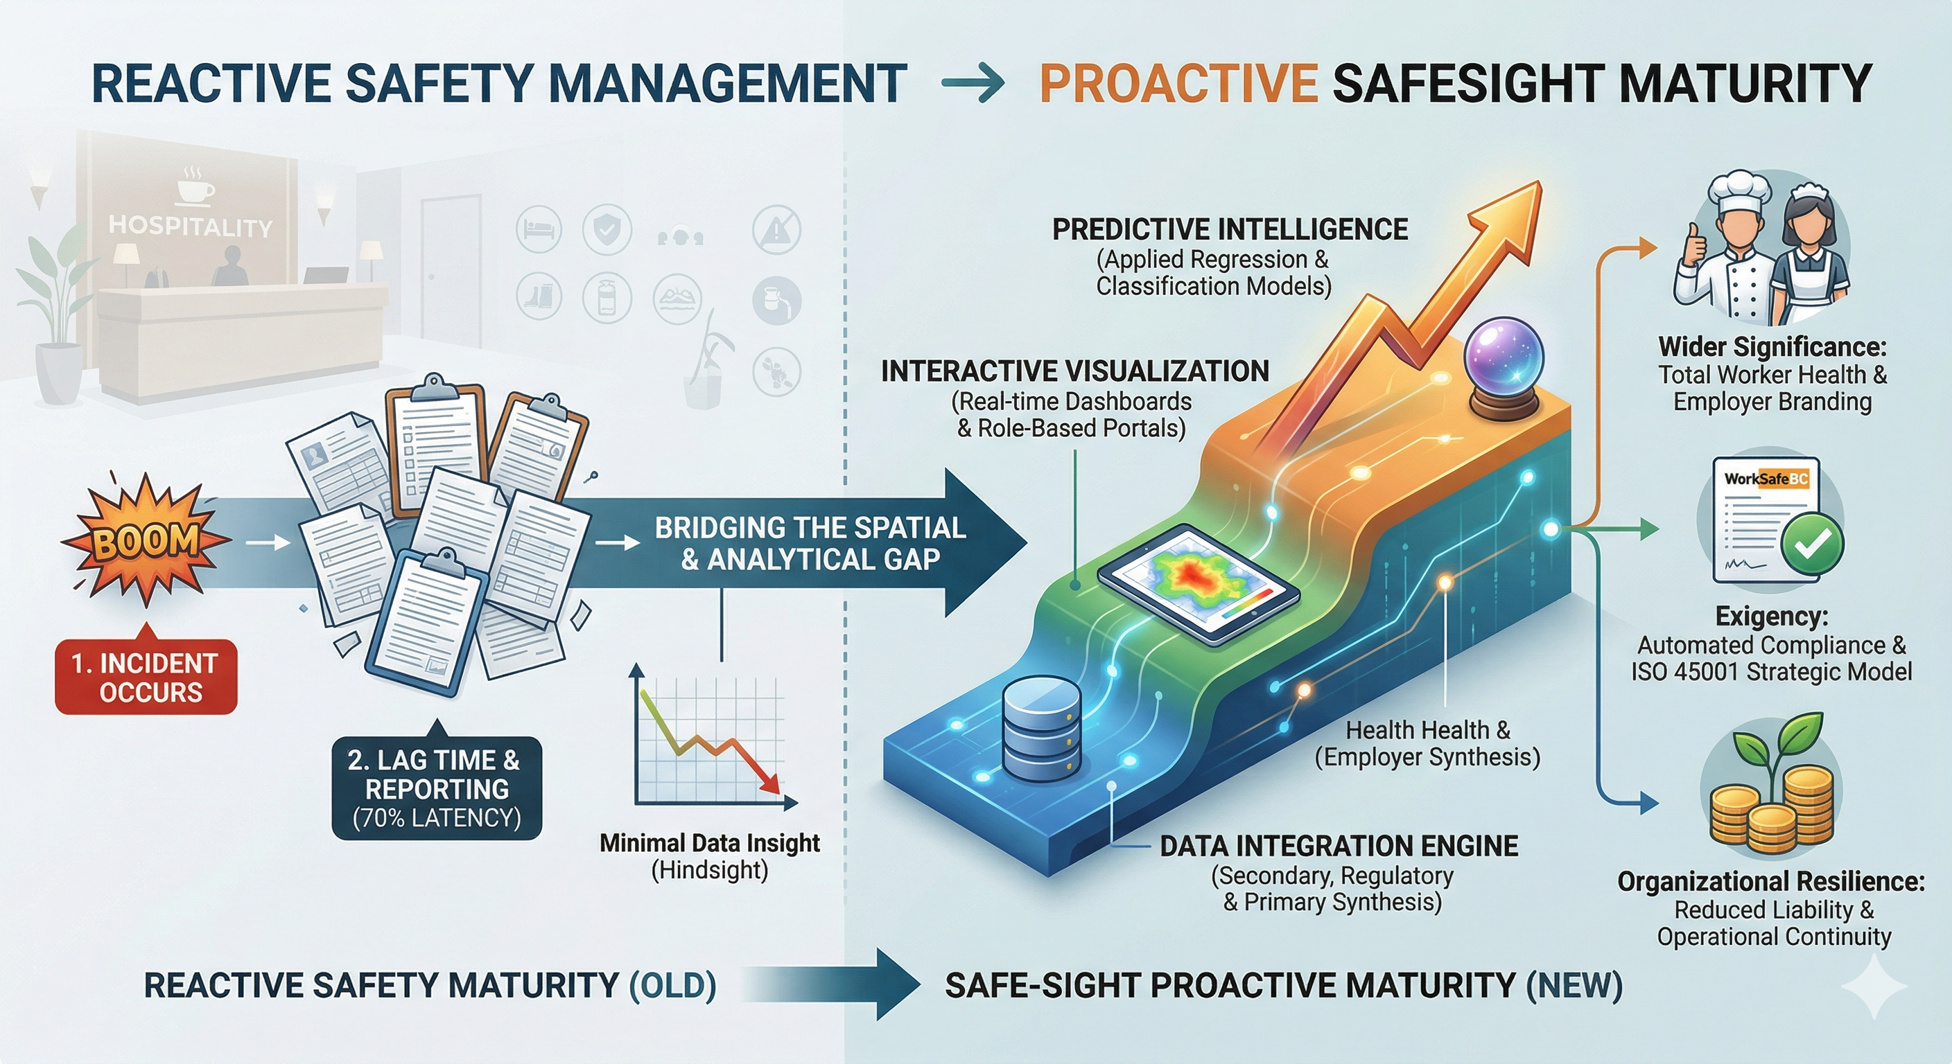

Slide 18
Challenges Faced
Data Imbalance: Balancing a model where 90% of days are "Safe" required moving beyond standard accuracy metrics.
Microservice Decoupling: Managing asynchronous communication between the Node.js backend and Python AI engine.
Validation Logic: Ensuring "Zero Null" data entries via checkFields.js to maintain ML model health.

Slide 19
Lessons Learned
Utility over Complexity: Stakeholders value clear instructions (Prescriptive Actions) more than complex statistical probabilities.
Clean Data = Accurate AI: The importance of strict SQL schemas in ensuring the quality of machine learning outputs.
Modular Design: How a decoupled architecture simplifies troubleshooting and allows for enterprise scalability.

Slide 20
Conclusion: The New Standard for Workplace Safety
From Reactive to Proactive: SafeSight successfully bridges the "Analytical Gap" by transforming 478 historical records into leading indicators for risk prevention.
Operational Excellence: The system achieves a 70% reduction in reporting latency, ensuring that WorkSafeBC compliance is a seamless part of the hospitality workflow.
Total Worker Health: By integrating predictive heatmaps with role-based dashboards, we move beyond simple compliance to a strategic model of organizational resilience and staff wellbeing.
The "So What": SafeSight proves that in the 2026 luxury hospitality market, protecting the workforce through digital intelligence is the ultimate competitive advantage

Slide 21
References
British Standard Institution, 1996. BS 8800: guide to occupational health and safety management systems. , London: British Standards Institution.
Chan, E. S. W. & Lam, D., 2013. Hotel safety and security systems: Bridging the gap between managers and guests. International Journal of Hospitality Management, 32(ISSN 0278-4319), pp. 202-216.
Cooper, M. D., 2000. Towards a model of safety culture. Safety Science, 36(2), pp. 111-136.
Future Skills Centre, 2024. Mind Your Health, Canada: https://fsc-ccf.ca/wp-content/uploads/2024/10/mind-your-health-2.pdf.
Gallagher, C., Underhill, E. & Rimmer, M., 2003. Occupational safety and health management systems in Australia: barriers to success. Policy and Practice in Health and Safety, 1(1), pp. 67-81.
ILO, 2001. Guidelines on Occupational Safety and Health Management Systems, International Labour Office, Geneva.: MEOSH/2001/2(Rev.).
Lindholm, M., Reiman, A. & Tappura, S., 2024. The evolution of new and emerging occupational health and safety risks: A qualitative review. Work (Reading, Mass.), 79(2), pp. 503-521.
Nelson, M. S., Wooditch, A. & Gabbidon, S. L., 2013. Is Criminology Out-of-Date? A Research Note on the Use of Common Types of Data. Journal of Criminal Justice Education, 25(1), pp. 12-16.
OSHA, 2026. Occupational Safety and Health Administration. [Online] Available at: https://www.osha.gov/severe-injury-reports [Accessed 15 01 2026].
Shah, F., 2026. Digital Incident Management: The Case For Modernizing Safety Reporting. [Online] Available at: https://www.cority.com/blog/digital-incident-management/ [Accessed 20 01 2026].
Stone, D. L., Deadrick, D. L., Lukaszewski, K. M. & Johnson, R., 2015. The influence of technology on the future of human resource management. Human Resource Management Review, 25(2), pp. 216-231.
The HUB International, 2026. How Risk Management Maturity Leads to Resilience and Profitability, Canada: HUB.
Workers Compensation Act (2026) [RSBC 2019] Chapter 1.
WorkSafe BC, 2025. WorkSafe BC. [Online] Available at: https://www.worksafebc.com/en [Accessed 20 01 2026].

Slide 22
THANK YOU!

