Slide 1
A method of planning optimal routes for Autonomous ‘Thermalling’ Gliders
Muhammad Aneeq uz Zaman

Slide 2
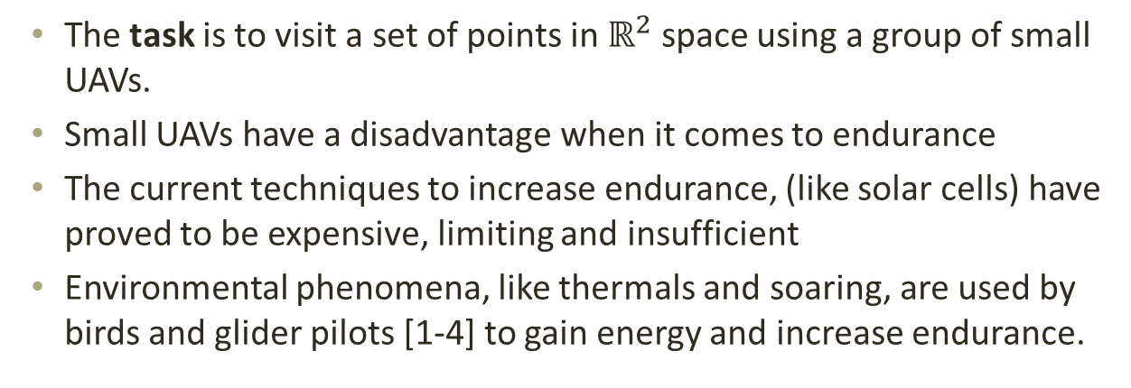
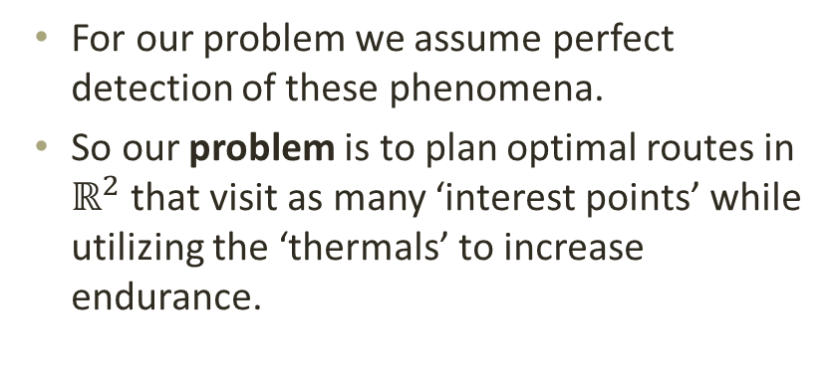
Problem Statement
The task is to visit a set of points in $ℝ^{2}$ space using a group of small UAVs.
Small UAVs have a disadvantage when it comes to endurance
The current techniques to increase endurance, (like solar cells) have proved to be expensive, limiting and insufficient
Environmental phenomena, like thermals and soaring, are used by birds and glider pilots [1-4] to gain energy and increase endurance.
For our problem we assume perfect detection of these phenomena.
So our problem is to plan optimal routes in $ℝ^{2}$that visit as many ‘interest points’ while utilizing the ‘thermals’ to increase endurance.
Fig. 1 Depiction of Thermal Lift
[1]. MacCready, P. B. “Optimum Airspeed Selector,” Journal of Soaring, 1958.
[2]. Reichmann, H., “Cross-Country Soaring,”, Soaring Society of America, Inc., Hobbs, NM, 1993, pp. 9-10, 91-92.
[3]. Wharington, J., “Autonomous Control of Soaring Aircraft by Reinforcement Learning,” PhD Thesis, Royal Melbourne Inst. Of Technology, Melbourne, Australia, Nov. 1998, pp.105-108.
[4]. Allen, M. J., and Lin, V., “Guidance and Control of an Autonomous Soaring UAV,” NASATM-2007-214611, 2007
Notes:
(e.g. NASA Helios).

Slide 3
Approach to solution
Team Orienteering Problem (TOP) is very similar to our problem [1].
We have a group of robots, each having a start and goal points.
A number of ‘waypoints’ each having a reward(or penalty if unvisited).
There is a limit on the mission time for each robot.
The objective is to maximize the reward (or minimize penalty) collected while minimizing the cumulative time spent, taking care that the maximum time is not exceeded for any robot.
Some differences between TOP and our problem are
The Maximum Flyable Time for each robot changes as the robot utilizes more thermals.
Thermals only need to be visited if the robot needs to refuel.
[1]. Vansteenwegen, P., Souffriau, W., Vanden Berghe, G., Van Oudheusden, “”The Orienteering Problem: A Survey”, in European Journal of Operations Research, 2011.
Notes:
TOP explain more

Slide 4
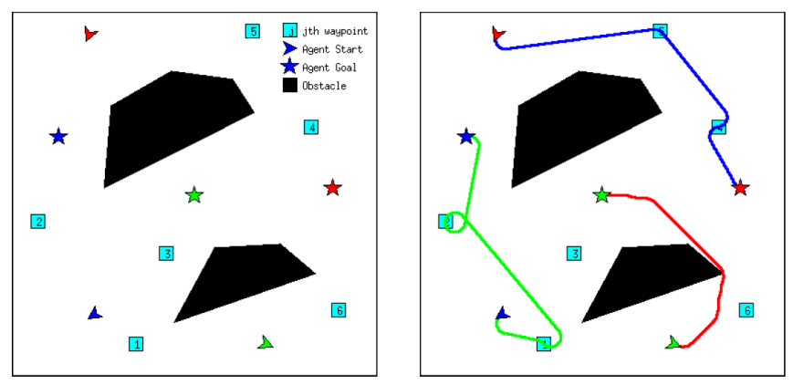
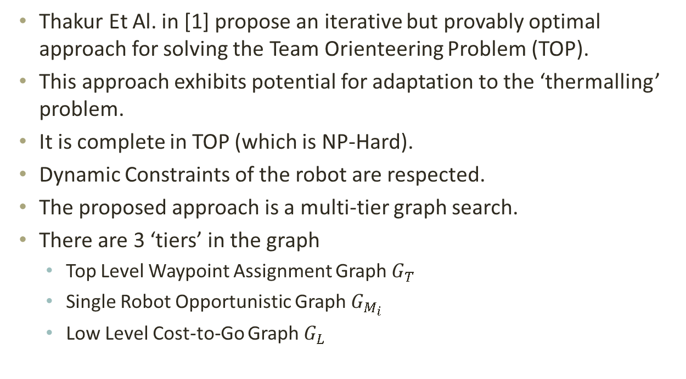
Multi-Tier Graph Search (MTGS)
Fig. 1 Multi-Tier Graph Search [1]
Thakur Et Al. in [1] propose an iterative but provably optimal approach for solving the Team Orienteering Problem (TOP).
This approach exhibits potential for adaptation to the ‘thermalling’ problem.
It is complete in TOP (which is NP-Hard).
Dynamic Constraints of the robot are respected.
The proposed approach is a multi-tier graph search.
There are 3 ‘tiers’ in the graph
Top Level Waypoint Assignment Graph $G_{T}$
Single Robot Opportunistic Graph $G_{M_{i}}$
Low Level Cost-to-Go Graph $G_{L}$
[1]. Thakur, D., Likhachev, M., Keller, J., Kumar, V., Dobrokhodov, V., Jones, K., Wurz, J., Kaminer, I., “Planning for Opportunistic Surveillance with Multiple Robots”, 2013 IEEE/RSJ International Conference on Intelligent Robots and systems (IROS), November 3-7, Tokyo, Japan.

Slide 5
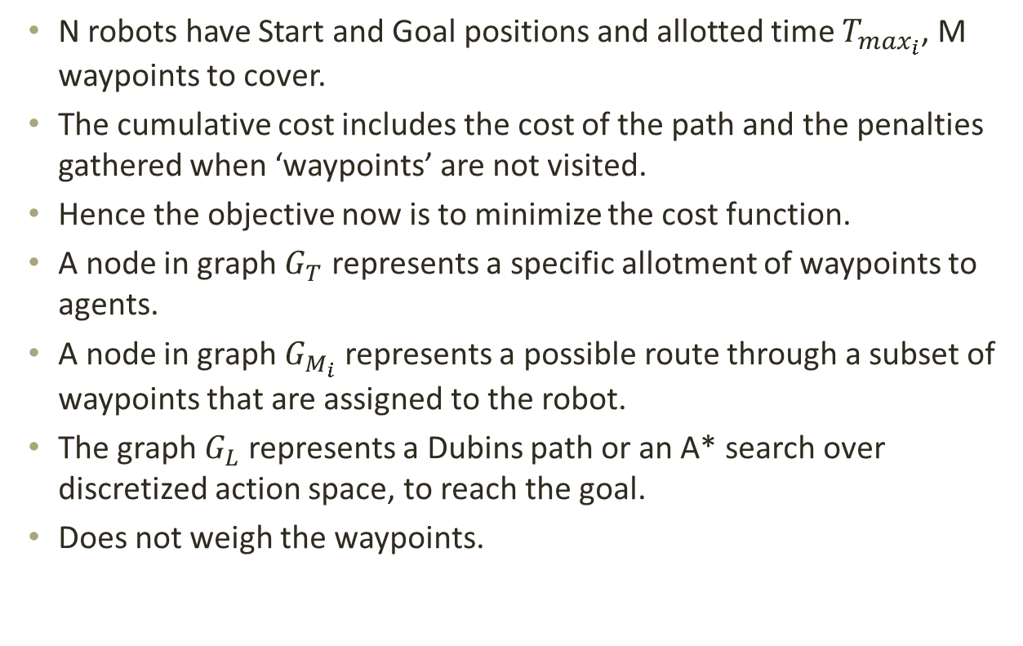
Multi-Tier Graph Search (MTGS)
N robots have Start and Goal positions and allotted time $T_{\max_{i}}$, M waypoints to cover.
The cumulative cost includes the cost of the path and the penalties gathered when ‘waypoints’ are not visited.
Hence the objective now is to minimize the cost function.
A node in graph $G_{T}$ represents a specific allotment of waypoints to agents.
A node in graph $G_{M_{i}}$ represents a possible route through a subset of waypoints that are assigned to the robot.
The graph $G_{L}$ represents a Dubins path or an A* search over discretized action space, to reach the goal.
Does not weigh the waypoints.

Slide 6
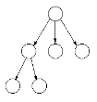


Pictorial depiction of Multi-Tier Graph
Middle Level Graph ($G_{M_{i}}$)
One Node of Top Level Graph ($G_{T}$)

Slide 7
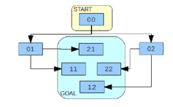

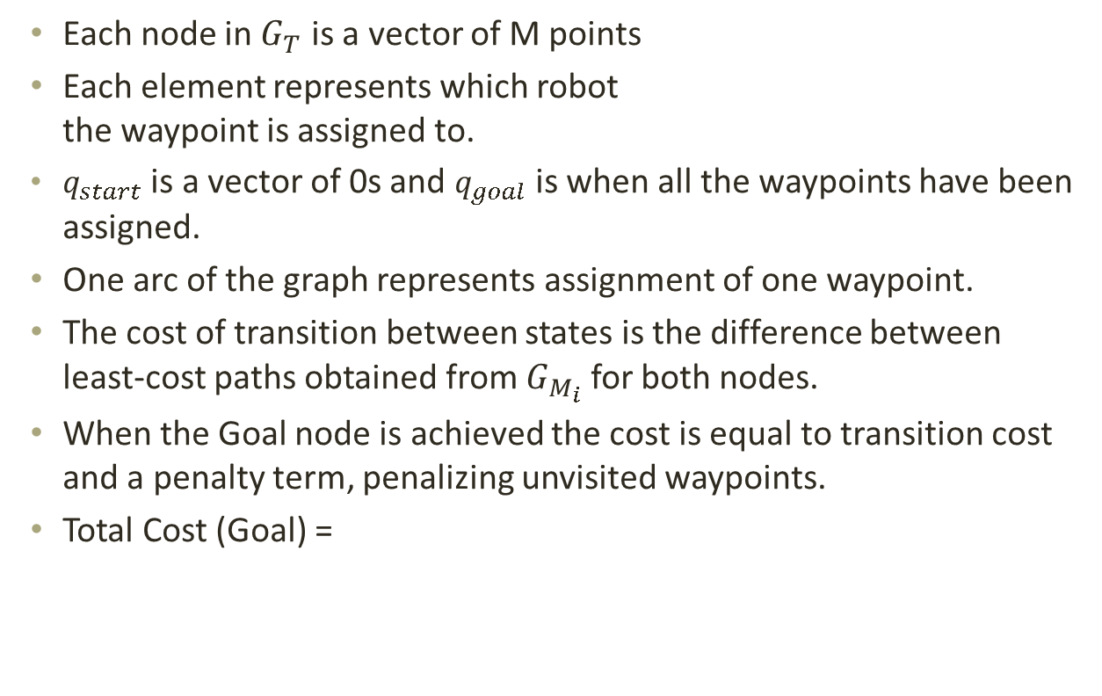
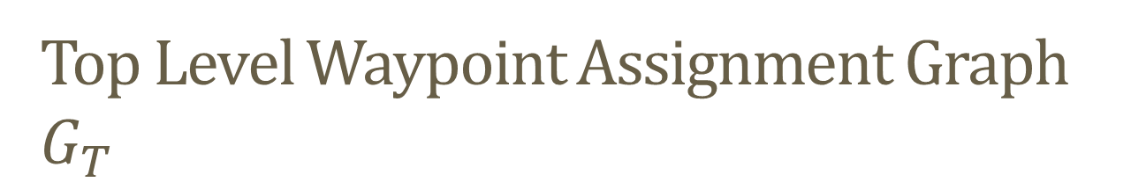
Top Level Waypoint Assignment Graph $G_{T}$
Each node in $G_{T}$ is a vector of M points
Each element represents which robot the waypoint is assigned to.
$q_{start}$ is a vector of 0s and $q_{goal}$ is when all the waypoints have been assigned.
One arc of the graph represents assignment of one waypoint.
The cost of transition between states is the difference between least-cost paths obtained from $G_{M_{i}}$ for both nodes.
When the Goal node is achieved the cost is equal to transition cost and a penalty term, penalizing unvisited waypoints.
Total Cost (Goal) =
Fig. 1 Top Level Waypoint Assignment Graph [1]
$$P_{T}= \sum_{i=1}^{N}{T_{\max_{i}}}+1$$
[1]. Thakur, D., Likhachev, M., Keller, J., Kumar, V., Dobrokhodov, V., Jones, K., Wurz, J., Kaminer, I., “Planning for Opportunistic Surveillance with Multiple Robots”, 2013 IEEE/RSJ International Conference on Intelligent Robots and systems (IROS), November 3-7, Tokyo, Japan.
Notes:
(M=# of waypoints)

Slide 8
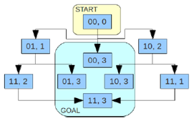


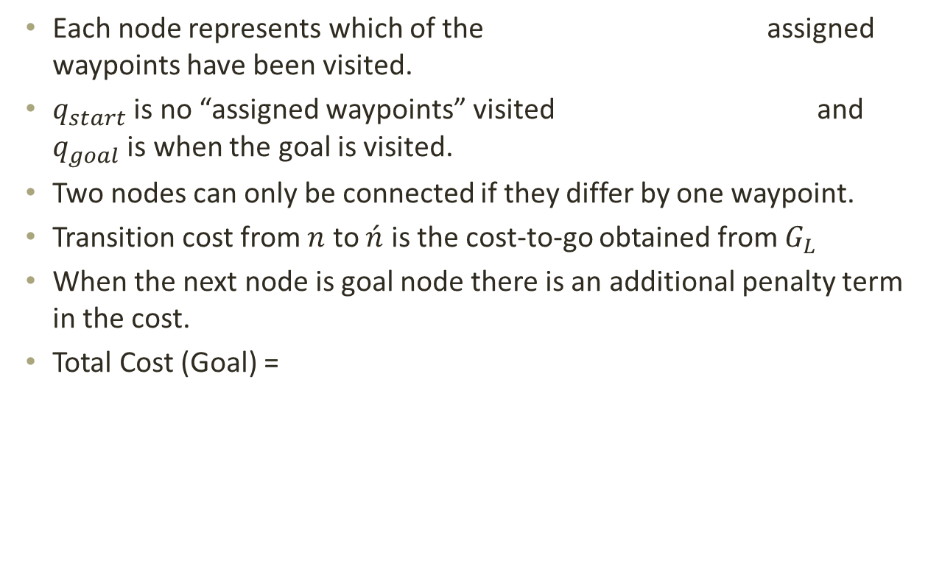
Single Robot Opportunistic Graph $G_{M_{i}}$
Each node represents which of the assigned waypoints have been visited.
$q_{start}$ is no “assigned waypoints” visited and $q_{goal}$ is when the goal is visited.
Two nodes can only be connected if they differ by one waypoint.
Transition cost from $n$ to $\acute{n}$ is the cost-to-go obtained from $G_{L}$
When the next node is goal node there is an additional penalty term in the cost.
Total Cost (Goal) =
Fig. 1 Middle Level Opportunistic Graph [1]
$$P_{M}= T_{\max_{i}}+1$$
[1]. Thakur, D., Likhachev, M., Keller, J., Kumar, V., Dobrokhodov, V., Jones, K., Wurz, J., Kaminer, I., “Planning for Opportunistic Surveillance with Multiple Robots”, 2013 IEEE/RSJ International Conference on Intelligent Robots and systems (IROS), November 3-7, Tokyo, Japan.

Slide 9
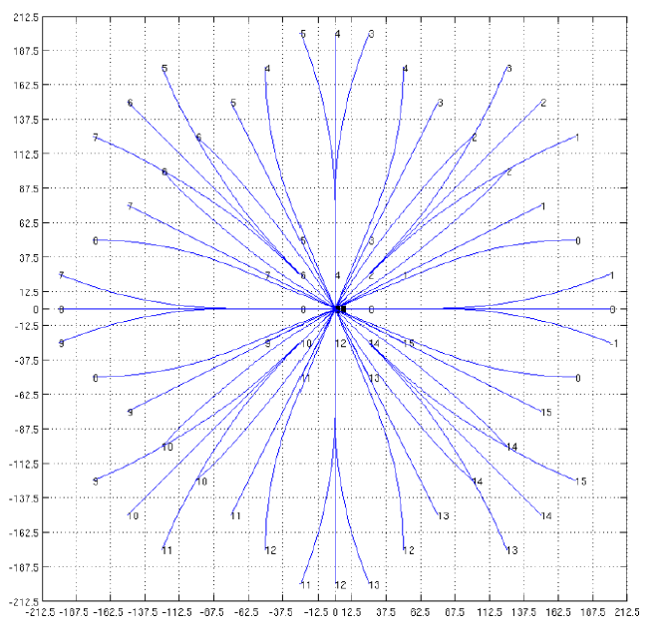
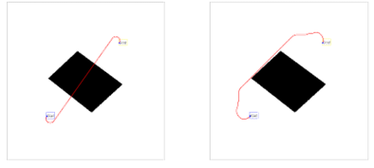


Low Level Cost-to-Go Graph $G_{L}$
The action space is discretized into motion primitives.
$G_{L}$ is the graph over the discretized action space.
The cost is the max of dubins cost or A* search cost with euclidean distance heuristic.
Fig. 2(a) Dubins Path [1] Fig. 2(b) Low Level Graph Search using A* [1]
Fig. 1 Low Level Cost-to-Go Graph [1]
[1]. Thakur, D., Likhachev, M., Keller, J., Kumar, V., Dobrokhodov, V., Jones, K., Wurz, J., Kaminer, I., “Planning for Opportunistic Surveillance with Multiple Robots”, 2013 IEEE/RSJ International Conference on Intelligent Robots and systems (IROS), November 3-7, Tokyo, Japan.

Slide 10
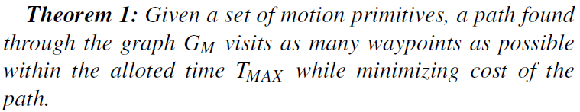
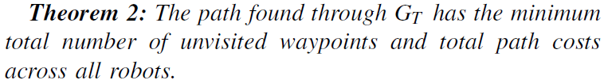
Guarantees for optimality of solution [1]
[1]. Thakur, D., Likhachev, M., Keller, J., Kumar, V., Dobrokhodov, V., Jones, K., Wurz, J., Kaminer, I., “Planning for Opportunistic Surveillance with Multiple Robots”, 2013 IEEE/RSJ International Conference on Intelligent Robots and systems (IROS), November 3-7, Tokyo, Japan.

Slide 11
Differences between TOP and Thermalling Problem
Our waypoints are of two different kinds, ‘interest points’ and ‘thermals’ and each has a different utility for us.
Visiting interest points reduces the penalties hence minimizes cost function.
Thermals give us more endurance which allows us to get more interest points, the current problem formulation doesn’t account for this.
Not directly applicable when total flyable time is dynamic.

Slide 12
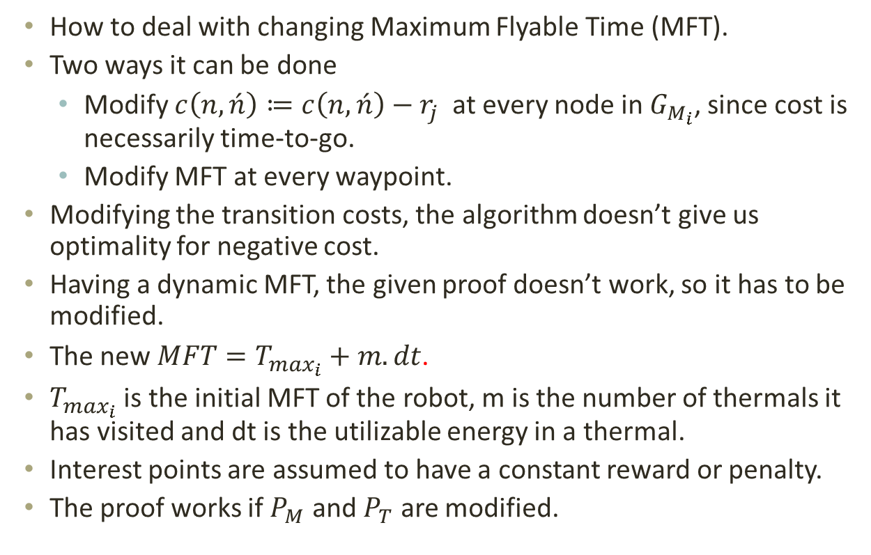
Extension to Thermalling Case
How to deal with changing Maximum Flyable Time (MFT).
Two ways it can be done
Modify $c\left(n,\acute{n}\right)≔c\left(n,\acute{n}\right)−r_{j}$at every node in $G_{M_{i}}$, since cost is necessarily time-to-go.
Modify MFT at every waypoint.
Modifying the transition costs, the algorithm doesn’t give us optimality for negative cost.
Having a dynamic MFT, the given proof doesn’t work, so it has to be modified.
The new $MFT=T_{\max_{i}}+m.dt$.
$T_{\max_{i}}$ is the initial MFT of the robot, m is the number of thermals it has visited and dt is the utilizable energy in a thermal.
Interest points are assumed to have a constant reward or penalty.
The proof works if $P_{M}$ and $P_{T}$ are modified.

Slide 13
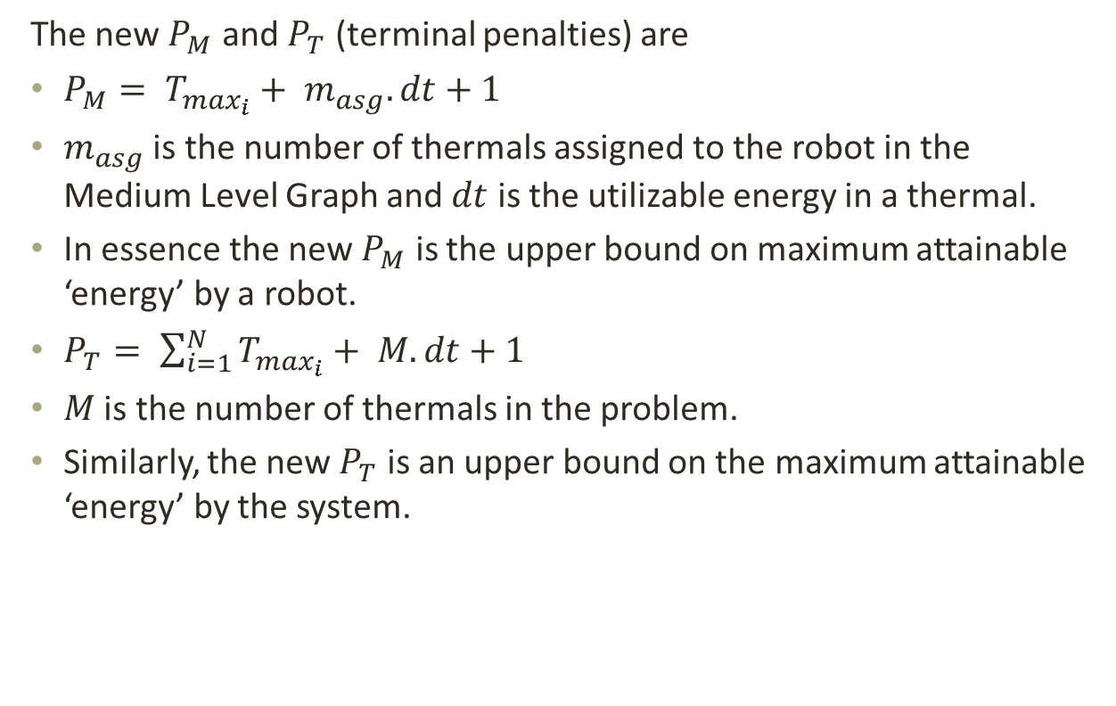
The Approach
The new $P_{M}$ and $P_{T}$ (terminal penalties) are
$P_{M}= T_{\max_{i}}+ m_{asg}. dt+1$
$m_{asg}$ is the number of thermals assigned to the robot in the Medium Level Graph and $dt$ is the utilizable energy in a thermal.
In essence the new $P_{M}$ is the upper bound on maximum attainable ‘energy’ by a robot.
$P_{T}= \sum_{i=1}^{N}{T_{\max_{i}}}+ M. dt+1$
$M$ is the number of thermals in the problem.
Similarly, the new $P_{T}$ is an upper bound on the maximum attainable ‘energy’ by the system.

Slide 14
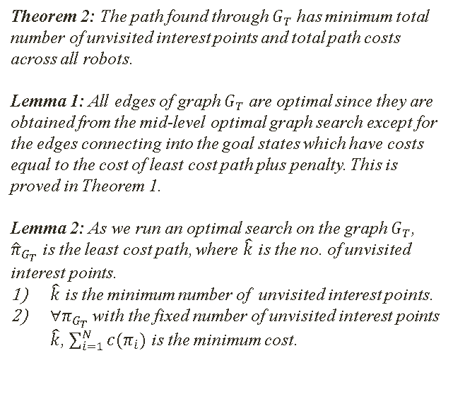
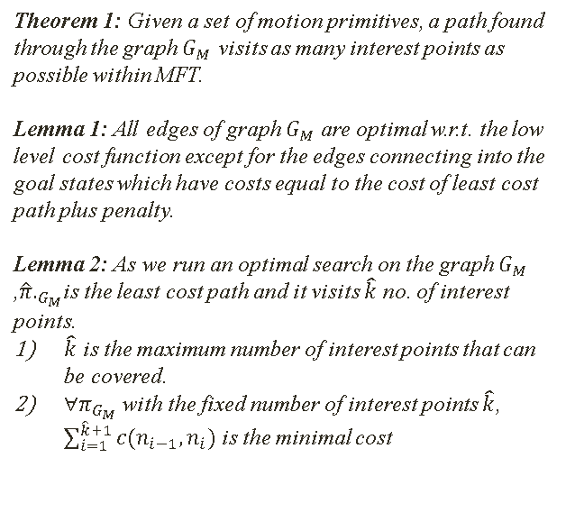
Theorems
Theorem 1: Given a set of motion primitives, a path found through the graph $G_{M}$ visits as many interest points as possible within MFT.
Lemma 1: All edges of graph $G_{M}$ are optimal w.r.t. the low level cost function except for the edges connecting into the goal states which have costs equal to the cost of least cost path plus penalty.
Lemma 2: As we run an optimal search on the graph $G_{M}$ ,${\hat{π}.}_{G_{M}}$is the least cost path and it visits $\hat{k}$ no. of interest points.
$\hat{k}$ is the maximum number of interest points that can be covered.
$∀π_{G_{M}}$ with the fixed number of interest points $\hat{k}$, $\sum_{i=1}^{\hat{k}+1}{c(n_{i−1},n_{i})}$ is the minimal cost
Theorem 2: The path found through $G_{T}$ has minimum total number of unvisited interest points and total path costs across all robots.
Lemma 1: All edges of graph $G_{T}$ are optimal since they are obtained from the mid-level optimal graph search except for the edges connecting into the goal states which have costs equal to the cost of least cost path plus penalty. This is proved in Theorem 1.
Lemma 2: As we run an optimal search on the graph $G_{T}$, ${\hat{π}}_{G_{T}}$ is the least cost path, where $\hat{k}$ is the no. of unvisited interest points.
$\hat{k}$ is the minimum number of unvisited interest points.
$∀π_{G_{T}}$ with the fixed number of unvisited interest points $\hat{k}$, $\sum_{i=1}^{N}{c(π_{i})}$ is the minimum cost.

Slide 15
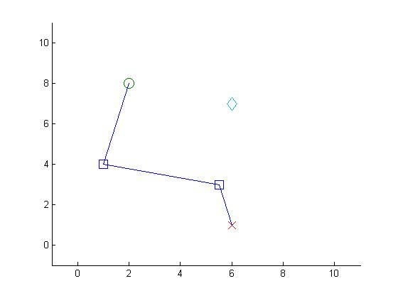
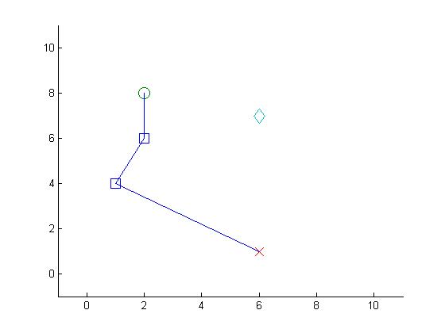
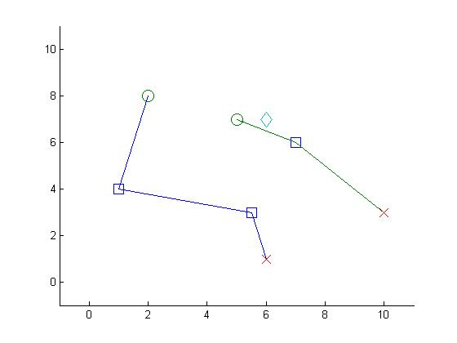
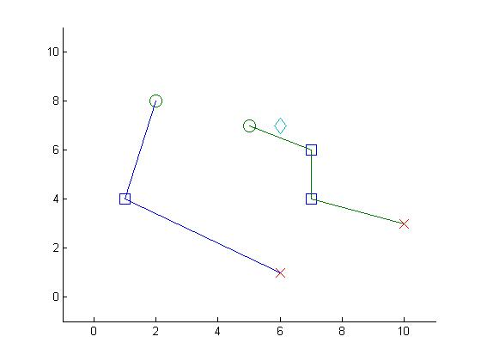
Test Cases
Interest points change order
Interest points swap routes
Fig. 1 1 Robot, 2 Interest Points, 1 Thermal
Fig. 2 2 Robots, 3 Interest Points, 1 Thermal

Slide 16
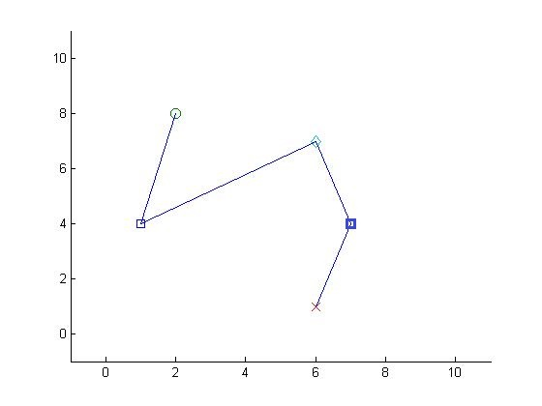
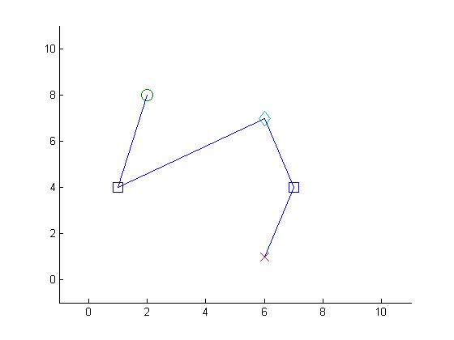
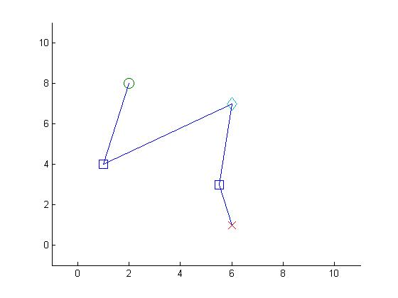
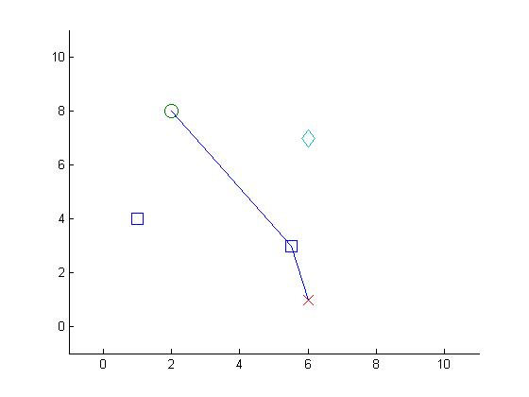
Test Cases
Robots start using thermals to get interest points
Robot modifies path due to different initial energy
Fig. 1 1 Robot, 2 Interest Points, 1 Thermal
Fig. 2 1 Robot, 2 Interest Points, 1 Thermal

Slide 17
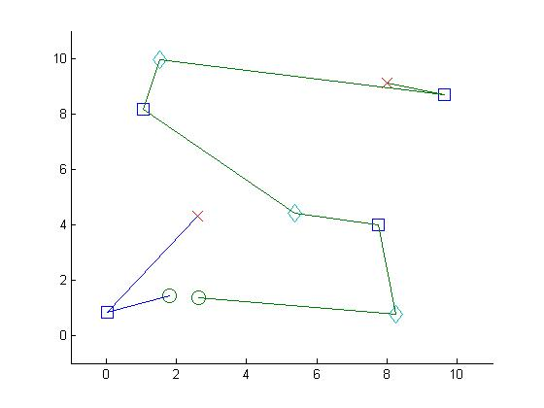
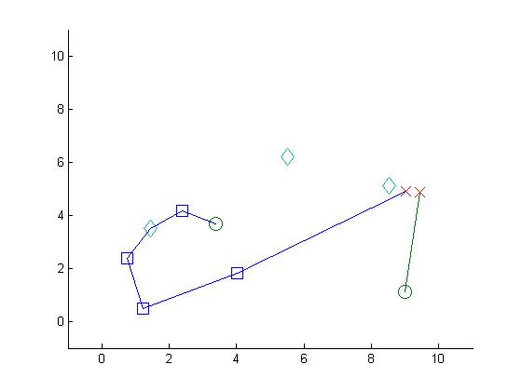
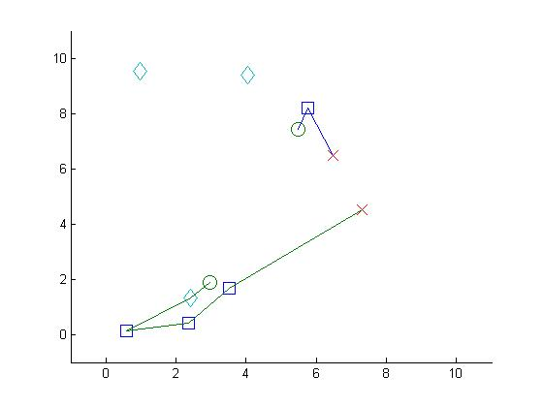
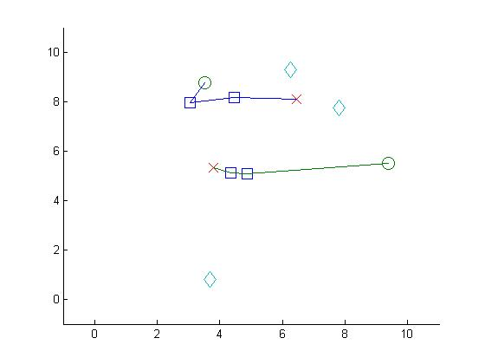
Results (4 interest points, 3 thermals, 2 robots)
Fig. 1 2 robots planning optimal routes through randomly generated interest points and thermals

Slide 18
Results
Algorithm type | Exhaustive (sec) | MTGS (sec) | MTGS_mex (sec)
Test Cases
4 interest points, 4 thermals, 2 robots | 5684 | 2369 | 24
4 interest points, 3 thermals, 2 robots | 227 | 106 | 2
3 interest points, 3 thermals, 2 robots | 6 | 23 | 1

Slide 19
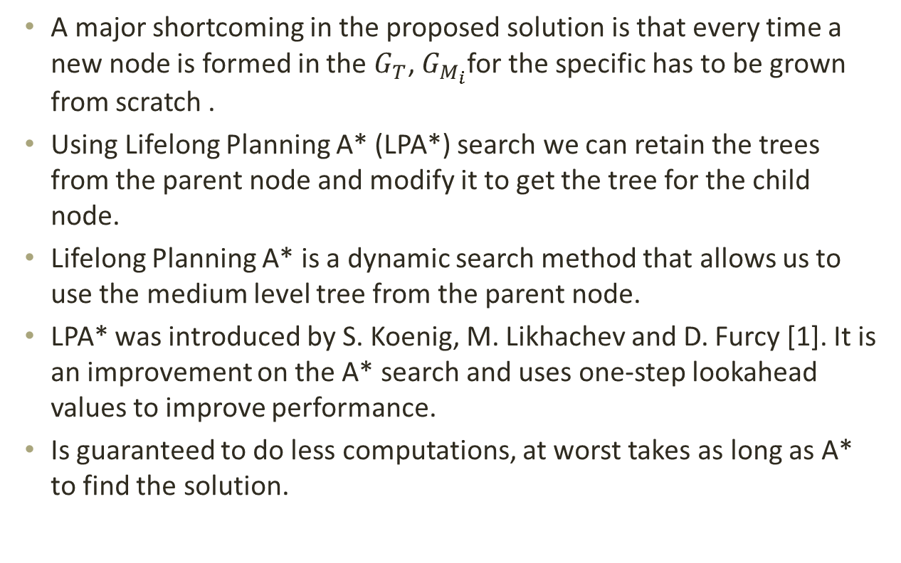
Lifelong Planning A*
A major shortcoming in the proposed solution is that every time a new node is formed in the $G_{T}$, $G_{M_{i}}$for the specific has to be grown from scratch .
Using Lifelong Planning A* (LPA*) search we can retain the trees from the parent node and modify it to get the tree for the child node.
Lifelong Planning A* is a dynamic search method that allows us to use the medium level tree from the parent node.
LPA* was introduced by S. Koenig, M. Likhachev and D. Furcy [1]. It is an improvement on the A* search and uses one-step lookahead values to improve performance.
Is guaranteed to do less computations, at worst takes as long as A* to find the solution.
[1]. Koenig, S., Likhachev, M., Furcy, D., “Lifelong Planning A*”. Elsevier Science, 2005.

Slide 20
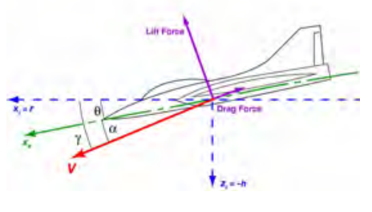
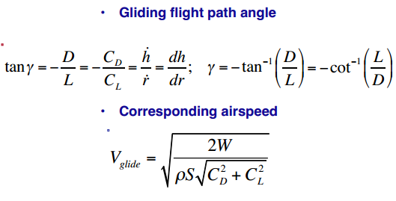
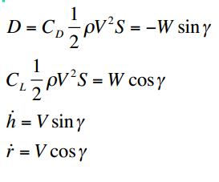
Path Planning
Glider Dynamics (Equilibrium)

Slide 21
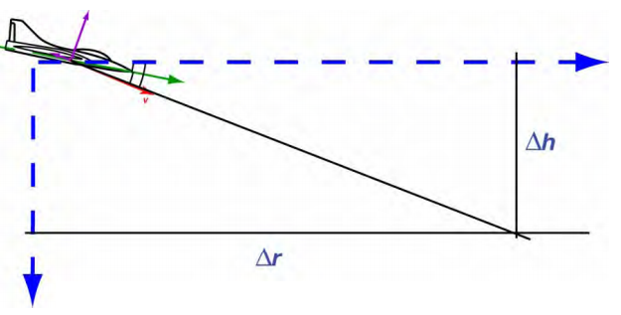
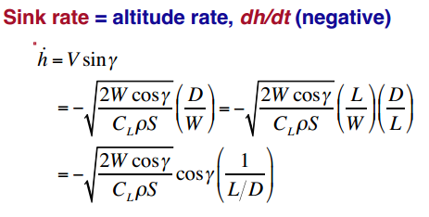
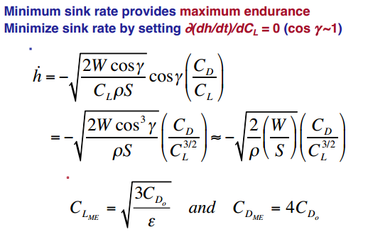

Path Planning
Optimal Flight $({\dot{h}}_{min})$

Slide 22

Path Planning
If there is an optimal velocity $V_{opt}$ and an optimal ${\dot{h}}_{opt}$ then our Path planning becomes a 2-d path planning problem.
Assumption $V_{opt}$ and ${\dot{h}}_{opt}$, remain constant for bounded $\dot{ψ}$, the turning rate.
Optimize over Energy lost, since velocity is $V_{opt}$, only optimize over $Δh$.

Slide 23



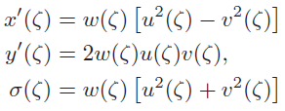
Path Planning
Pythagorean Hodograph Bezier Curves
Timing Law is determined by

Slide 24


Path Planning
Now we have N paths in one robot’s trajectory.
N paths generated from start to end for each path in each trajectory.
Parametric speeds $x^{′}(ζ)$ and $y^{′}(ζ)$ have to be same at paths connected by ‘interest points’ so that curvature $κ(ζ)$ is continuous.

Slide 25

Path Planning
For parametric speeds to be same
$z^{′}$is a linear function of parametric speed

Slide 26
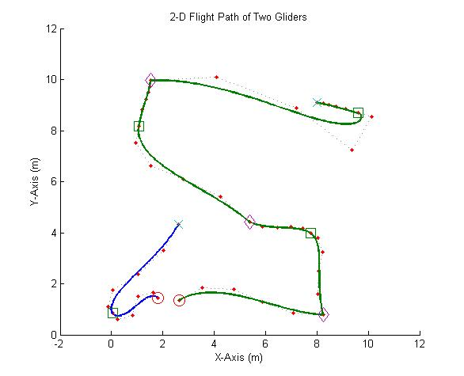
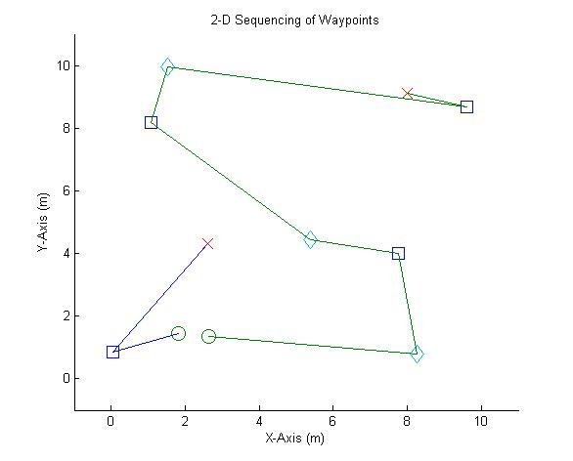
Path Planning (Results)

Slide 27
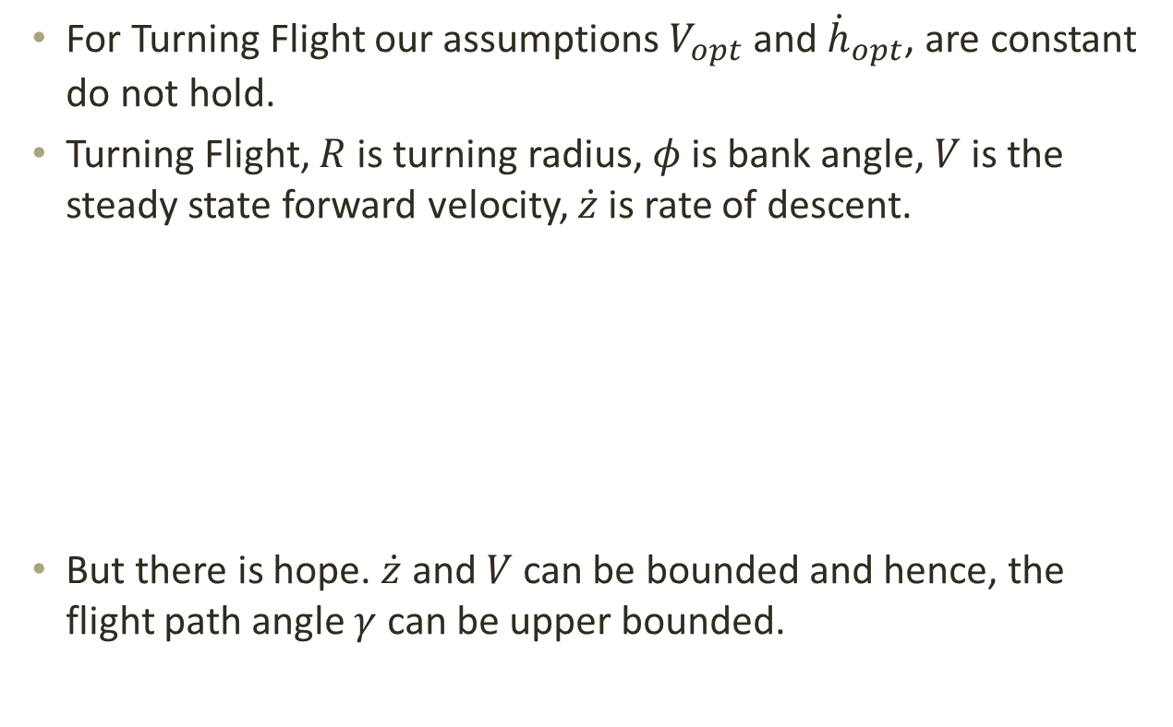
Path Planning (Extension)
For Turning Flight our assumptions $V_{opt}$ and ${\dot{h}}_{opt}$, are constant do not hold.
Turning Flight, $R$ is turning radius, $φ$ is bank angle, $V$ is the steady state forward velocity, $\dot{z}$ is rate of descent.
But there is hope. $\dot{z}$ and $V$ can be bounded and hence, the flight path angle $γ$ can be upper bounded.

Slide 28
Path Planning (Extension)
Extension to ‘powered’ gliders with limited fuel.
More freedom, 3-d path planning
Extension of planning algorithm using Branch and Bound approach. The Upper and Lower bounds of the cost are cost are considered.

Slide 29


Theorem 1 (Proof)
Theorem 1: Given a set of motion primitives, a path found through the graph $G_{M}$ visits as many interest points as possible within MFT.
Lemma 1: All edges of graph $G_{M}$ are optimal w.r.t. the low level cost function except for the edges connecting into the goal states which have costs equal to the cost of least cost path plus penalty.
Lemma 2: As we run an optimal search on the graph $G_{M}$ ,${\hat{π}.}_{G_{M}}$is the least cost path and it visits $\hat{k}$ no. of interest points.
$\hat{k}$ is the maximum number of interest points that can be covered.
$∀π_{G_{M}}$ with the fixed number of interest points $\hat{k}$, $\sum_{i=1}^{\hat{k}+1}{c(n_{i−1},n_{i})}$ is the minimal cost
Proof:
1) Assume , whose time does not exceed the MFT and visits larger no. of interest points $\tilde{k}>\hat{k}$ while
But since $P_{M}=T_{\max_{i}}+m_{asg}.dt+1$ and $\tilde{k}>\hat{k}$, we get a contradiction.
2) Assume is another path whose time does not exceed the maximum and has visited interest points $\dot{k}$. And we have $\dot{k}=\hat{k}$, where $\hat{k}$ is the no. of interest points visited by our least cost path .
Hence , is the minimum cost for $\dot{k}=\hat{k}$, number of points.

Slide 30

Theorem 2 (Proof)
Theorem 2: The path found through $G_{T}$ has minimum total number of unvisited interest points and total path costs across all robots.
Lemma 1: All edges of graph $G_{T}$ are optimal since they are obtained from the mid-level optimal graph search except for the edges connecting into the goal states which have costs equal to the cost of least cost path plus penalty. This is proved in Theorem 1.
Lemma 2: As we run an optimal search on the graph $G_{T}$, ${\hat{π}}_{G_{T}}$ is the least cost path, where $\hat{k}$ is the no. of unvisited interest points.
$\hat{k}$ is the minimum number of unvisited interest points.
$∀π_{G_{T}}$ with the fixed number of unvisited interest points $\hat{k}$, $\sum_{i=1}^{N}{c(π_{i})}$ is the minimum cost.
Proof:
1)We prove by contradiction. Consider a path , s.t. it has less unvisited waypoints than the optimal path
$\tilde{k}<\hat{k}$.
As
We have a contradiction for $\tilde{k}<\hat{k}$.
2) Assume another solution , s.t. $\dot{k}=\hat{k}$, and we have the optimal path .
Hence is minimum with fixed number of interest points.

Slide 31


Proofs of Theorem 1 and Theorem 2 [1]
[1]. Thakur, D., Likhachev, M., Keller, J., Kumar, V., Dobrokhodov, V., Jones, K., Wurz, J., Kaminer, I., “Planning for Opportunistic Surveillance with Multiple Robots”, 2013 IEEE/RSJ International Conference on Intelligent Robots and systems (IROS), November 3-7, Tokyo, Japan.

Slide 32
References
[1]. MacCready, P. B. “Optimum Airspeed Selector,” Journal of Soaring, 1958.
[2]. Reichmann, H., “Cross-Country Soaring,”, Soaring Society of America, Inc., Hobbs, NM, 1993, pp. 9-10, 91-92.
[3]. Wharington, J., “Autonomous Control of Soaring Aircraft by Reinforcement Learning,” PhD Thesis, Royal Melbourne Inst. Of Technology, Melbourne, Australia, Nov. 1998, pp.105-108.
[4]. Allen, M. J., and Lin, V., “Guidance and Control of an Autonomous Soaring UAV,” NASATM-2007-214611, 2007.
[5]. Cheng, K. and Langelaan, J. , “Guided Exploration for Coordinated Autonomous Flight”, in AIAA Guidance, Navigation & Control Conference, 2014.
[6]. Kagabo, W. B., Kolodziej, J. R., “Trajectory Determination for Energy Efficient Autonomous Soaring,” in proceedings of IEEE American Control Conference (ACC), 2011, pp 4655-4660, 2011
[7]. Klesh, A. T., Kabamba, P. T., Girard, A. R., “Optimal Cooperative Thermalling of Unmanned Aerial Vehicles” in Optimization and Cooperative Control Strategies, Springer, pp.355-369, 2009.
[8]. Butt, S., Ryan, D., 1999. “An optimal solution procedure for the multiple tour maximum collection problem using column generation”. Computers and Operations Research 26, 427–441.
[9]. Boussier, S., Feillet, D., Gendreau, M., 2007. “An exact algorithm for the team orienteering problem”. 4OR 5, 211–230.
[10]. Tang, H., Miller-Hooks, E., 2005. “A tabu search heuristic for the team orienteering problem”. Computer and Operations Research 32, 1379–1407.
[11]. Archetti, C., Hertz, A., Speranza, M., 2007. “Metaheuristics for the team orienteering problem”. Journal of Heuristics 13, 49–76.
[12]. Vansteenwegen, P., Souffriau, W., Vanden Berghe, G., Van Oudheusden, D., 2009c. “Metaheuristics for tourist trip planning”. Metaheuristics in the Service Industry, Lecture Notes in Economics and Mathematical Systems, vol. 624. Springer-Verlag, pp. 15–31.
[13]. Thakur, D., Likhachev, M., Keller, J., Kumar, V., Dobrokhodov, V., Jones, K., Wurz, J., Kaminer, I., “Planning for Opportunistic Surveillance with Multiple Robots”, 2013 IEEE/RSJ International Conference on Intelligent Robots and systems (IROS), November 3-7, Tokyo, Japan.
[14]. Vansteenwegen, P., Souffriau, W., Vanden Berghe, G., Van Oudheusden, “”The Orienteering Problem: A Survey”, in European Journal of Operations Research, 2011.

