Slide 1
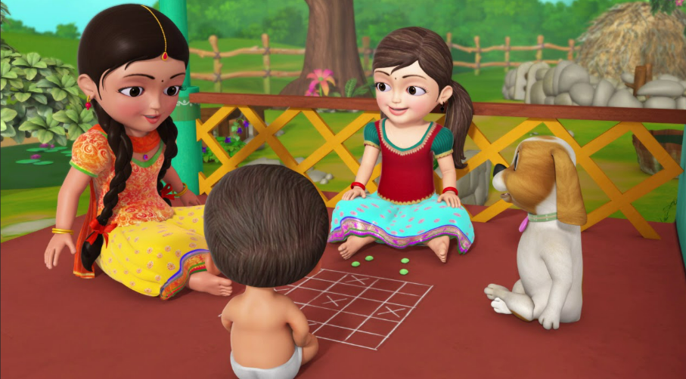
ASHTA CHAMMA
Mirukula Pravalika
Sandeep Kumar Sutharapu
Sardarni Harjoth Kaur

Slide 2
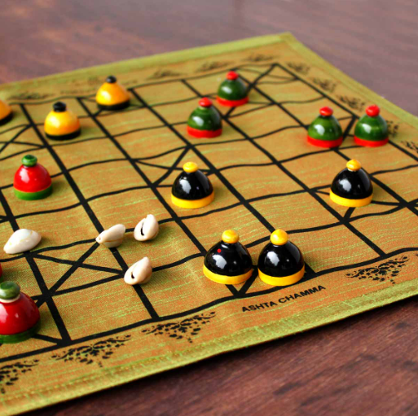
CONTENT:
Intro to “Ashta Chamma”
Initial Prototype
Functional Requirements
UML Diagram
Testing
Demo
Future Extensions
Rules of the Game
Reflection

Slide 3
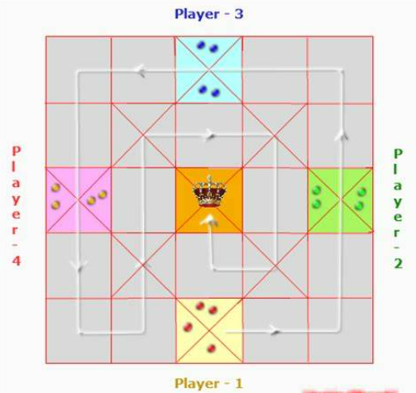
Intro to Ashta Chamma:
Indian version of a Ludo game, which is very common and one of the oldest games back in India.
Consists of 25 squares which are divided into 5 Rows X 5 Columns.
Each player takes a turn to roll the Dice.
In telugu, If Dice rolls 4 it means Ashta and If Dice rolls 8 its chamma
A block can be a safe place, or it can be an unsafe place. Each player has a turn in sequence and is asked to flip a die. Each player has a couple of pawns and are moved according to the dice value..

Slide 4
Rules of The Game
Each player has a fixed path in which the player’s pawns move, which is in counter-clockwise direction.
The possible values of the Dice are 1, 2, 3, 4 and 8. Depending on the number rolled, the player can move one of their pawns that many number of squares on the board
Dice value is n than moves by n squares.
Killing spirit turns true for a player then player's pawns can move into inner loop.
For a player to win, he/she must move all their pawns to the center square.

Slide 5
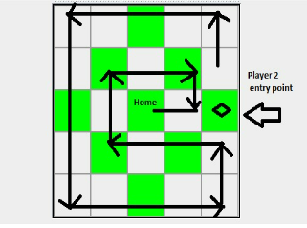
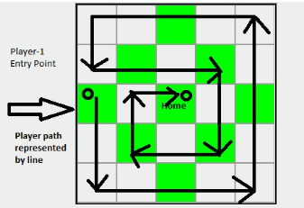

Slide 6
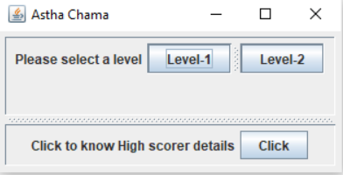
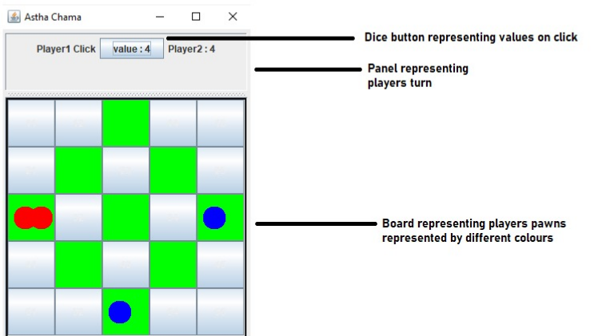
Initial Prototype

Slide 7
Requirements:
User Interface requirements:
Board with 2 Different color squares. Panel with level 1 and 2 creation.
Pawns of 2 different colors of 2 players movement according to dice value on their turn.
On winning the game new panel with highest score as well as their name
Functional Requirements:
Dice:
Board :
Level-1 : Normal Play B/w 2 players
Level-2: Less possibility of Dice rolling 4 and 8.
Placing pawns on board
Updating pawn positions
Knockout Checking
Storing pawn positions
Checking if the game is complete
Player :
Tracking No of pawns on board
Tracking killing sprit

Slide 8
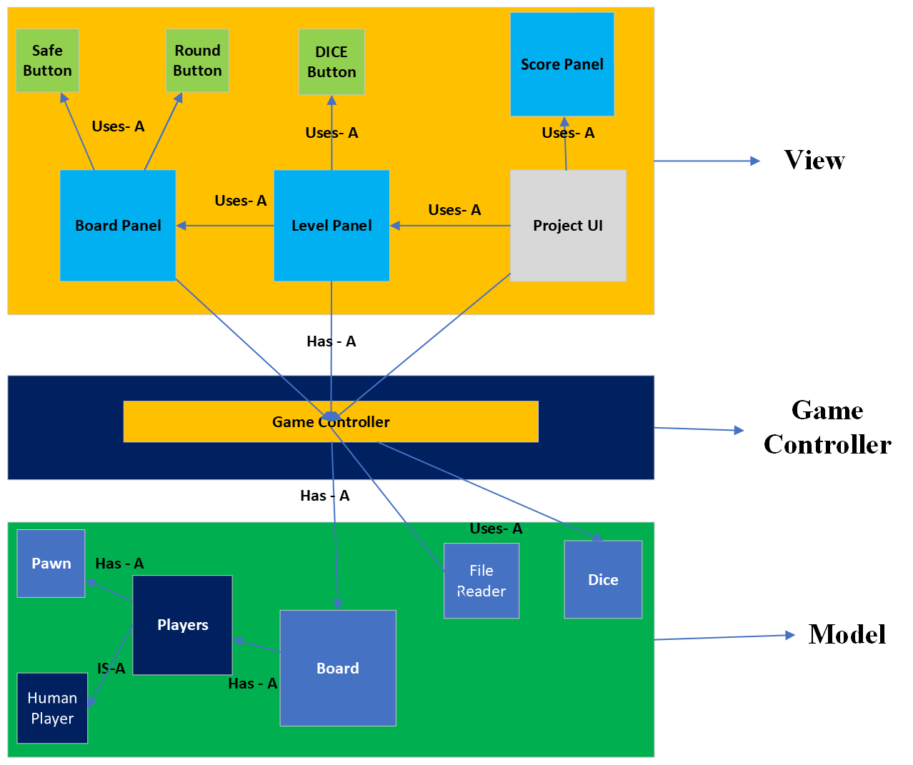
UML Diagram:

Slide 9
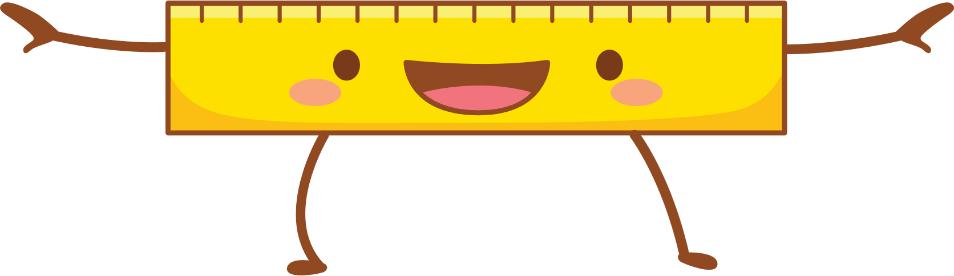
Testing:
Classes of Model:
Board
Pawn
Player
Dice
No issues while testing.

Slide 10


Slide 11
Future extensions:
We have designed our game with respect to design patterns. There are many features that can be added to our game. One of the major features will be adding different types of players to the game.
In our game the human player is implementing the interface player.
In case there is any requirement to add a different kind of player such as a typical computer player/ human player with more probability of winning.

Slide 12
We can increase the number of pawns assigned to a player.
Improving the difficulty level of the game.
We have maintained our user interface in different classes by differentiating the panels and adding it to the main panel. In future if a developer who needs to add a feature to UI can just add a panel and follow by adding it to the main panel.

Slide 13
Reflection
At every part of our development, we have faced no of issues in contrast the few major problems we faced are to give a clear-cut picture of user interface on every condition of the game which led us to create a tree of if-else conditions.
Issue while taking input from button listener and moving the pawn on the interface.
Implementing serializer.

Slide 14

THANK YOU

