Slide 1
Algorithm and analysis laboratory
LAB-1
Instructed by Professor ABHIK MUKHERJEE
Submission By: -
510519074 – PASUMARTHI VENKATA SIVA SANDEEP
510519075 – MUNAVATH TEJASREE
510519080 – SOORAJ VENUGOPAL

Slide 2
Merge sort
Merge Sort is an example of divide and conquer strategy. It first divide array into two equal halves and merge them in sorted manner. It is a recursive algorithm that continually divide array into half.
If the array is empty or has one element, it is sorted by definition. If the array has more than one element, we split the array and recursively call merge sort on both halves.
Once two halves are sorted, the fundamental operation merge is called. Merging is a process of combining two sorted array into single sorted array.
Time complexity: - T(n) = 2T(n/2) + O(n).

Slide 3
Time complexity of merge sort
Best case time complexity: - O(nlogn).
Average case time complexity: - O(nlogn).
Worst case time complexity: - O(nlogn).

Slide 4
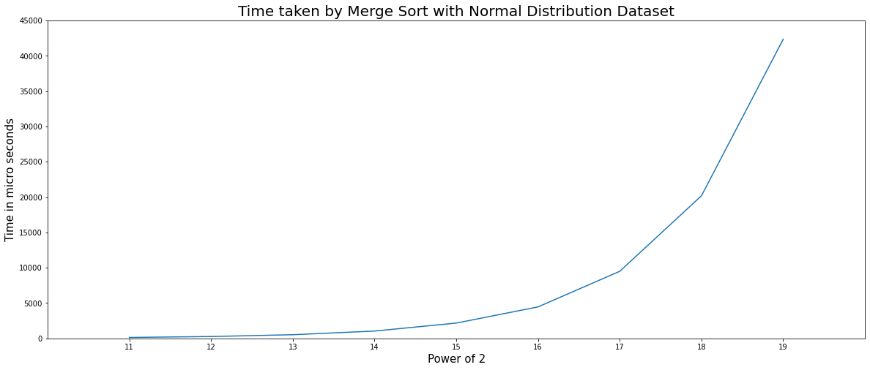
Time taken by merge sort Normal distribution

Slide 5
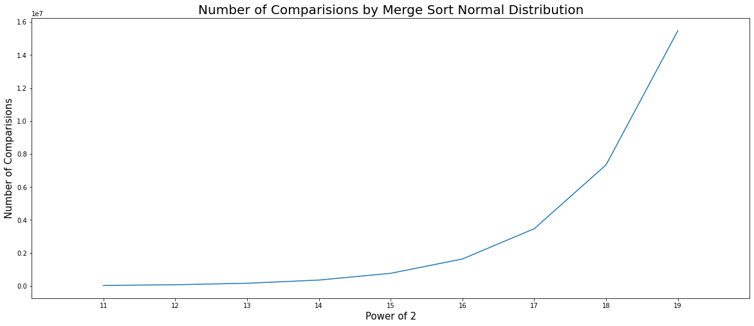
Comparisons by merge sort Normal distribution

Slide 6
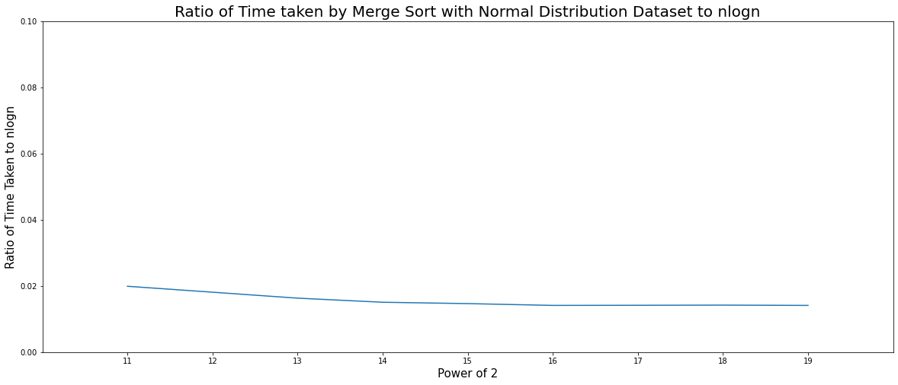
Ratio of time taken to nlogn merge sort normal distribution

Slide 7
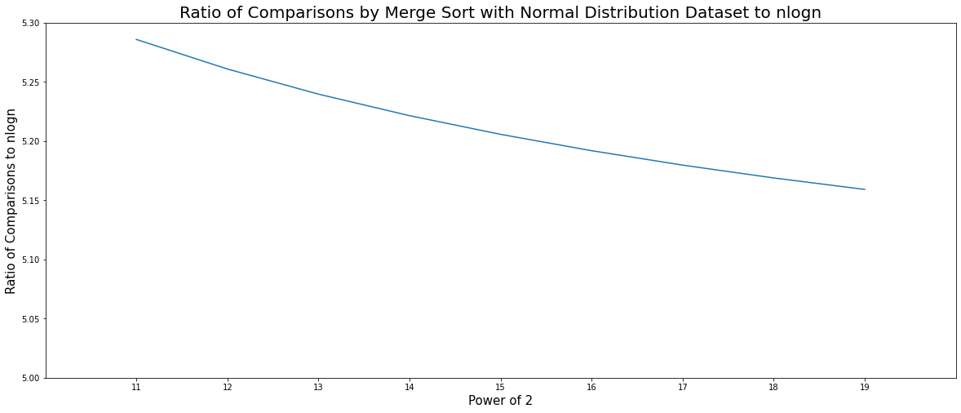
Ratio of comparisons to nlogn merge sort normal distribution

Slide 8
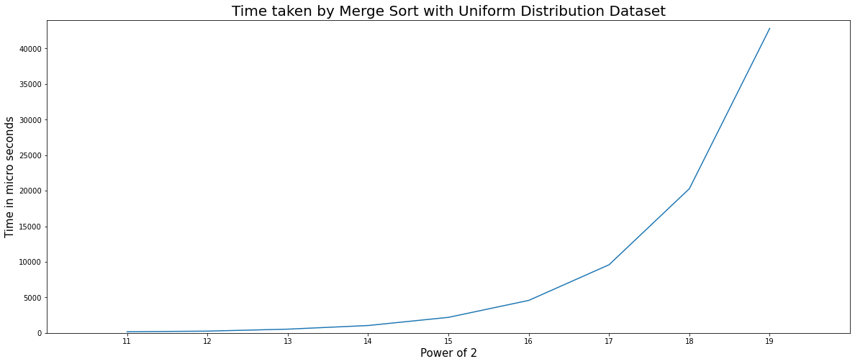
Time taken by merge sort Uniform distribution

Slide 9
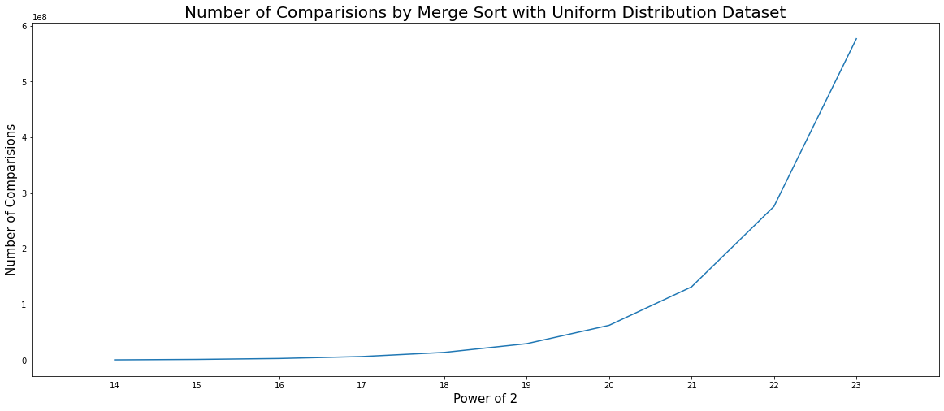
Comparisons by merge sort uniform distribution

Slide 10
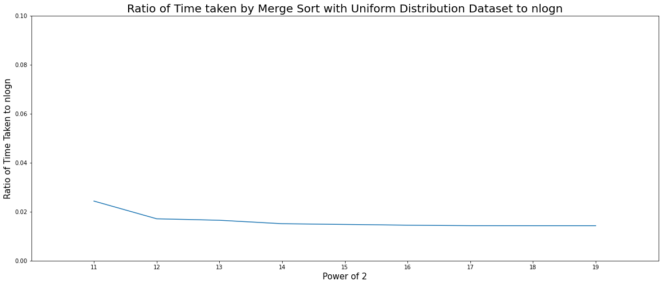
Ratio of time taken to nlogn merge sort uniform distribution

Slide 11
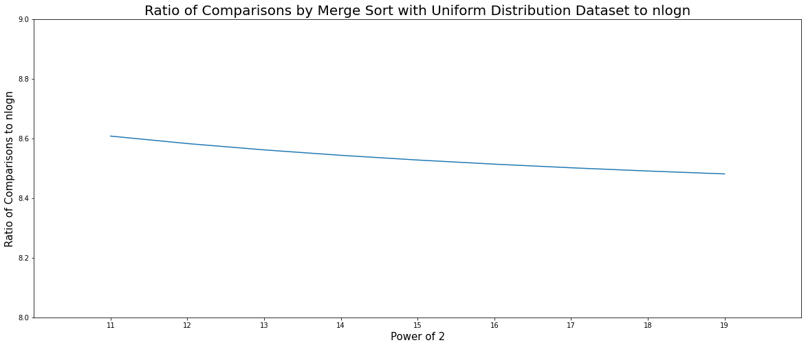
Ratio of comparisons to nlogn merge sort uniform distribution

Slide 12
Quick sort
As merge sort, quick sort is also a algorithm based on divide and conquer strategy.
It will choose an element as a pivot element and split the two parts into one side greater than pivot element and other side less than pivot element.
This step is recursively called on the two halves of the original array.
In normal quick sort generally first element acts as pivotal element.
Time complexity: - nT(n) = (n+1)T(n-1) + 2n.

Slide 13
Time complexity of quick sort
Best case: - O(nlogn).
Average case: - O(nlogn).
Worst case: - O(n^2).

Slide 14
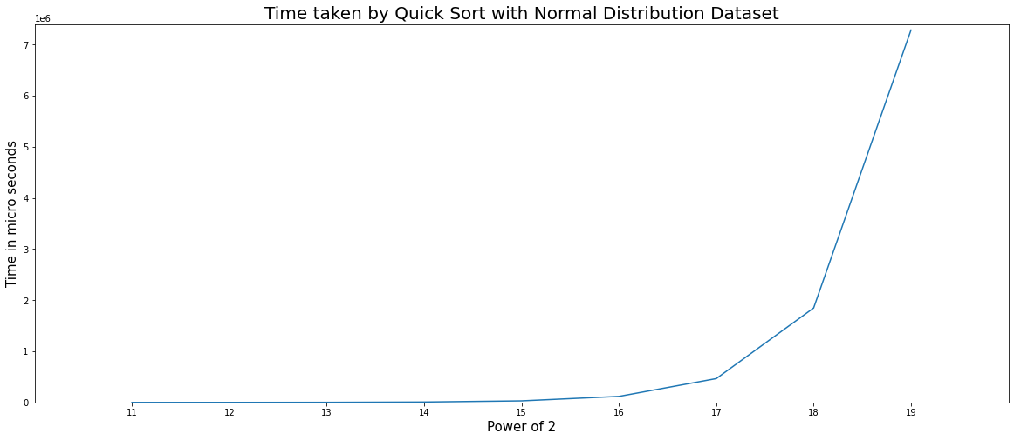
Time taken by quick sort Normal distribution

Slide 15
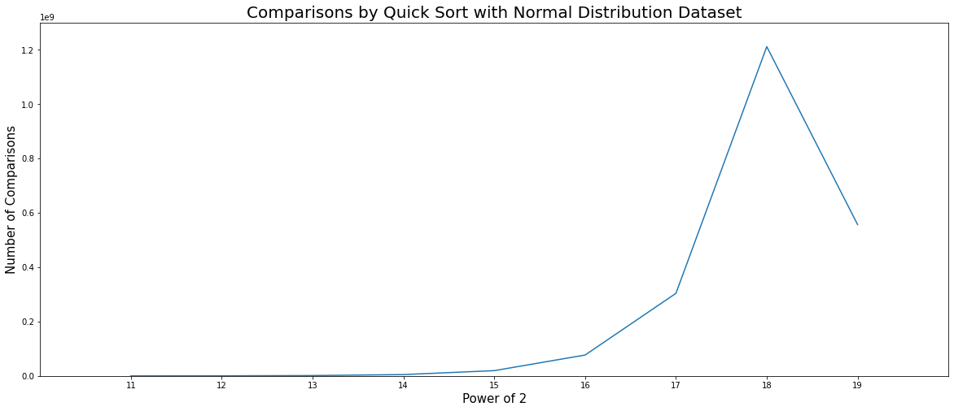
Comparisons by quick sort Normal distribution

Slide 16
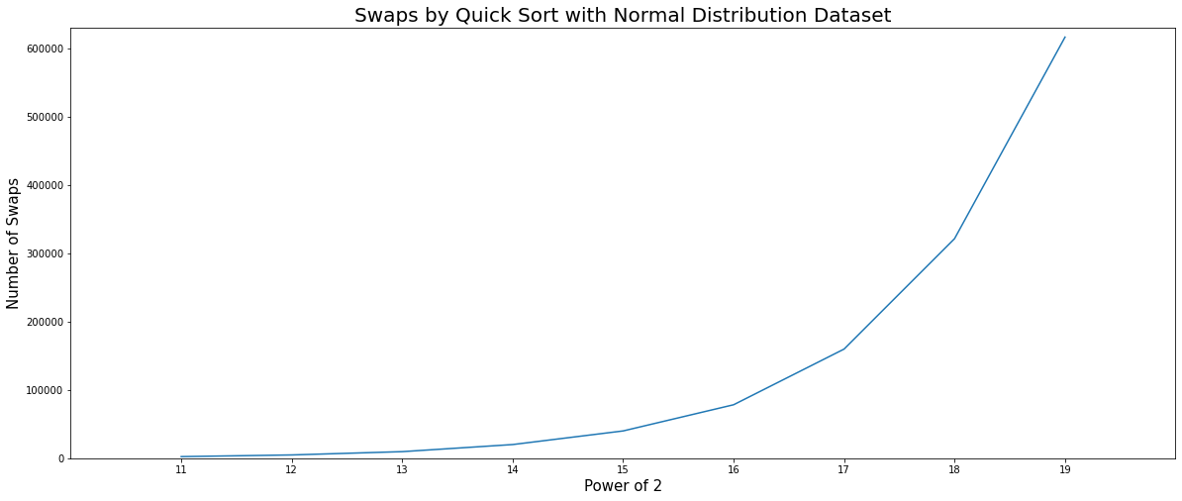
swaps by quick sort Normal distribution

Slide 17
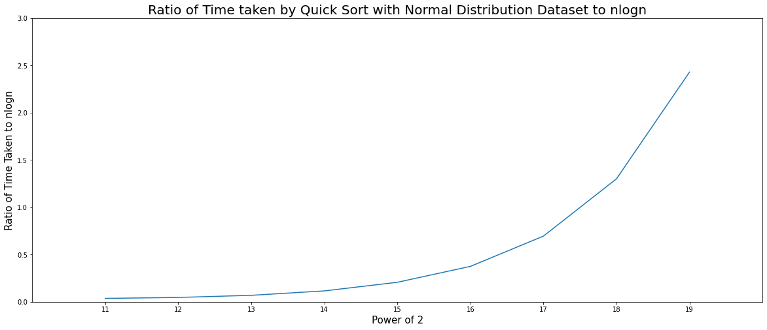
Ratio of time taken to nlogn quick sort normal distribution

Slide 18
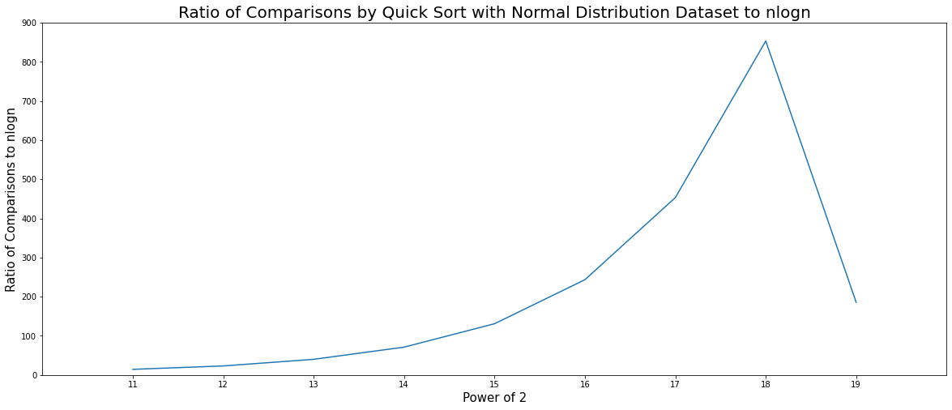
Ratio of comparisons to nlogn quick sort normal distribution

Slide 19
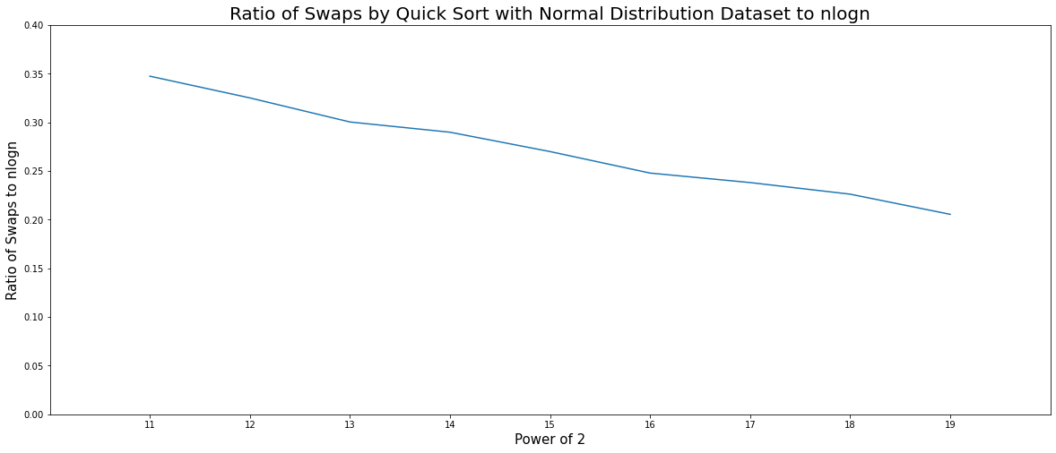
Ratio of swaps to nlogn quick sort normal distribution

Slide 20

Time taken by quick sort Uniform distribution

Slide 21
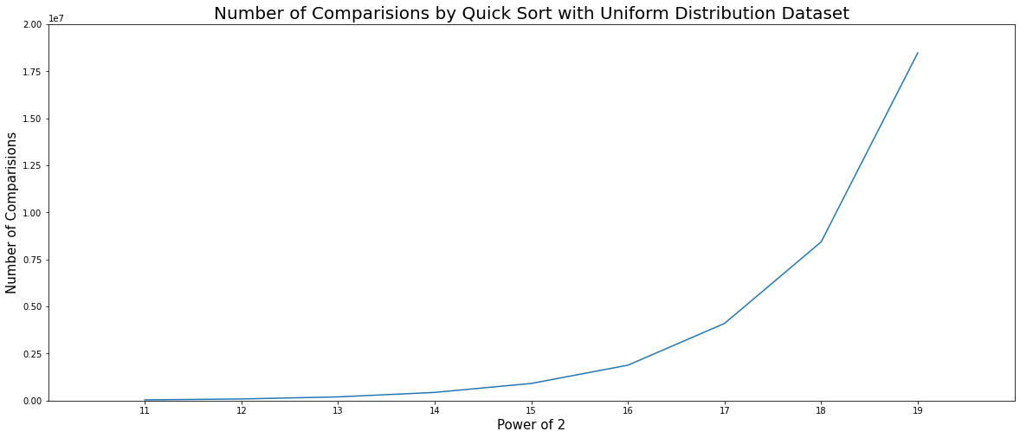
Comparisons by quick sort uniform distribution

Slide 22
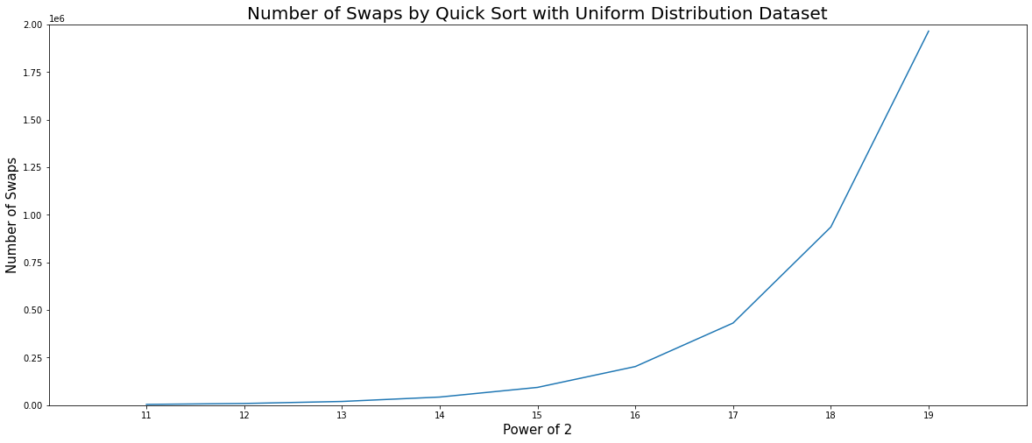
swaps by quick sort uniform distribution

Slide 23
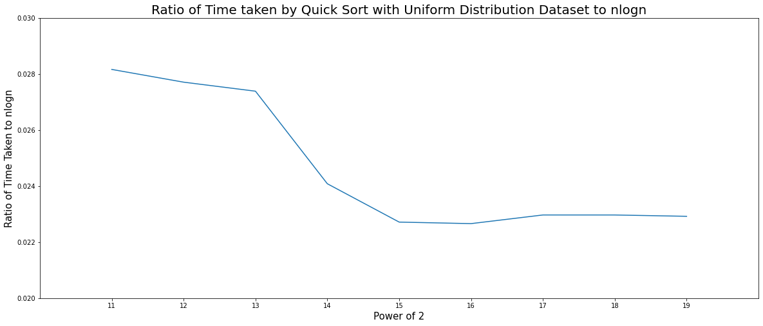
Ratio of time taken to nlogn quick sort uniform distribution

Slide 24
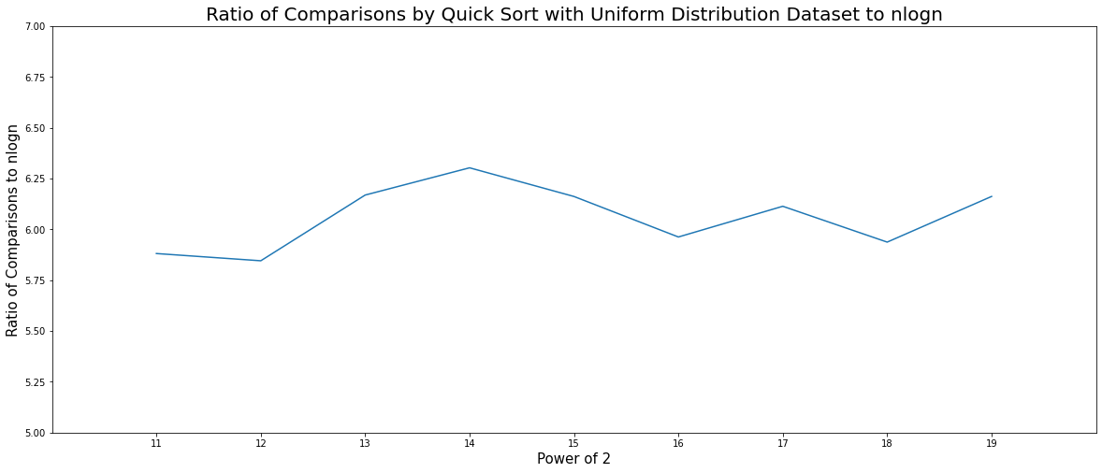
Ratio of comparisons to nlogn quick sort uniform distribution

Slide 25
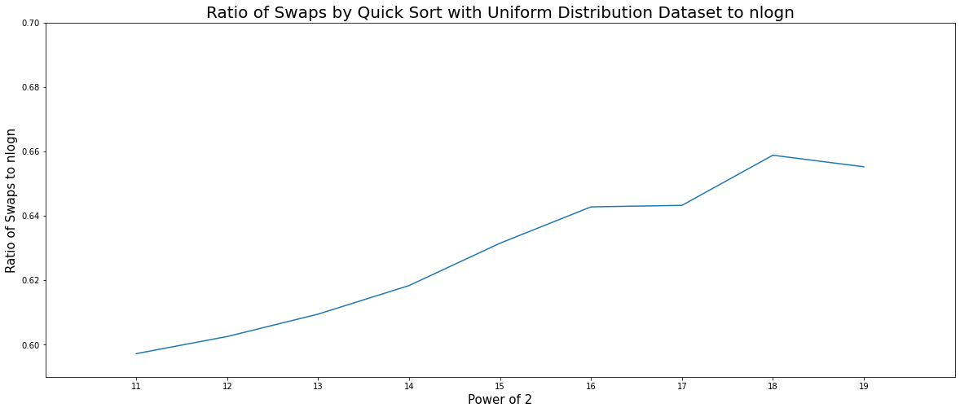
Ratio of swaps to nlogn quick sort uniform distribution

Slide 26
Randomized quick sort
Unlike in normal quick sort, in randomized quick sort we pick a random element as a pivotal element and we exchange it with first element and uses the traditional quick sort on it.
Every time the randomized quick sort is called a random element is picked and served as pivotal element.
Time complexity is same as quick sort.

Slide 27
Time complexity of randomized quick sort
Best case: - O(nlogn).
Average case: - O(nlogn).
Worst case: - O(nlogn).

Slide 28
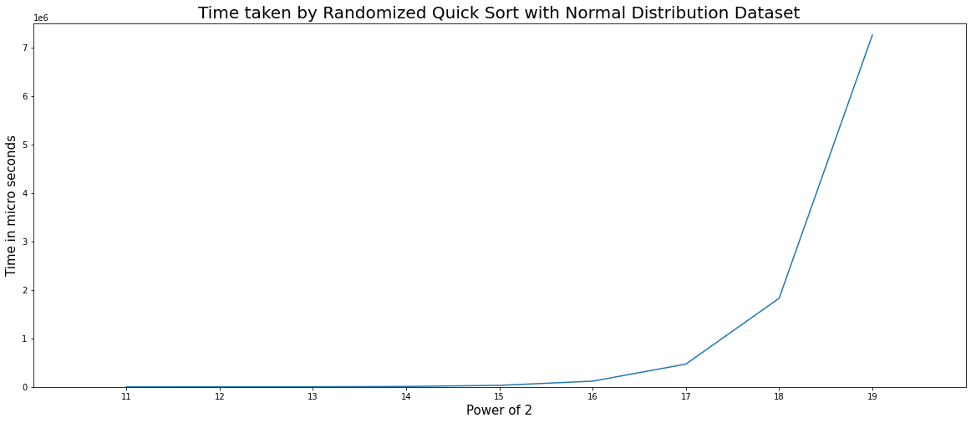
Time taken by randomized quick sort Normal distribution

Slide 29
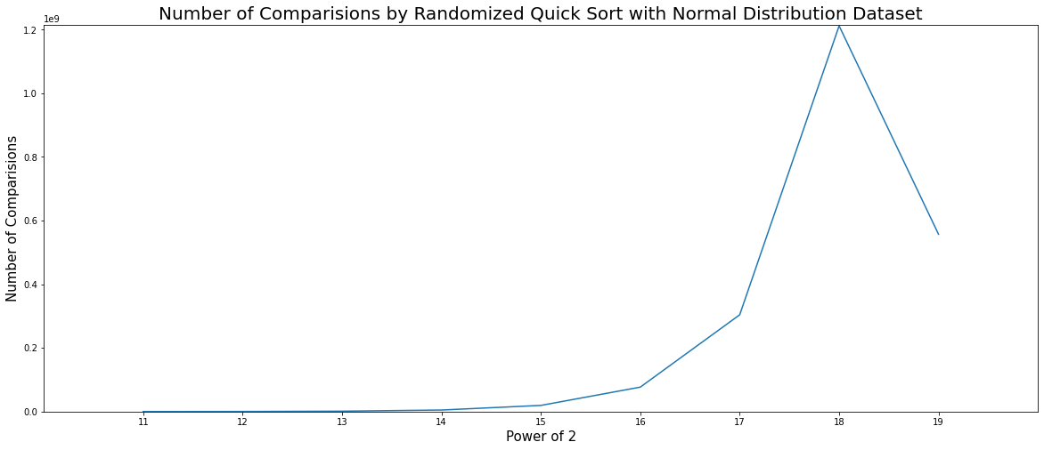
Comparisons by randomized quick sort Normal distribution

Slide 30
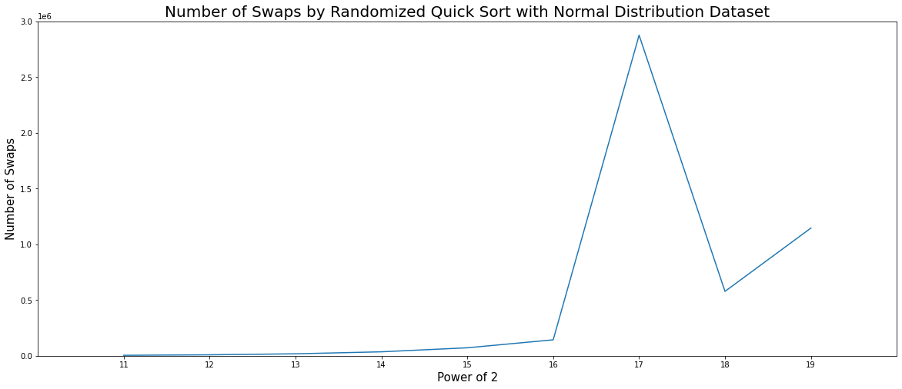
swaps by randomized quick sort Normal distribution

Slide 31
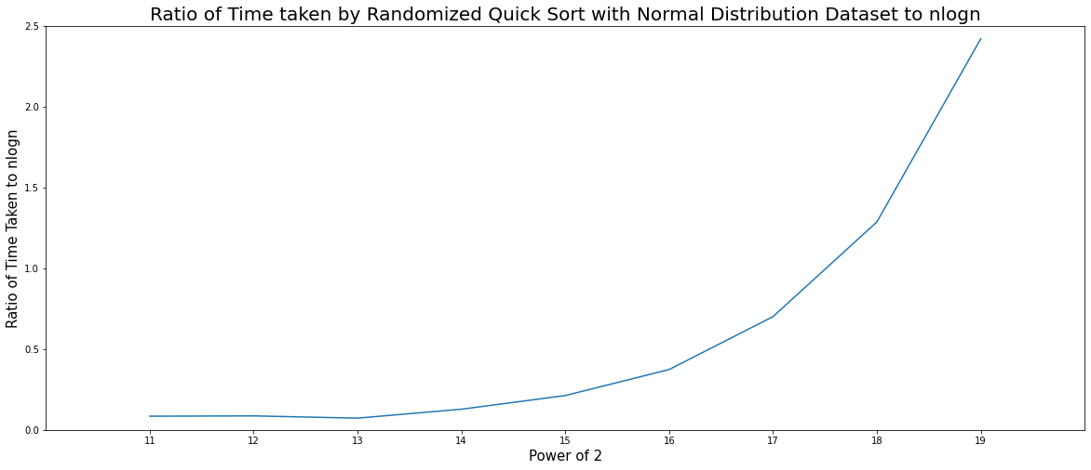
Ratio of time taken to nlogn randomized quick sort normal distribution

Slide 32
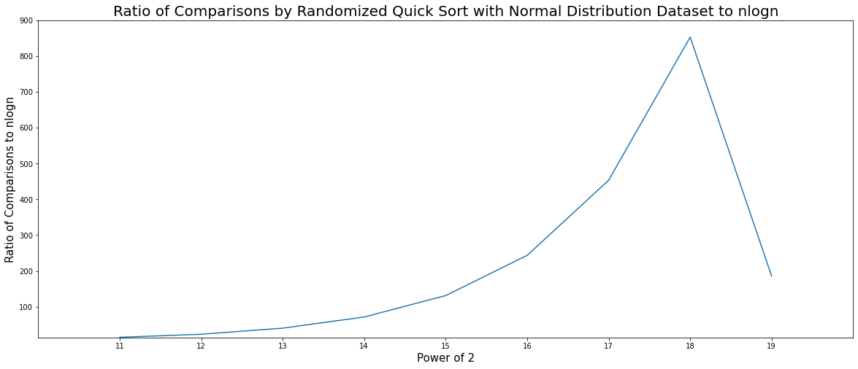
Ratio of comparisons to nlogn randomized quick sort normal distribution

Slide 33
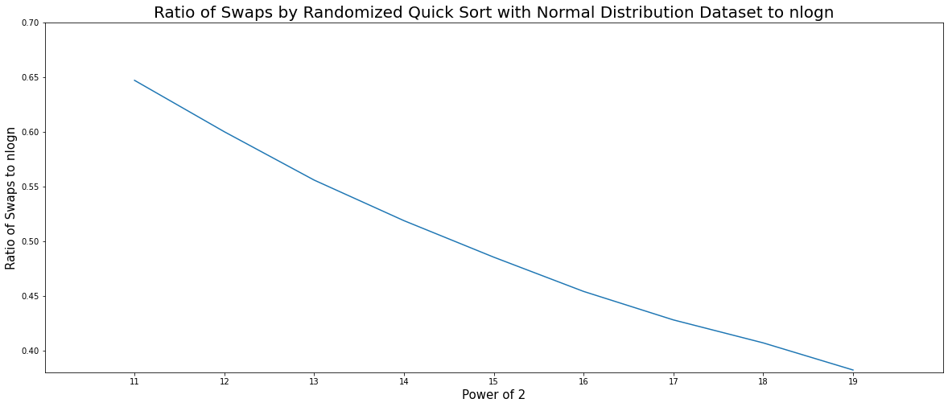
Ratio of time taken to nlogn randomized quick sort normal distribution

Slide 34
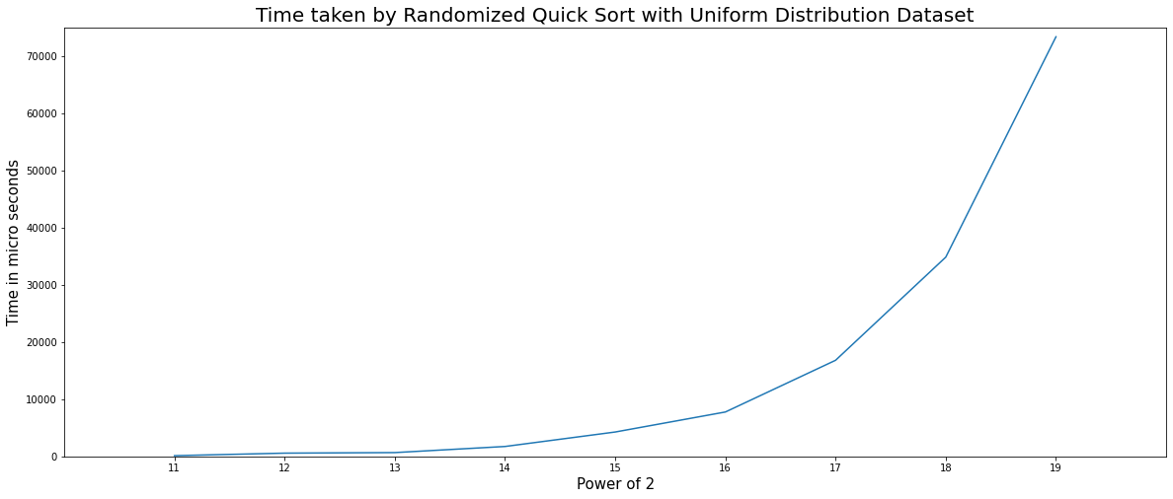
Time taken by randomized quick sort Uniform distribution

Slide 35
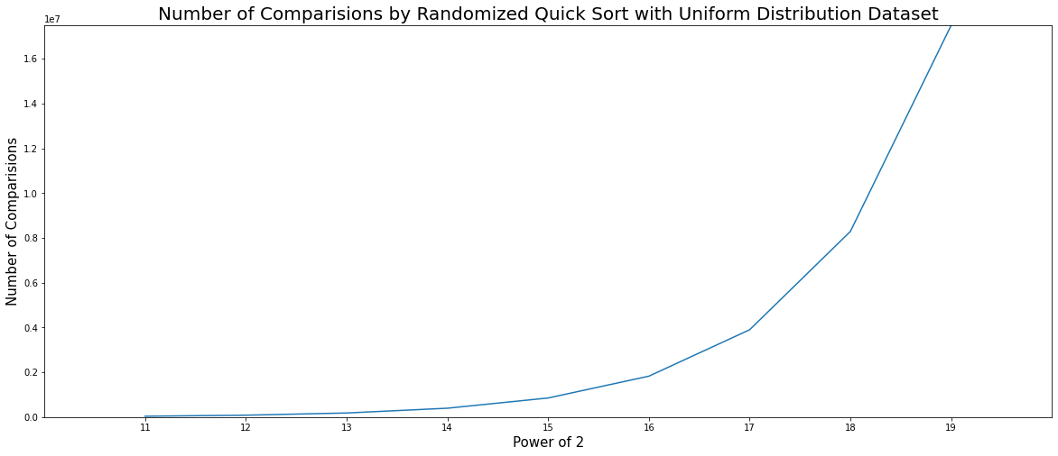
Comparisons by randomized quick sort uniform distribution

Slide 36
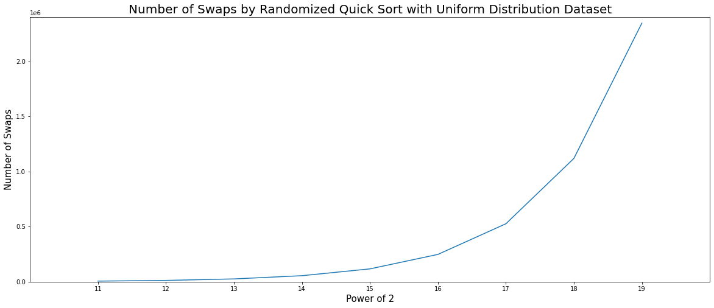
swaps by randomized quick sort uniform distribution

Slide 37
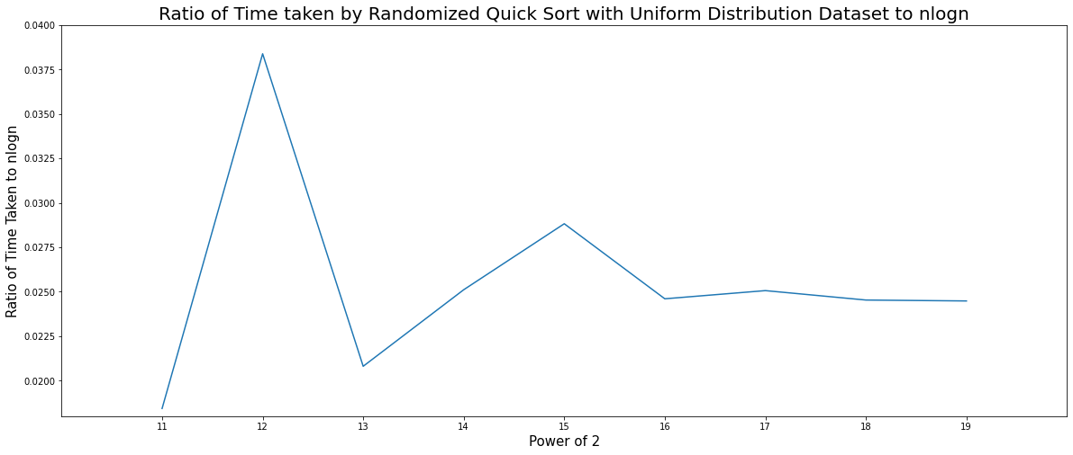
Ratio of time taken to nlogn randomized quick sort uniform distribution

Slide 38
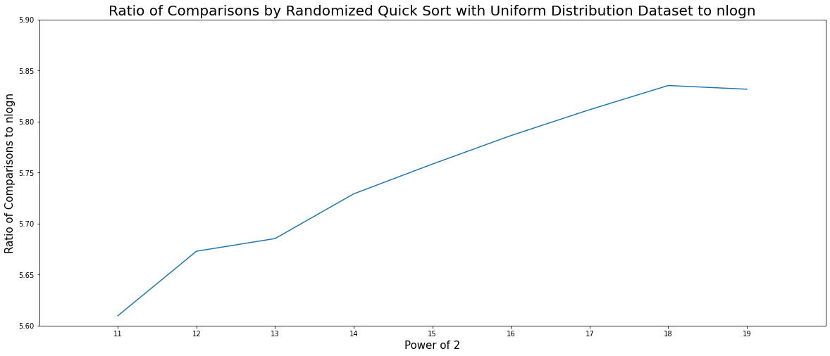
Ratio of comparisons to nlogn randomized quick sort uniform distribution

Slide 39
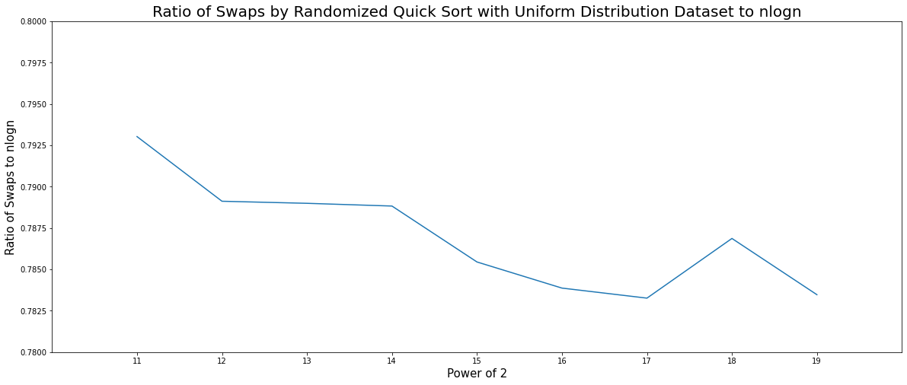
Ratio of swaps to nlogn randomized quick sort uniform distribution

Slide 40
MEDIAN OF MEDIANS
It is a selection algorithm in which we select median of medians recursively.
In median of medians selection algorithm, first we split the given data set into n groups containing equal number of elements (3 or 5 or 7…) except the last one which will have elements length(array) mod (3 or 5 or 7…).
Then we sort each group differently using any sorting algorithm like insertion sort and fetches the median of each group and then store all medians into an another array.
Then we find the median of the medians array, let’s say the median of medians is m.
We will split the given array if required according to the ‘m’.
Finally returns the kth element (length(array) / 2, we used).

Slide 41
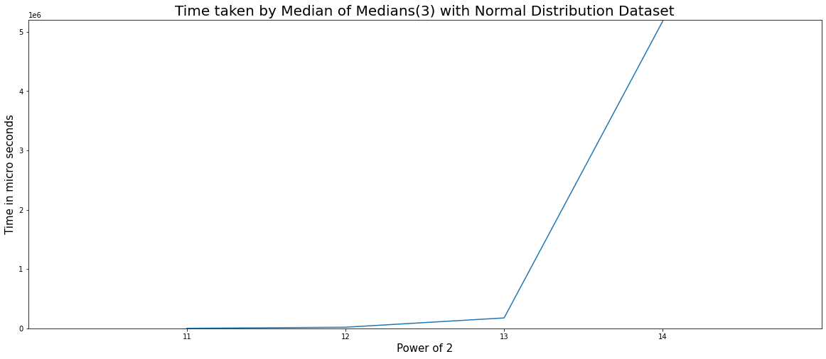
TimE TAKEN BY mom(3) – normal distribution

Slide 42
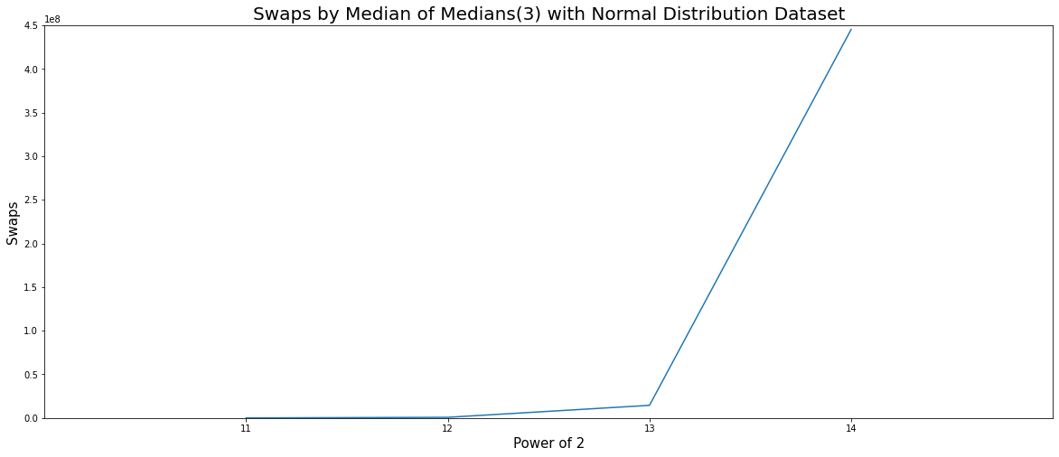
swaps BY mom(3) – normal distribution

Slide 43

Number of medians BY mom(3) – normal distribution

Slide 44
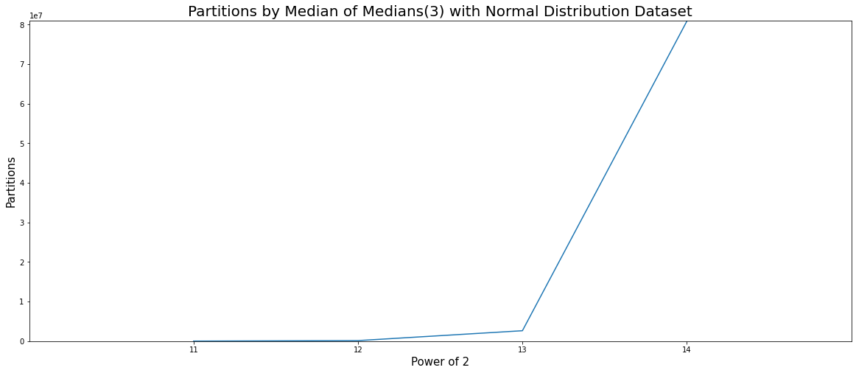
partitions BY mom(3) – normal distribution

Slide 45
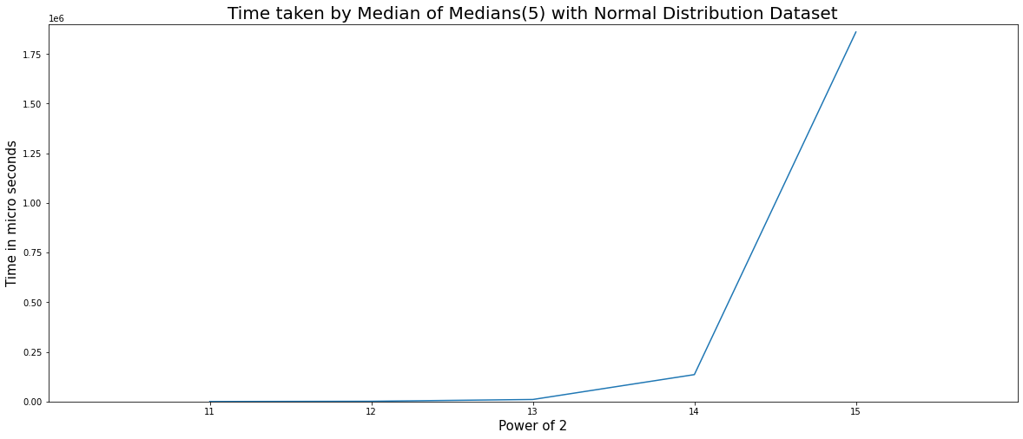
TimE TAKEN BY mom(5) – normal distribution

Slide 46
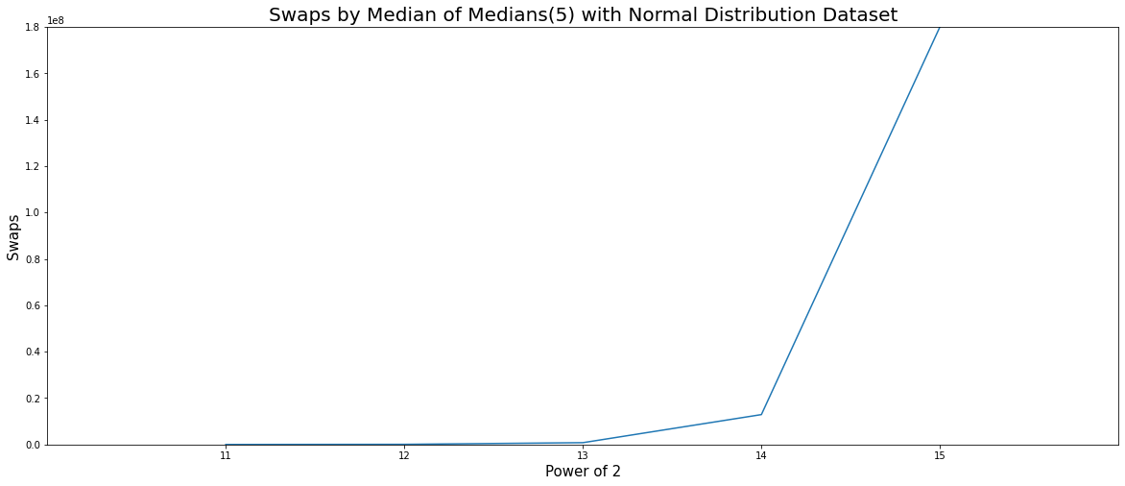
swaps BY mom(5) – normal distribution

Slide 47
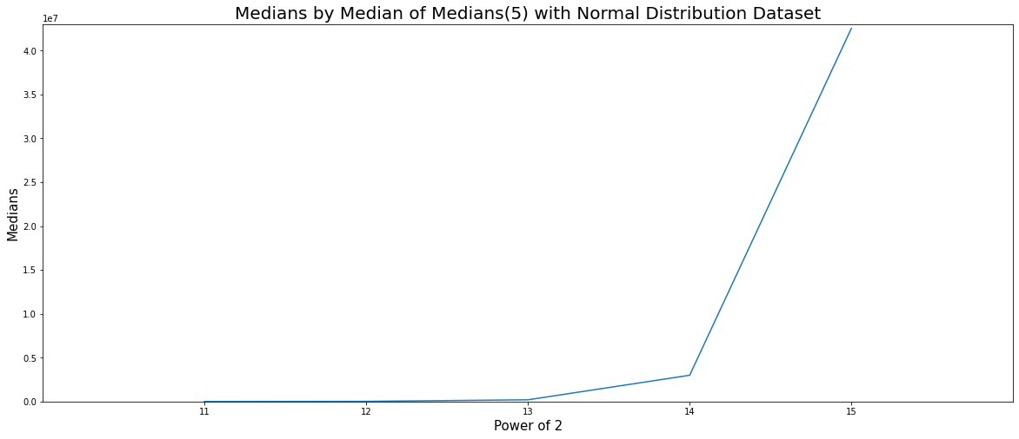
Number of medians BY mom(5) – normal distribution

Slide 48
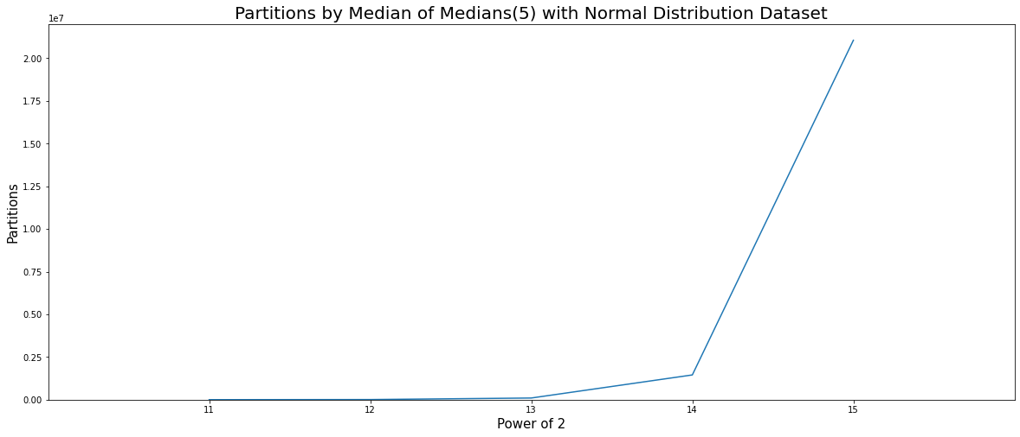
partitions BY mom(5) – normal distribution

Slide 49
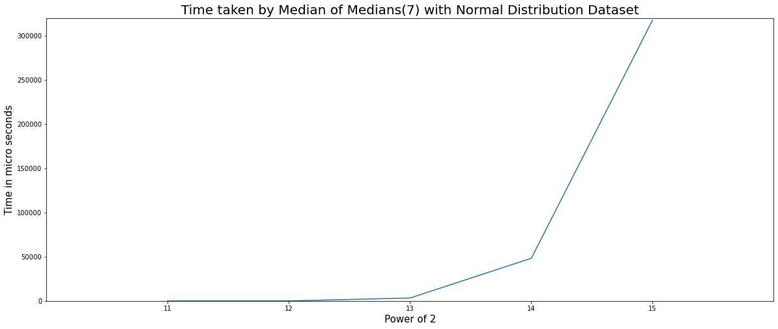
TimE TAKEN BY mom(7) – normal distribution

Slide 50

swaps BY mom(7) – normal distribution

Slide 51
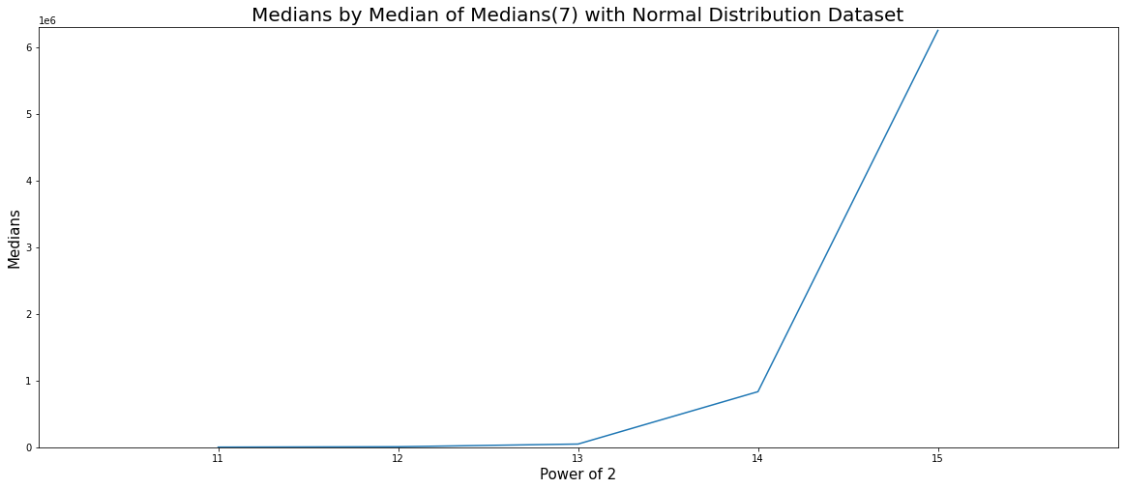
Number of medians BY mom(7) – normal distribution

Slide 52

partitions BY mom(7) – normal distribution

Slide 53
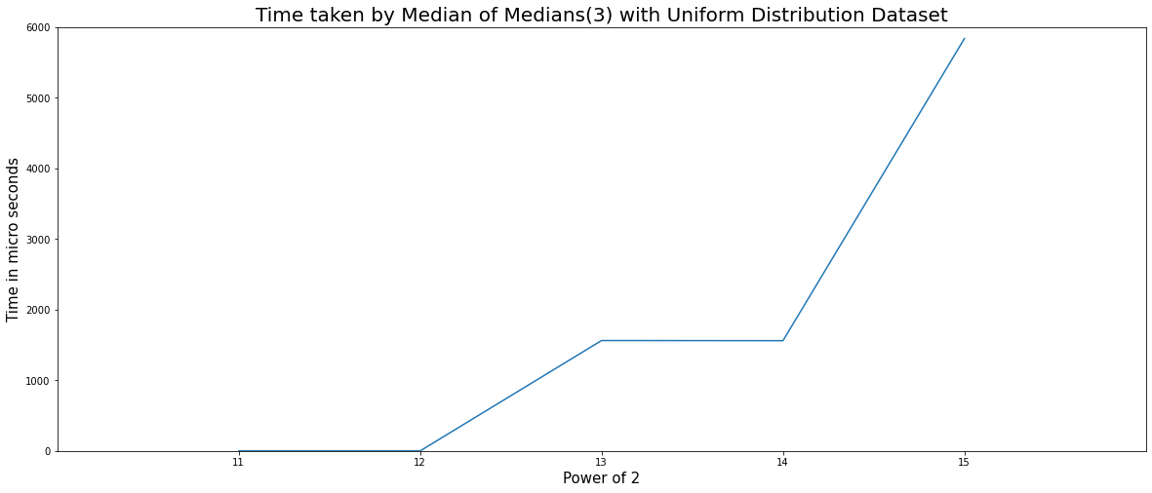
TimE TAKEN BY mom(3) – uniform distribution

Slide 54
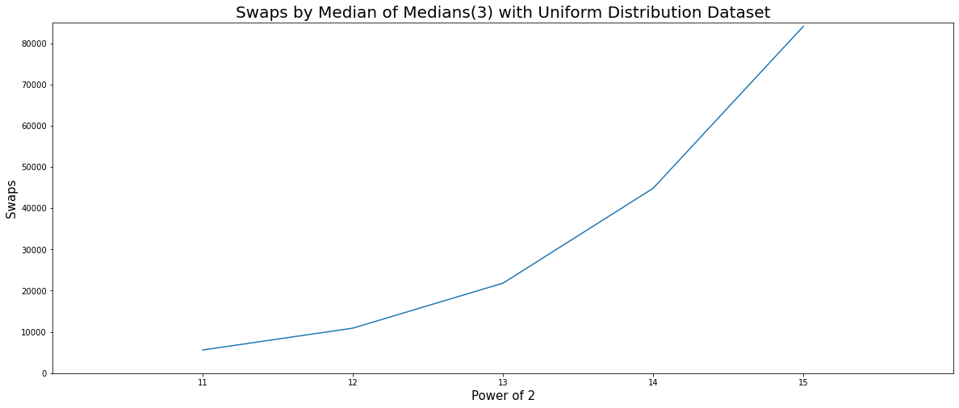
swaps BY mom(3) – uniform distribution

Slide 55

Number of medians BY mom(3) – uniform distribution

Slide 56
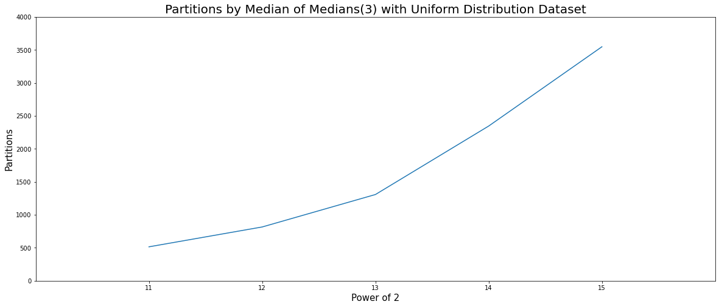
partitions BY mom(3) – uniform distribution

Slide 57
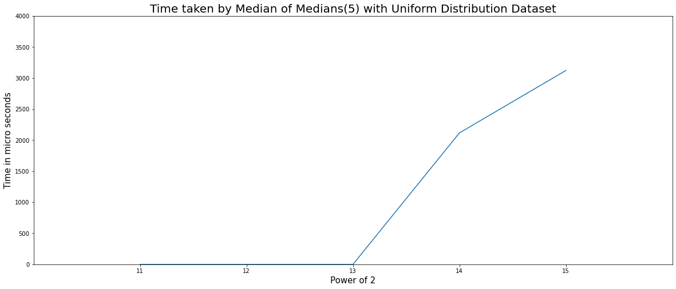
TimE TAKEN BY mom(5) – uniform distribution

Slide 58
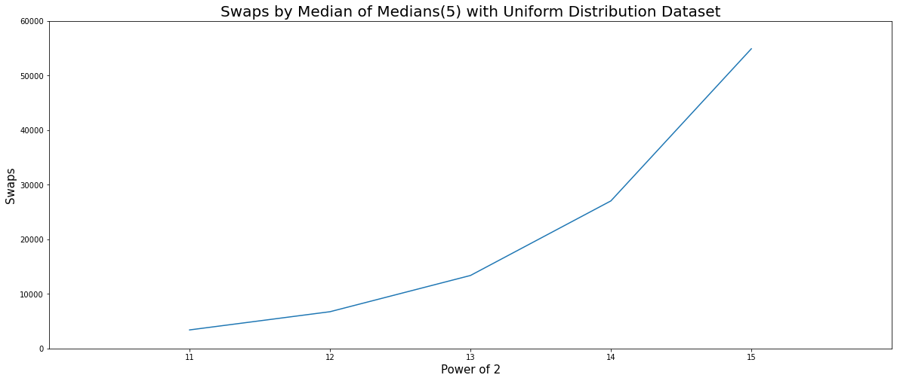
swaps BY mom(5) – uniform distribution

Slide 59
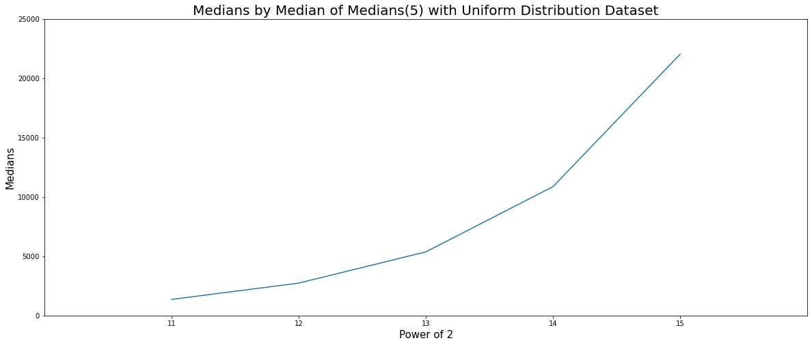
Number of medians BY mom(5) – uniform distribution

Slide 60
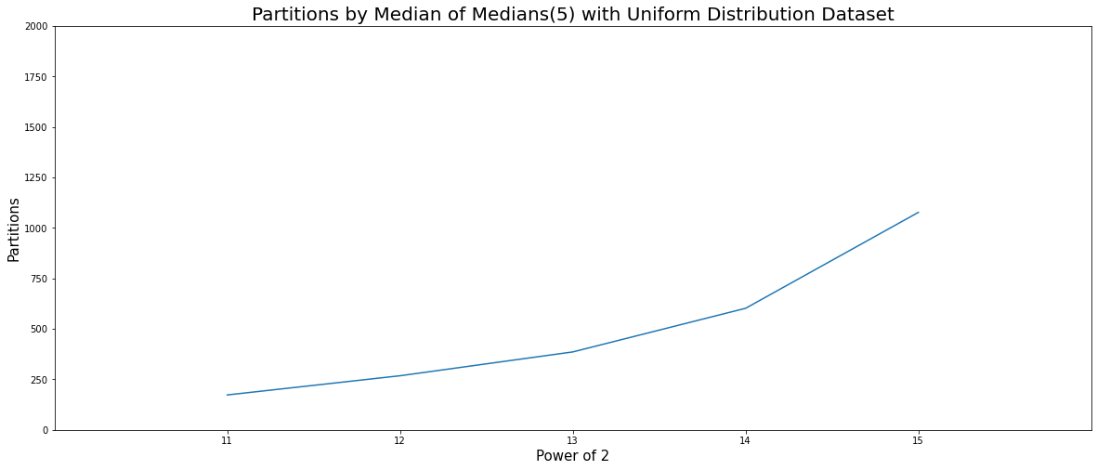
partitions BY mom(5) – uniform distribution

Slide 61
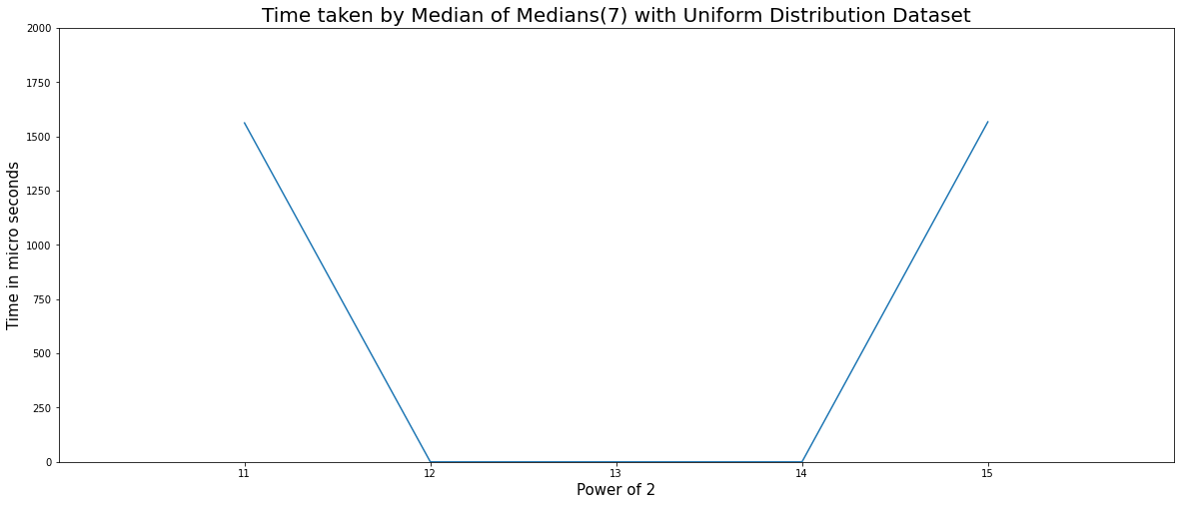
TimE TAKEN BY mom(7) – uniform distribution

Slide 62
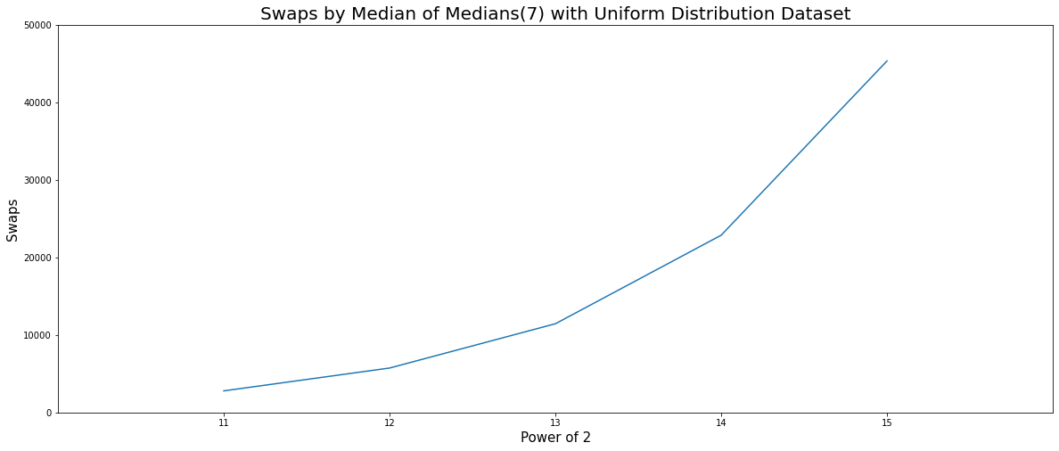
swaps BY mom(7) – uniform distribution

Slide 63
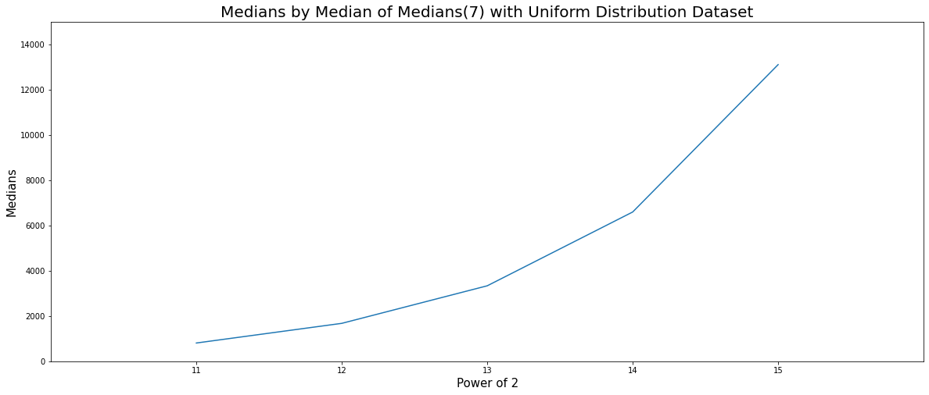
Number of medians BY mom(7) – uniform distribution

Slide 64

partitions BY mom(7) – uniform distribution

Slide 65
Bucket sort
Bucket Sort is one of the linear sorting algorithms. Bucket sort uses some restrictions on the given data set to perform better.
Bucket sort uses some number of buckets, the number of buckets used is equal to the size of the data set.
It uses a hash function to store a data point in a bucket relevant to it.

Slide 66

Time taken by bucket sort – normal distribution

Slide 67
DATA SETS
We have taken two kinds of data sets, one is normal distribution and other is uniform distribution.
The normal distribution data sets are created using inbuilt c++ normal distribution generator. The generated data sets are having mean 1000000 and a standard deviation of 0.5.
The uniform distribution data sets are created using inbuilt c++ uniform distribution generator. The generated data sets are having minimum value 1000 and the maximum value of 1000000.

Slide 68

DATA SET – 2^11 – UNIFORM DISTRIBUTION

Slide 69

DATA SET – 2^12 – UNIFORM DISTRIBUTION

Slide 70

DATA SET – 2^13 – UNIFORM DISTRIBUTION

Slide 71

DATA SET – 2^14 – UNIFORM DISTRIBUTION

Slide 72

DATA SET – 2^15 – UNIFORM DISTRIBUTION

Slide 73

DATA SET – 2^16 – UNIFORM DISTRIBUTION

Slide 74

DATA SET – 2^17 – UNIFORM DISTRIBUTION

Slide 75

DATA SET – 2^18 – UNIFORM DISTRIBUTION

Slide 76

DATA SET – 2^19 – UNIFORM DISTRIBUTION

Slide 77
For source code click below
MyImplementation

Slide 78
Thank you.

