Slide 1



Part-1
Object Oriented Programming
Lecture - 1
What is OOP?

Slide 2
What is object-oriented programming?
It is one of the most popular programming paradigm.
In simple words, it is a programming pattern that resolves around objects or entities.
Object-oriented programming teaches us how to build software by closely imitating the real world objects or entities.

Slide 3
Popular programming approaches
Procedure Oriented Programming
Object Oriented Programming
Functional Programming
Aspect Oriented Programming

Slide 4
Advantages of object-oriented Programming
Better Representation of Real World Scenario
Class
Enhanced Security
Object
OOP
Code Reusability & Easy Code Modification
Better Software Maintenance

Slide 5

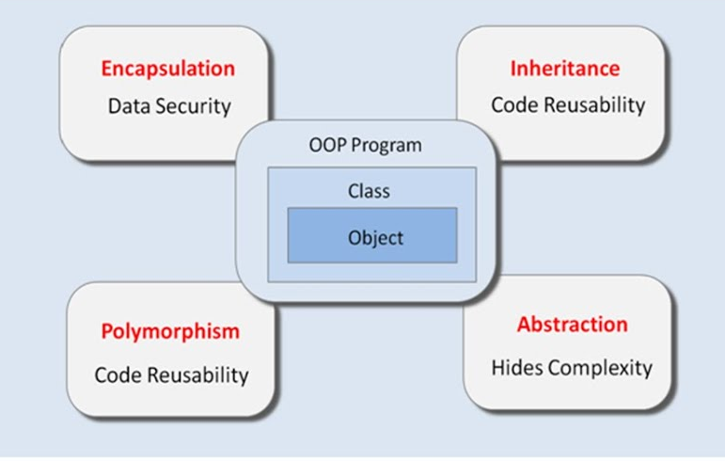
Key Concepts Of Object-Oriented Programming
Class
Object
Encapsulation
Abstraction
Polymorphism
Inheritance
Simplicity

Slide 6
Part-2
Class & Objects
Lecture - 2
Class & Object

Slide 7

What is an Object ?
In programming any real world entity is an Object.

Slide 8
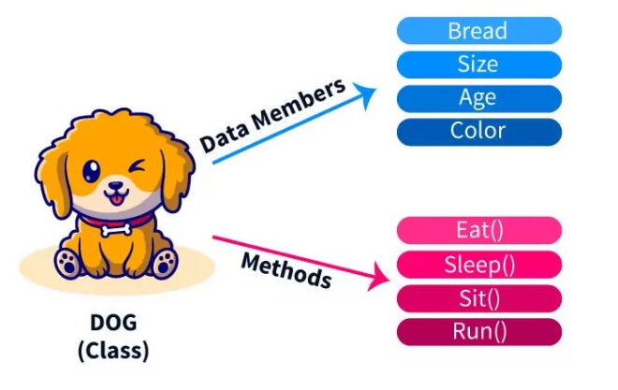
Components of an Object ?
Every Object has two main components :- Property and Behaviours
Breed
Weight
Object

Slide 9


Question -
Are you an Object ?
Yes,we humans are objects because:
We have attributes as name, height, age etc.
We also can show behaviors like walking, talking, running, eating etc.

Slide 10

Question -
Is your phone an Object ?
Yes, it is an object because:
It has attributes like model, price, color, weight etc.
It can also perform actions/behaviors like calling, recording, photo clicking etc.

Slide 11
How to create an object?
Now to create/represent objects we first have to write all their attributes and methods under a single group.
This group is called a class

Slide 12
What is Class ?
A class is used to specify the basic structure of an object.
It contains
Data members/Attributes
Methods/Behaviour

Slide 13

Example -
Each person collectively comes under a class called Human. So we belong to the class Human
Amit
Ravi
Kiran

Slide 14
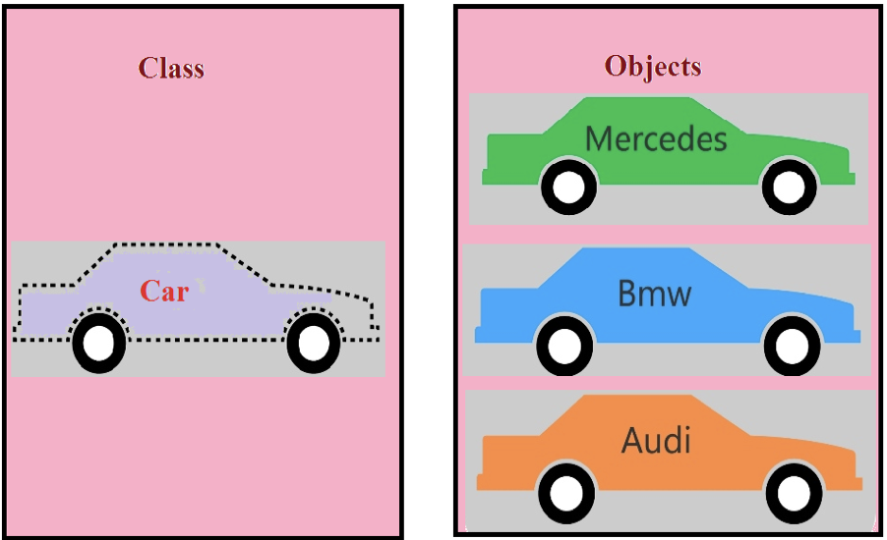
Example -
Each Type of car collectively comes under a class called Car .
Class

Slide 15
Syntax of Object Oriented Programming
<access modifier> class <class Name> {
// Declaration of Data Types
<access modifier> <data_Type> <variable_Name> = value;
............... ......... ............ = .....;
............... ......... ............ = .....;
// Declaration of Methods
<access modifier> <return_Type> <method_Name>( <argument_dataType> argument )
{
// Method Body
}
}

Slide 16

Driver Class
Sample code of Object Oriented programming
Entity Class
class UseStudent {
public static void main(String [] args)
{
Student s;
s=new Student();
S.roll = 101;
S.name = “Amit”;
S.per = 82.9;
System.out.println(“Roll:” + s.roll);
System.out.println(“Name:” + s.name);
System.out.println(“Per:” + s.per);
}
}
class Student {
int roll;
String name;
double per;
}

Slide 17
Part-3
Object Oriented Programming
Lecture - 3
Encapsulation

Slide 18
What Is Encapsulation ?
Encapsulation is the process of binding or wrapping the data and the codes that operates on the data into a single entity
Another way to think about encapsulation is, that it is a protective shield that prevents the data from being accessed by the code outside this shield.

Slide 19
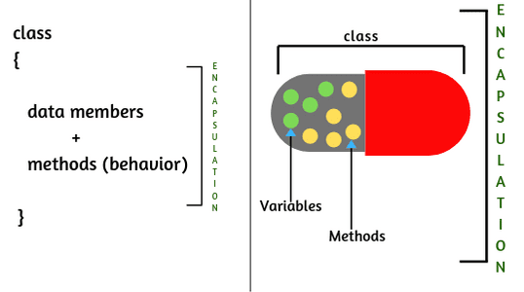
According To Encapsulation. . .
Data :- Data members must be kept private.
Methods :- Methods only can access these data members and these methods can be made public.

Slide 20
Real world example of Encapsulation
Suppose you have an account in the bank. Is it possible for anyone obtain your account details like your account balance, transactions done etc.? Obviously No.
This means that your bank details are private, so that anyone cannot see your account details.
Only you will have access to your account details and that too using method defined inside that class and this method will ask your account id and password for authentication.

Slide 21
How to achieve or implement Encapsulation in Java
There are two steps required to achieve or implement encapsulation in Java program.
Declaring the instance variable of the class as private so that it cannot be accessed directly by anyone from outside the class.
Provide the public setter and getter methods in the class to set/modify the values of the variable/fields.

Slide 22
Entity Class (Without Encapsulation)
class Student {
int roll;
String name;
double per;
}

Slide 23
Driver Class
class UseStudent
{
public static void main(String [] args)
{
Student s;
s=new Student();
s.roll = 101;
s.name = “Amit”;
s.per = 82.9;
System.out.println(“Roll:” + s.roll);
System.out.println(“Name:” + s.name);
System.out.println(“Per:” + s.per);
}
}

Slide 24
Correction In Previous Code
class Student{
private int roll;
private String name;
private double per;
public void setData(int r, String n, double p){
roll=r;
name=n;
per=p;
}

Slide 25
Correction In Previous Code
public void showData( ) {
System.out.println(“Roll no is ” +roll);
System.out.println(“Name is ” +name);
System.out.println(“Percentage is ”+per);
}
}

Slide 26
Correction In Previous Code
class UseStudent
{
public static void main(String [] args)
{
Student s;
s=new Student();
s.setData(101, “Amit”, 82.9);
s.showData();
}
}

Slide 27

Advantages Of Encapsulation

Slide 28
Part-4
Object Oriented Programming
Lecture - 4
Abstraction

Slide 29
What Is Abstraction ?
1. Abstraction is one of the key concepts of object-oriented programming that “shows” only essential attributes and “hides” unnecessary information.
2. The main purpose of abstraction is to make the interaction with the application/product simple.

Slide 30
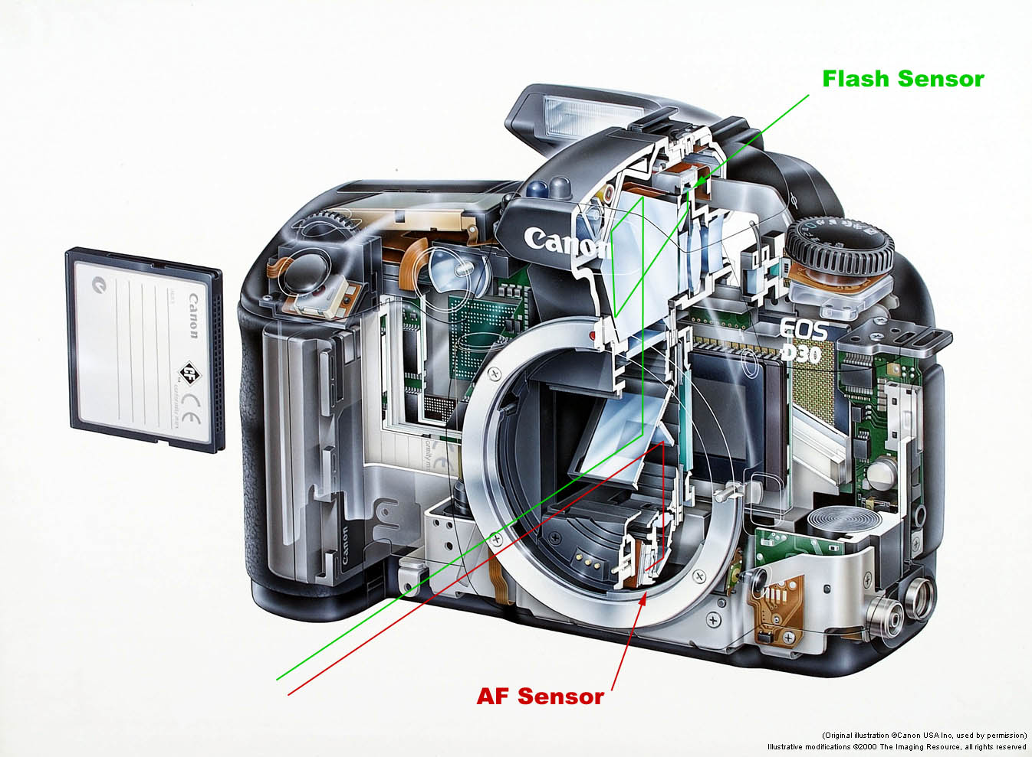

Let's Understand Abstraction With
Example
Without Abstraction
Abstraction

Slide 31


Another example to Understand Abstraction
Without Abstraction
Abstraction

Slide 32
Let's Understand Abstraction With
Code
public class Car {
private void moveBreakPads() {
}
private void changePistonSpeed(){
}
private void createSpark(){
}
public void turnOnCar(){
createSpark();
}
public void accelerate(){
changePistonSpeed();
}
public void brake(){
moveBreakPads();
}
}

Slide 33
Let's Understand Abstraction With
Code
//Driver Class
public class UseCar {
public static void main(String[] args) {
Car C=new Car(); //Create Object
C.turnOnCar();
C.accelerate();
C.brake();
}
}

Slide 34
Difference Between
Abstraction And Encapsulation
Abstraction | Encapsulation
Abstraction hides the implementation details and shows only the functionality to the user | Encapsulation binds and wraps the data and methods together into a single unit
Hides the implementation details to reduce the code complexity | Hides data for the purpose of data protection
Abstraction can be achieved by using abstract class and interfaces | It can be achieved by making data members private and accessing them through public methods

Slide 35
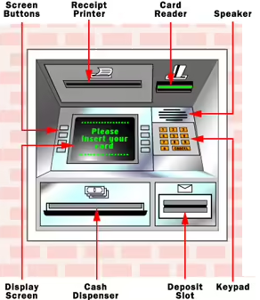
Abstraction
Vs
Encapsulation

Slide 36
Part-5
Object Oriented Programming
Lecture - 5
Constructor

Slide 37
What Is Constructor?
A constructor is a special method of a class in object-oriented programming that initializes a newly created object of that class.

Slide 38
Constructors are methods which…
Have the same name as that of the class.
Don’t have any return type.
Automatically called as soon as object is created

Slide 39
What is Default Constructor
Our Code
Compiler’s Code
Default constructor is automatically inserted by java compiler, if we have not created any constructor explicitly .
class Account {
private int accid;
private String name;
private double balance;
}
class Account {
private int accid;
private String name;
private double balance;
public Account() {
}
}

Slide 40
Entity Class
Non Parameterized
Constructor
Driver Class
class Account {
private int accid;
private String name;
private double balance;
public Account() {
accid=101;
name=“AMIT”
balance=50000.0;
}
public void show() {
System.out.println(accid);
System.out.println(name);
System.out.println(balance);
}
}
class CreateAccount
{
public static void main(String [] args) {
Account A;
A=new Account();
A.show();
}
}

Slide 41
Entity Class
Parametrized
Constructor
Driver Class
class Account
{
private int accid;
private String name;
private double balance;
public Account(int id, String s, double b) {
accid=id;
name=n;
balance=b;
}
public void show() {
System.out.println(accid);
System.out.println(name);
System.out.println(balance);
}
}
class CreateAccount
{
public static void main(String [] args)
{
Account A;
A=new Account(101,”Ravi”,56000);
A.show();
}
}

Slide 42
Part-6
Object Oriented Programming
Lecture - 6
Getter & Setter

Slide 43
What Is Getter and Setter
Getter and Setter are methods defined to work upon instance variables of the class.
For each instance variable, a getter method returns its value
Setter method sets or updates instance variable value.

Slide 44
Let’s Understand With Example
Entity Class
Driver Class
class Vehicle {
private String color;
public String getColor() {
return color;
}
public void setColor(String c) {
this.color = c;
}
}
class UseVehicle {
public static void main(String[] args) {
Vehicle v1;
v1=new Vehicle();
v1.setColor("Red");
System.out.println(v1.getColor());
}
}

Slide 45
Advantages Of Getter and Setter
It helps us achieve encapsulation
Better control over setting the value of the property correctly
Achieve immutability by declaring the fields as private and using only getters

Slide 46
Part-7
Object Oriented Programming
Lecture - 7
Method Overloading

Slide 47
What Is Method Overloading ?
Overloading is a concept of OOPS in which we can create multiple versions of the same entity in the same scope.
So , if a class has multiple methods having same name but different parameters, it is known as Method Overloading.

Slide 48
Benefits of using Method Overloading. . .
Method overloading minimises the complexity of the code.
It increases the readability of the program.

Slide 49
How to do Method Overloading?
In Java, we do method overloading in three ways:
1. By changing data types of parameters.
2. By changing the number of parameters.
3. By changing order of parameters.

Slide 50
By changing data types.
Entity Class
Driver Class
class Addition{
public int add(int a, int b){
return a+b;
}
public double add(double a, double b){
return a+b;
}
}
class UseAddition{
public static void main(String[] args){
Addition obj;
obj=new Addition();
System.out.println(obj.add(2,4));
System.out.println(obj.add(22.6,28.7));
}
}

Slide 51
By changing the number of parameters.
Entity Class
Driver Class
class Addition{
public int add(int a, int b){
return a+b;
}
public int add(int a,int b,int c){
return a+b+c;
}
}
class UseAddition{
public static void main(String[] args){
Addition obj;
obj=new Addition();
System.out.println(obj.add(2,11));
System.out.println(obj.add(6,4,12));
}
}

Slide 52
By Changing Order Of Paramaters
Entity Class
Driver Class
class Addition{
private int a;
private String b;
public String add(int a, String b){
return a+b;
}
public String add(String a, int b){
return a+b;
}
}
class UseAddition{
public static void main(String[] args){
Addition A;
A=new Addition();
System.out.println(A.add(2,"Ravi"));
System.out.println(A.add("Ajay",28));
}
}

Slide 53
Part-10
Object Oriented Programming
Lecture - 10
this Keyword

Slide 54
What Is this keyword ?
“this” is a special object reference, which is also a keyword.
“this” is automatically created by Java in a method’s argument, as soon we call that method.
“this” stores the memory address of the CURRENT OBJECT (the object on which the method has been called)

Slide 55
Benefits Of Using “this”. . .
By using “this” we can resolve the overlapping of instance variable of a class done by the local variables of a method with the same name.
2. By using “this” we can perform CONSTRUCTOR CHAINING

Slide 56
Part-11
Object Oriented Programming
Lecture -11
Inheritance

Slide 57
What Is Inheritance?
Inheritance is a technique using which we can acquire the features of an existing class/object in a newly created class/object

Slide 58
Let’s Understand With An Example
As per OOP , the class Orange must inherit the class Fruit so that all the features (data & methods) of the Fruit class get inherited in Orange class also
class Fruit
{
//data
...
..
.
//method
}
class Orange
{
..
}

Slide 59
Benefits of Inheritance. . .
Reusability: The child class programmer is not required to rewrite those methods or data again which have already been designed by the parent class programmer
Maintainability: Easy to incorporate changes in the code

Slide 60
Terminologies Used In Inheritance
The class which gets inherited is knows by 3 names
a. Parent class OOP
b. Base class C++
c. Super class Java/Python

Slide 61
Terminologies Used In Inheritance
2. The class which inherits is known by 3
Names
a. Child class OOP
b. Derived class C++
c. Sub class Java/Python

Slide 62
Types Of Inheritance
Single
Multilevel
Multiple
Hierarchical
Hybrid
Note: Java does not support multiple inheritance and thus it also does not support hybrid inheritance

Slide 63
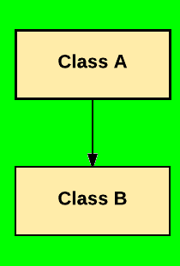
Single Inheritance:
In Single Inheritance one class extends another class (one class only).

Slide 64
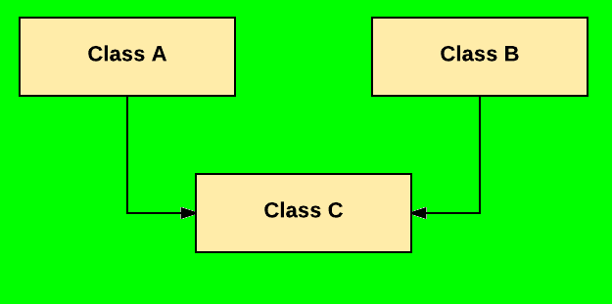
Multiple Inheritance:
Multiple Inheritance is one of the inheritance in OOP where one class extends more than one class. Java does not support multiple inheritance.

Slide 65
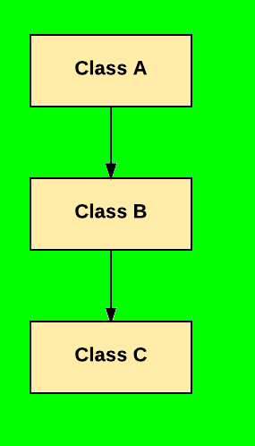
Multilevel Inheritance:
In Multilevel Inheritance, one class can inherit from a derived class. Hence, the derived class becomes the base class for the new class.

Slide 66
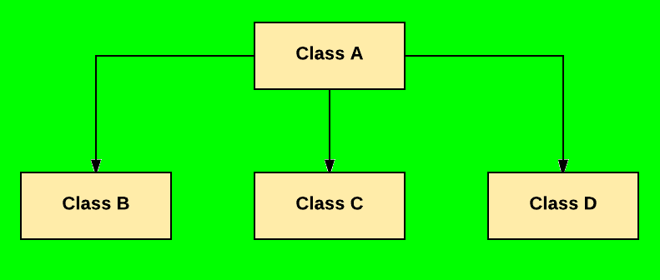
Hierarchical Inheritance:
In Hierarchical Inheritance, one class is inherited by many sub classes.

Slide 67
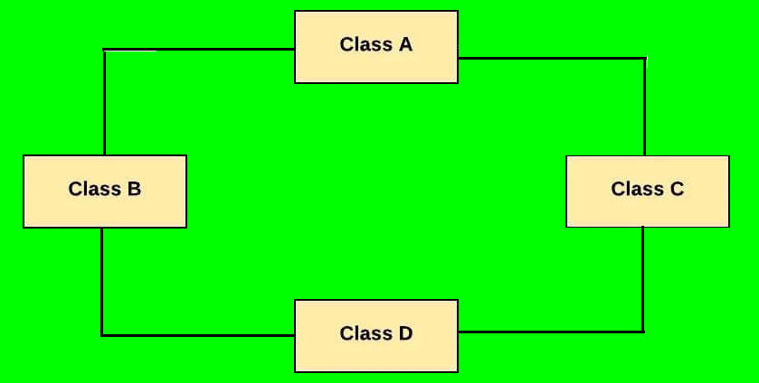
Hybrid Inheritance:
Hybrid inheritance is one of the inheritance types in OOP which is a combination of Single and Multiple inheritance.

Slide 68
SYNTAX OF INHERITANCE IN JAVA
class <class_name>
{
//body of class
}
class <class_name> extends <class_name>
{
//body of class
}

Slide 69
Let’s Understand With Example
Driver Class
Entity Class
public class Hospital {
public static void main(String args[]) {
Surgeon s = new Surgeon();
s.qualification();
s.specialist();
}
class Doctor {
public void qualification() {
System.out.println("Qual Details...");
}
}
class Surgeon extends Doctor {
public void specialist() {
System.out.println("Surgeon Detail...");
}
}

Slide 70
Part-12
Object Oriented Programming
Lecture -12
super Keyword

Slide 71
What Is “super”?
In Java, the keyword “super” is used by a CHILD CLASS for EXPLICITLY referring (Using dot operator) the members of its PARENT CLASS.

Slide 72
Let’s Understand With Example
Entity Class
Driver Class
class A
{
public void display() {
...
}
public void print() {
...
}
}
class B extends A
{
public void show()
{
display();
print();
}
}
B obj=new B();
obj.show();

Slide 73
Uses of “super”
For calling constructor of PARENT class from CHILD class
For resolving method overriding

Slide 74
Part-13
Object Oriented Programming
Lecture -13
Method
Overriding

Slide 75
What is Method Overriding
Whenever a child class contains a method with the same prototype as the parent class, then we say that the method of child class has OVERRIDDEN the method of parent class

Slide 76
Let’s Understand With Example
Entity Class
Driver Class
class DemoA {
public void show(){
//Some code
}
}
class DemoB extends DemoA {
public void show(){
//Some other code
}
}
class UseDemo {
public static void main(String []args){
DemoB obj=new DemoB();
obj.show();
}
}

Slide 77

Question ?
Why we override a super class method ?
Answer :- To provide better/correct implementation of that method in child class
Let us understand this with an example

Slide 78
Let’s Understand With Example
Entity Class
Driver Class
class Fruit{
public void taste(){
System.out.println(“Sweet”);
}
}
class Grapes extends Fruits{
public void taste(){
System.out.println(“Citrus”);
}
}
class UseFruit{
public static void main(String []args){
Grapes G=new Grapes();
G.taste();
}
}

Slide 79
Role of super in Overriding
If the child class has overriding a method of parent class, but due to some reason now the programmer of child class also wants to execute the version of parent class of the overridden method.
In this case he will use super and the syntax will be:
super.<method_name>(<list_of_arg>);

Slide 80
Method Overriding V/s Method Overloading
Method Overloading
Method Overriding
Overloading can be done either within the same or between methods of PARENT & CHILD class
Overriding can never be done within a single class and it always requires INHERITANCE i.e
overriding can be done between between of PARENT & CHILD only
Overloading says methods must have same, but COMPULSORILY different arguments
Overriding says methods MUST COMPULSORILY have exactly same prototype. Although overriding allows CO-VARIANT return types

Slide 81
Part-16
Object Oriented Programming
Lecture -16
final keyword

Slide 82
What is “final” keyword in java
final is a non access modifier in java and can be used in three ways
final
variable
method
class

Slide 83
“final” variable
final variable: Once we declare a variable as a final we can’t perform re-assignment.

Slide 84
Let’s Understand With Example
class Circle {
private int radius;
private final double pi = 3.14; //Now this value is fixed
public Circle(int radius) {
this.radius = radius;
}
}

Slide 85
Another Way To Initialize final Data
class Circle {
private int radius;
private final double pi;
public Circle(int radius) {
this.radius = radius;
pi = 3.14; //Now this value is fixed
}
}

Slide 86
Let’s Understand With Example
class Circle {
private int radius;
private final double pi = 3.14;
public Circle(int radius) {
this.radius = radius;
pi = 5.0; //Error: final cannot be changed
}
}

Slide 87
“final” method
final method: Whenever we declare a method as a final it can’t be overridden in the child class.
Let us understand with an Example

Slide 88
//Entity Class
class Bike {
final public void run(){
System.out.println("running");
}
}
class Honda extends Bike {
public void run() {
System.out.println("running safely with 100kmph");
}
}
// Driver Class
class UseBike {
public static void main(String args[]){
Honda honda= new Honda();
honda.run();
}
}
Error: Overriding a final method is not allowed

Slide 89
“final” class
final class: Whenever we declare a class as final it can’t be extended or inherited by sub classes.

Slide 90
//Entity Class
final class Bike {
public void run(){
System.out.println("running");
}
}
class Honda extends Bike {
}
Error: final classes cannot be inherited

Slide 91
Some predefined final classes provide by java
Math
String
All Wrapper Classes like
Integer
Double
Character
etc.

Slide 92
Part-17
Object Oriented Programming
Lecture -17
Polymorphism

Slide 93
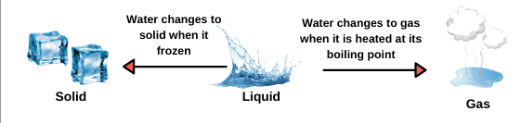
What is Polymorphism
Real Life Example of Polymorphism
The derivation of the word Polymorphism is from two different Greek words- poly and morph.
“Poly” means multiple, and “Morph” means forms.
So, polymorphism means ability to acquire multiple forms.

Slide 94
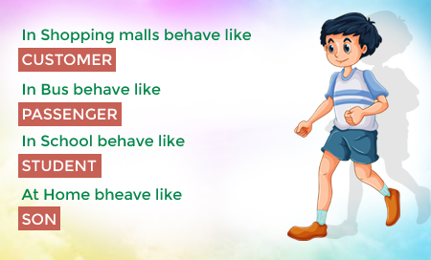
Another Example of Polymorphism

Slide 95
Types of polymorphism in Java
Compile time polymorphism
Runtime polymorphism

Slide 96
Compile time polymorphism
Compile-time polymorphism is also known as static polymorphism.
To achieve compile time polymorphism we must have different implementations of the same method in a class.
And this is done using method overloading

Slide 97
Part-18
Object Oriented Programming
Runtime Polymorphism

Slide 98
Runtime Polymorphism
Runtime polymorphism is also called as Dynamic Method Dispatch in java.
To achieve Runtime polymorphism in java we must be able to call different versions of the same method using the same reference variable.
These methods should be present in child class and the reference must be of parent class.

Slide 99
How to call area() of Every Class?
Entity Class
Driver Class
Although it works, but it is
not runtime polymorphism
class Rectangle
{
public void area()
{
...
}
}
class Circle
{
public void area()
{
...
}
}
class Triangle
{
public void area()
{
...
}
}
public class UseShape
{
public static void main(String[] args)
{
Rectangle r = new Rectangle();
r.area();
Circle c = new Circle();
c.area();
Triangle t = new Triangle();
t.area();
}
}

Slide 100
Runtime Polymorphism
But to Understand how this concepts works we must first understand the concept of binding.

Slide 101
What Is Binding ?
The word binding is the mechanism using the compiler decides that which function call which function body will get executed.

Slide 102
In Java we have 2 types of binding
Early binding Or Compile time binding or static binding
Late binding or runtime binding or dynamic binding

Slide 103
Part-19
Object Oriented Programming
Types of Binding

Slide 104
Early Binding
If the method being called is a static method, then java selects the method by looking at the (class) of the reference used in the call and not the type of object to which the reference is pointing.

Slide 105
Let’s Understand With Example
Entity Class
Driver Class
class Parent
{
public static void show()
{
...
}
}
class Child extends Parent
{
public static void show()
{
...
}
}
public class UseShape
{
public static void main(String[] args)
{
Parent p = new Child ();
p.show();
}
}
Which method will execute ?

Slide 106
Late Binding
If the method being called is a non-static method i.e instance method, then Java selects the method by considering the type of object, pointed by the reference and not considering the type of reference itself

Slide 107
Let’s Understand With Example
Entity Class
Driver Class
class Parent
{
public void show()
{
...
}
}
class Child extends Parent
{
public void show()
{
...
}
}
public class UseShape
{
public static void main(String[] args)
{
Parent p=new Child();
p.show();
}
}
Which method will execute ?

Slide 108
Part-21
Object Oriented Programming
Abstract
Method & class

Slide 109
Find The Problem In This Code?
class Language{
public void greetings(){
}
}
The problem with the code is that we have left the body of the method greetings() empty
This is because we don’t have any suitable logic for the method greetings() in the class Language

Slide 110
Can we improve it ?
Yes we can improve it by removing the body of the method and just declaring it in the class Language
But to do this we must prefix the method as well as the class with the keyword abstract
For ex:-
abstract class Language
{
abstract public void greetings();
}

Slide 111
When we should declare a method as abstract ?
There are situations when we have a method in super class which cannot be implemented properly due to lack of information in super class.
But we need this method for achieving runtime polymorphism and thus in such cases we must declare a method as abstract.

Slide 112
For ex:-
Suppose we have class called Instrument and the class has a method called sound ().
What will be the implementation of sound () in the Instrument ?

Slide 113
Entity Class
Let’s Understand With Example
Driver Class
class Instrument{
public void sound(){
}
}
class Violin extends Instrument{
public void sound(){
...
}
}
class Guitar extends Instrument{
public void sound(){
...
}
}
class UseInstrument{
public static void main(String args[]){
Instrument I1;
I1=new Violin();
I1.sound();
I1=new Guitar();
I1.sound();
}
}
What is the implementation ?

Slide 114
Entity Class
Improved version
Driver Class
abstract class Instrument{
abstract public void sound();
}
class Violin extends Instrument{
public void sound(){
...
}
}
class Guitar extends Instrument{
public void sound(){
...
}
}
class UseInstrument{
public static void main(String args[]){
Instrument I1;
I1=new Violin();
I1.sound();
I1=new Guitar();
I1.sound();
}
}

Slide 115
Object Oriented Programming
Abstract
Method & class

Slide 116
Some important points
To make a method abstract it is compulsory to use the keyword abstract in the method prototype.
An abstract method should never have any implementation in the class where it is being declared.
If a method has been declared as “abstract” in the class, then the class itself must be prefixed with the keyword abstract

Slide 117
For:- example
class A
{
public abstract void show();
}
Error !
abstract class A
{
public abstract void show();
}
Now it is OK

Slide 118
Some important points
If a class is abstract then we are not allowed to create its “object” .
Although we can create reference of the class.
A obj;// Ok
obj=new A();// Error

Slide 119
Some important points
An abstract class can CONTAIN concrete methods as well as Constructors.
This is because abstract classes can be inherited and these methods can be inherited and these methods can be accessed by the objects of child classes.

Slide 120
Some important points
If a class inherits an abstract class then
Either it must compulsorily override all the abstract methods inherited from the super class.
OR
The child class itself will have to be prefix with the keyword abstract and we won’t be allowed to create its object also.

Slide 121
Part-23
Object Oriented Programming
Abstract

Slide 122

Which methods cannot be declared as abstract ?
Static Methods
Constructors
Private methods
Final methods

Slide 123
Part-24
Object Oriented Programming
Interface

Slide 124
What is an interface?
An interface is almost same as a pure abstract class.
Just like a class or abstract class an interface also can contain data members.

Slide 125
What is an interface?
But every data declared in an interface is automatically converted to “public” “static” and “final” by java.
An interface can also contain methods but every method by default is “public” and “abstract”
However from java 8, an interface can also contain “default” and “static” methods

Slide 126
What is an interface?
Just like we cannot instantiate an abstract class, similarly we also cannot instantiate an interface
However we can create a reference of an interface.

Slide 127
What is an interface?
Just like an abstract class an interface also can be inherited by child classes but the keyword used for this inheritance is implements.
The reference of an interface can point to the object of its implementation class or child class
And this forms the basis of runtime polymorphism

Slide 128
What is an interface?
If a class inherits an interface then it is compulsory to override every abstract method inherited from the interface.
Otherwise, the derived class also will have to be declared as abstract.

Slide 129
Syntax of declaring an interface
interface <interface_name>
{
<data_type> <var_name>=<value>;
.
.
.
<return_type> <method_name> (list_of_arg);
.
.
.
}

Slide 130
Let’s Understand With Example
Interface declaration
public interface Animal {
void makeSound();
void eat();
}
//Both the above methods are by default public and abstract

Slide 131
Let’s Understand With Example
Entity class
public class Elephant implements Animal {
@Override
public void makeSound() {
System.out.println("Trumpet!");
}
@Override
public void eat() {
System.out.println("Elephant eats grasses and leaves");
}
}

Slide 132
Let’s Understand With Example
Entity class
public class Lion implements Animal {
@Override
public void makeSound() {
System.out.println("Roar!");
}
@Override
public void eat() {
System.out.println("Lion eats flesh");
}
}

Slide 133
Let’s Understand With Example
Driver class
class UseAnimal{
public static void main(Sring []args){
Animal obj;
obj= new Elephant();
obj.makeSound();
obj.eat();
obj= new Lion();
obj.makeSound();
obj.eat();
}
}

Slide 134
Part-25
Object Oriented Programming
Abstract Class
vs
Interface

Slide 135
Abstract Class
Interface
1) Abstract class can have abstract and non-abstract methods. | 1) Interface can have only abstract methods. Since Java 8, it can have default and static methods also.
2) Abstract class doesn't support multiple inheritance. | 2) Interface supports multiple inheritance.
3) Abstract class can have final, non-final, static and non-static variables. | 3) Interface has only static and final variables.

Slide 136
Abstract Class
Interface
4) Abstract class can provide the implementation of interface. | 4) Interface can't provide the implementation of abstract class.
5) The abstract keyword is used to declare abstract class. | 5) The interface keyword is used to declare interface. we
6) An abstract class can extend another Java class and implement multiple Java interfaces. | 6) An interface can extend another interface only. However it can extend multiple interfaces.

Slide 137
Abstract Class
Interface
7) An abstract class can be extended using keyword "extends". | 7) An interface can be implemented using keyword "implements".
8) A Java abstract class can have class members like private, protected, etc. | 8) Members of a Java interface are public by default. But from java 9 onwards methods of an interface can also be declared as private
9) Example: public abstract class Shape{ public abstract void draw(); } | 9) Example: public interface Drawable{ void draw(); }

Slide 138
Part-26
Object Oriented Programming
Association

Slide 139
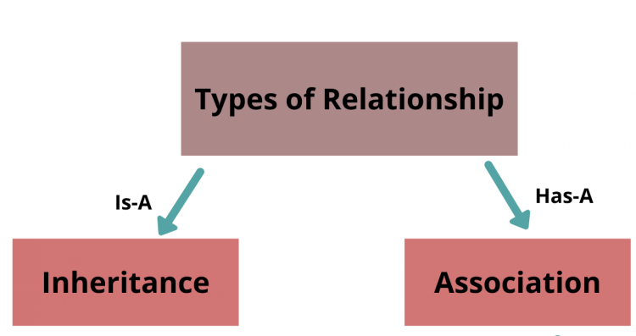
Java has two types of relationship
1. Inheritance (IS-A)
2. Association (HAS-A)

Slide 140
What Is Inheritance ?
1. Inheritance (IS-A)
An IS-A relationship signifies that one object is a type of another.
For Example:
CAR IS-A vehicle
Apple IS-A fruit
Circle IS-A shape
It is implemented using “extends” or “implements” keywords.

Slide 141
Let’s Understand With Example
Driver Class
Entity Class
public class UseCar {
public static void main(String args[]){
Car car = new Car();
//Some More Code
}
}
class Vehicle {
//Some Code
}
class Car extends Vehicle{
//Some Code
}

Slide 142
What Is Association ?
2. Association (HAS-A)
A HAS-A relationship signifies that a class is associated with that is it holds object(s) of another class in its body
For Example:
Car has Engine
College has Students
House has Rooms
For instance, class A holds class B’s reference and can access all properties of class B.

Slide 143
Entity Class
Let’s Understand With Example
Driver Class
class Engine {
public void start() {
//Some Code
}
}
class MusicPlayer {
public void start() {
//Some Code
}
}
class Car {
Engine engine = new Engine();
MusicPlayer player = new MusicPlayer();
public void startEngine() {
engine.start();
}
public void startMusicPlayer() {
player.start();
}
}
public class UseCar{
public static void main(String args[]){
Car car = new Car();
car.startEngine();
car.startMusicPlayer();
//Some More Code
}
}

Slide 144
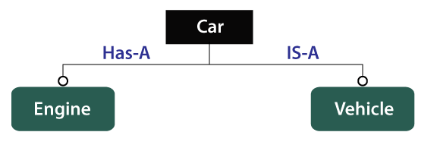
Types of Relationship

Slide 145
Part-27
Object Oriented Programming
Types
of Association

Slide 146
What Is Association ?
A HAS-A relationship signifies that a class is associated with that is it holds object(s) of another class in its body
For Example:
Car has Engine
College has Students
Building has Rooms
In simple words we can say that, class A holds class B’s reference and can access methods of class B.

Slide 147
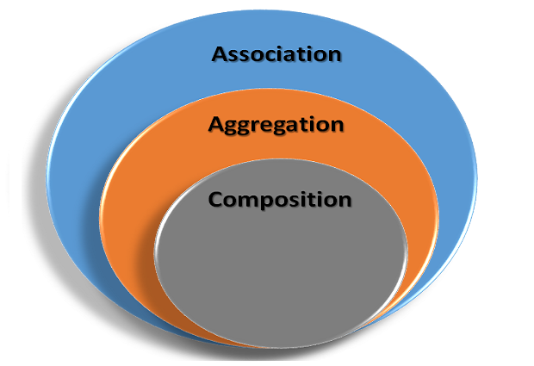
Types Of Association

Slide 148
Aggregation
Aggregation is often represented using a "has-a" relationship.
For example, a car object "has-a" music player object.
Similarly, a computer object "has-a" hard drive object and so on.
In aggregation, the component object can exist independently of the container object.

Slide 149
Let’s Understand With Example
class MusicPlayer {
public void start() {
//Some Code
}
}
class Car {
private String name;
private MusicPlayer player;
}

Slide 150
Part-28
Object Oriented Programming
Types
of Association

Slide 151
Composition
A composition in Java between two objects associated with each other exists when there is a strong relationship between one class and another.
Means contained object cannot exist without the owner or container object.
For example, A College is a composition of Department. If the College object doesn’t exist or dies then Department object will also not exist
Thus we can say that composition is a restricted form of Aggregation.

Slide 152
Implementation of Composition in Java
The College and Department relationship is implemented using the concept of inner class in Java.
Also we use, the “final” keyword while representing composition.
This is because the ‘Owner’ object expects a part object to be available and function by making it “final”.

Slide 153


