Slide 1
OOP

Slide 2
Quiz Revision
What is the output of the following code? (2 pts)
int a = 5;
int b = 7;
int c = 8;
double avg = (a + b + c) / 3;
System.out.println(avg);
Which Scanner method reads a whole line of input as a String? (1 pt)
next()
nextLine()
nextInt()
nextDouble()
Which type of error occurs when code compiles and runs but produces the wrong result? (1 pt)
Logic error
Runtime error
Syntax error

Slide 3
What is the best primitive type to store the number of items in a shopping cart? (1 pt)
What is the value of (double) 9 / 2? (2 pts)
Evaluate: (3 pts) "Total: " + 2 + 3 * 2 + 5

Slide 4
Objects

Slide 5
What we’ll cover:
What an object is and why we use them.
Classes as blueprints for objects.
Constructors, fields, and instance methods.

Slide 6
The Transition to Objects
So far, we’ve focused on procedural programming. The program is a set of instructions (main method) that operates on data (variables).
Problem: What happens when our programs get bigger? We end up with long lists of methods that all operate on the same data.
Solution: Object-Oriented Programming (OOP). We combine data and the methods that operate on that data into a single unit called an object.

Slide 7
What is an Object?
An object is a self-contained unit that has state and behavior.
State: The data or properties of the object. These are stored in fields (variables).
Behavior: The actions the object can perform. These are defined by methods.
Analogy: A car is an object.
State: Color, make, model, speed.
Behavior: accelerate(), brake(), turnOn().

Slide 8
Classes as Blueprints
A class is the blueprint or template for creating objects. It defines the fields and methods that all objects of that type will have. You don’t interact with the blueprint directly; you use it to build things.

Slide 9
Analogy:
Class: The blueprint for a car. It specifies that all cars will have a color, a model, and methods like accelerate().
Object: A specific, physical car created from that blueprint (e.g., a “red Ford Mustang”). You can have many objects from the same class, each with its own unique state.

Slide 10
Defining a Class
To define a class, you use the class keyword. Inside the class, you declare fields and methods.
public class Dog {
// Fields (State)
String name;
int age;
// Methods (Behavior)
public void bark() {
System.out.println("Woof!");
}
}
This class defines a Dog object. Every Dog object we create from this blueprint will have a name, an age, and the ability to bark().

Slide 11
Syntax for Class
Syntax for <class_name>.java
public class <class_name> {
}
Syntax for Book.java
public class Book {
}

Slide 12
Fields
Object a programming entity that contains state(data) and behavior(methods)
State
  A set of values (internal data) stored in an object.
  Represented by fields within the class
Behavior
  A set of actions an object can perform, often reporting or modifying its internal state.
  Represented by instance methods within the class

Slide 13
Field: a variable inside an object that makes up part of its internal state
State-only
public class Book {
/** Title of the book */
String title;
/** Author of the book */
String author;
/** Publication year of the book */
int pubYear;
}
Declaring field is same normal variables: type and name
Difference - Directly inside braces of class - We’re saying –we want every object of the class to have the variables

Slide 14
Fields are given default initial values when an object is constructed
Define the fields at the top of the class definition
Classes that create instances of your class can access the fields (unless private)
Retrieve value: book1.title; Modify value: book1.title = "Harry Potter";

Slide 15
Book Example - Fields
import java.util.Date;
public class Book {
/** Title of the book */
String title;
/** Author of the book */
String author;
/** Publication year of the book */
int pubYear;
/** Person who has checked out the book */
String checkedOut;
/** Location of the book in the stacks */
int location;
/** Date a checked out book is due */
Date dueDate;
}

Slide 16
Instance Methods
Methods defined inside a class are called instance methods. They operate on the specific object they are called on. They can access the object’s fields directly.
public class Dog {
String name;
public void bark() { // An instance method
System.out.println(name + " says woof!");
}
}
// In main:
Dog myDog = new Dog("Fido", 3);
myDog.bark(); // Output: Fido says woof!
When myDog.bark() is called, the bark() method knows to use myDog’s name field.

Slide 17
Static Methods vs. Instance Methods
This is a common point of confusion.
Static Methods (static): Belong to the class, not a specific object. You call them using the class name (e.g., Math.random()). They cannot access instance fields.
Instance Methods (no static): Belong to a specific object. They can access the object’s fields and methods. You must have an object to call them (e.g., myDog.bark()).

Slide 18
The toString() Method
The toString() method is a special instance method that returns a String representation of an object. It’s often used for debugging or printing objects.
Default behavior: It prints a gibberish-looking string (e.g., Dog@765f33f0).
Good practice: Override the toString() method to provide a meaningful string.
Example:
@Override // This annotation is good practice
public String toString() {
return "Dog[name=" + name + ", age=" + age + "]";
}

Slide 19
The toString() in Action
Now, when you try to print your object, you get a clean output.
Dog myDog = new Dog("Fido", 3);
System.out.println(myDog);
// Output: Dog[name=Fido, age=3]
The println() method automatically calls toString() if you pass it an object.

Slide 20
Exercise: Creating a Transaction Class
Let’s do a quick exercise to refresh these concepts.
Problem: Create a class called Transaction.
It should have fields for description (String), date (String), and amount (double)
override the toString method to display the transaction information in a clear format.

Slide 21
Creating an Object
You create an object from a class using the new keyword. This is also called instantiating an object.
Syntax: ClassName objectName = new ClassName();
Example:
Dog myDog = new Dog();
myDog is an object variable that holds a reference to a new Dog object.
The new Dog() part creates the new object in memory.

Slide 22
Accessing an Object’s Fields and Methods
You use the dot operator (.) to access an object’s fields and methods.
Example:
Dog myDog = new Dog();
// Set the state of the object
myDog.name = "Fido";
myDog.age = 3;
// Call a method on the object
myDog.bark(); // Output: "Woof!"
System.out.println(myDog.name + " is " + myDog.age + " years old.");
// Output: "Fido is 3 years old."

Slide 23
Exercise - creating a Course class
Create a Course class with the string fields code and title.
Add a method called print() to print these fields.
Create an object and assign the values "COSC130", and "INTRO TO COMPUTER SCIENCE II" to the code and title respectively.
Call the print() method of the object to print these fields.

Slide 24
Constructors
A constructor is a special method used to initialize a new object. It’s called automatically when you use the new keyword.
A constructor has the same name as the class.
It has no return type (not even void).

Slide 25
Example:
public class Dog {
String name;
int age;
// Constructor
public Dog(String dogName, int dogAge) {
name = dogName;
age = dogAge;
}
}

Slide 26
Using a Constructor
Now, when we create a Dog object, we can provide the initial values directly.
// Create a Dog object using the constructor
Dog myDog = new Dog("Fido", 3);
System.out.println(myDog.name); // Output: Fido
This is a much cleaner way to create and set up an object.

Slide 27
The Default Constructor
If you don’t provide any constructor, Java creates a default constructor for you. It’s a constructor with no parameters that doesn’t do anything.
public class Dog {
// No constructor defined
String name;
}
// In main:
Dog myDog = new Dog(); // This works!
But once you create your own constructor, the default constructor is no longer available.

Slide 28
this Keyword
Inside a class, the this keyword refers to the current object. It’s often used to distinguish between a parameter and a field that have the same name.
Example:
public class Dog {
String name;
int age;
public Dog(String name, int age) {
this.name = name; // refers to the object's name
this.age = age; // refers to the object's age
}
}
This makes the code more concise and readable.

Slide 29
Review of Object Concepts
Class: The blueprint.
Object: An instance of a class.
Fields: The data (state) of an object.
Methods: The actions (behavior) of an object.
Constructor: A special method to create and initialize an object.
new: The keyword used to create an object.
this: Refers to the current object.
Dot operator (.): Used to access an object’s fields and methods.

Slide 30
Exercise: Creating a Student Class
Let’s do a quick exercise to refresh these concepts.
Problem: Create a class called Student.
It should have fields for studentName (String), major (String), and gradYear (int)
create constructor to initialize the fields
override the toString method to display the “ is majoring in and will graduate in ”.

Slide 31
Passing Objects to Methods
You can pass objects to methods as arguments. This is a powerful way to share and manipulate data.
Example:
public void giveShot(Dog dog) {
System.out.println(dog.name + " got a shot!");
}
public static void main(String[] args) {
Vet myVet = new Vet();
Dog myDog = new Dog("Fido", 3);
myVet.giveShot(myDog); // Passing the myDog object
}

Slide 32
Array of Objects

Slide 33
Student Object
Student stores student name, major, and graduation year.
Must be constructed using the new keyword
Student <name> = new Student(<student_name>, <major>, <grad_year>);
Example:
Student studentA = new Student("Student A", "COSC", 208);

Slide 34
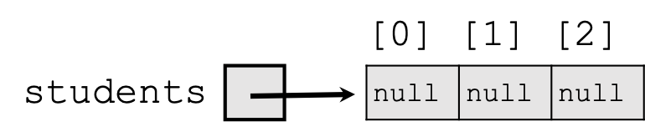
Array of Objects
Student[] students = new Student[3];
Student Array

Slide 35
null
It is legal (will not throw an exception) to:
store null in a variable or array element (often as a dummy value, an initial value to be overwritten later)
String s = null;
words[2] = null;
print a null reference
System.out.println(s); // will print: null
ask whether a variable or array element is null
if (words[i] == null) { ... }
pass null as a parameter to a method
return null from a method (often as an indication of failure, such as a method that searches for an object in a file/array but does not find it)

Slide 36
NullPointerException
It is not legal to dereference a null value (trying to access any of its methods or data using . (dot) notation)
Since null is not an actual object, it has no methods or data. Trying to access them crashes your program.
public class ExampleNull {
public static void main(String[] args) {
String[] words = new String[5];
System.out.println("word 0 is: " + words[0]);
words[0] = words[0].toUpperCase(); // bad
System.out.println("word 0 is now: " + words[0]);
}
}

Slide 37
$ java -cp bin ExampleNull
word 0 is: null
Exception in thread "main" java.lang.NullPointerException
at ExampleNull.main(ExampleNull.java:6)

Slide 38
Avoiding NullPointerException
When dealing with elements that may be null, you must take care to check for null before any calls.
public class WordCounts {
public static void main(String[] args) {
String[] words = new String[5];
words[0] = "hello";
words[2] = "goodbye";
// words[1], [3], [4] are null
int totalLetters = 0;
for (int i = 0; i < words.length; i++) {
if (words[i] != null) {
totalLetters += words[i].length();
}
}
System.out.println("letters: " + totalLetters); // 12
}
}

Slide 39
$ java -cp bin WordCounts
letters: 12

Slide 40
Two-Phase Initialization
Arrays of objects should use a 2-phase initialization:
initializing the array itself
Student[] students = new Student[3];
Student Array

Slide 41
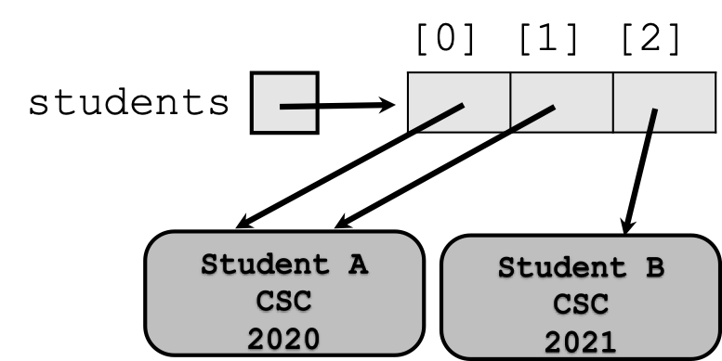
* initializing the object stored into each element of the array
students[0] = new Student("Student A", "CSC", 2020);
students[1] = students[0];
students[2] = new Student("Student B", "CSC", 2021);
Student Array

Slide 42
Client Code
Objects themselves are not complete programs; they are components that are given distinct roles and responsibilities
Objects can be used as part of larger programs to solve programs
Client (or Client Code): code that interacts with a class or objects of that class
Thus, objects are reusable. Example: String Class.

Slide 43
Pass-by-Value (for objects)
In Java, arguments are always passed by value. For primitive types (int, double), the value is copied. For objects, the reference to the object is copied.
If you change the object’s state inside the method (e.g., dog.age = 4), the change persists outside the method.
You cannot change the object reference itself to point to a new object.

Slide 44
What’s Next?
This review sets the stage for core topics of this course.
Encapsulation: Using access modifiers (private, public) to hide an object’s internal state.
Inheritance: Creating new classes based on existing ones.
Polymorphism: The ability of an object to take on many forms.
Interfaces: Defining a contract for a class.
These topics are the next logical steps in your journey to mastering object-oriented programming.

Slide 45
Exercise: Creating an Array of Student
Let’s do a quick exercise to refresh these concepts.
Problem: Create a class called Student.
It should have fields for studentName (String), major (String), and gradYear (int) [You can reuse the class you created earlier]
create constructor to initialize the fields
override the toString method to display the “ is majoring in and will graduate in ”. [not use method below to get firstName]
create an instance method getFirstName to get student’s first name. [note you do not need to pass any parameters, use the class field]
Now in a different file called StudentTest.java:
  create an array of Student objects with a size of at least 3
  use two-phase initialization to fill the array: first create the array, then create and assign a Student object to each index [do not create the objects inline when declaring the array]
  add at least 3 different students to the array, each with a different name, major, and graduation year
  use a loop to print each student in the array by calling toString [you can print the object directly with System.out.println, since it will call toString automatically]

