Slide 1

A COMPREHENSIVE ANALYSIS ON Climate Action and Carbon Emissions
Course Code: CSE3040 Team I
Team Members: Sandeep Kumar R (23MIA1040) Shakthi Surya S (23MIA1151) W Rexlin (23MIA1106)
Guide: Prof. Asnath Victy Phamila

Slide 2
Introduction
Climate change is accelerating due to unchecked carbon emissions, with far-reaching impacts on ecosystems and human life. Through this project, we aim to explore how carbon emissions and climate indicators have evolved over time. Our study uses data-driven methods to provide insights that can support sustainability efforts under SDG 13: Climate Action.

Slide 3
Abstract
This project involves exploratory data analysis (EDA) of climate data from 15 countries over the years 2000 to 2023. The dataset includes variables like CO₂ emissions, temperature, sea level, and renewable energy use. Our goal is to detect patterns and relationships that highlight environmental risks. The findings are intended to support climate policy-making and awareness through visual and statistical insights.

Slide 4
Objectives
Analyze emissions trends globally and regionally
Study how temperature, rainfall, and energy sources evolve
Investigate the impact of population and deforestation
Identify potential climate risks using data
Support international goals under the UN’s SDG 13

Slide 5
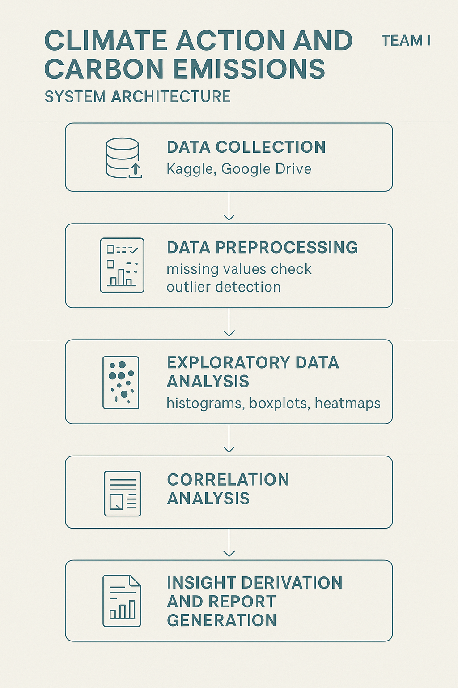
Proposed Methodology

Slide 6
Module Description
Module 1: Data Loading and Cleaning Loaded dataset with 1000 entries from 15 countries between 2000–2023. Checked for missing values – none found. Outlier detection (Z-score and IQR) showed clean data.
Module 2: Feature Understanding Understood the role of each feature: Temperature, Rainfall, CO₂ Emissions, Sea Level Rise, Population, Renewable Energy %, Forest Area %, Extreme Weather Events.
Feature | Description
CO₂ Emissions | Tons per capita
Avg Temperature (°C) | Annual average
Sea Level Rise (mm) | From melting glaciers
Renewable Energy (%) | Share of energy from renewables
Extreme Weather Events | Storms, droughts, etc.

Slide 7
Dataset Description
Key Dataset Columns:
Dataset Description
Year & Country: For temporal and regional tracking
Avg Temperature (°C): Climate warming indicator
CO₂ Emissions (Tons/Capita): Central focus for SDG 13
Sea Level Rise (mm): Affected by polar melting
Rainfall (mm): Weather pattern changes
Renewable Energy (%): Sustainability measure
Extreme Weather Events: Climate change impact
Forest Area (%): Reflects sequestration potential
The dataset consists of environmental and population-related data from 15 countries, including both developed and developing nations. The period covered is 2000–2023. It includes climate indicators essential for analyzing emission trends and sustainability metrics.

Slide 8
SDG 13 – Climate Action Alignment
SDG 13 urges countries to take urgent action to combat climate change and its impacts. Through this project, we provide a clear picture of historical emission trends, the adoption of renewable energy, and the frequency of extreme weather events across countries. These insights can guide strategic planning, policymaking, and awareness efforts.
This analysis helps:
Monitor national carbon outputs
Track the impact of renewable energy
Highlight vulnerabilities through extreme events data
Inform sustainable practices

Slide 9
Data Preprocessing
The dataset was clean, with no missing values across the columns. We confirmed data quality by applying Z-score and IQR-based outlier detection, which returned no significant anomalies. Encoding was applied to the country column for numerical correlation analysis. This ensured our dataset was analysis-ready, and we could proceed without data imputation or rescaling.

Slide 10
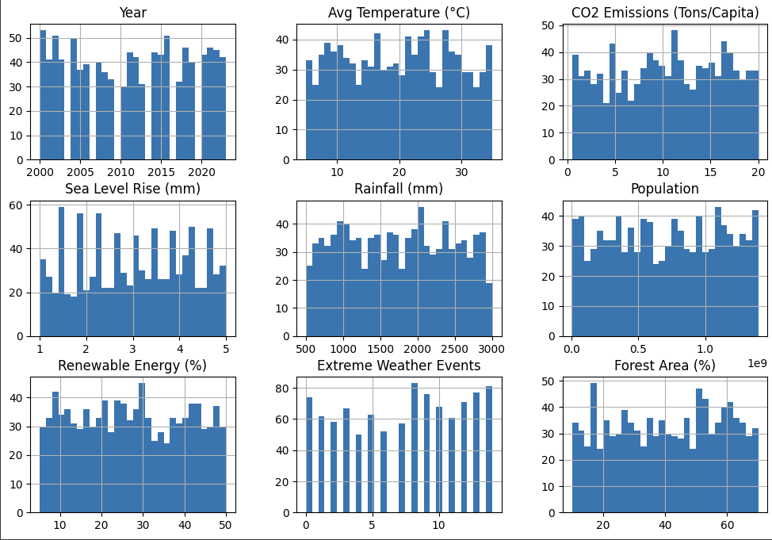
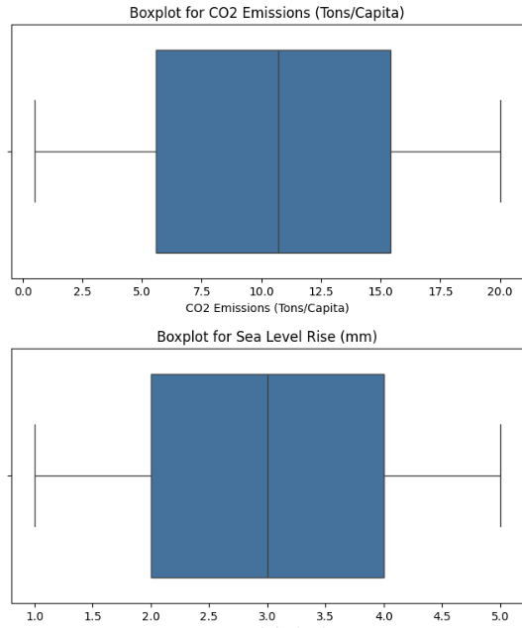
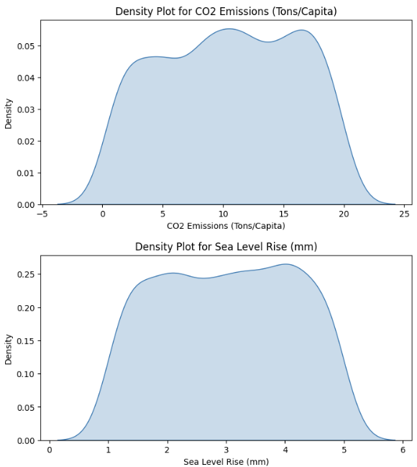
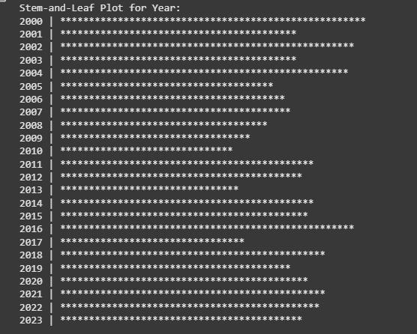
Data Trends & Distribution

Slide 11
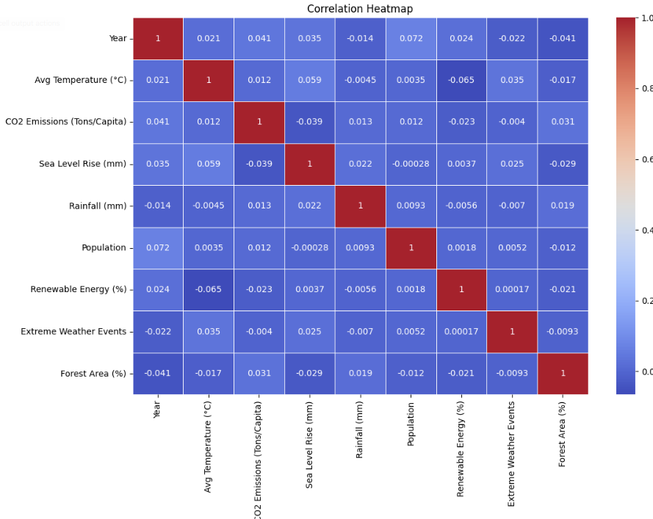
Correlation Analysis
The correlation heatmap reveals that CO₂ emissions moderately correlate with population, indicating that denser populations may contribute more to emissions. Renewable energy usage showed a weak but notable negative correlation with CO₂ emissions. Other factors, like forest area and rainfall, had minimal correlation, reflecting the multifactorial nature of climate change.

Slide 12
Outlier Analysis Using IQR Method
Using the Interquartile Range (IQR) method, no outliers were detected in any of the dataset’s numerical features. This confirms that all values fall within the expected range between Q1 - 1.5×IQR and Q3 + 1.5×IQR. The result aligns with the Z-score method, indicating a clean and consistent dataset.
Year: No outliers; values are sequential from 2000–2023.
Avg Temperature: Stable data; no sudden spikes.
CO₂ Emissions: All values within normal limits.
Sea Level Rise: Gradual changes; no abrupt jumps.
Rainfall: Values are consistent; no extremes.
Population: Likely scaled; evenly distributed.
Renewable Energy (%): Balanced adoption rates.
Extreme Weather Events: No unusually high or low frequencies.
Forest Area (%): No sharp fluctuations; gradual changes observed.
This clean dataset ensures reliable analysis without the need for additional filtering.

Slide 13
Model Performance:
Random Forest
Decision Tree
Random Forest Results
MAE: 5.05
MSE: 34.54
R² Score: -0.059
The Random Forest model demonstrated only moderate performance. While Random Forests typically excel in handling non-linear patterns and reducing overfitting, this model struggled due to weak correlations between input features and the target variable (CO₂ emissions). The negative R² score suggests that the model failed to generalize well to unseen data. Overfitting may have occurred, likely due to the small dataset and possibly excessive depth or number of estimators.
Decision Tree Results
MAE: 6.93
MSE: 69.33
R² Score: -1.13
The Decision Tree model performed the worst among the models tested. It produced the highest errors and an extremely negative R² score, indicating very poor predictive ability. Decision trees are prone to overfitting, especially on small datasets, and this effect is clearly observed here. The model likely memorized the training data instead of learning generalized patterns, leading to poor performance on the test set.

Slide 14
Summary of Key Results
Our analysis of the climate dataset revealed several important patterns:
CO₂ Emissions Trends: Emissions have generally increased over time across most countries. High-emission countries include the USA, China, and India, aligning with their large populations and industrial output.
Temperature Rise: A steady increase in global average temperature was observed from 2000 to 2023, supporting ongoing concerns about global warming.
Renewable Energy Adoption: Countries with higher renewable energy percentages showed slightly lower emissions, indicating a potential positive impact of sustainable practices.
Correlation Insights: Moderate correlation exists between population and CO₂ emissions. Other features like forest area, rainfall, and extreme weather events had weaker or negligible correlations with emissions.
Outlier Analysis: Both IQR and Z-score methods confirmed there were no outliers in the dataset, ensuring reliability in analysis.
Model Performance: Machine learning models (Random Forest and Decision Tree) underperformed due to limited data and weak feature-target relationships, suggesting the need for further feature engineering or larger datasets.

Slide 15
Conclusion
Our study shows that data science can uncover powerful insights about climate trends. We identified how emissions, temperature, and renewable energy usage interact. These findings support the goals of SDG 13 and suggest areas for deeper exploration, including predictive modeling and policy simulation. Tackling climate change begins with understanding it—and our data helps do just that.

Slide 16
Reference
Dataset
Source: https://www.kaggle.com/api/v1/datasets/download/bhadramohit/climate-change-dataset
United Nations SDG 13: Climate Action
Source: https://sdgs.un.org/goals/goal13
IPCC (Intergovernmental Panel on Climate Change) Reports
Source: https://www.ipcc.ch/
Our World in Data: CO2 and Greenhouse Gas Emissions
Source: https://ourworldindata.org/co2-and-other-greenhouse-gas-emissions

