Slide 1
Genetic Algorithm and Its Application in Solving the Travelling Salesman Problem
A brief introduction to Genetic Algorithms and TSP
SANDEEP KUMAR S
RA241100 3020462
CSE-H

Slide 2
What is a Genetic Algorithm?
Genetic Algorithm (GA) is an optimization technique inspired by natural selection.
Key concepts: Selection, Crossover, Mutation, Fitness, Generations.

Slide 3
Basic Steps in Genetic Algorithms
Population Initialization: Create a population of random potential solutions.
Fitness Evaluation: Evaluate each solution's quality using a fitness function.
Selection: Choose individuals based on fitness for reproduction.
Crossover (Recombination): Combine parents to produce offspring.
Mutation: Randomly alter offspring to maintain diversity.
Replacement & Termination: Repeat until stopping criteria is met.

Slide 4
What is the Travelling Salesman Problem?
TSP is a combinatorial optimization problem.
Objective: Find the shortest route that visits every city once and returns to the starting city.

Slide 5
Why Apply Genetic Algorithm to TSP?
Explored various possible routes between the cities.
Improved the quality of routes through selection, crossover, and mutation.
Found a near-optimal route that minimizes the total travel distance.
GA explore large solution spaces efficiently.
Avoids computational expense of brute-force methods.
Selection, crossover, mutation evolve towards better solutions.
Diversity prevents getting stuck in local minima.

Slide 6
concepts for the Travelling Salesman Problem (TSP) using Genetic Algorithm
Fitness – Shortest route: In TSP, fitness is inversely proportional to the total distance of the route. The shorter the route, the higher the fitness.
Selection – Choosing best parents: Selection is the process of choosing the best routes (parents) based on fitness. Better solutions are more likely to be selected for reproduction.

Slide 7
Crossover – Mixing routes: Crossover combines two parent routes to create new offspring routes, ensuring new solutions are created by inheriting genes (cities) from both parents.
Mutation – Small changes: Mutation randomly swaps cities in a route, introducing new variations and maintaining diversity within the population to prevent premature convergence.
Representation of Solution – Chromosomes as city sequences: Each solution is represented as a chromosome, which is a sequence (permutation) of cities that defines a specific route.

Slide 8
Libraries Used
random – Generates random numbers:
Used for initializing the population with random routes, performing selection, and applying random mutations.
numpy – Efficient array operations:
Helps in managing and manipulating arrays, calculating distances between cities, and handling the population as arrays for efficient computation.
matplotlib.pyplot – Data visualization:
Used to plot and visualize the cities and the final route found by the Genetic Algorithm. This library helps in displaying the shortest route graphically.

Slide 9
Classes Used
City:
Represents a city with its x and y coordinates.
Contains a method distance() to calculate the Euclidean distance between two cities.
Has a __repr__() method for easy representation of city coordinates.
Fitness:
Manages the evaluation of the fitness of a given route (solution).
Contains the route_distance() method to calculate the total distance of the route.
route_fitness() method computes the fitness as the inverse of the route distance (shorter routes have higher fitness).

Slide 10
Code OF CLASSES:
import random
import numpy as np
import matplotlib.pyplot as plt
# Define a City with x, y coordinates
class City:
def __init__(self, x, y):
self.x = x
self.y = y
def distance(self, city):
return np.sqrt((self.x - city.x) ** 2 + (self.y - city.y) **
def __repr__(self):
return f"({self.x}, {self.y})"

Slide 11
class Fitness:
def __init__(self, route):
self.route = route
self.distance = 0
self.fitness = 0.0
def route_distance(self):
if self.distance == 0:
path_distance = 0
for i in range(len(self.route)):
from_city = self.route[i]
to_city = self.route[(i + 1) % len(self.route)]
path_distance += from_city.distance(to_city)
self.distance = path_distance
return self.distance
def route_fitness(self):
if self.fitness == 0:
self.fitness = 1 / float(self.route_distance())
return self.fitness

Slide 12
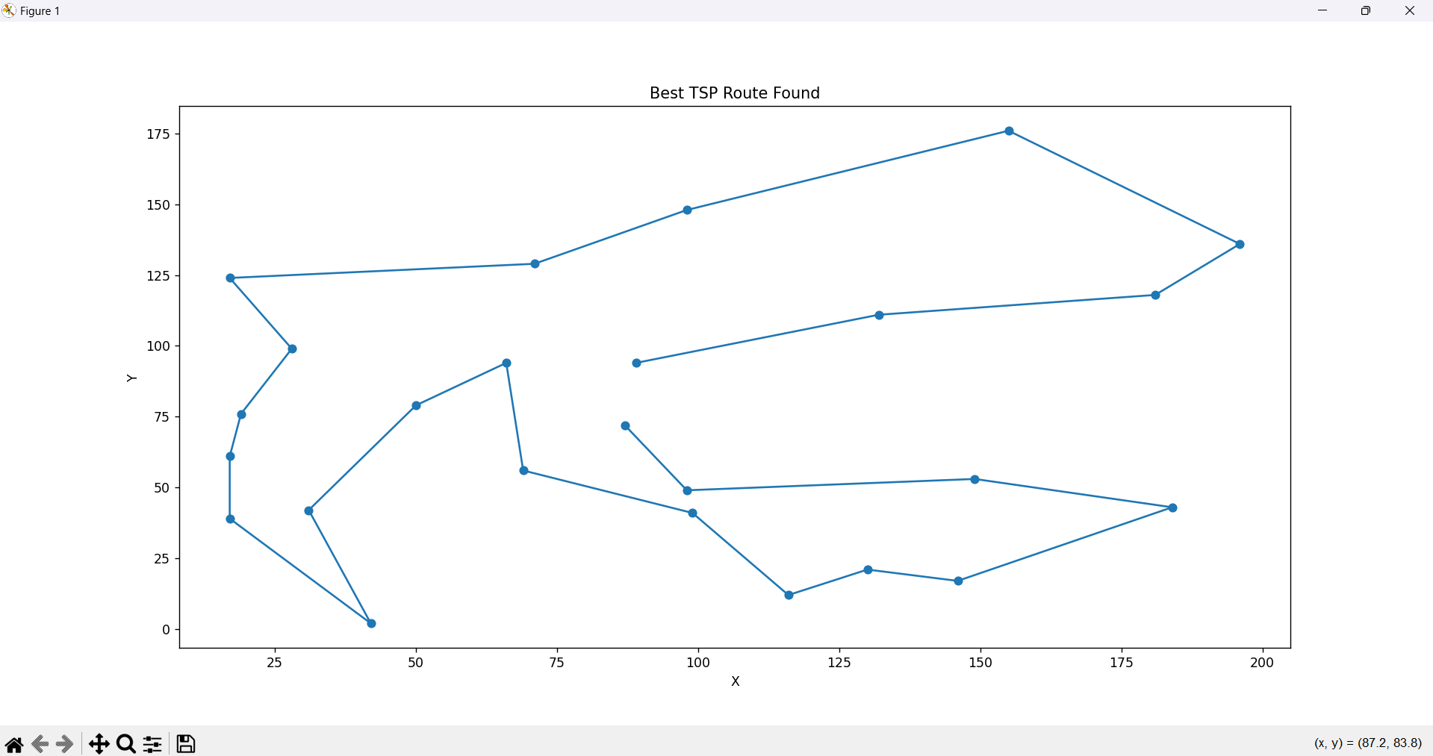
Sample output

Slide 13


