Slide 1

Name : Sandeep Kumar
Roll no. - 2022915
B.Tech - 8thsem (SE)
Project – Medicare

Slide 2
INTRODUCTION
The Doctor Appointment System is an innovative web-based solution designed to streamline and enhance the process of scheduling appointments between doctors and patients. This system aims to alleviate the administrative burdens associated with traditional appointment scheduling methods, offering a more efficient and user-friendly alternative. The core functionalities of the system include user registration and authentication, real-time availability management, appointment booking, rescheduling, and cancellation. The Doctor Appointment System not only simplifies the appointment scheduling process but also enhances patient satisfaction and operational efficiency in health

Slide 3

TRADITIONAL HEALTHCARE CHALLENGES
Long waiting times, limited to specialists, and di culty scheduling appointments have been persistent challenges in traditional healthcare .These issues have led to patient dissatisfaction and delayed treatment.

Slide 4

ONLINE DOCTOR APPOINTMENT SYSTEM
The Convinience and efficiency of online doctor appointments have reshaped the healthcare landscape . Patients can easily schedule appointments, consult with healthcare providers, and access medical records from the comfort of their homes.

Slide 5

BENEFITS FOR PATIENTS
,
Online appointments are convinece and reduced travel time, and the ability to seek medical advice without disrupting daily routines. Patients can also access a wider range of healthcare providers and specialists.

Slide 6

BENEFITS FOR HEALTHCARE PROVIDERS
Healthcare providers can optimize their schedules, reach a larger patient base, and provide Timely care through online appointments. This system also facilitates better management of patient records and history.

Slide 7

DATA PRIVACY AND SECURITY
Ensuring the privacy and security of patient data is paramount in the online doctor appointment system. Robust measures must be in place to protect sensitive medical information and maintain patient conﬁdentiality.

Slide 8
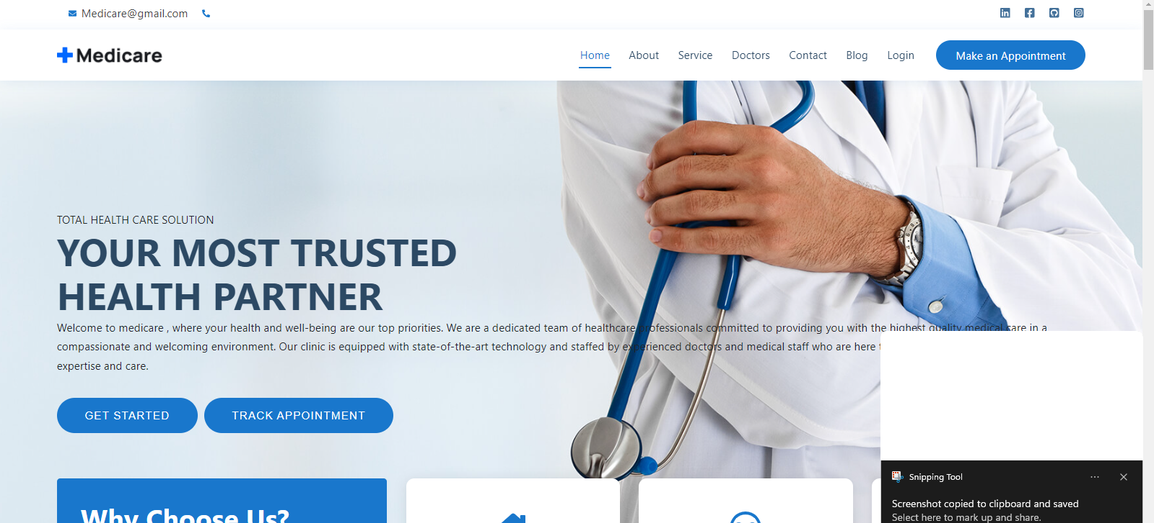
Project Outcomes

Slide 9
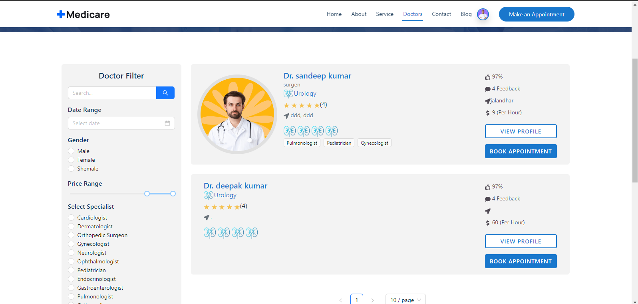

Slide 10
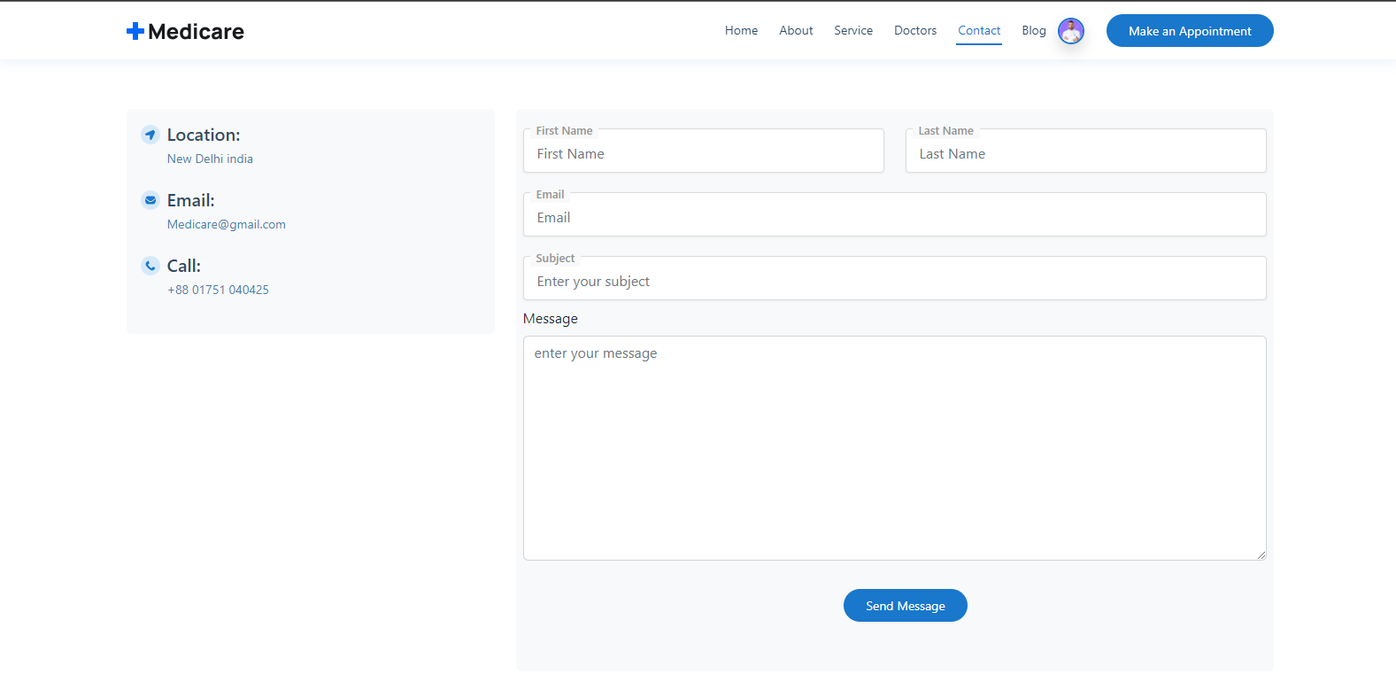

Slide 11
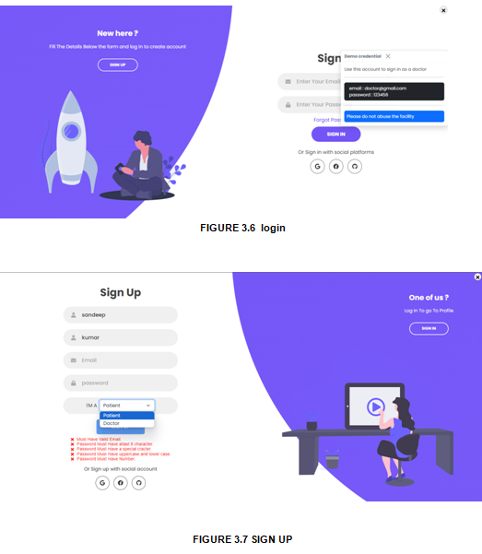

Slide 12
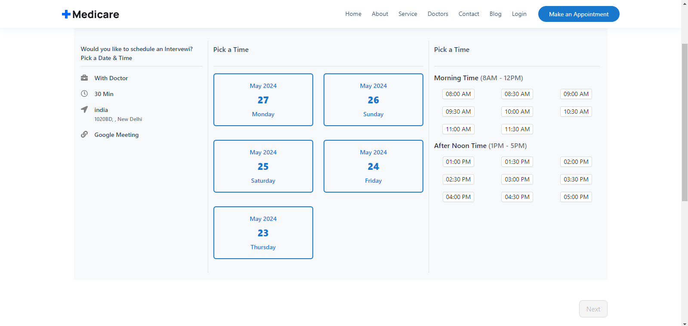

Slide 13
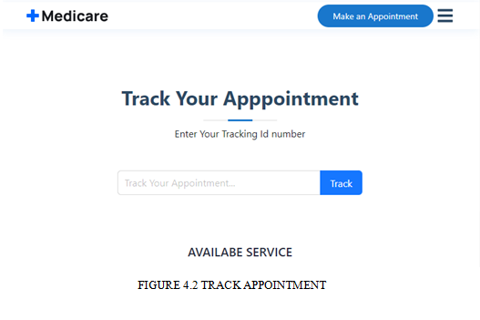

Slide 14
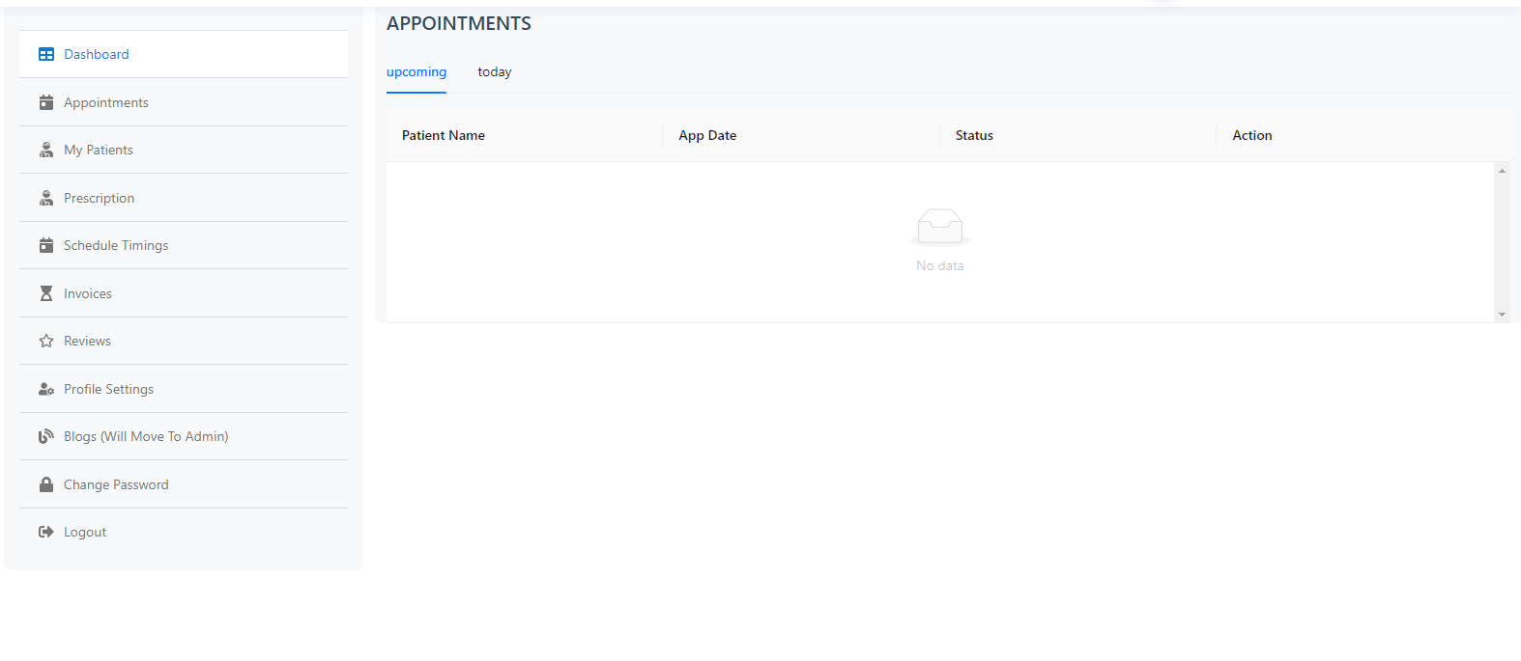

Slide 15
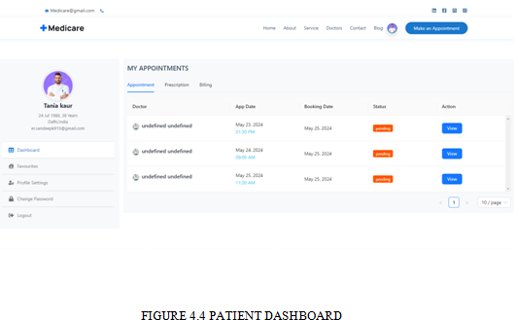

Slide 16

CONCLUSION
In conclusion, the online doctor appointment system represents a in healthcare delivery, o ering unprecedented
convenience, access, and potential for enhanced patient care.
Embracing this transformation will shape the future of healthcare.

